Slide 1
Figure S1
A
Expansion fold of CD34+CD90+ cells
TSA
DLS3
SAHA
VPA
Merk60
TCP
UNC0638
SR1
EPZ4777
EPZ5676
B
Expansion fold of CD34+ cells
TSA
DLS3
SAHA
VPA
Merk60
TCP
UNC0638
SR1
EPZ4777
EPZ5676

Slide 2
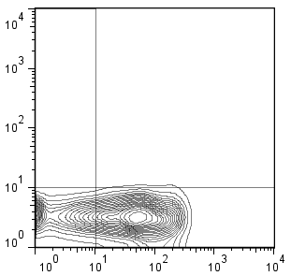
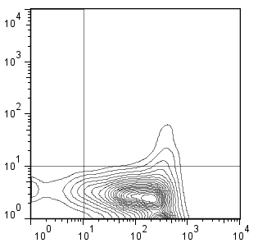
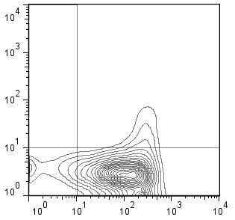
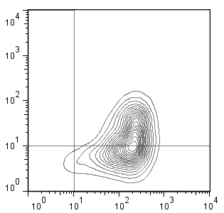
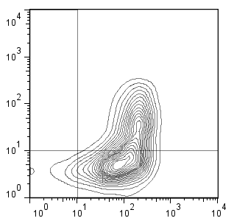
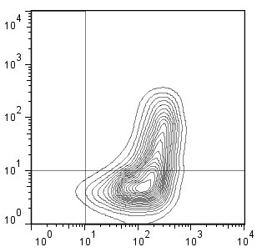
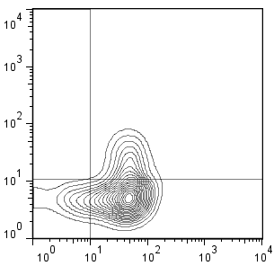
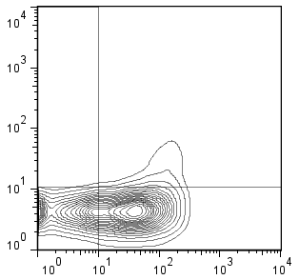
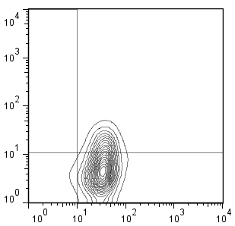
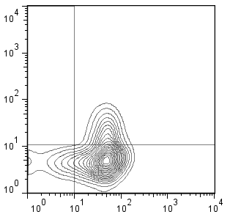
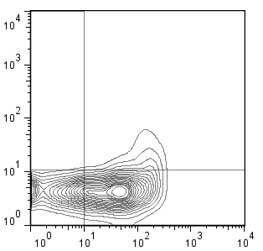
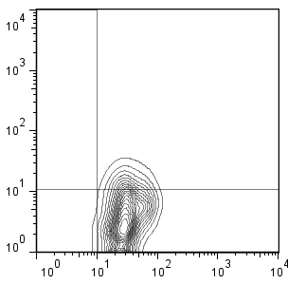
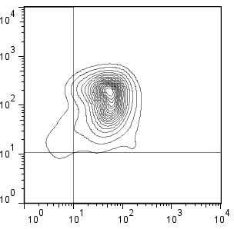
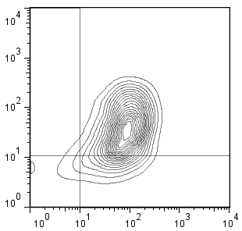
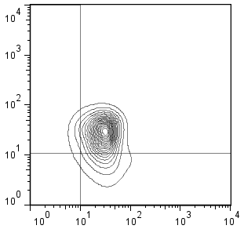
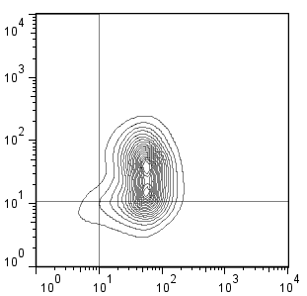
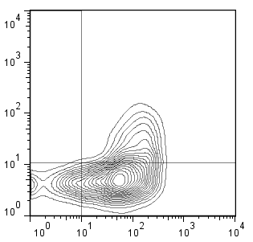
Figure S2
A
0.93
3.36
4.41
DMSO
SR1 1uM
SR1 2.5uM
57.3
59.9
63.1
38.2
TSA 50nM
32.4
TSA 50nM
29.5
TSA 50nM
SR1 1uM
SR1 2.5uM
CD90
33.5
41.2
39.7
CD34
Day 3
Day 5
continue to culture
10.6
4.8
B
Day 1 (24 hours)
10.7
50.7
50.7
DMSO
12.4
5.38
Day 0
48.9
wash
11.1
56.2
49.4
73.0
continue to culture
62.7
65.6
CD90
CD34
52.1
0.38
11.2
TSA 50nM
57.4
21.8
7.6
wash
13.6
49.7

Slide 3
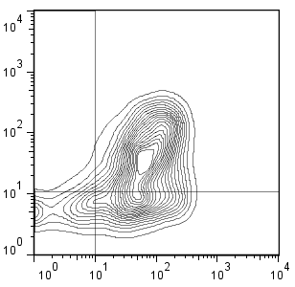
Figure S3
A
DMSO
TSA
MS275
CD90
CD90
CD90
CD34
CD34
CD34
B
(%)
2
1.5
%human CD45+ cells
1
0.5
Cells
transplanted
0
(x10⁵)
0.2
1.0
2.0
0.5
1.0
primary CB
DMSO
TSA
MS275
(Day 0)
(Day 5 progeny)
Notes:
Figure S1 Treatment of CB cells with TSA and MS275 leads to expansion of CD34+CD90+ and enhances the marrow-repopulating potential
A, Cord blood CD34⁺ cells were cultured with MS275 and TSA for 5 days. Representative of two independent experiments flow cytometric analysis were shown. Note the percentage of CD34+CD90+ increased with either TSA or MS275 treatment. B, scatter plot showing the levels of human CD45+ cell engraftment in the PB of NSG mice 2 weeks after transplantation with the progeny of 2x 10⁴ CD34+ cells after culture with DMSO, TSA or MS275.

Slide 4
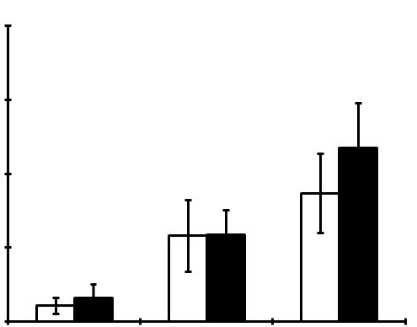
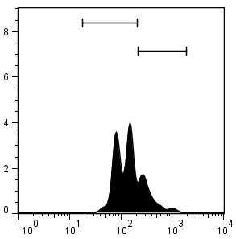
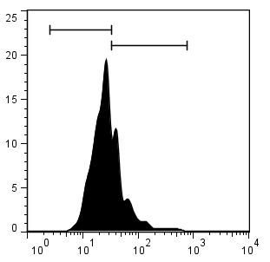
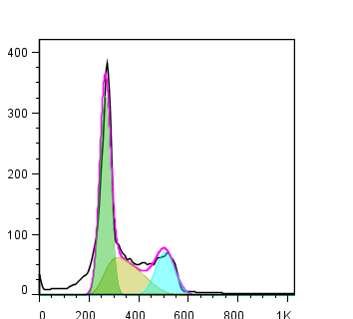
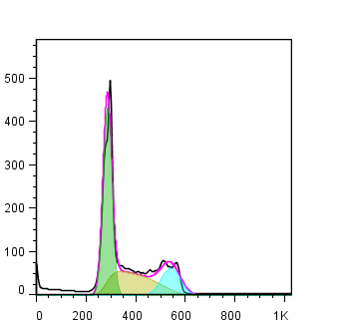
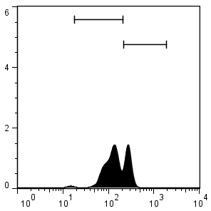
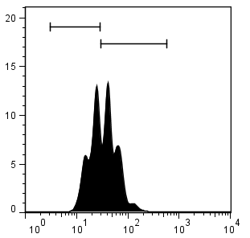
Figure S4
A
B
E
DMSO
DMSO
(%)
DMSO
TSA 50nM
TSA 50nM
40
TSA 50nM
(%)
(x10⁴)
30
100
40
% Annexin V+ cells
20
% CD34+ cells
The number of
CD34+ cells
50
20
10
0
0
0
3
5
7
day3
day5
day7
day3
day5
day7
days
C
Day 5
Day 7
D
77.5
25.8
67.4
32.4
DMSO
TSA 50nM
CD34+
CD90- cells
counts
counts
counts
counts
66.7
31.4
44.6
54.4
CD34+
CD90+ cells
counts
counts
Propidium iodide
CFSE
CFSE

Slide 5
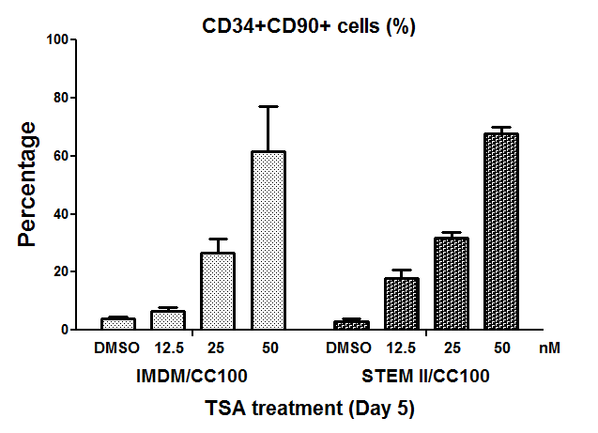
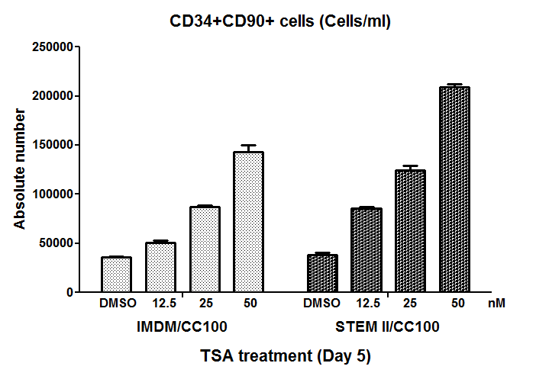
Figure S5
A
B
Notes:
Figure S5 TSA treatment can increase CD34⁺CD90⁺ cells in PBMC CD34⁺ cells cultured in serum free StemSpanTM SFEM II and serum containing IMDM/CC100
(A) Effect of TSA on CD34 and CD90 expression following the two culture conditions. Each value represents mean ± standard error of two independent experiments. (B) Absolute number of CD34⁺CD90⁺cells cultured with the compounds. Each value represents mean ± standard error of two independent experiments. (C) Dose effect of TSA on CD34 and CD90 expression following the two culture conditions. (D) Time course of TSA on CD34 and CD90 expression following the two culture conditions.

Slide 6
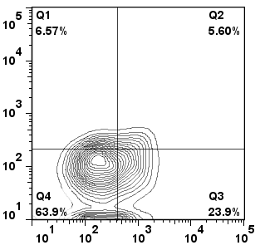
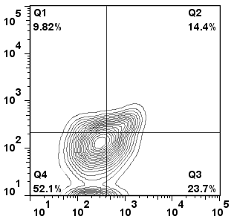
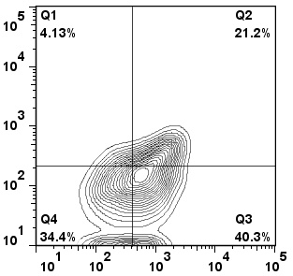
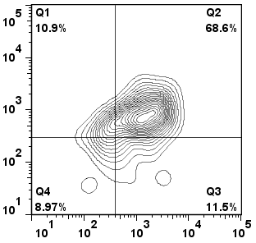
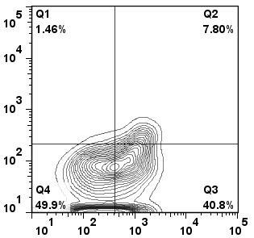
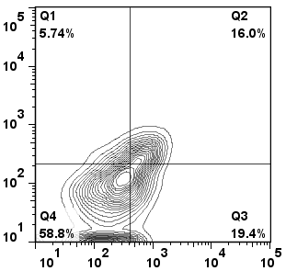
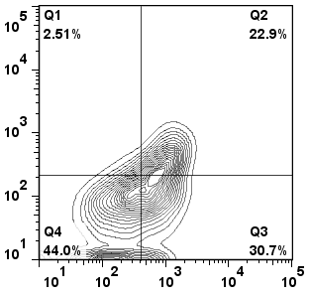
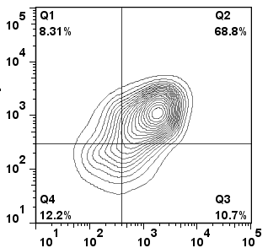
C
IMDM/30%FBS
DMSO 12.5 nM TSA 25 nM TSA 50 nM TSA
CD90
SFEM II
DMSO 12.5 nM TSA 25 nM TSA 50 nM TSA
CD34

Slide 7
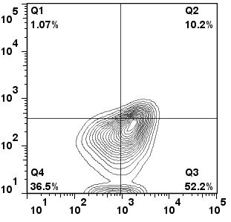
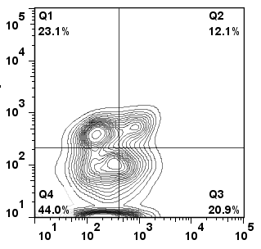
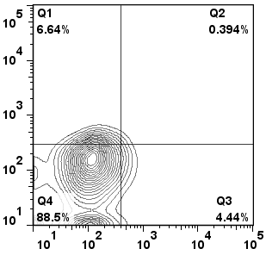
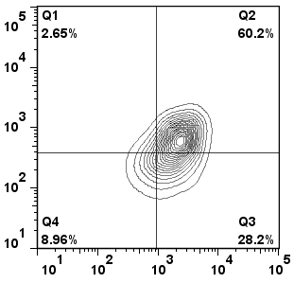
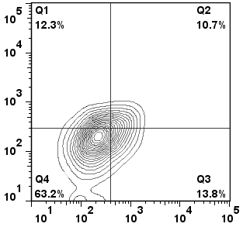
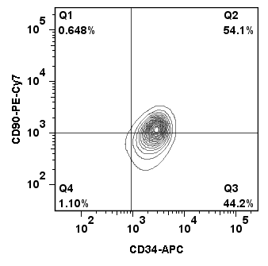
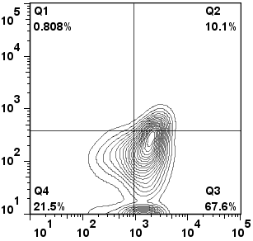
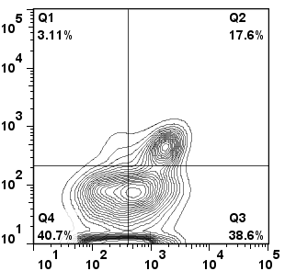
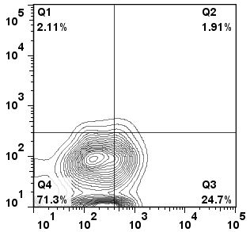
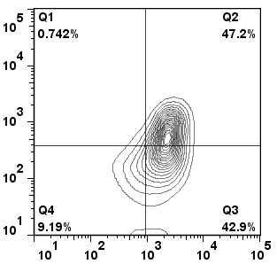

D
Day 3 Day 5 Day 7
DMSO DMSO DMSO
CD90
10.2%
12.1%
0.394%
TSA nM TSA 50 nM TSA 50 nM
60.2%
68.6%
10.7%
SFEM II IMDM/30%FBS
DMSO DMSO DMSO
10.1%
17.4%
1.91%
TSA 50 nM TSA 50 nM TSA 50 nM
42.9%
68.8%
15.6%
CD34

Slide 8
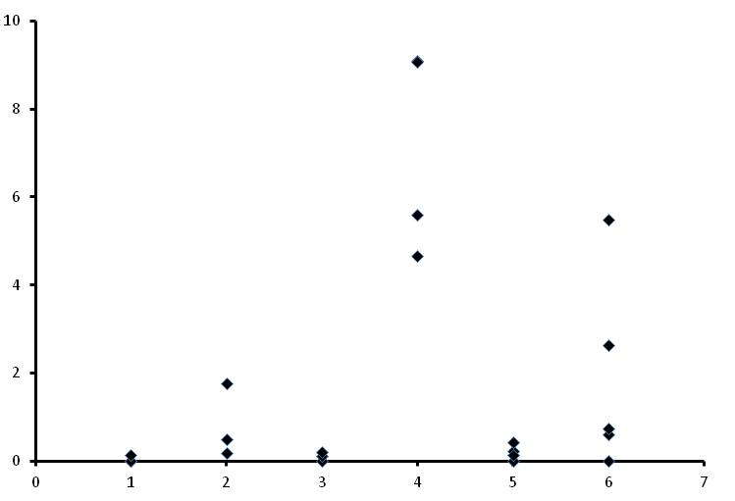
Figure S6
(%)
10
8
6
%human CD45+ cells
4
2
0
2.0 x 10⁴
progenies
1.0 x 10⁴
progenies
2.0 x 10⁴
1.0 x 10⁵
1.0 x 10⁴
1.0 x 10⁵
PBSC
CB
PBSC
CB
non cultured
6 days culture

Slide 9
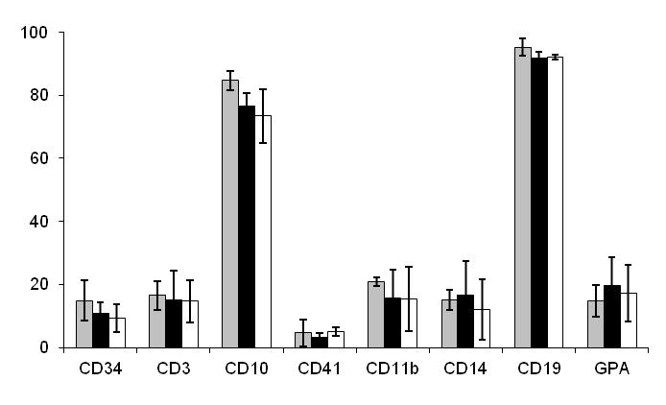
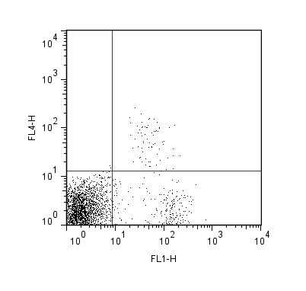
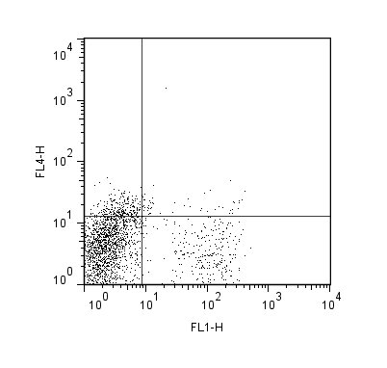
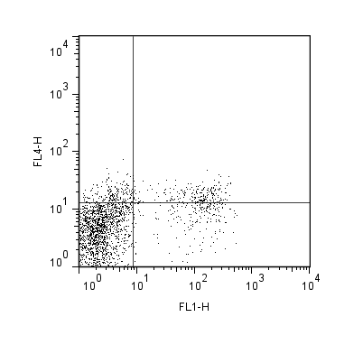






Figure S7
B
Fresh CD34+ cells
A
(%)
TSA 50nM; day5 progeny
(%)
3
P<0.05
DMSO; day5 progeny
2
%human CD45+ cells
1
0
Cells
transplanted
3.0
1.2
0.6
3.0
1.2
0.48
0.24
(x 10^6)
DMSO
TSA
C
D
(%)
100
CD34
CD3
CD10
CD11b
75
CFU-mix
hCD45
hCD45
hCD45
hCD45
50
CFU-GM
Colonies /1500 cells plated
BFU-E
25
CD14
CD19
CD41
GPA
0
Fresh CD34+
DMSO
TSA
hCD45
hCD45
hCD45
hCD45

Slide 10




Figure S8
A
B
C
(%)
(%)
CD10
hCD45
DMSO
TSA 50nM
DMSO
TSA 50nM
CD19
hCD45

Slide 11
Figure S9
Fresh CD34+ cells
DMSO
Relative expression
*
*
*
*
*
*
*
*
*
GATA1
GATA2
BMI1
HOXB4
SALL4
PU.1
PTEN
BCL2
CMYC
MPO

