Slide 1
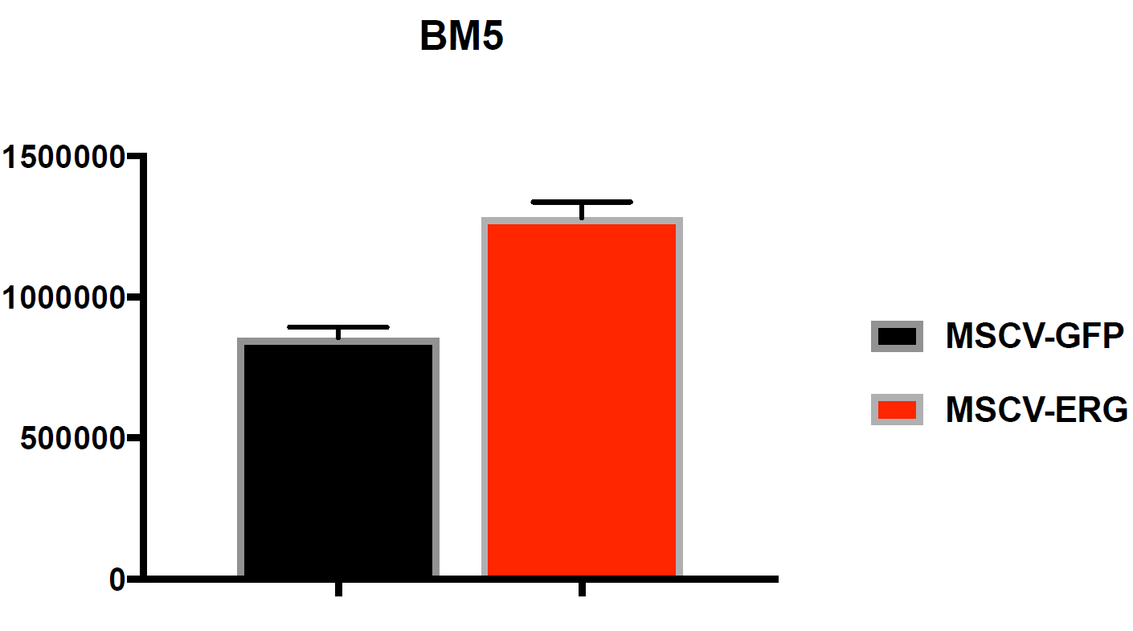
Supplementary Figure 2
Mao et al, 2019
A.
MSKPCa2
p-value = 0.002
Cell Titer Glo
MDV3100
B.
Supplementary Figure 2. ERG over-expression pre-clinical models.
A) ERG over-expression in MSKPCa2 prostate cancer organoids display in vitro resistance to AR targeted therapy B) Over-expression of ERG results in up-regulation of the AR target genes PSA and STEAP1 and abolishes the inhibitory effect of MDV3100 on the expression of these genes.

