Slide 1
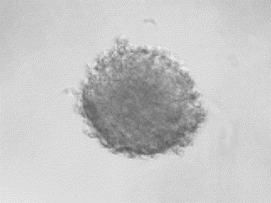
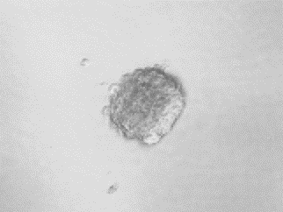
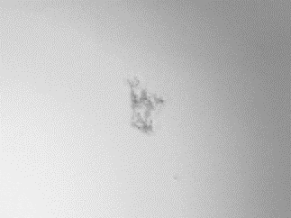
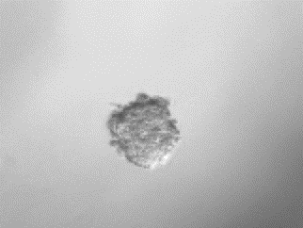
Figure. S2
SCC47(HPV+)
Vector
NDI1
150
**
**
Control
100
% of spheres
relative to control
Metformin
50
0
100µm
0
-
+
-
+
Metformin
Vector
NDI1
cDNA
CAL27
Vector
NDI1
150
**
**
Control
100
% of spheres
relative to control
Metformin
50
100µm
0
Metformin
-
+
-
+
cDNA
Vector
NDI1

