Slide 1
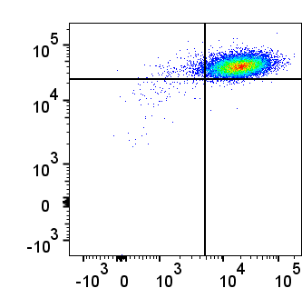
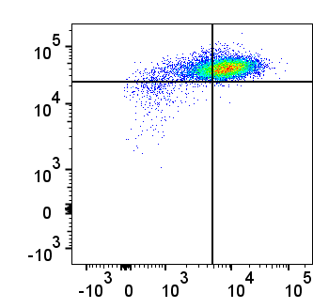
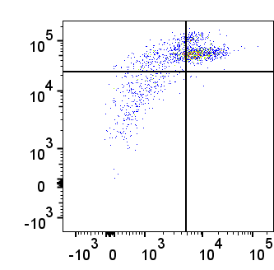
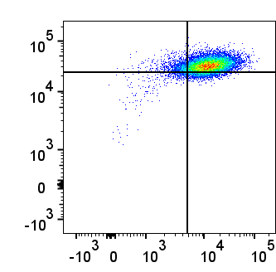
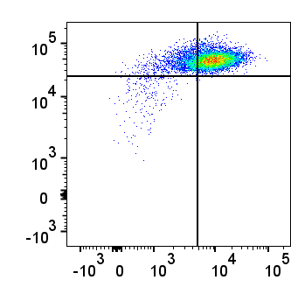
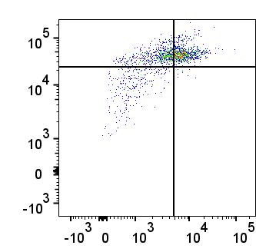
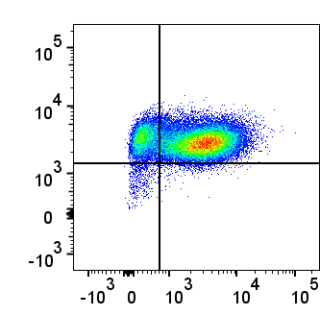
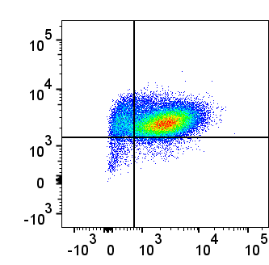
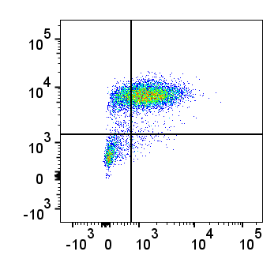
Figure. S4
Metformin
CAL27
Control
1mM
3mM
CD44^{high}/ALDH1^{high}
2.48
96.1
24.8
71.3
27.3
51.4
0.76
0.68
3.53
0.32
21.0
0.39
SCC47
ALDH1
6.68
82.2
18.9
79.1
36.9
47.8
2.57
8.50
2.00
0.047
14.7
0.51
CAL33
17.8
80.3
12.4
83.6
65.3
19.0
1.10
0.83
1.74
2.30
14.5
8.50
CD44

