Slide 1
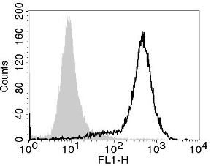
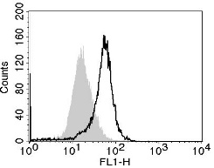
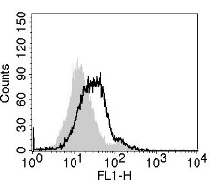
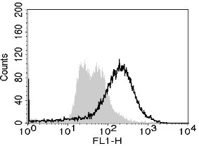
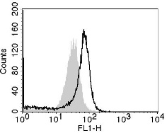
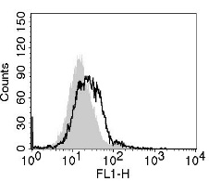
Supplementary Figure S1
MDA-MB-231
BT-549
MCF-7
None
Relative cell number
DXR
anti-EGFR-FITC
Figure S1. Expression of EGFR on three breast cancer cell lines. Cancer cells were treated with or without DXR (250 nM for MDA-MB-231, 100 nM for BT-549, and 200 nM for MCF-7) for 2 days. After harvesting, cancer cells were stained with FITC-conjugated anti-EGFR antibody. Gray background shows staining with FITC-conjugated IgG as a control.

Slide 2
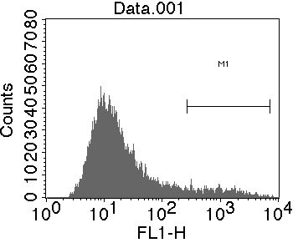
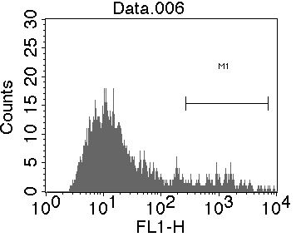
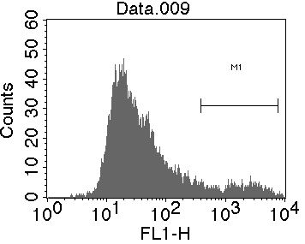
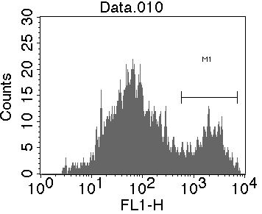
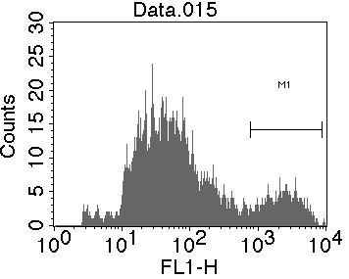
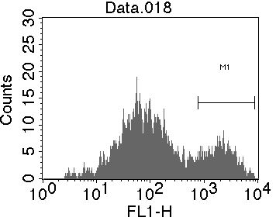
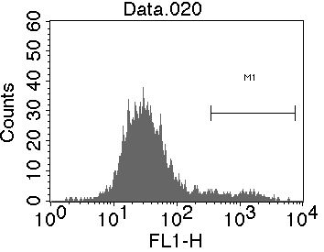
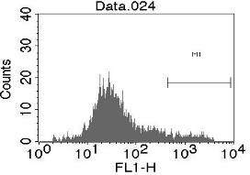
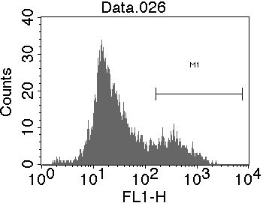
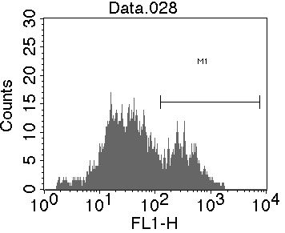
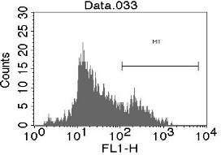
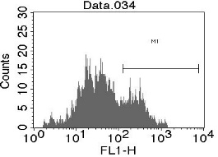
Supplementary Figure S2
(a)
Untreated MDA-MB-231
T cells
relative cell number
6.1
7.9
DXR-treated MDA-MB-231
T cells
cont Ig
anti-TRAIL
CMA
relative cell number
8.3
21.2
12.8
20.4
annexin V-FITC
(b)
Untreated BT-549
T cells
relative cell number
5.1
6.7
DXR-treated BT-549
T cells
cont Ig
anti-TRAIL
CMA
relative cell number
16.4
26.0
21.5
24.7
annexin V-FITC
Figure S2. Treatment with DXR increases the sensitivity of MDA-MB-231 and BT-549 cells to activated T cells. DXR-treated MDA-MB-231 (a) and BT-549 cells (b) were examined for their sensitivity against in vitro expanded activated T cells, as described in Figure 3B. A representative result of flow cytometry is shown. The numbers are the percentages of annexin V⁺ apoptotic cells among gated cancer cells.

Slide 3
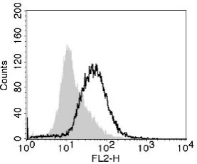
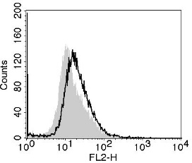
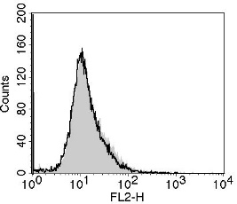
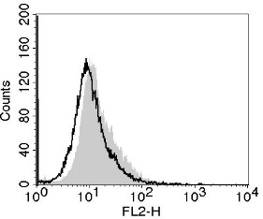
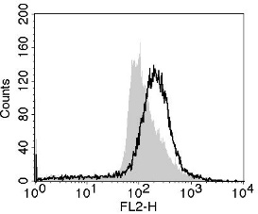
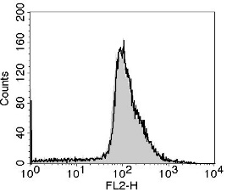
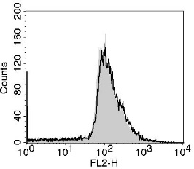
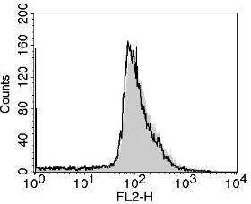
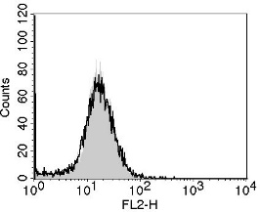
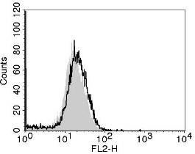
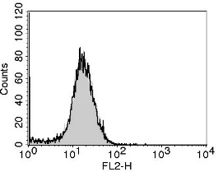
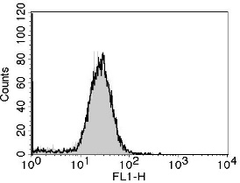
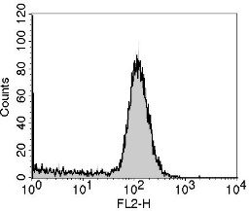
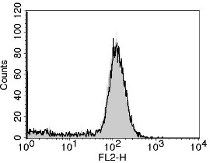
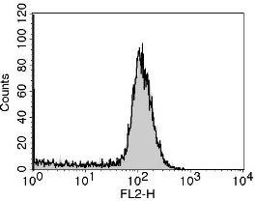
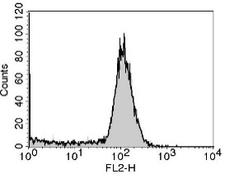
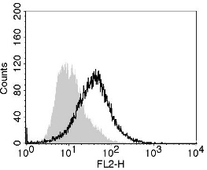
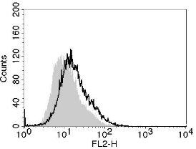
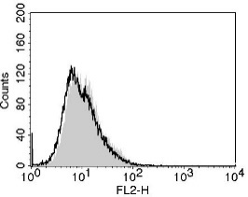
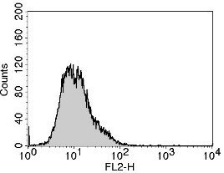
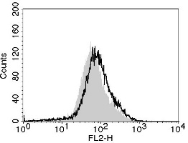
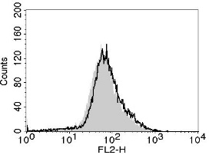
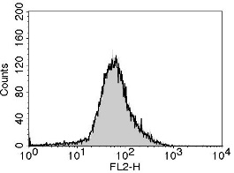
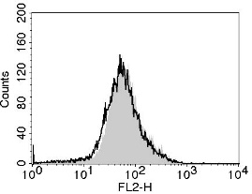
Supplementary Figure S3
DXR
(-)
MDA-MB-231
(+)
(-)
BT-549
Relative cell number
(+)
(-)
MCF-7
(+)
anti-DR4
anti-DR5
anti-DcR1
anti-DcR2
Figure S3. Expression of death receptors and decoy receptors on three breast cancer cell lines. Cancer cells were treated with or without DXR (250 nM for MDA-MB-231, 100 nM for BT-549, and 200 nM for MCF-7) for 2 days. After harvesting, cancer cells were stained with the indicted PE-conjugated antibodies or control PE-conjugated antibody. Gray background shows staining with the control antibody.

Slide 4
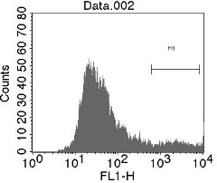
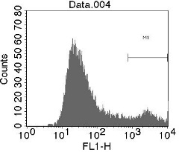
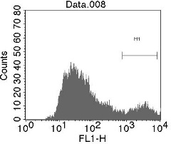
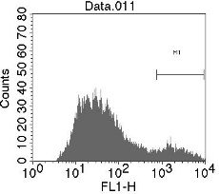
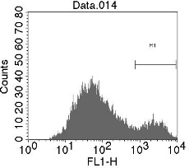
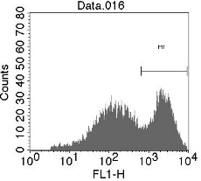
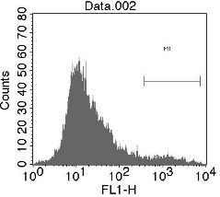
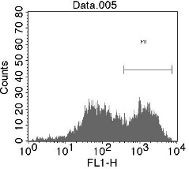



Supplementary Figure S4
(a)
Untreated MDA-MD-231
DXR-treated MDA-MD-231
+ NK/cont. Ab
+ NK/anti-Her2
+ NK/cont. Ab
+ NK/anti-Her2
8.0
11.2
13.7
9.7
14.9
42.7
Relative cell number
annexin V-FITC
(b)
NK/αHER2
None
Cont Ig
anti-TRAIL
DMSO
CMA
Relative cell number
4.9
41.3
37.1
41.4
28.9
annexin V-FITC
Figure S4. Treatment with DXR increases the sensitivity of MDA-MB-231 cells to ADCC by NK cells. (a) Untreated or DXR-treated MDA-MB-231 cells were examined for their sensitivity to ADCC by NK cells and anti-HER2 antibody, as described in Figure 3B. (b) In some groups, anti-TRAIL antibody or concanamycin A (CMA) was added 1 h before the addition of NK cells and anti-HER2 antibody. A representative result of flow cytometry is shown. The numbers are the percentages of annexin V⁺ apoptotic cells among gated cancer cells.

Slide 5









Supplementary Figure S5
MDA-MB-231
none
DXR
abem
5.5
9.6
5.6
Relative cell number
6.8
29.2
14.2
+ T cells
38.0
65.5
41.9
+ NK /
anti-EGFR
Annexin V-FITC
Figure S5. Sensitivity of DXR-treated or abemaciclib-treated MDA-MB-231 cells to T cells and ADCC by NK cells. Untreated, DXR-treated, or abemaciclib-treated MDA-MB-231 cells were examined for their sensitivity to activated T cells and ADCC by NK cells and anti-EGFR antibody, as described in Figure 3B. A representative result of flow cytometry is shown. The numbers are the percentages of annexin V⁺ apoptotic cells among gated cancer cells.

