Slide 1
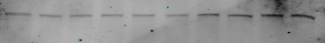
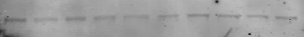
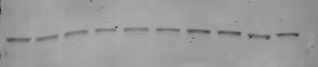
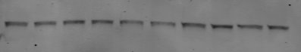
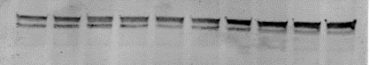
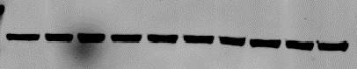
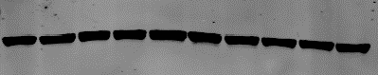
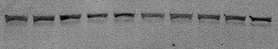
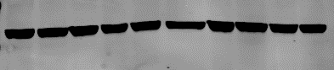
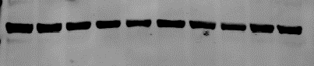
Supplemental Figure 1
A.
**
**
**
**
**
**
B.
Veh
BHT
DEA
Veh
PCE
MDEA
ERα
24hr
ERα
24hr
β-Actin
β-Actin
ERα
ERα
48hr
48hr
β-Actin
β-Actin
ERβ
ERβ
24hr
24hr
β-Actin
β-Actin
ERβ
ERβ
48hr
48hr
β-Actin
β-Actin

Slide 2
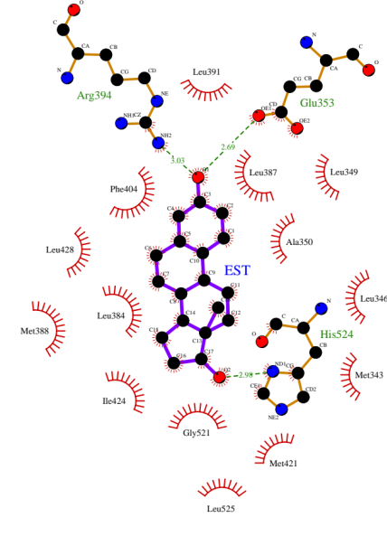
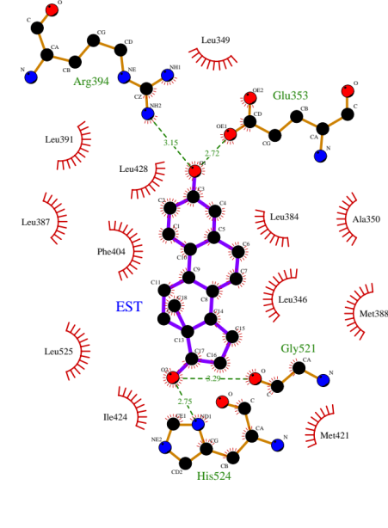
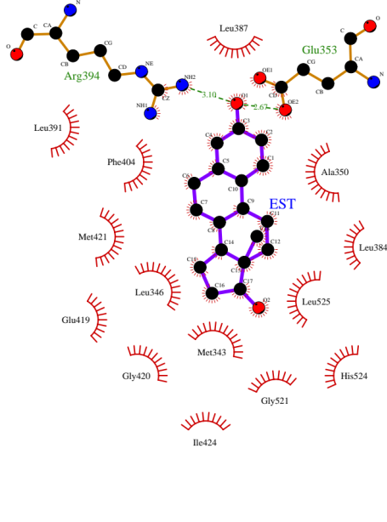
Supplemental Figure 2
A.
E₂-docked to the inactive form (1a52.pdb)
E₂-docked to the agonist form (3uud.pdb)
Tamoxifen-docked to the antagonist form (3ert.pdb)
B.
E₂-docked to the inactive form (1a52.pdb)
E₂-docked to the agonist form (3uud.pdb)
E₂-docked to the antagonist form (3ert.pdb)

Slide 3
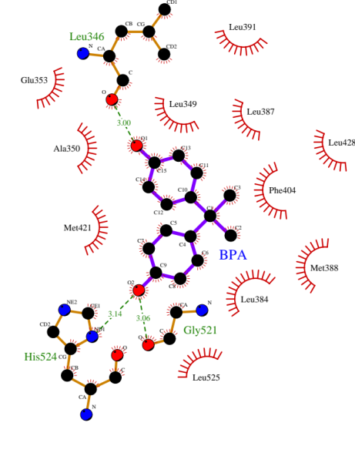
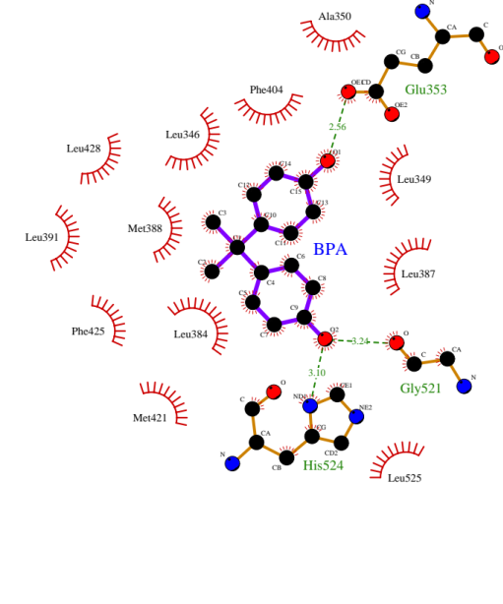
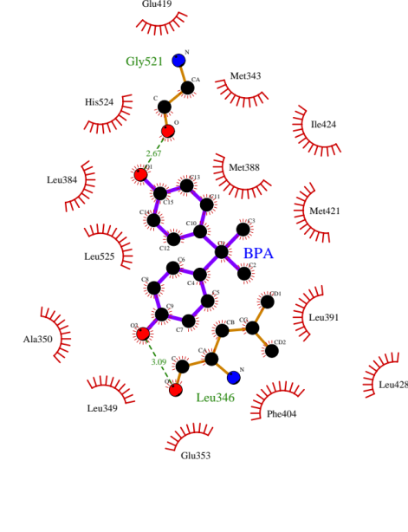
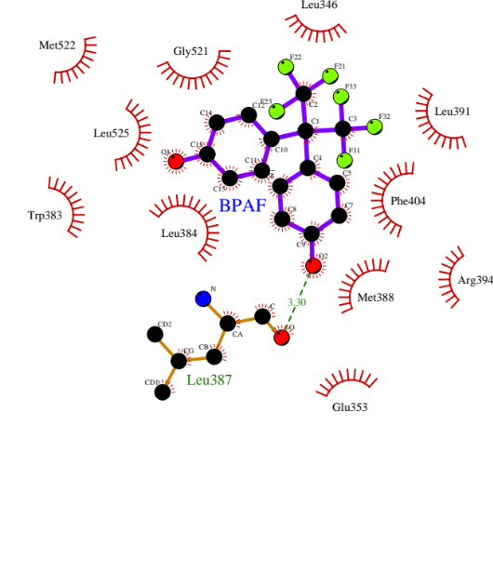
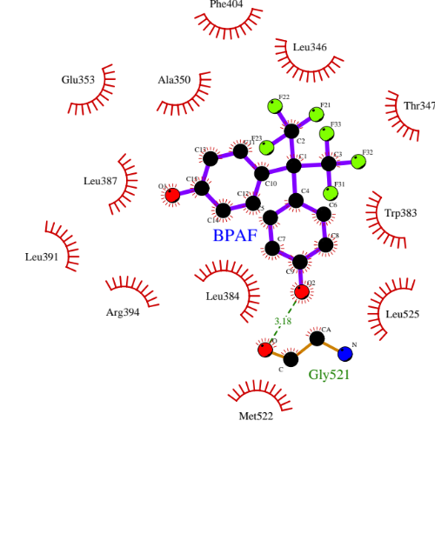
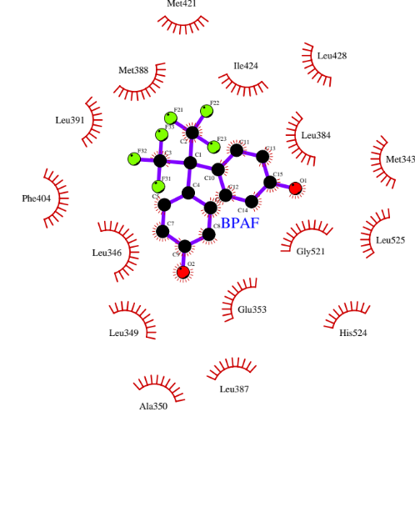
Supplemental Figure 2
C.
BPA-docked to the inactive form (1a52.pdb)
BPA-docked to the agonist form (3uud.pdb)
BPA-docked to the antagonist form (3ert.pdb)
D.
BPAF-docked to the inactive form (1a52.pdb)
BPAF-docked to the agonist form (3uud.pdb)
BPAF-docked to the antagonist form (3ert.pdb)

Slide 4
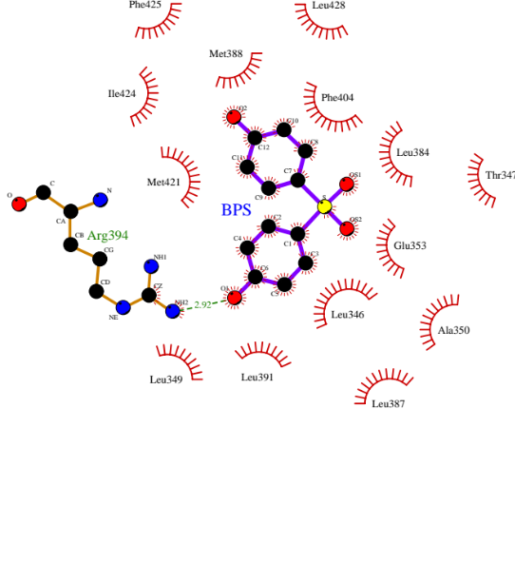
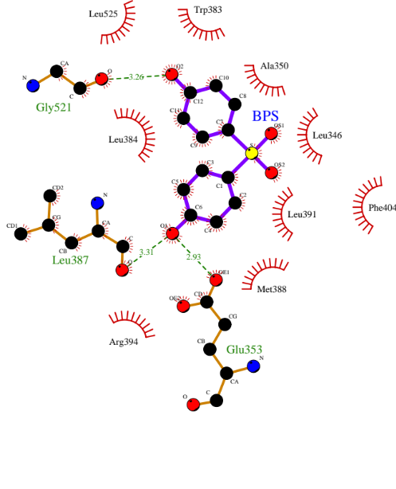
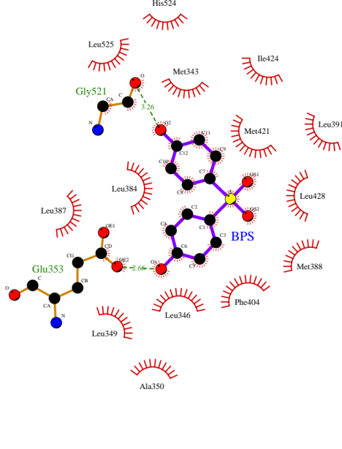
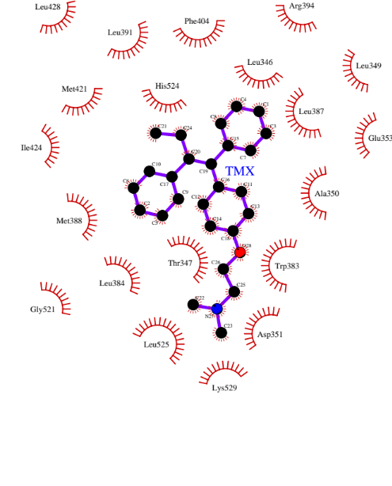
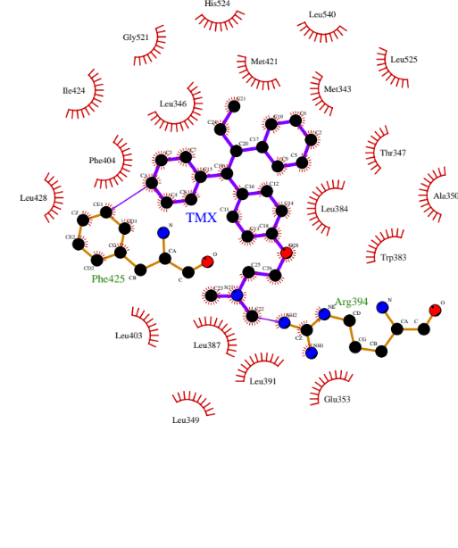
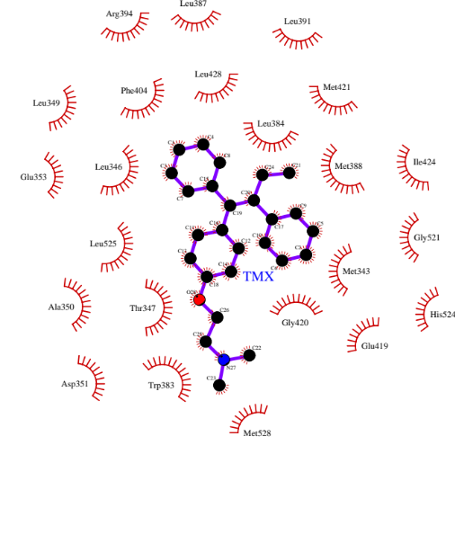
Supplemental Figure 2
E.
BPS-docked to the inactive form (1a52.pdb)
BPS-docked to the agonist form (3uud.pdb)
BPS-docked to the antagonist form (3ert.pdb)
F.
Tamoxifen-docked to the inactive form (1a52.pdb)
Tamooxifen-docked to the agonist form (3uud.pdb)
Tamoxifen-docked to the antagonist form (3ert.pdb)

Slide 5
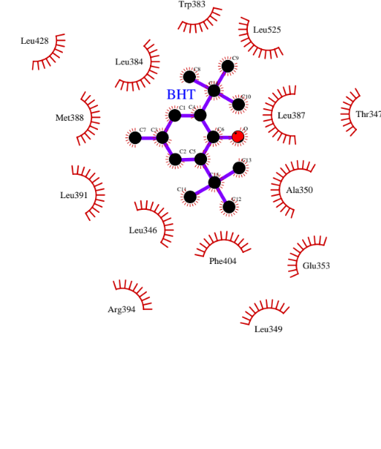
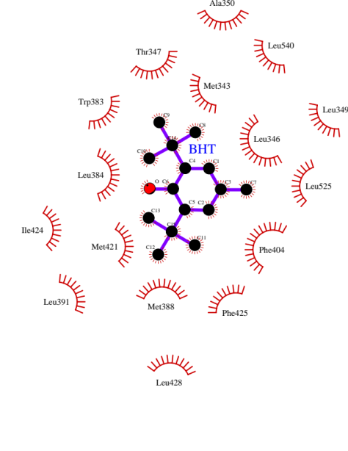
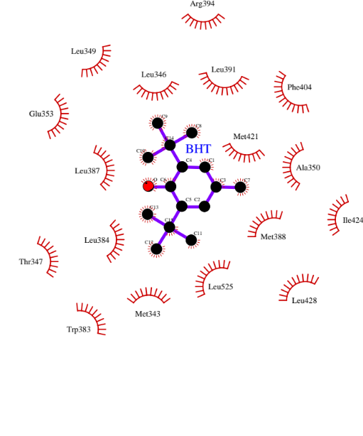
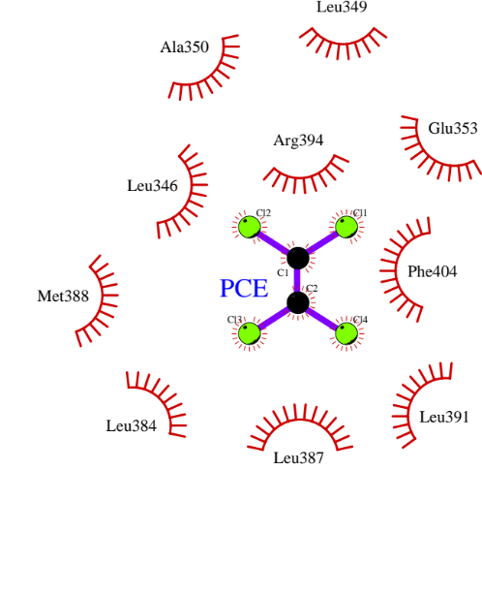
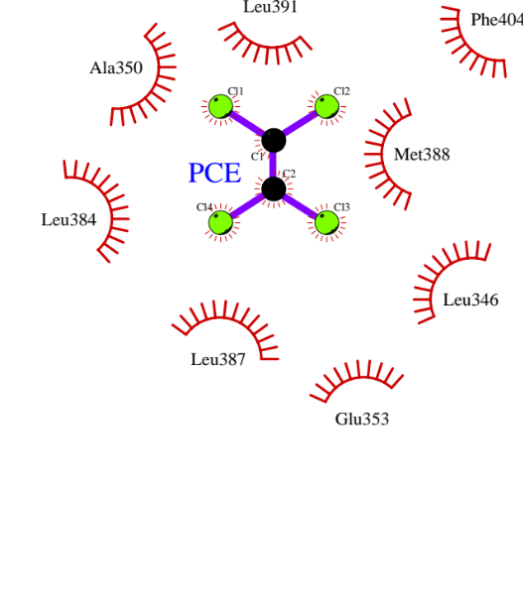
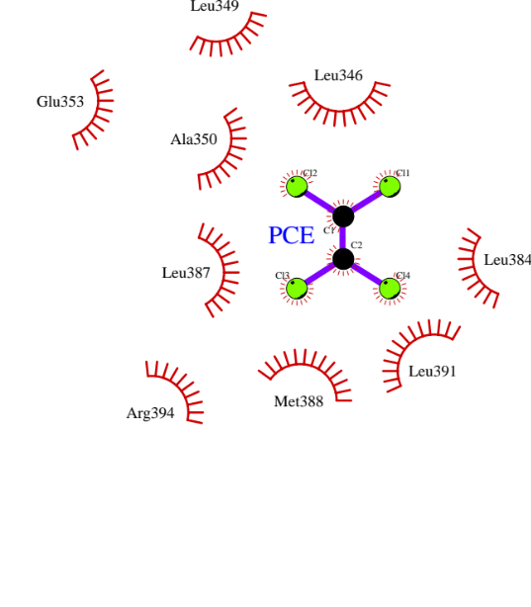
Supplemental Figure 2
G.
BHT-docked to the inactive form (1a52.pdb)
BHT-docked to the agonist form (3uud.pdb)
BHT-docked to the antagonist form (3ert.pdb)
H.
PCE-docked to the inactive form (1a52.pdb)
PCE-docked to the agonist form (3uud.pdb)
PCE-docked to the antagonist form (3ert.pdb)

Slide 6
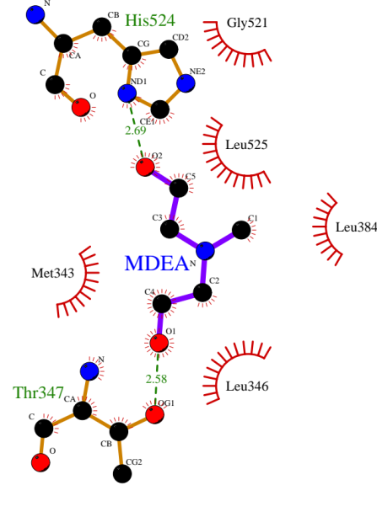
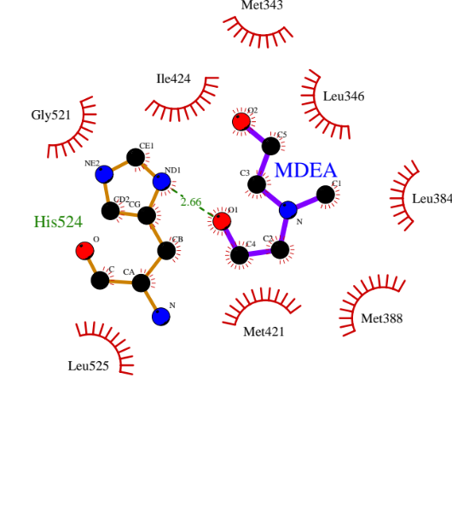
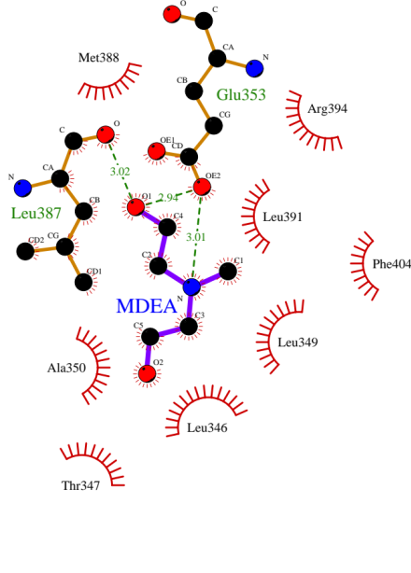
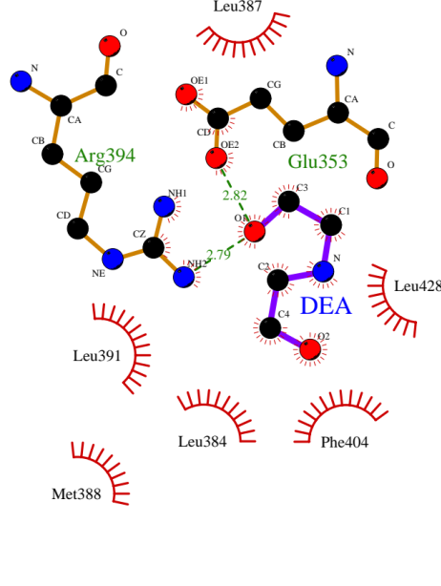
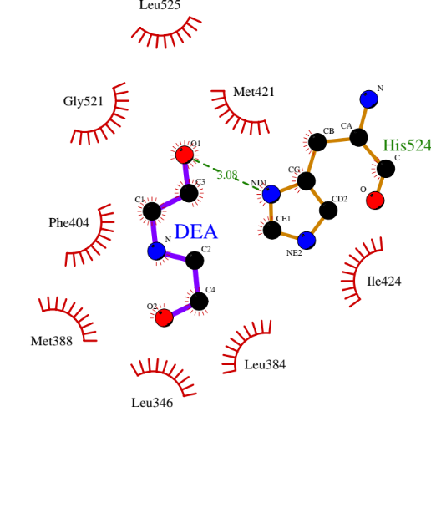
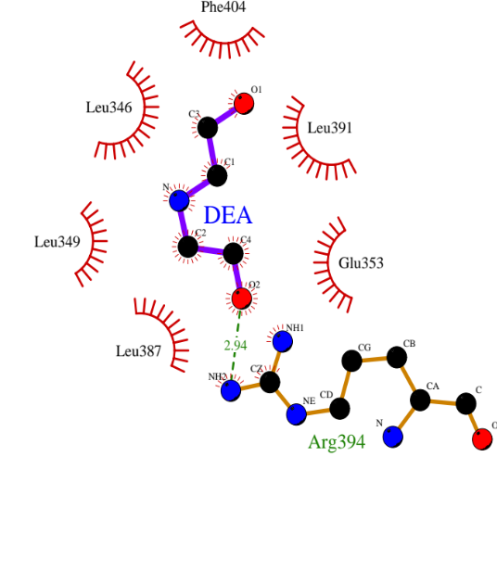
Supplemental Figure 2
I.
MDEA-docked to the inactive form (1a52.pdb)
MDEA-docked to the agonist form (3uud.pdb)
MDEA-docked to the antagonist form (3ert.pdb)
J.
DEA-docked to the inactive form (1a52.pdb)
DEA-docked to the agonist form (3uud.pdb)
DEA-docked to the antagonist form (3ert.pdb)

Slide 7
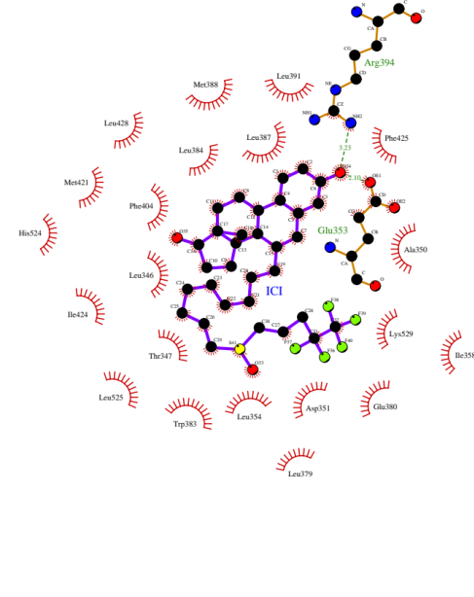
Supplemental Figure 2
K.
ICI 182 780-docked to the inactive form (1a52.pdb)

