Slide 1
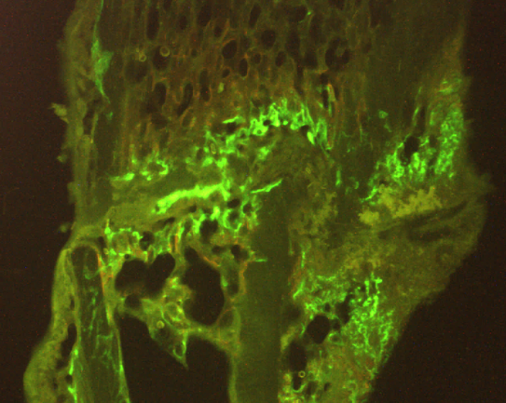
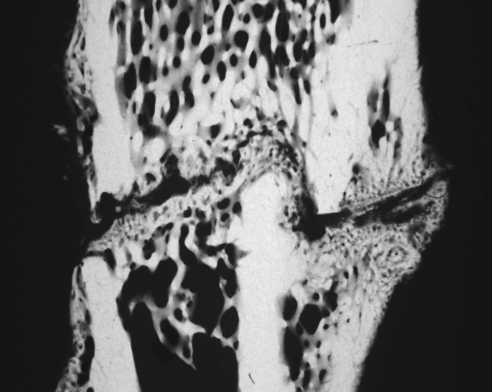
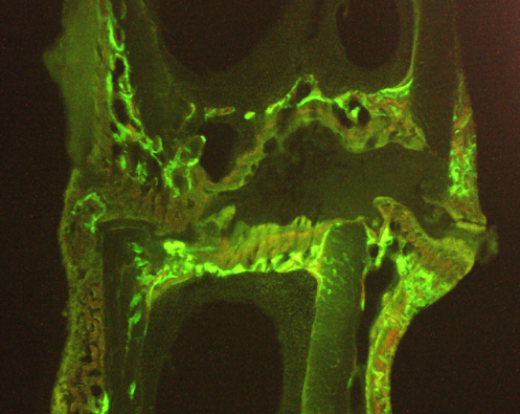
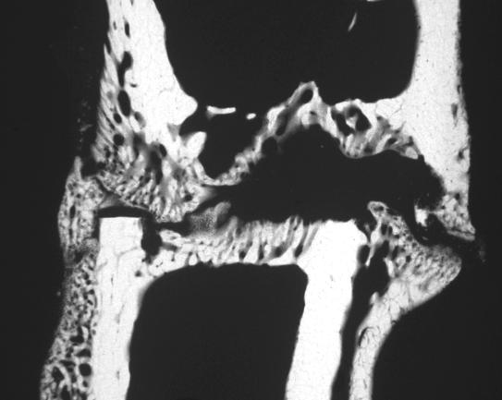
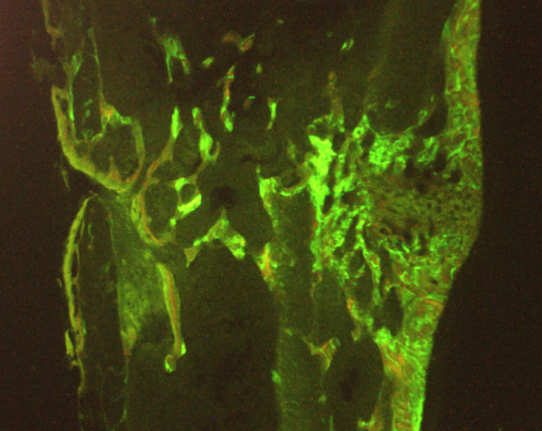
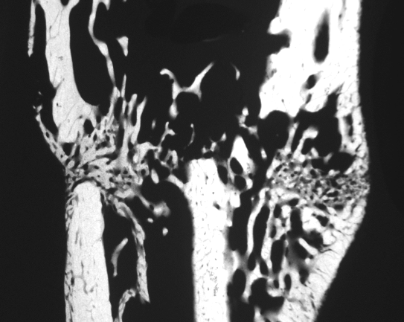
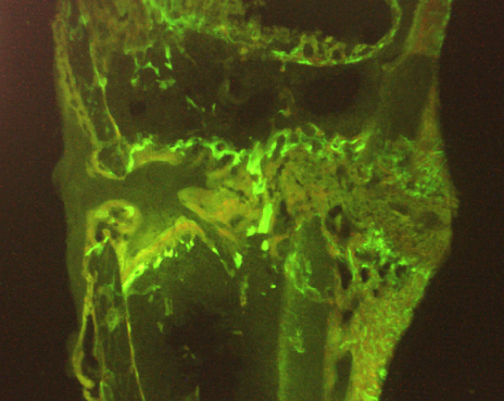
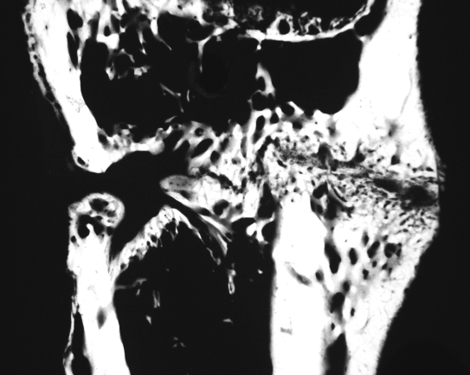
A
B
C
D
E
F
G
H

Slide 2
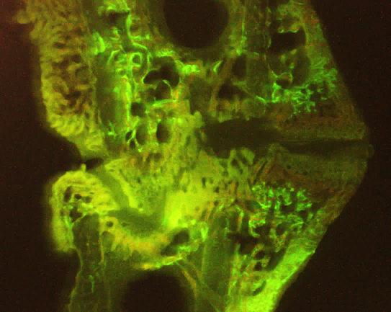
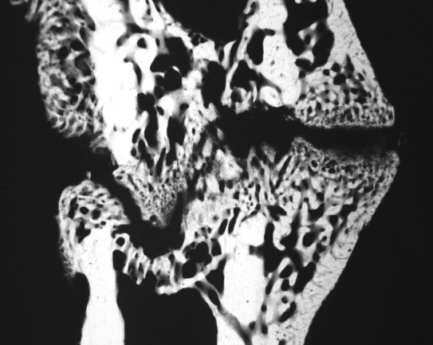
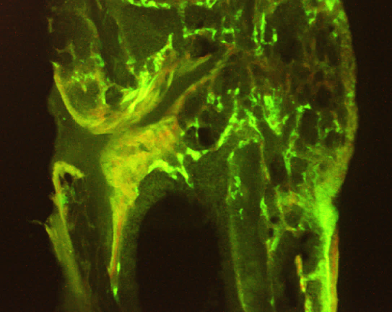
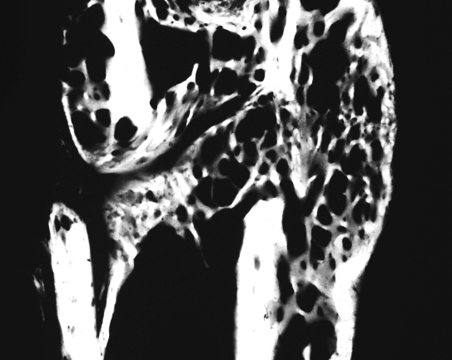
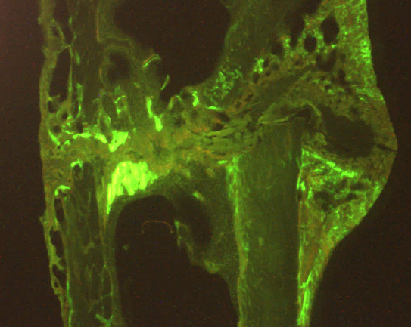
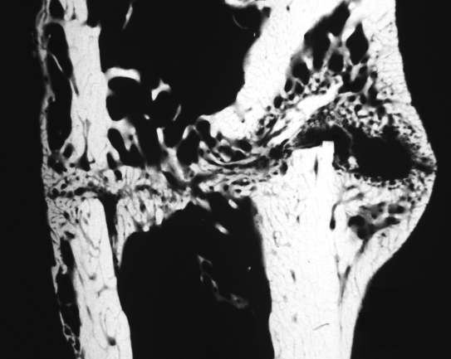
I
J
K
L
M
N
Supplementary Figure 3. Images of longitudinal sections of tibia metaphysis labeled with fluorochromes and the corresponding microradiographs (within row) made 42 days after osteotomy in treatment groups: (A,B) Non-Ovx; (C,D) Ovx; (E,F) Ovx+Vib; (G,H) Ovx+ALN; (I,J) Ovx+ALN+Vib; (K,L) Ovx+8-PN; (M,N) Ovx+8-PN+Vib.

