Slide 1
Supplemental Figure 1
A)
B)
Normal Adjacent
Stage 0
B
Stage I
Inflammation
B
Hyperplasia
Stage IIA or IIB
B
Fibroadenoma
Stage IIIA or IIIB
B
C)
D)
E)
Supplemental Figure 1. Tissue microarray. A) Gross pathological status, see details in supplemental Table 1; B) Hematoxylin and Eosin stain; C) Estrogen receptor stain; D) progesterone receptor stain; E) HER2 stain.

Slide 2
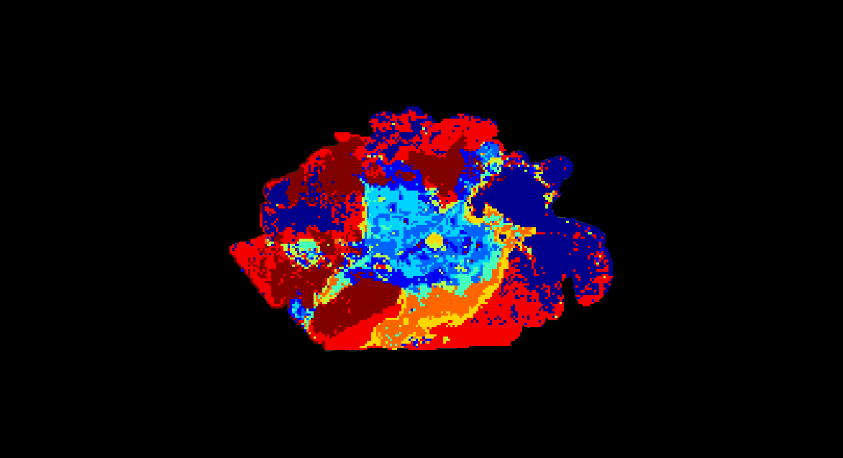
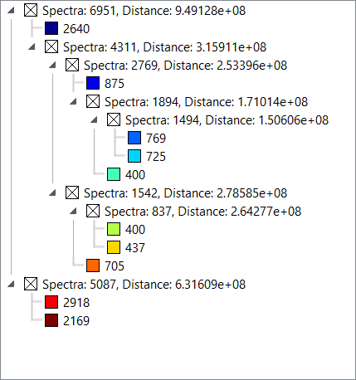
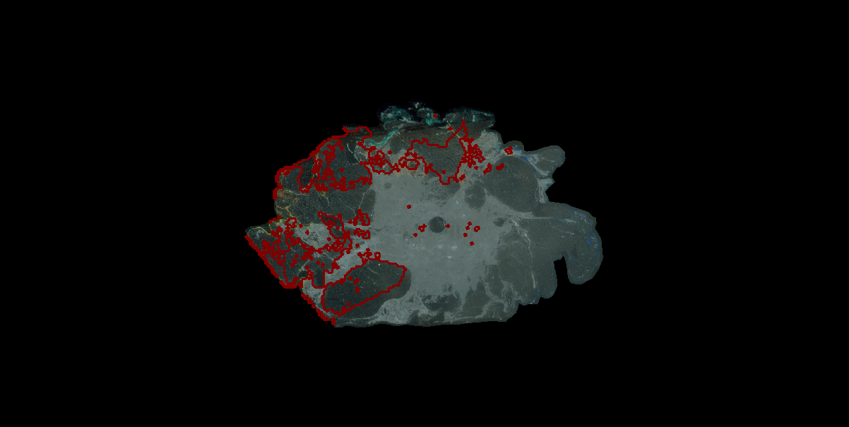
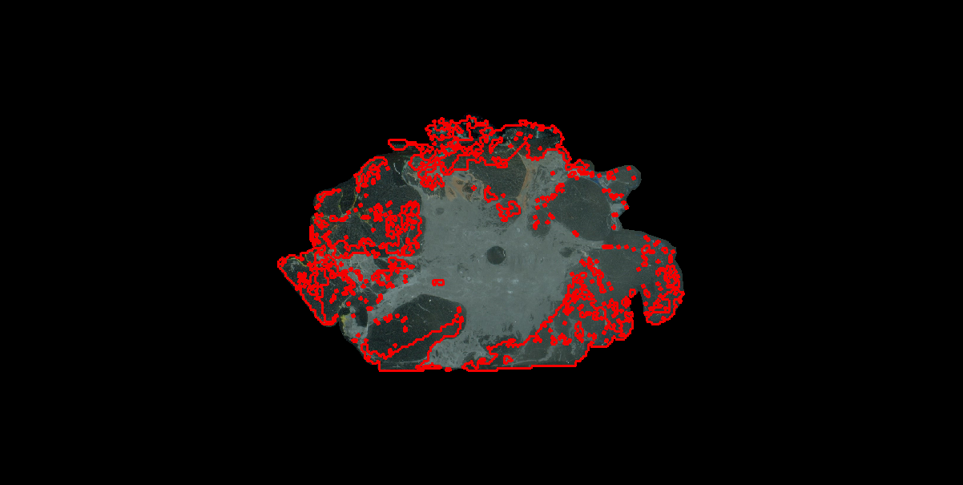
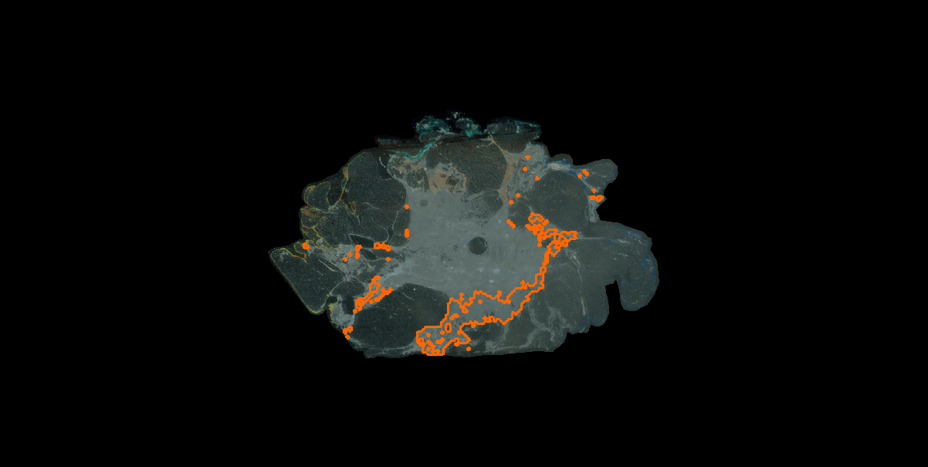
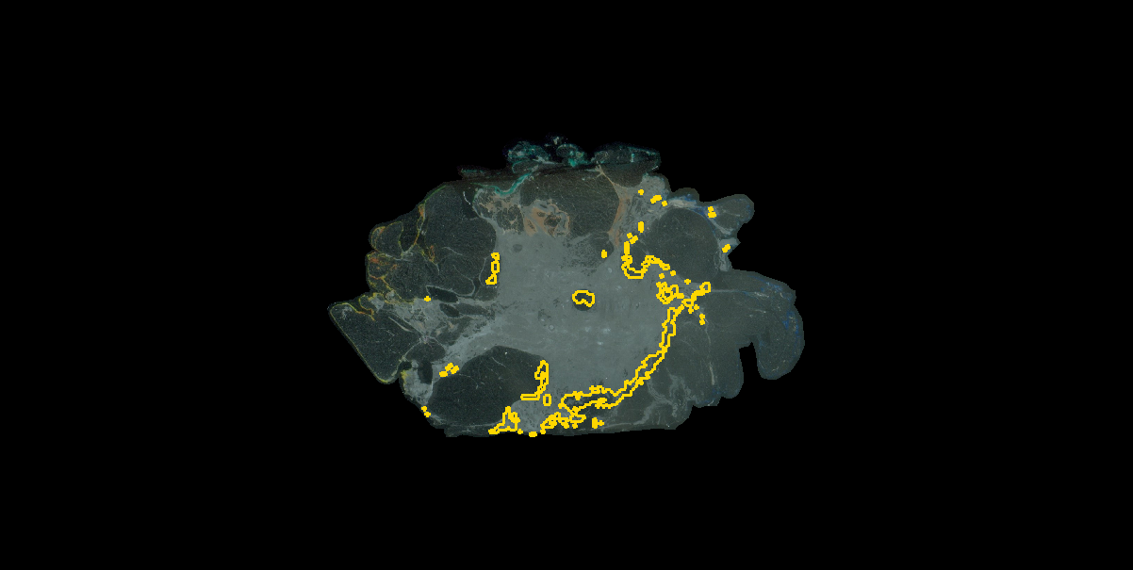
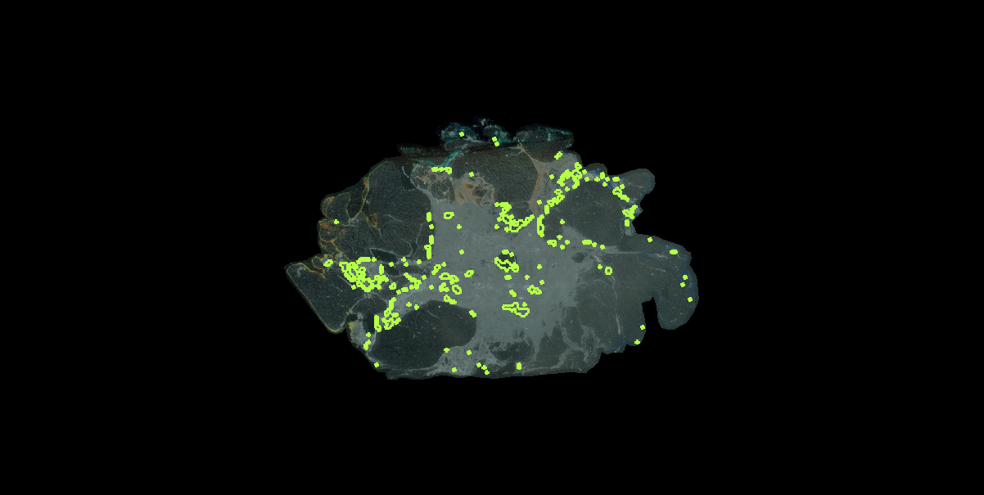
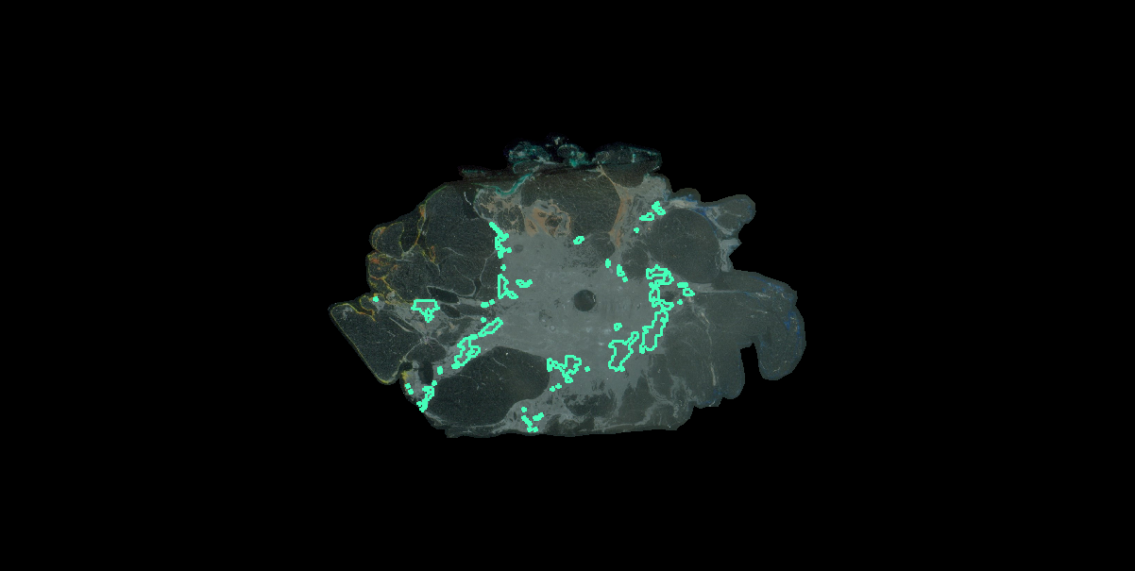
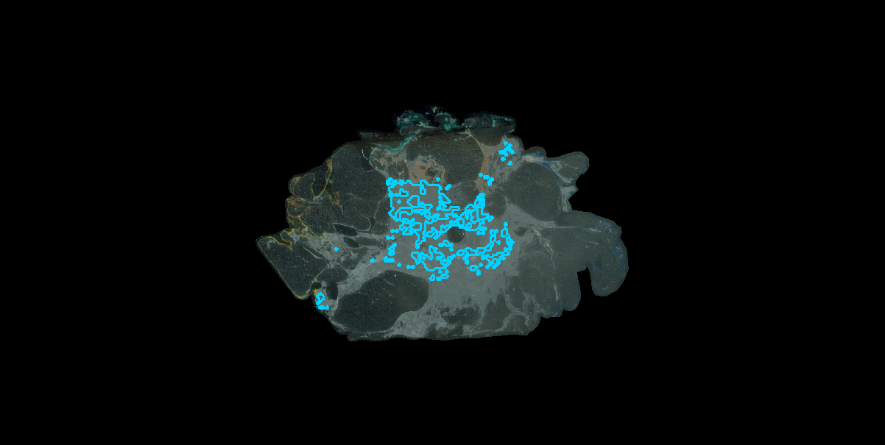
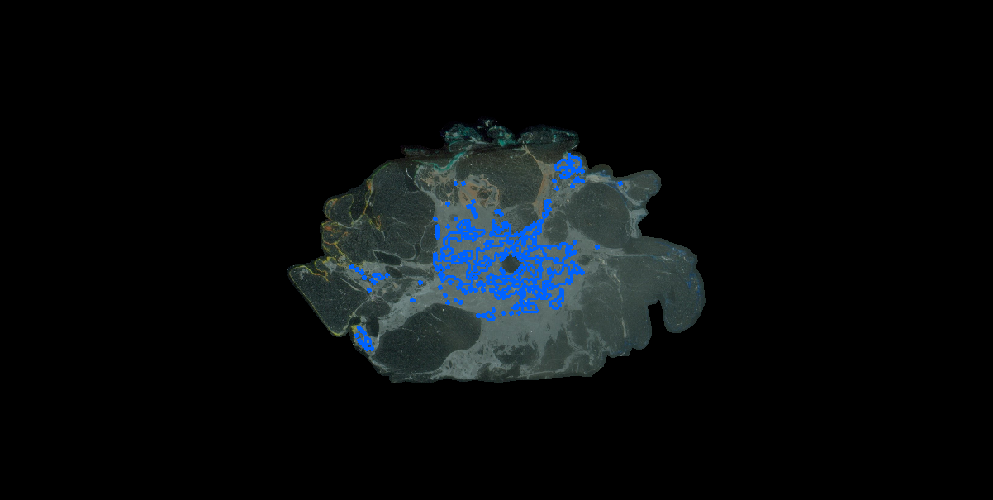
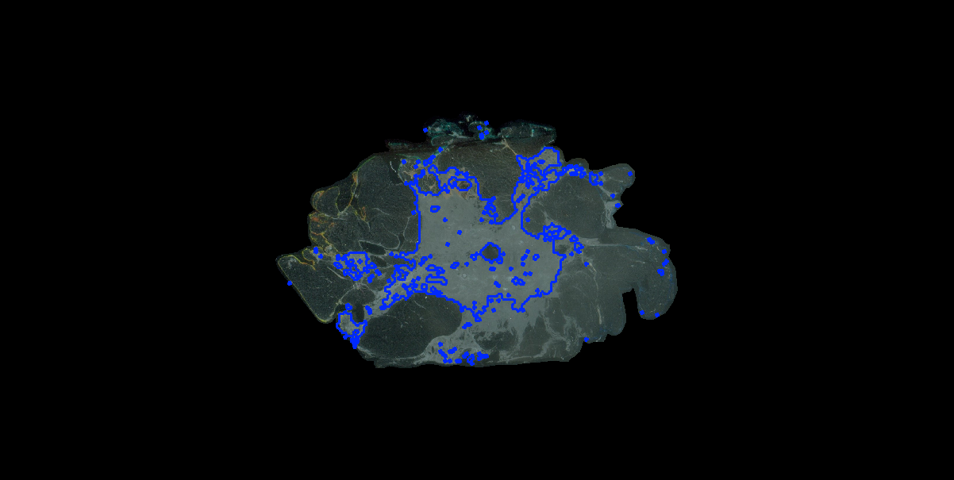
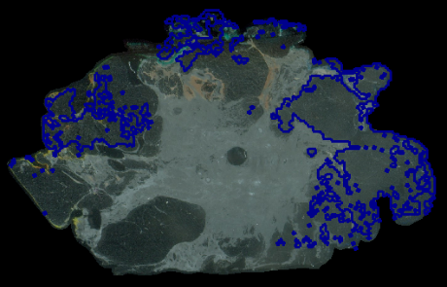
Supplemental Figure 2
A)
B)
NAT
Central Tumor Region
C)
D)
E)
F)
G)
H)
I)
J)
K)
L)
Supplemental Figure 2. Image segmentation on peptides reported by ECM IMS on a breast tissue biopsy. A) Combined image segmentation map showing normal adjacent tissue (NAT). B) Hierarchical clustering of spectra. C-L) Reporting of individual clusters outlining cluster region on the tissue. Each cluster region is colored by hierarchical cluster shown in (B). Clusters in G and H are associated with matrix peaks. Clusters C, D and L map portions of fatty tissue. Clusters I,j,K define the breast tumor.

