Slide 1
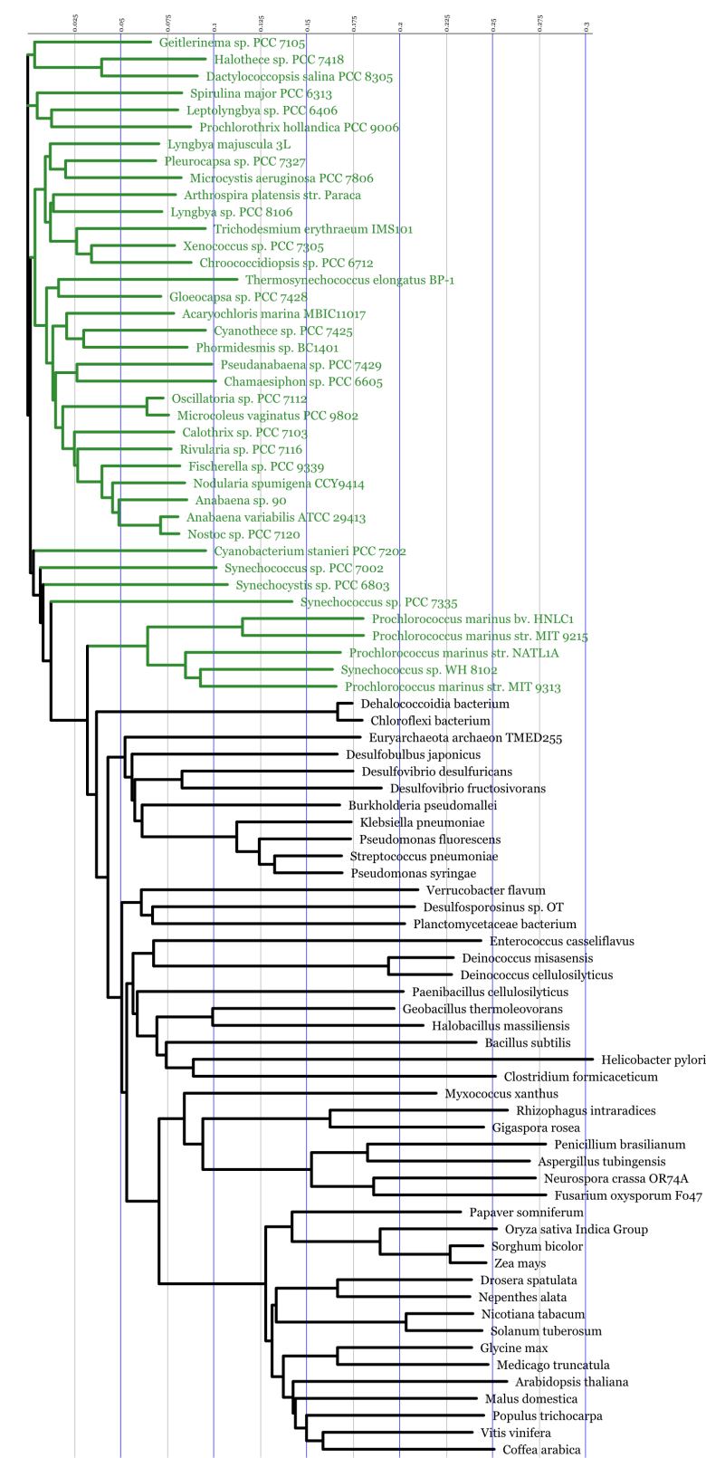
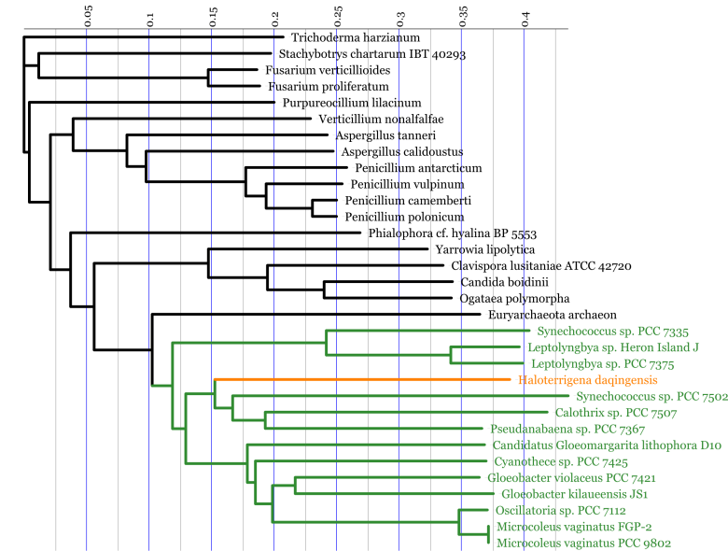
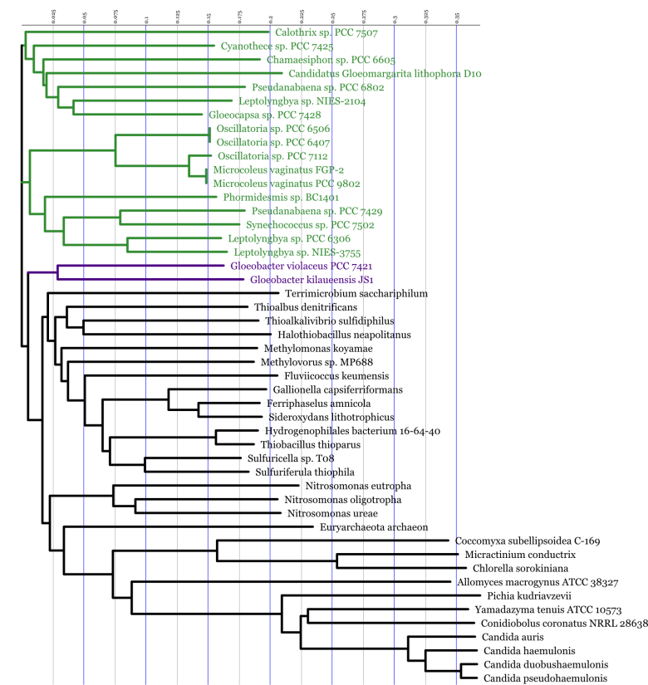
A
B
C
Supplementary Figure S2. Phylogenetic distribution of the genes encoding the urease (ureC subunit, panel A), allophanate hydrolase (B) and urea carboxylase (C) proteins in various organisms
The phylogenetic trees were constructed with Clustal Omega, using 39 ureC genes representative species of the cyanobacterial phylum (highlighted in green), or all presently studied genes encoding either allophanate hydrolase or urea carboxylase.

