Slide 1
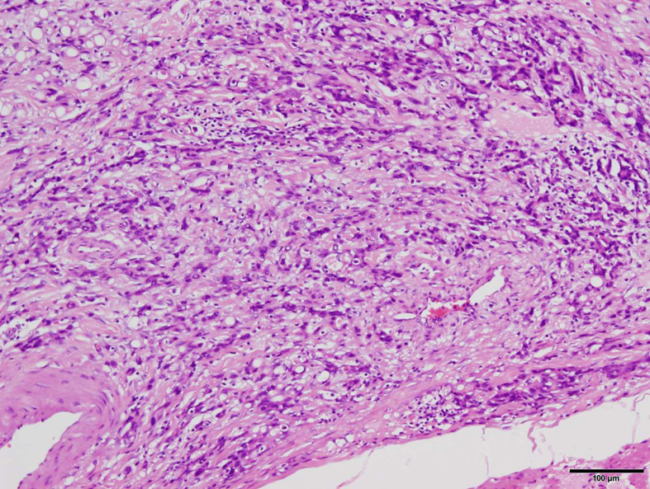
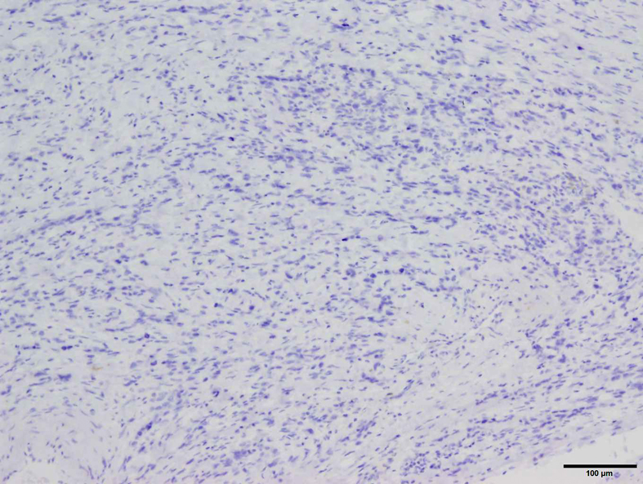
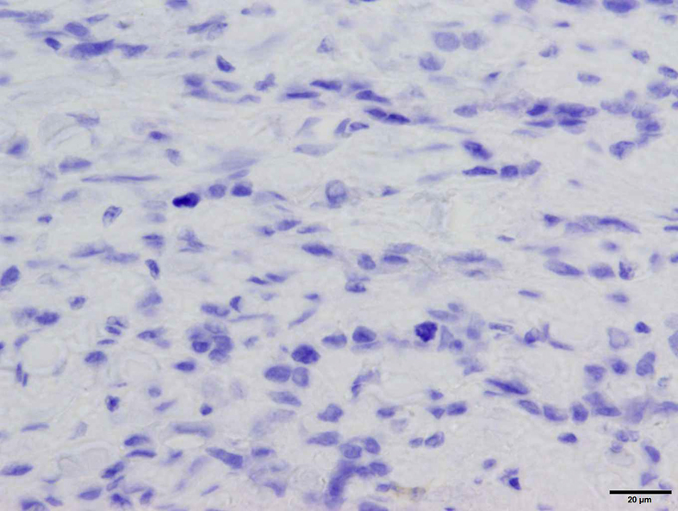
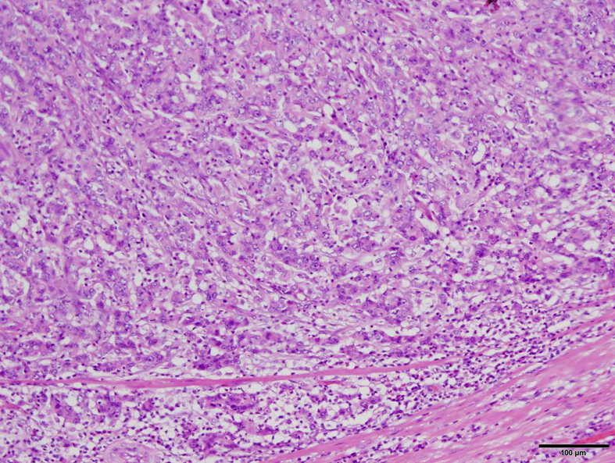
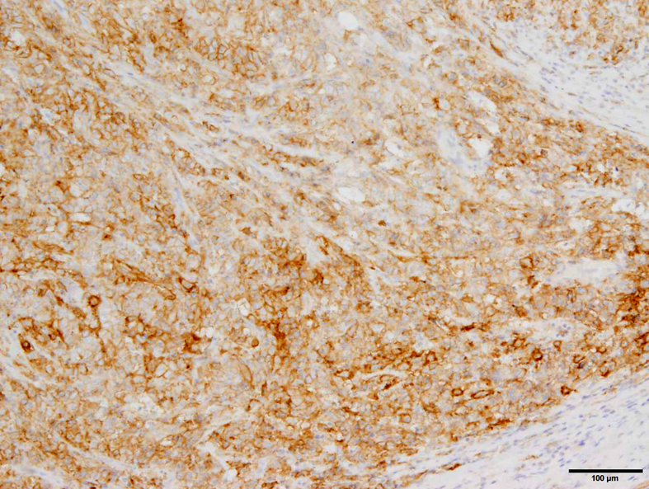
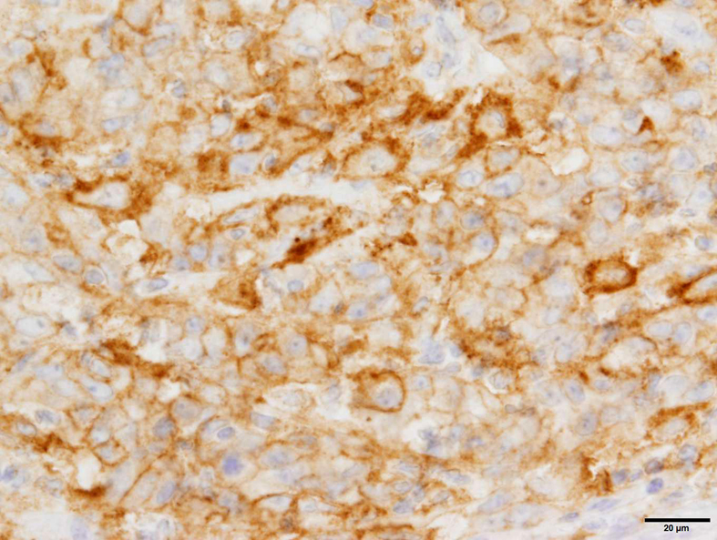
PD-L1 negative
(a)
(b)
(c)
PD-L1 positive
(d)
(e)
(f)
Fig. S1 Representative images of IHC staining for PD-L1 in gastric cancer
(a)-(c) PD-L1 negative case. (d)-(f) PD-L1 positive case. (a), (d) H&E staining (original magnification x 40). (b), (e) IHC staining for PD-L1 (original magnification x 40). (c), (f) IHC staining for PD-L1 (original magnification x 400).

