Slide 1
Supplementary Figure 1
A
i
ii
iii
iv
B
C
*
*
*
*
Figure S1. Effect of FGF signaling on HFAs viability and recombinant FGF2 effect on DENV2-infected HFAs. HFAs were treated for three days with or without recombinant human FGF2 (Ai-ii), neutralizing antibody to FGF2 or isotype-matched mouse IgG (Aiii) or the FGF receptor inhibitor BGJ398 (Aiv) at the same concentrations used for ZIKV replication studies. HFAs were harvested by trypsin detachment and counted with a mini automated cell counter at the 2 and 4 days of culture (Ai) or relative cell viability was determined by measuring cellular ATP levels using the CellTiter-Glo assay kit at the 2 day of culture (Aii, Aiii-iv). Values are expressed as the mean of three independent experiments. Error bars represent standard error of the mean. (B) HFAs were pre-treated for 24 hr with or without recombinant human FGF2 (6.25-12.5 ng/ml) prior to infection with DENV-2 (MOI=3) and cultured in the presence or absence of the cytokine. Two days later, total RNA was extracted from the cells followed by viral RNA quantitation by qRT-PCR. (C) Culture supernatants were also collected and viral titers were determined by plaque assay. Values are expressed as the mean of three independent experiments. Error bars represent standard error of the mean. *P<0.05 (Student’s t-test).

Slide 2
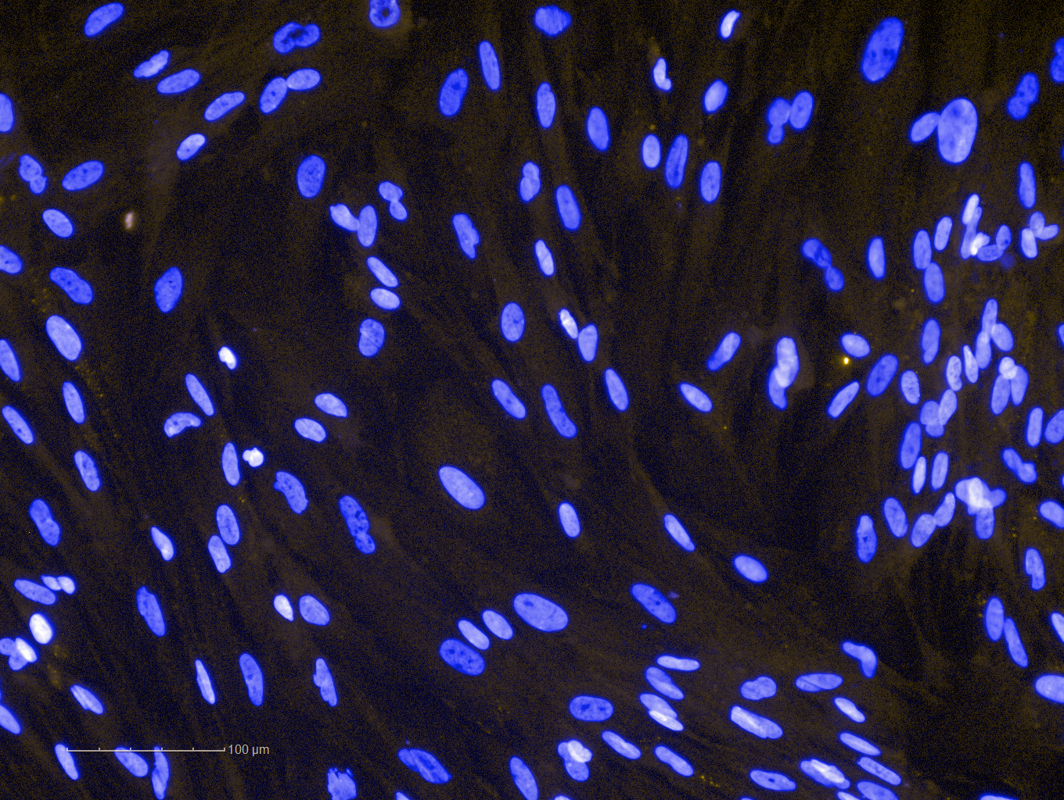
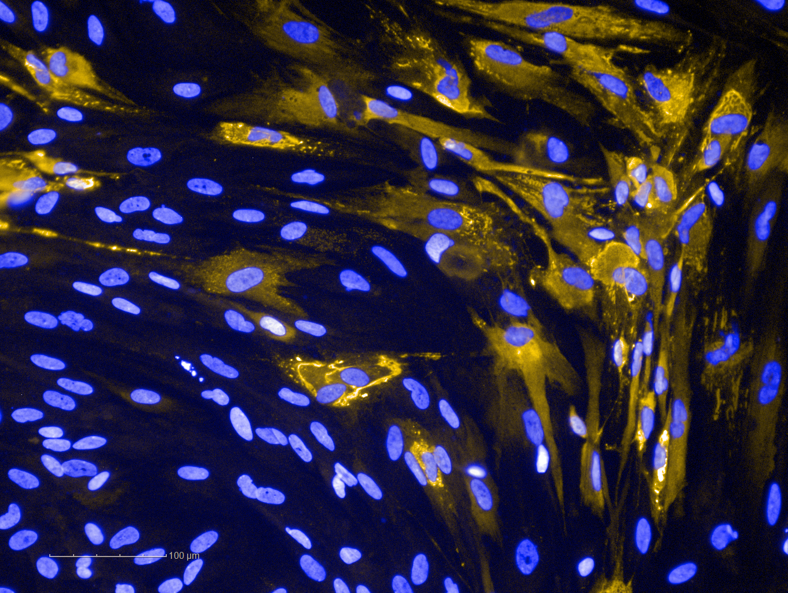
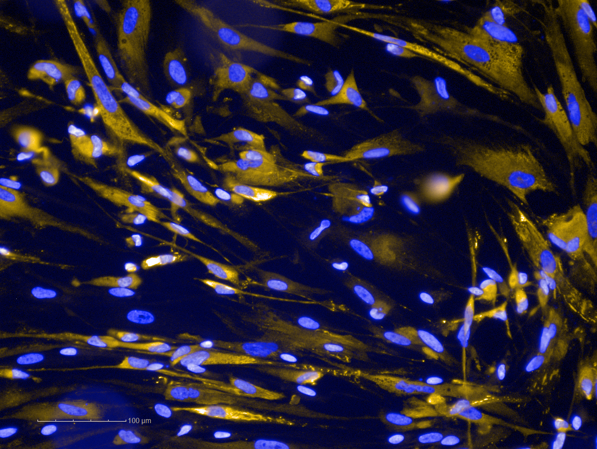
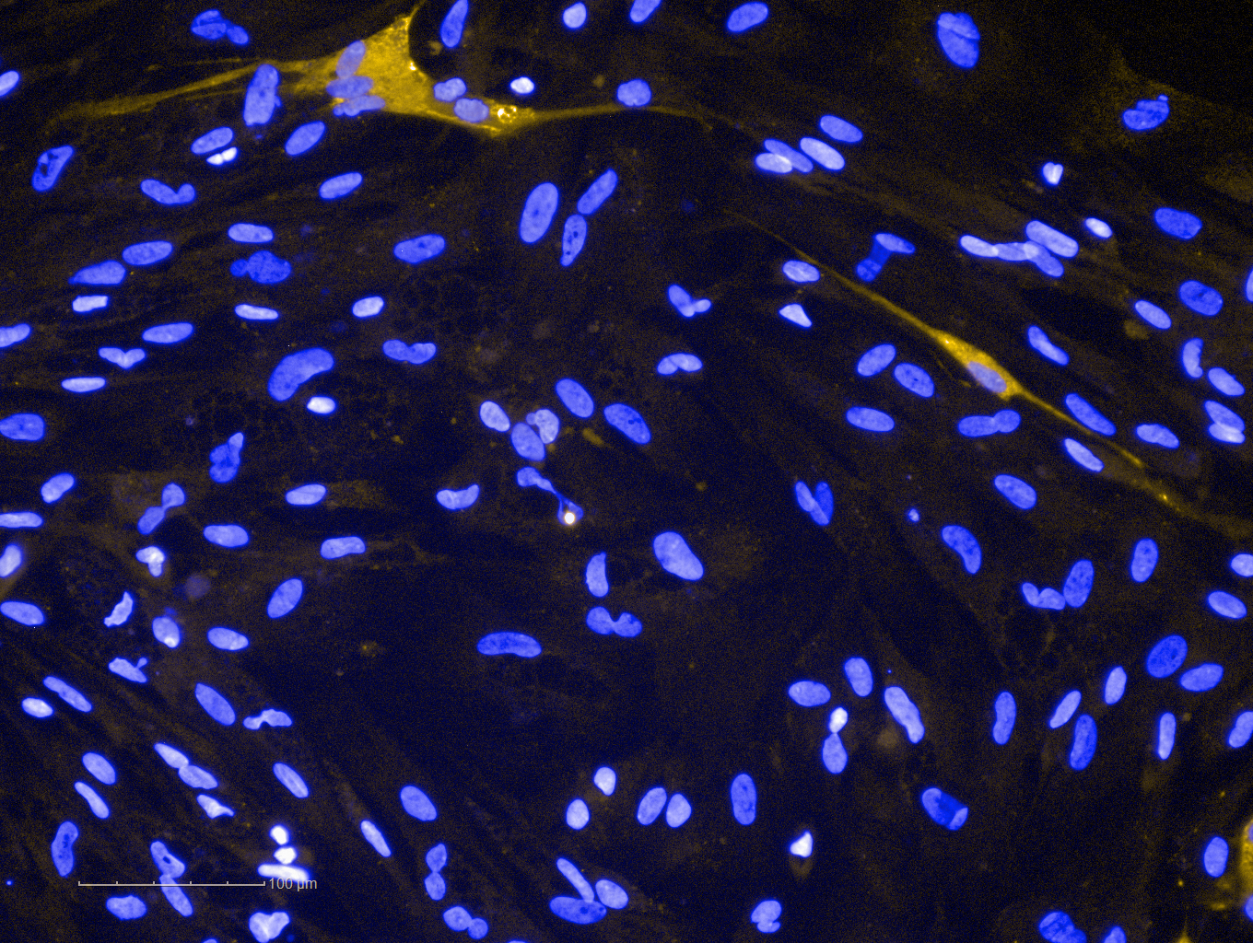
Supplementary Figure 2
A
i
ii
Mock
ZIKV
DAPI
ZIKV E + DAPI
iii
ZIKV + rFGF2
iv
ZIKV + BGJ398
ZIKV E + DAPI
ZIKV E + DAPI
B
i
ii
DMSO
LY294002 (µM)
DMSO
U-73122 (µM)
iii
iv
Figure S2. FGF2 signaling and viral spreading in HFAs. (A) Automated high-content immunofluorescence imaging (20X) of mock (i) and ZIKV-infected (PRVABC-59 (MOI=0.3)) HFAs (ii) treated with 12.5 µg/mL of recombinant FGF2 (iii) or 2.5 nM of FGF receptor inhibitor BGJ398 (iv). ZIKV-infected cells were identified using a mouse monoclonal antibody to E protein. Nuclei were stained with DAPI. Bars = 100 µm. (B) ZIKV-infected HFAs (MOI=0.3) were treated with or without inhibitors of (i) PI3K/Akt (LY294002) and (ii) PLCγ (U-73122) for 2 days at the indicated concentrations. (iii, iv) Cellular ATP levels in HFAs were determined two days after drug treatment using the CellTiter-Glo assay kit. Values are expressed as the mean of three independent experiments. Error bars represent standard error of the mean.

Slide 3
Supplementary Figure 3
A
B
A
i
PD98059 (µM)
ii
iii
***
0.02
0.1
Poly(I:C) (µg)
iv
C
*
*
**
*
*
D
*
Figure S3. Effect of FGF2 signaling inhibition, poly(I:C) transfection and IFN-α treatment on HFAs viability and expression of ISGs. HFAs were treated with PD98059 or DMSO for two days (A) or treated with neutralizing mouse anti-FGF2 antibody or an isotype-matched mouse IgG for 24 hr followed by poly(I:C) for 12 hr after which cellular ATP levels (Bi) were measured using the CellTiter-Glo assay kit. (Bii) Total RNA was extracted from HFAs pre-treated with neutralizing mouse anti-FGF2 antibody or an isotype-matched mouse IgG for 24 hr followed by poly(I:C) transfection for 12 hr. Relative levels of IFN-α mRNA were quantitated by qRT-PCR. (Biii and iv) HFAs were treated with DMSO alone or the MEK inhibitor PD98059 (50 µM) for 24 hr and then transfected with poly(I:C) for 12 hr after which cellular ATP levels were measured (iii) or levels of ISG transcripts were determined by qRT-PCR (iv). (C) Expression of ISG mRNA by qRT-PCR was measured after pre-treatment of HFAs with FGF receptor inhibitor BGJ398 (2.5 nM) or DMSO for 24 hr followed by IFN-α (25 U/mL) treatment for 4 hr. (D) ISGs expression was determined in HFAs by qRT-PCR after pre-treatment with PD98059 (50 µM) or DMSO for 24 hr followed by IFN-α (25 U/mL) treatment for 12 hr. Values are expressed as the mean of three independent experiments. Error bars represent standard error of the mean. *P<0.05, **P<0.01, ***P<0.001 (Student’s t-test).

Slide 4
Supplementary Figure 4
A
B
C
D
Figure S4. BGJ398 does not induce cytotoxicity in human fetal brain explants. (A) Representative bright field microcopy imaging (10X) showing mock-infected neural explant after 96 hr in culture. H&E stained tissue sections (X20) of (B) DMSO- and (C) BGJ398-treated explants did not reveal gross histopathological abnormalities. Bars = 200 µM. (D) LDH enzyme was measured in explant culture media supernatants after 96 hr of DMSO- or 10 nM BGJ398-treatment.

Slide 5
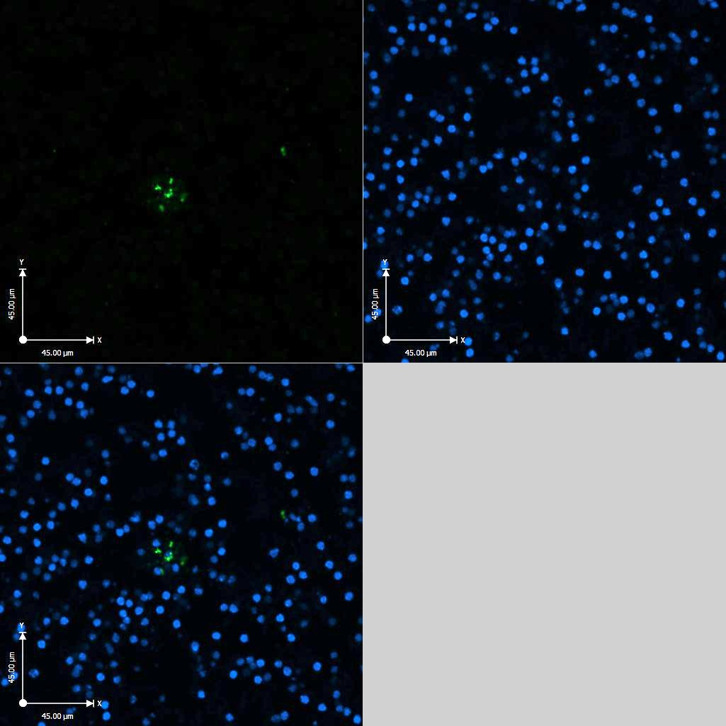
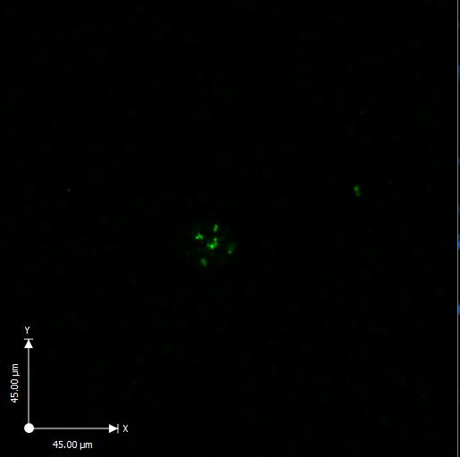
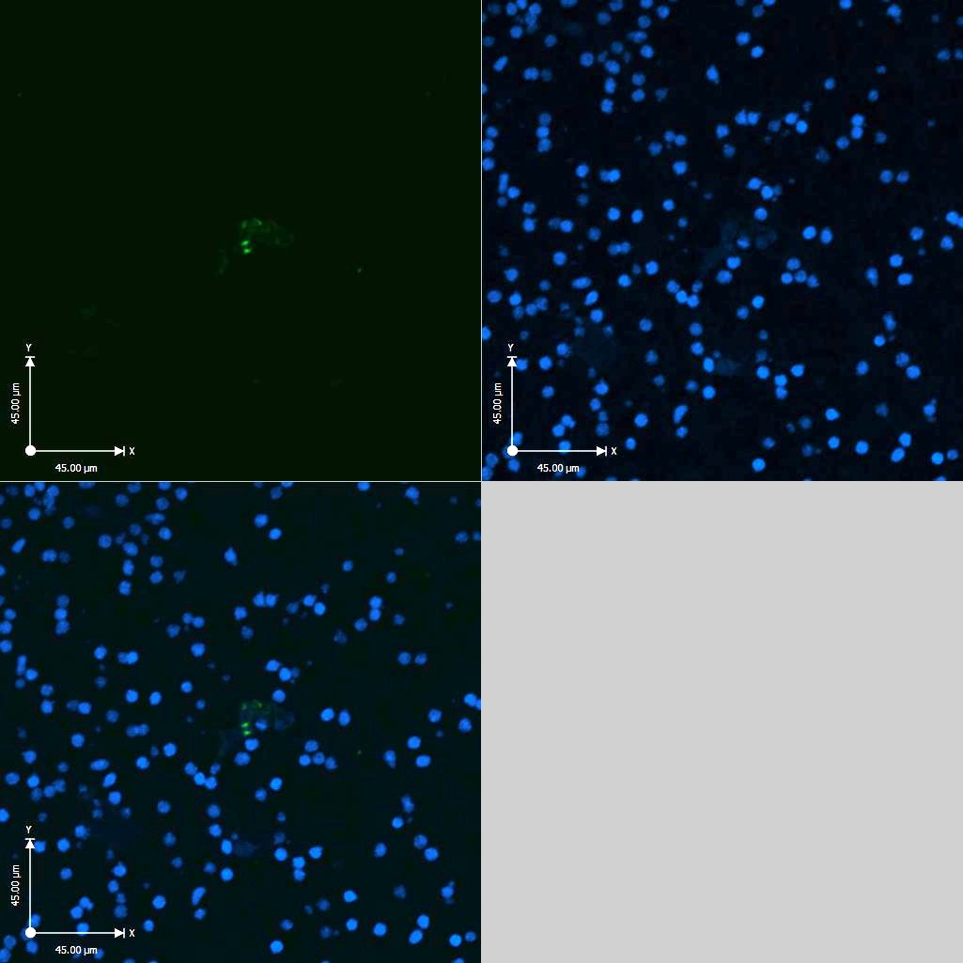
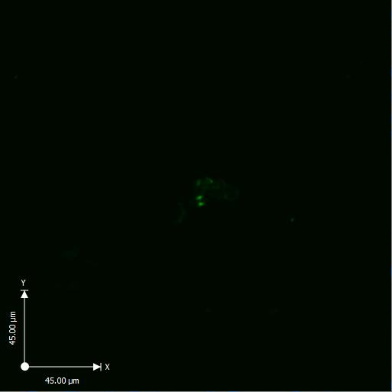
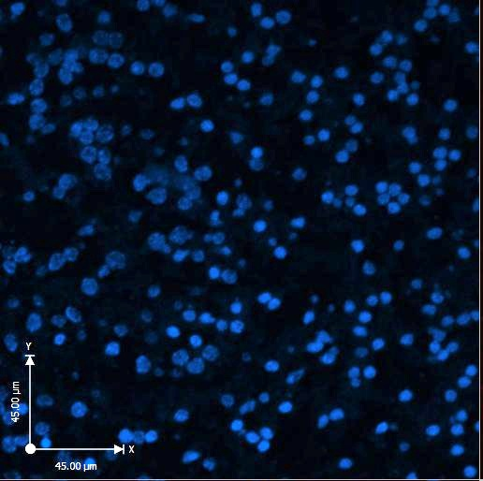
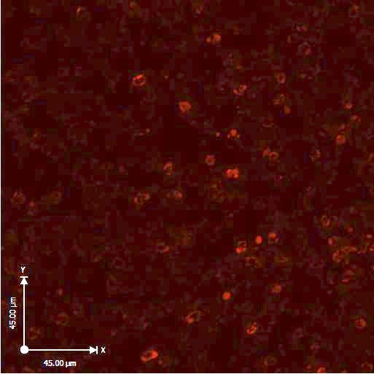
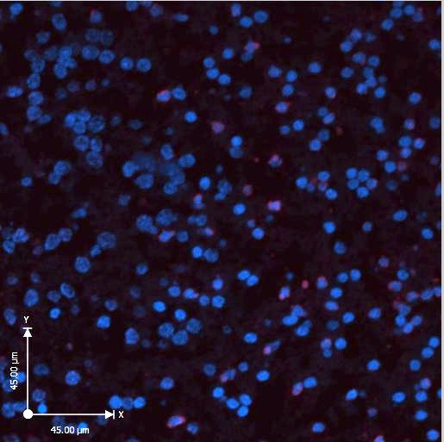
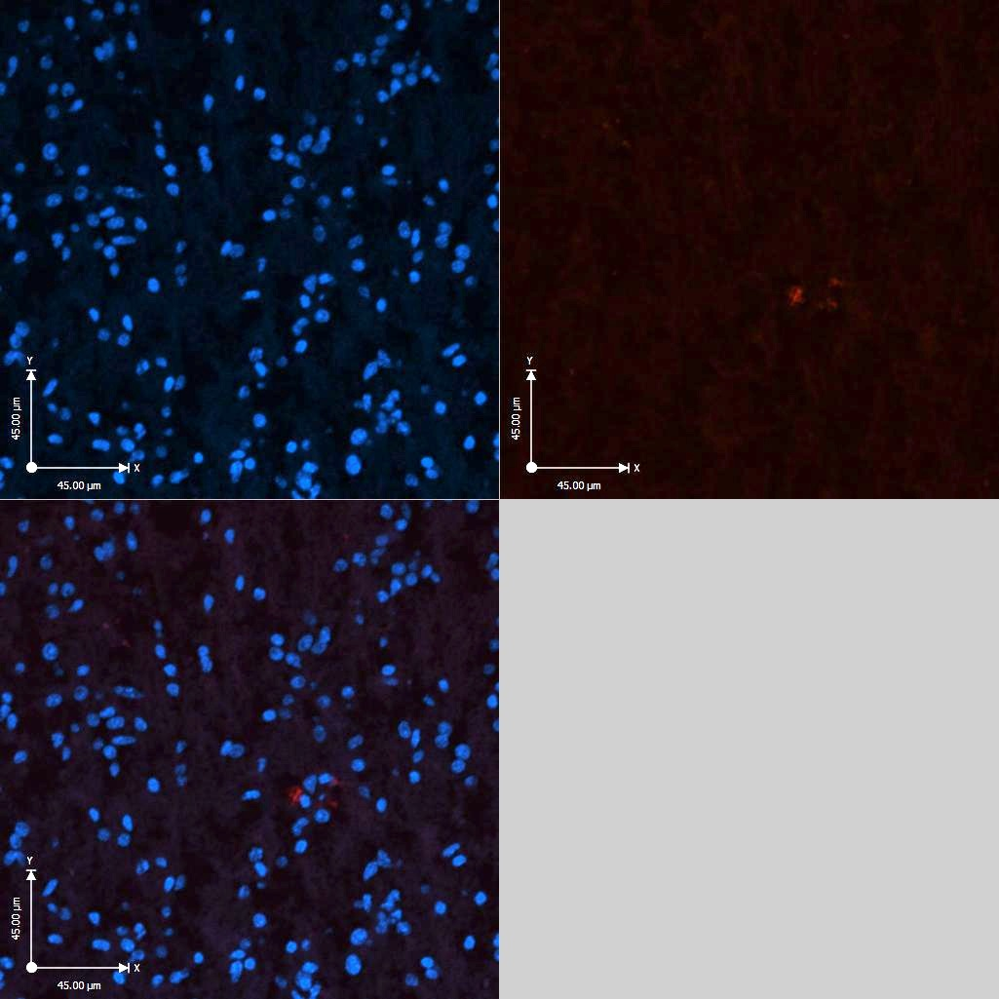
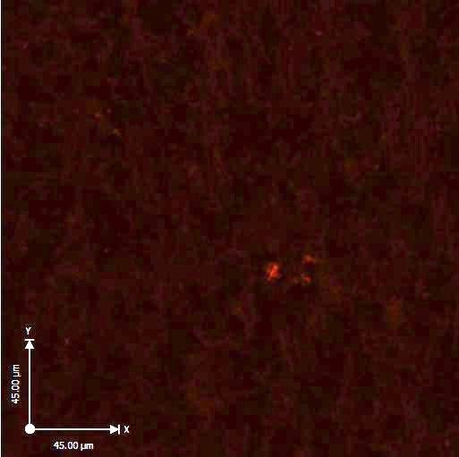
Supplementary Figure 5
A
DAPI
ZIKV E
DAPI + ZIKV E
DMSO
B
DAPI
ZIKV E
DAPI + ZIKV E
BGJ398
C
DAPI
TUNEL
DAPI + TUNEL
DMSO
D
DAPI
TUNEL
DAPI + TUNEL
BGJ398
Figure S5. BGJ398 reduces ZIKV spread and virus-induced apoptosis in human fetal brain explants. Representative confocal imaging (20X) of neural tissue 2-days post-infection (with PRVABC-59 ZIKV) and treatment with BGJ398 (10 nM) or DMSO. (A and B) ZIKV envelope protein was detected using the mouse anti-E 4G2 antibody. (C and D) Apoptotic cells were detected using an in situ TUNEL assay. Nuclei were stained with DAPI.

Slide 6
Supplementary Table 1.
Sheet 1. Description of RNAseq libraries from the acutely infected HFAs. Description of samples, the number of reads obtained for each sample and the number of reads that aligned to the human genome are indicated.
Sheet 2. Differentially expressed genes as detected by the Kallisto/Sleuth pipeline in the acutely infected HFAs. Kallisto was run with default parameters. During Sleuth analysis, two factors were defined, one for donor (including donors 1, 2 and 3) and another one for infection condition (Zika and mock), and the following design was defined for analysis: sleuth_prep (s2c, ~ condition + patient, target_mapping = t2g). Results with a FDR < 0.05 and a fold-change > 2 were considered differentially expressed, and finally were annotated with BioMart. Upregulated genes are in black font and downregulated are in blue font.

