Slide 1
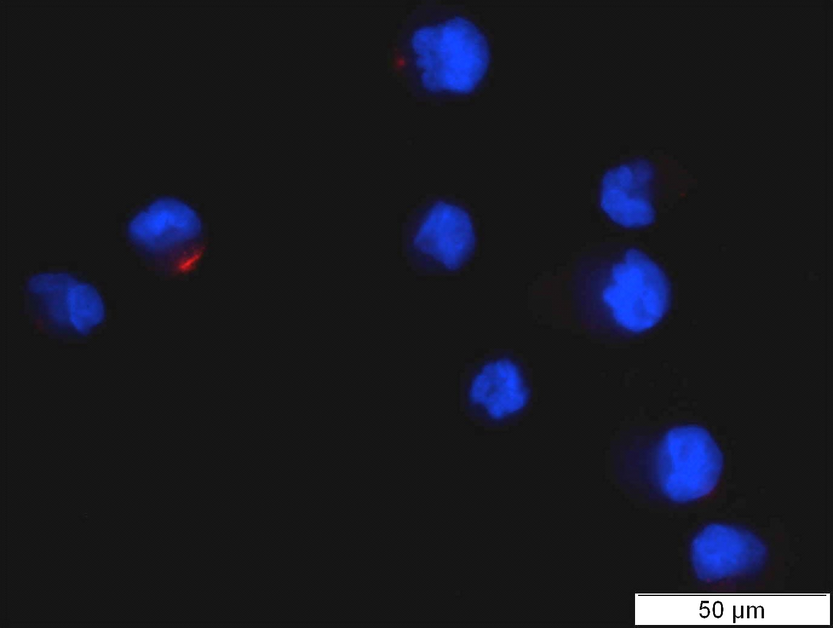
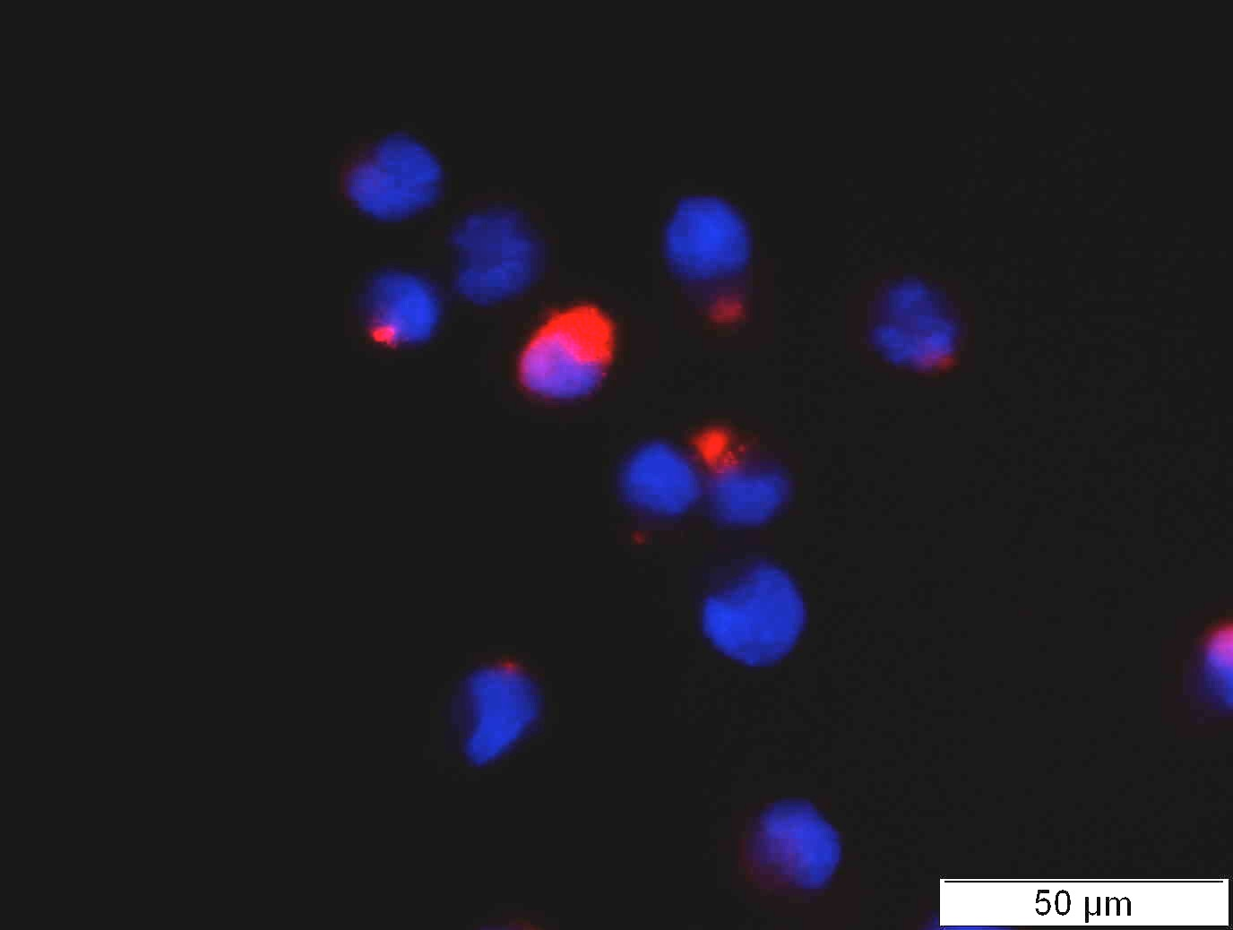
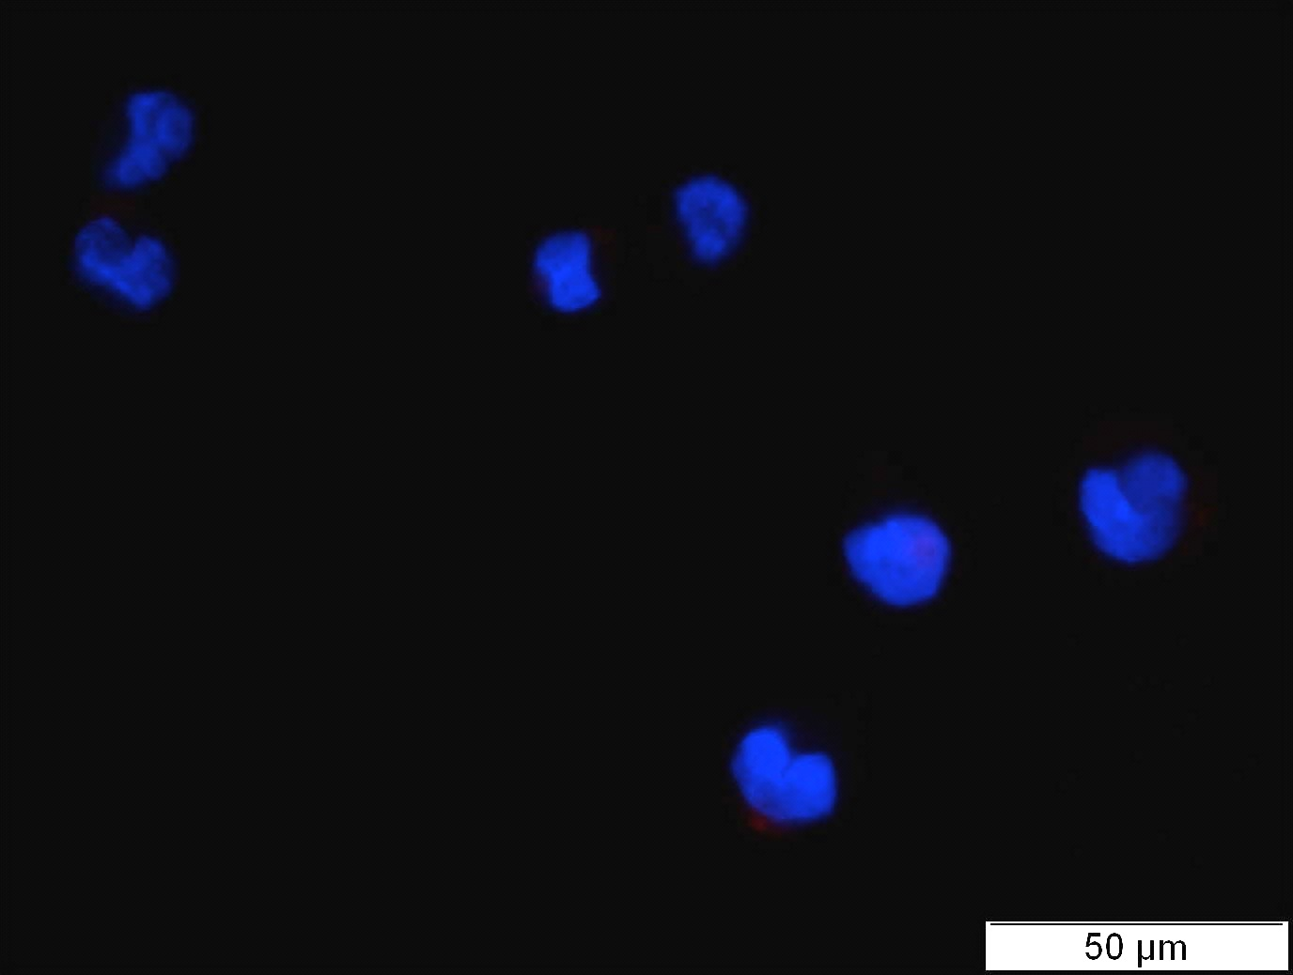
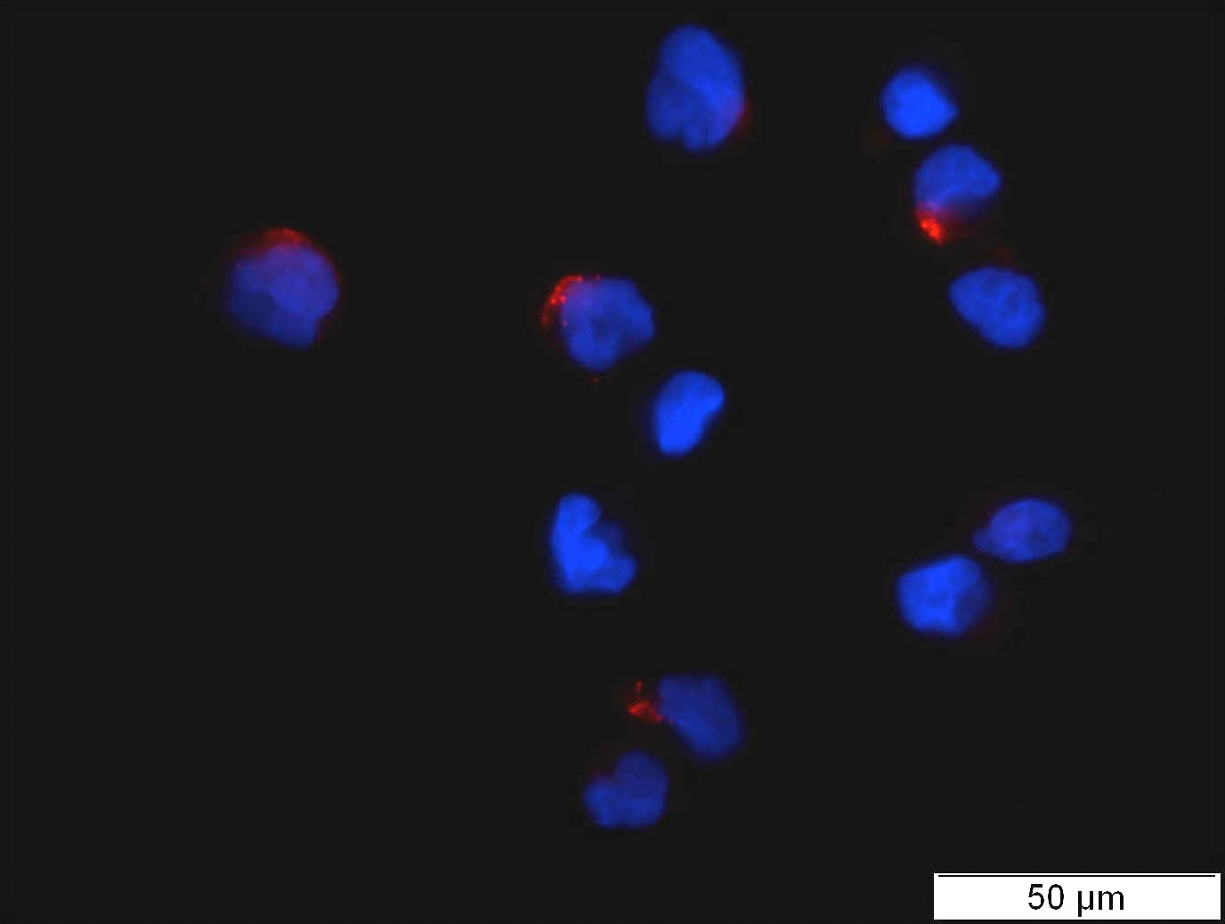
a
2 minutes
b
Untreated
TNFα
*
CD34/HSPC
*
Untreated
TNFα
TNFα
-
+
-
+
EpoCD34/HSPC
CD34/HSPC
EpoCD34/HSPC
c
EpoCD34/HSPC
2 minutes
Untreated
TNFα
% relative to CD34/HSPCs
TNFα
Supplementary Figure S1:
CD34/HSPCs and EpoCD34/HSPCs were untreated or treated with TNFα for two minutes. (a) Ceramides were stained with an anti-ceramide antibody coupled with a fluorescent secondary antibody (red) and nuclei with 4',6-diamidino-2-phenylindole (DAPI) and observed with a 20X objective. Each picture is representative of three independent experiments. (b) Numeration of ceramide producing cells. Bars represent the mean ± SD of three independent experiments. A Student’s t-test show the statistical significance *P<0.05. (c) Mass spectrometry analysis of indicated ceramide species produced after 2 minutes in untreated and TNFα-treated EpoCD34/HSPCs, relative to untreated CD34/HSPCs.

Slide 2



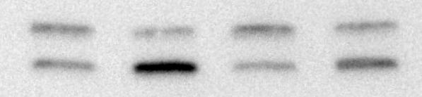

a
CD34/HSPC 24h
CD34/HSPC 24h
si-SMPD3
si-Atg5
**
*
C
si-SMPD3
C
si-Atg5
nSMase 2
71kDa
Atg5
33kDa
β-actin
42kDa
β-actin
42kDa
b
EpoCD34/HSPC 96h
EpoCD34/HSPC 96h
Mock + - + -
Mock + -
TNFα - - + +
si-Atg5 - +
si-SMPD3 - + - +
c
EpoCD34/HSPC 24h
Mock + + - -
si-Atg5 - - + +
BafA1 - + - +
LC3-I
18kDa
LC3-II
16kDa
β-actin
42kDa
Supplementary Figure S2:
Knock-down of nSMase and Atg5 by siRNA against SMPD3 and Atg5. (a) CD34/HSPCs were untransfected (C) or transfected with siRNA targeting the nSMase2 (si-SMPD3) or Atg5 (si-Atg5). Silencing of genes was assessed by analyzing mRNA and protein expression by real-time PCR and western blot, respectively. (b) Effect of transfection on cell viability by Trypan blue assay. Bars represent the mean ± SD of three independent experiments. Student’s t-test show the statistical significance *P<0.05, **P<0.01. (c) Western blot analysis of LC3 conversion in EpoCD34/HSPCs. Baf A1: Bafilomycin A1

Slide 3
a
EpoCD34/HSPC 96h
b
EpoCD34/HSPC 96h
α-globin
β-globin
γ-globin
Ratio to reference U
**
2^{-ΔΔCt}
*
*
*
C6-ceramide
-
+
C6-ceramide
-
+
-
+
-
+
c
d
EpoCD34/HSPC 96h
EpoCD34/HSPC 96h
CD11b
MFI
*
% Viability
C6-ceramide
-
+
C6-ceramide
-
+
Supplementary Figure S3:
CD34/HSPCs and EpoCD34/HSPCs were untreated (U) or treated with 30 µM C6-ceramide for 96h. (a) Benzidine staining. (b) Real-time PCR analysis of globin expression. (c) Trypan blue assays. (d) Flow cytometry analysis of CD11b expression in EpoCD34/HSPCs. Bars represent the mean ± SD of three independent experiments. A Student’s t-test show the statistical significance *P<0.05, **P<0.01.

Slide 4
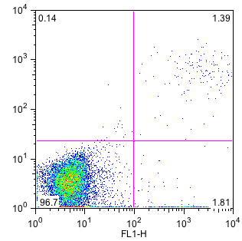
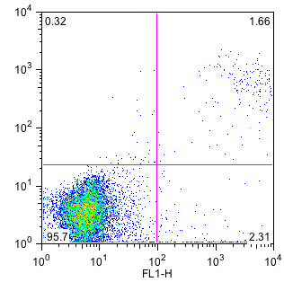
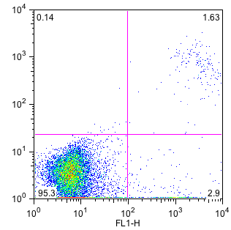
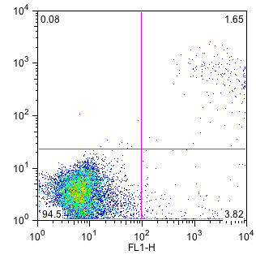
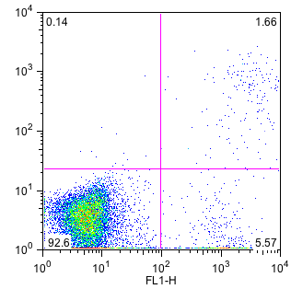
a
Annexin V
Untreated
TNFα
TNFα/GW4869
C2-ceramide
bSMase
n
ea
PI
v
la
b
c
*
TNFα
-
+
+
-
-
-
-
-
+
+
-
-
-
+
-
-
-
+
-
+
-
-
+
-
GW4869
-
-
+
-
-
TNFα
-
+
TNFα
-
+
-
-
-
-
-
-
-
-
-
-
-
+
-
+
-
-
C2-ceramide
-
Rapamycin
+
-
-
+
-
-
-
-
-
C2-ceramide
-
-
-
+
-
Dihydroceramide
-
-
-
-
-
-
-
-
+
+
-
-
bSMase
-
-
-
-
-
-
-
bSMase
+
-
-
-
-
-
-
-
-
-
-
+
bSMase
-
-
-
-
+
-
BafA1
-
-
-
-
-
-
+
+
-
-
GW4869
-
-
-
-
-
-
-
-
-
-
-
Desipramine
-
+
+
-
-
-
-
-
-
-
-
-
-
-
-
S1P
-
+
+
-
-
-
-
-
-
-
-
-
-
PF-543
-
-
+
+
Supplementary Figure S4: Treatments do not affect hematopoietic stem and progenitor cells (HSPC) viability. EpoCD34/HSPCs were untreated or treated as indicated during four days. (a) Cells were stained with annexin V and Propidium Iodide (PI) and analyzed by flow cytometry. Scatter plots represent the distribution of cells in the different categories v (viable cells), la (late apoptotic cells), ea (early apoptotic cells), n (necrotic cells). Each picture is representative of three independent experiments. (b) Mean of percentages of cell events from each of the four categories. (c) Trypan blue assays. Bars represent the mean ± SD of three independent experiments. One-way Anova followed by Dunnett’s post-hoc test show the statistical significance. S1P: Sphingosine-1-phosphate, bSMase: bacterial sphingomyelinase, BafA1: bafilomycin A1.

Slide 5
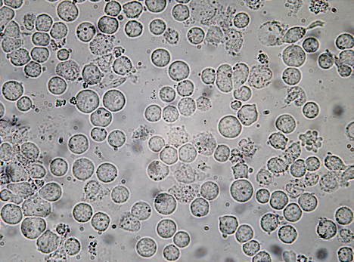
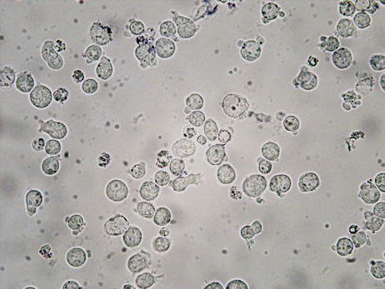
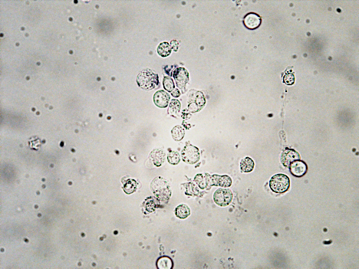
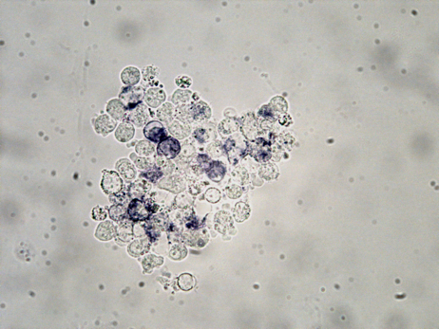
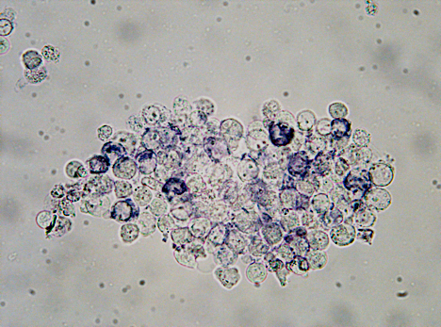
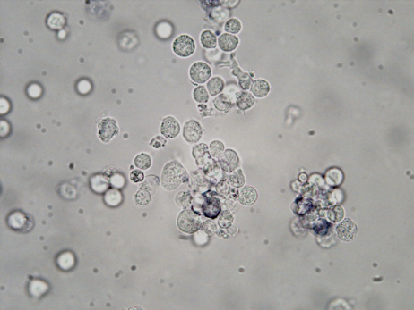
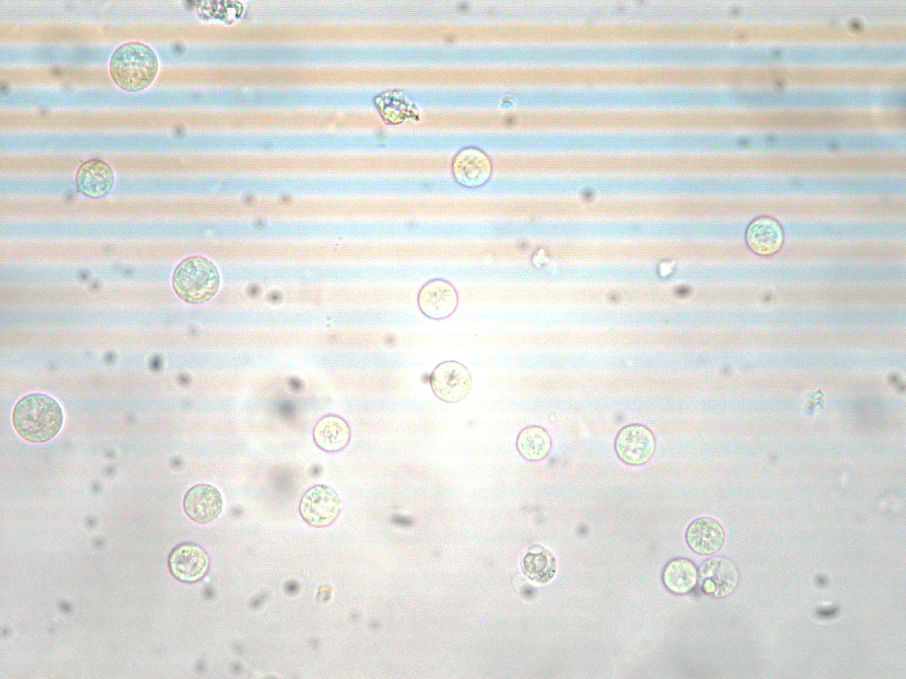
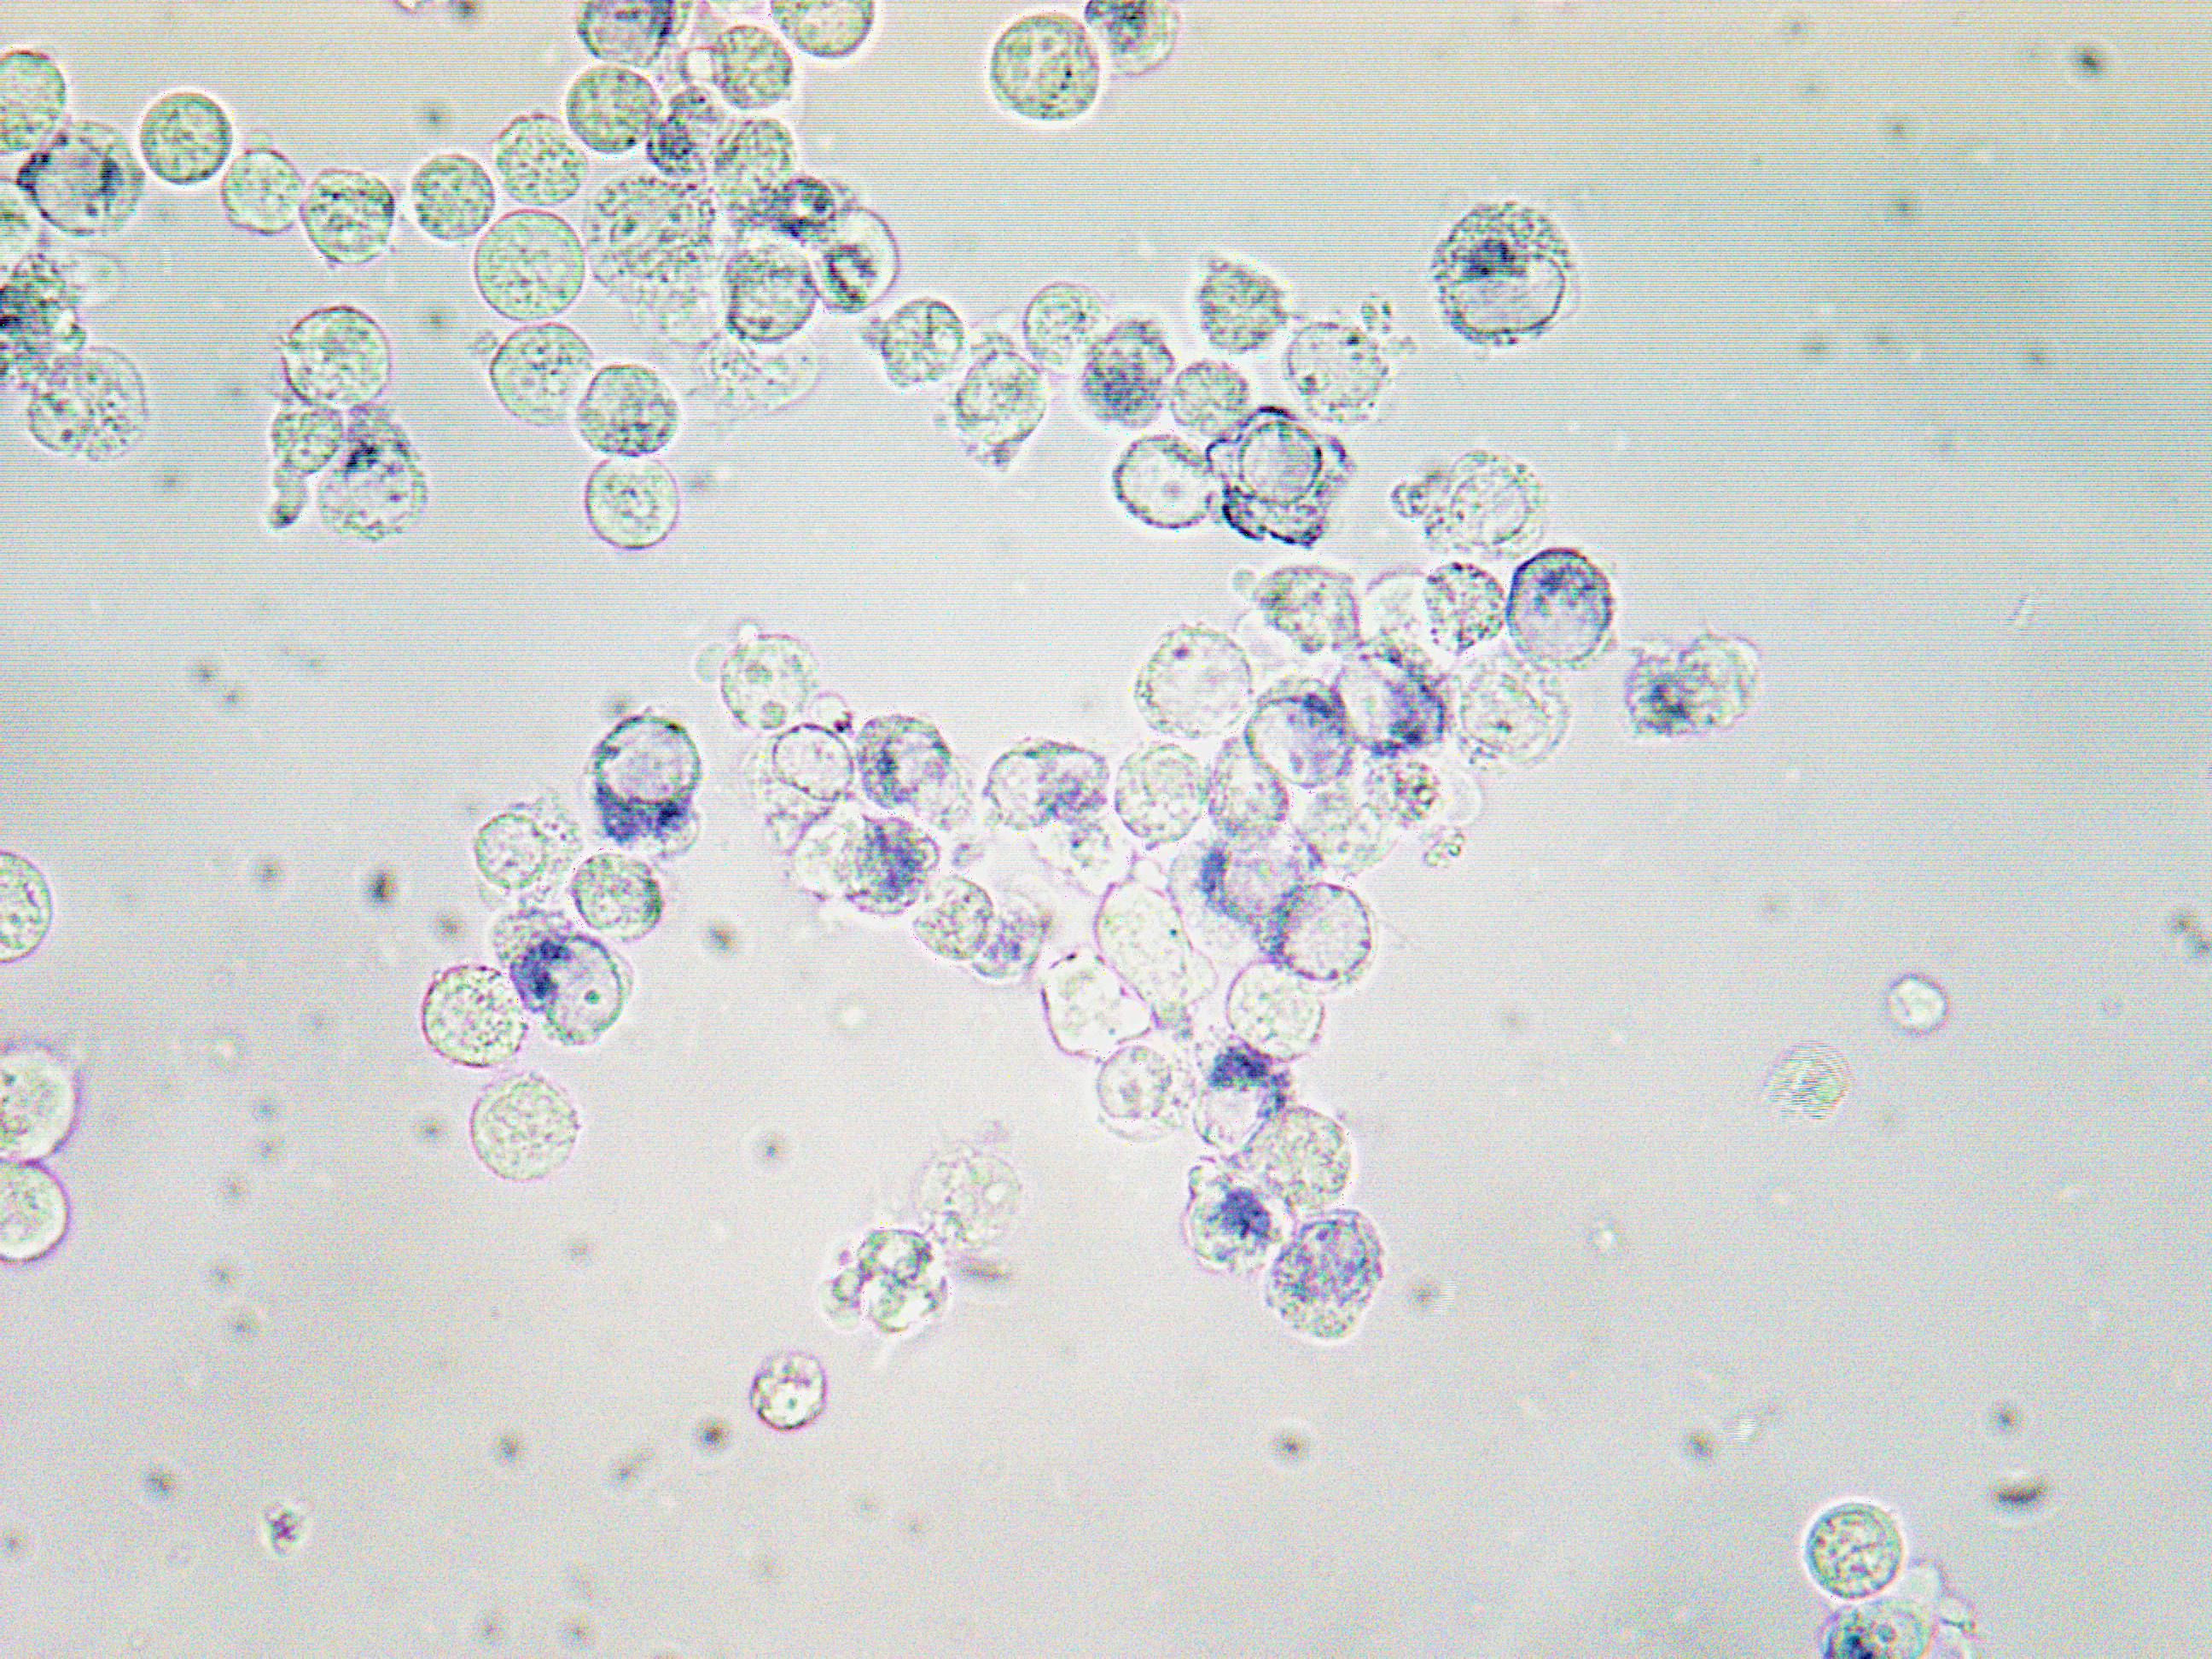
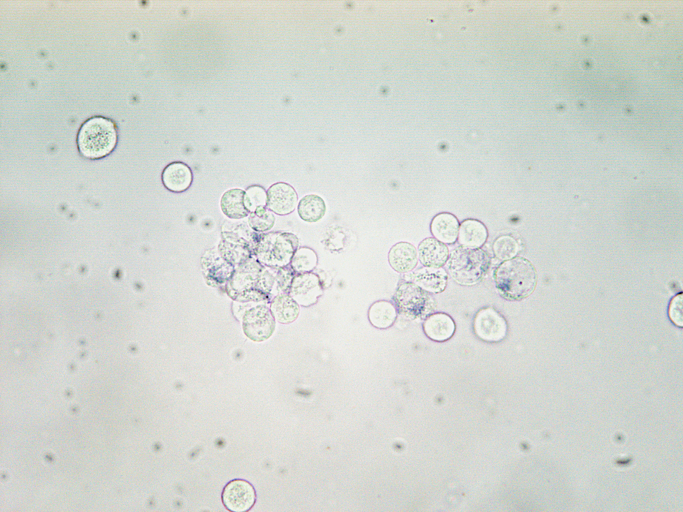
a
EpoCD34/HSPC 96h
-
NBT
mock
si-SMPD3
-
TNFα
b
EpoCD34/HSPC 96h
-
NBT
TNFα
TNFα/GW4869
Supplementary Figure S5:
Granulocytic differentiation of EpoCD34/HSPCs treated with TNFα (a) and/or transfected with si-SMPD3 (b) treated with GW4869 for 96h by Nitroblue Tetrazolium (NBT) staining. Microscope observation (20X).

Slide 6






TNFα
EpoCD34/HSPC 24h
-
+
PU.1
40 kDa
β-actin
42 kDa
GATA-1
47 kDa
β-actin
42 kDa
GATA-2
50 kDa
β-actin
42 kDa
Supplementary Figure S6: TNFα does not modulate transcription factor expression at 24h in Erythropoietin-treated CD34/HSPC (Hematopoietic stem and progenitor cells). Western blot analysis of GATA-1, GATA-2 and PU.1 untreated cells or after 24h of treatment with TNFα. β-actin expression was used as an internal control. N=3

Slide 7
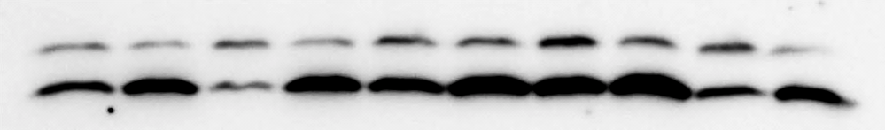
Days
D0
EpoCD34/HSPC
Baf A1
-
+
D1
D3
D4
D5
-
+
-
+
-
+
-
+
LC3-I
18 kDa
LC3-II
16 kDa
β-actin
42 kDa
LC3-II/LC3-I ratio
1
3.1
0.6
2.7
1.6
2.5
2.0
3.5
0.8
3.4
Supplementary Figure S7: Western blot analysis of LC3 conversion in EpoCD34/HSPCs at indicated days. The ratio LC3-II/LC3-I reported to β-actin was quantified from 3 experiments and the mean expressed in fold change is reported under the blots. D: days ; Baf A1: Bafilomycin A1

Slide 8


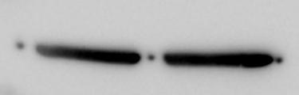


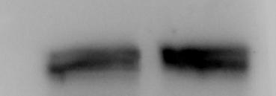




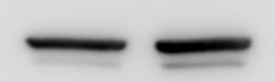
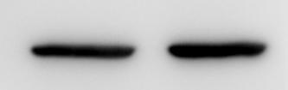

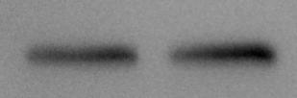

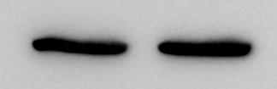
EpoCD34/HSPC
24h
24h
-
-
TNFα
-
+
TNFα
+
P-PI3K^{Y458}
85 kDa
P-mTOR^{S2448}
289 kDa
β-actin
42 kDa
mTOR
289 kDa
PI3K
85 kDa
P-ULK1^{S758}
150 kDa
β-actin
42 kDa
β-actin
42 kDa
P-Atg13^{S355}
P-AKT^{S473}
60 kDa
β-actin
72 kDa
β-actin
42 kDa
42 kDa
AKT
60 kDa
Atg13
72 kDa
β-actin
42 kDa
β-actin
42 kDa
Supplementary Figure S8: Western blot analysis of PI3K/AKT/mTOR/ULK1/Atg13 pathway in EpoCD34/HSPCs untreated or treated with TNFα at 24h. β-actin expression was used as an internal control. Each blot is representative of three independent experiments.

Slide 9
CD34/HSPC
EpoCD34/HSPC
CD34⁺/HSPCs isolation
Treatments
D-3
D0
D4
D6
D9
IL-3 (10 ng/mL)
SCF (50 ng/mL)
Epo (2 U/mL)
Proliferation
Differentiation
Supplementary Figure S10: Experimental scheme of CD34/Hematopoietic stem and progenitor cells (HSPC) treatment. CD34/HSPCs are isolated from umbilical cord blood at day 3 (D-3) and then cultured to proliferate in serum-free Stem Line Medium II (Sigma) containing interleukin (IL)-3 and Stem Cell Factor (SCF) for 3 days. Afterwards, recombinant Human erythropoietin, epoietin-β (Epo) is added to the medium to induce erythroid differentiation, corresponding to day 0 (D0). At D0, D4 and D6 EpoCD34/HSPCs are treated or not with the different compounds. In all cases, IL-3 and SCF are discarded from the medium at D4 and D6 respectively.

Slide 10
Quantification Fig 1d
EpoCD34/HSPC 24h
SphK1
*
TNFα
-
+
Quantification Fig 1g
EpoCD34/HSPC 96h
EpoCD34/HSPC 96h
EpoCD34/HSPC 96h
α-globin
β-globin
γ-globin
**
**
**
bSMase
-
+
-
+
-
+
EpoCD34/HSPC 96h
EpoCD34/HSPC 96h
EpoCD34/HSPC 96h
α-globin
β-globin
γ-globin
$
*
*
TNFα
-
+
+
-
-
+
+
-
-
+
+
-
GW4869
-
-
+
+
-
-
+
+
-
-
+
+
EpoCD34/HSPC 96h
EpoCD34/HSPC 96h
EpoCD34/HSPC 96h
α-globin
β-globin
γ-globin
*
*
*
*
*
*
TNFα
-
+
+
-
-
+
+
-
-
+
+
-
Desipramine
-
-
+
+
-
-
+
+
-
-
+
+
Supplementary Figure S11: Western Blot quantifications. Bars represent the mean ± SD of three independent experiments. Student’s t-test or one-way Anova with repeated measures followed by Dunnett’s post-hoc test show the statistical significance *P<0.05, **P<0.01, ***P<0.001.
HSPC: Hematopoietic stem and progenitor cells, Epo: Erythropoietin, bSMase: bacterial sphingomyelinase.

Slide 11
Quantification Fig 2f
EpoCD34/HSPC 96h
EpoCD34/HSPC 96h
EpoCD34/HSPC 96h
GATA-2
*
PU.1
GATA-1
*
TNFα
-
+
-
-
-
+
-
-
-
+
-
-
C2-ceramide
-
-
+
-
-
-
+
-
-
-
+
-
Dihydroceramide
-
-
-
+
-
-
-
+
-
-
-
+
EpoCD34/HSPC 96h
EpoCD34/HSPC 96h
EpoCD34/HSPC 96h
GATA-2
PU.1
GATA-1
*
*
$
$
TNFα
-
+
+
-
-
+
+
-
-
+
+
-
GW4869
-
-
+
+
-
-
+
+
-
-
+
+
EpoCD34/HSPC 96h
EpoCD34/HSPC 96h
EpoCD34/HSPC 96h
GATA-2
PU.1
GATA-1
*
*
*
bSMase
-
+
-
+
-
+
Quantification Fig 3a
EpoCD34/HSPC 24H
LC3
Baf A1
-
+
-
+
-
+
TNFα
-
-
+
+
+
+
GW4869
-
-
-
-
+
+
Supplementary Figure S11: Western Blot quantifications. Bars represent the mean ± SD of three independent experiments. Student’s t-test or one-way Anova with repeated measures followed by Dunnett’s post-hoc test show the statistical significance *P<0.05, **P<0.01, ***P<0.001.
HSPC: Hematopoietic stem and progenitor cells, Epo: Erythropoietin, bSMase: bacterial sphingomyelinase.

Slide 12
Quantification Fig 4a
EpoCD34/HSPC 96h
EpoCD34/HSPC 96h
EpoCD34/HSPC 96h
EpoCD34/HSPC 96h
P-PI3K
PI3K
P-AKT
*
AKT
*
TNFα
-
+
-
+
-
+
-
+
EpoCD34/HSPC 96h
EpoCD34/HSPC 96h
EpoCD34/HSPC 96h
EpoCD34/HSPC 96h
P-PI3K
PI3K
P-AKT
AKT
*
**
bSMase
-
+
-
+
-
+
-
+
EpoCD34/HSPC 96h
EpoCD34/HSPC 96h
EpoCD34/HSPC 96h
EpoCD34/HSPC 96h
P-mTOR/mTOR
P-ULK1
*
P-Atg13
Atg13
**
**
*
TNFα
-
+
-
+
-
+
-
+
EpoCD34/HSPC 96h
EpoCD34/HSPC 96h
EpoCD34/HSPC 96h
P-ULK1
*
P-Atg13
Atg13
*
bSMase
-
+
-
+
-
+
Supplementary Figure S11: Western Blot quantifications. Bars represent the mean ± SD of three independent experiments. Student’s t-test or one-way Anova with repeated measures followed by Dunnett’s post-hoc test show the statistical significance *P<0.05, **P<0.01, ***P<0.001.
HSPC: Hematopoietic stem and progenitor cells, Epo: Erythropoietin, bSMase: bacterial sphingomyelinase.

Slide 13
Quantification Fig 4b (24h)
CD34/HSPC
CD34/HSPC
CD34/HSPC
Beclin1
Atg5-Atg12
Atg7
*
Epo
-
+
+
-
+
+
-
+
+
TNFα
-
-
+
-
-
+
-
-
+
0h
24h
0h
24h
0h
24h
CD34/HSPC
CD34/HSPC
SQSTM1/p62
Rubicon
*
*
**
*
Epo
-
+
+
-
+
+
TNFα
-
-
+
-
-
+
0h
24h
0h
24h
EpoCD34/HSPC 24h
EpoCD34/HSPC 24h
Beclin1
Atg5-Atg12
*
*
bSMase
-
+
-
+
EpoCD34/HSPC 24h
EpoCD34/HSPC 24h
Atg7
SQSTM1/p62
bSMase
-
+
-
+
Supplementary Figure S11: Western Blot quantifications. Bars represent the mean ± SD of three independent experiments. Student’s t-test or one-way Anova with repeated measures followed by Dunnett’s post-hoc test show the statistical significance *P<0.05, **P<0.01, ***P<0.001.
HSPC: Hematopoietic stem and progenitor cells, Epo: Erythropoietin, bSMase: bacterial sphingomyelinase.

Slide 14
Quantification Fig 4b (96h)
EpoCD34/HSPC 96h
EpoCD34/HSPC 96h
EpoCD34/HSPC 96h
Beclin1
Atg5-Atg12
Atg7
TNFα
-
+
-
+
-
+
EpoCD34/HSPC 96h
EpoCD34/HSPC 96h
SQSTM1/p62
Rubicon
*
**
TNFα
-
+
-
+
EpoCD34/HSPC 96h
EpoCD34/HSPC 96h
Beclin1
Atg5-Atg12
**
bSMase
-
+
-
+
EpoCD34/HSPC 96h
EpoCD34/HSPC 96h
Atg7
SQSTM1/p62
*
bSMase
-
+
-
+
Supplementary Figure S11: Western Blot quantifications. Bars represent the mean ± SD of three independent experiments. Student’s t-test or one-way Anova with repeated measures followed by Dunnett’s post-hoc test show the statistical significance *P<0.05, **P<0.01, ***P<0.001.
HSPC: Hematopoietic stem and progenitor cells, Epo: Erythropoietin, bSMase: bacterial sphingomyelinase.

Slide 15
Supplementary table S1: Ceramide quantifications (pmol/10⁶cells)
EpoCD34HSPC 24h | - | TNFα | TNFα/GW4869
C16:1 | 0.98 | 1.22 | 0.72
C16 | 49.81 | 31.37 | 42.03
C18:1 | 3.59 | 4.50 | 3.19
C18 | 5.98 | 6.84 | 4.93
C20 | 1.89 | 2.13 | 1.33
C22 | 9.35 | 9.97 | 6.05
C24:1 | 47.13 | 70.10 | 35.94
C24 | 28.62 | 36.77 | 20.94
C26:1 | 3.24 | 5.95 | 3.38
C26 | 1.63 | 3.42 | 1.65

Slide 16
Supplementary table S2: Colony formation assay quantifications
 | BFU/CFU-E | CFU-GEMMeg/-GM | CFU-G | CFU-M
Untreated | 79.23 ± 5.00 | 12.47 ± 0.94 | 5.57 ± 3.6 | 2.73 ± 1.74
TNFα | 40.93 ± 18.43 | 17.27 ± 1.64 | 30.04 ± 10.68 | 11.7 ± 6.23
C2-ceramide | 51.47 ± 8.81 | 19.87 ± 6.77 | 21.43 ± 1.98 | 7.23 ± 6.09
bSMase | 22.57 ± 6.92 | 12.7 ± 11.1 | 46.93 ± 5.3 | 18.03 ± 4.67
TNFα/GW4869 | 77.77 ± 9.33 | 8.7 ± 2.04 | 10.3 ± 4.49 | 3.23 ± 3.28
TNFα/Desipramine | 8.4 ± 6.86 | 45.47 ± 0.71 | 40.57 ± 11.98 | 5.57 ± 4.84
S1P | 59.6 ± 9.65 | 19.23 ± 12.58 | 14.6 ± 4.17 | 6.57 ± 2.45
TNFα/S1P | 66.53 ± 15.6 | 15.73 ± 14.2 | 13.73 ± 5.73 | 4 ± 2.46
S1P: Sphingosine-1-phosphate, BFU: Burst forming unit, CFU: Colony forming unit, -E: erythroid,
-GEMM: Granulocyte erythrocyte monocyte macrophage, -G: granulocyte, -M: monocyte

Slide 17
Supplementary table S3: Sequences of primers used for Real-Time PCR experiments
Gene | Forward 5'-3' | Reverse 5'-3'
α-globin | TCAAGCTCCTAAGCCACTGC | AGAAGCCAGGAACTTGTCCA
β-globin | CTGGGCAGATTACTGGTGGT | TTAGGGTTGCCCATAACAGC
γ-globin | CCCAGAGGTTCTTTGACAGC | GGAAGTCAGCACCTTCTTGC
Atg5 | GCATCAAGTTCAGCTCTTCCTTG | TGCATCCTTAGATGGACAGTGC
EpoR | CTCA TCCTCGTGGTCA TCCT | CAGGCCAGA TCTTCTGCTTC
MMP-9 | GCCTTTGGACACGCACGA | GGAACTCACGCGCCAGTAG
SMPD3 | GGTACTCTGCTGGACACGAAC | GTGGGAAACGCCAGGTACTC
SphK1 | CTTGCAGCTCTTCCGGAGTC | GCTCAGTGAGCATCAGCGTG
EpoR: Erythropoietin receptor, MMP-9: Matrix metallopeptidase 9, SphK1: Sphingosine kinase 1

Slide 18
Supplementary table S4: References of primer sequences used for Real-Time analysis of miRNAs
miRNA | Ref.
hsa-miR-144-3p | MS00020328
hsa-miR-451a | MS00004242
hsa-miR-146a-5p | MS00003535
hsa-miR-155-5p | MS00031486
hsa-miR-223-3p | MS00003871
RNU1A | MS00013986

