Slide 1
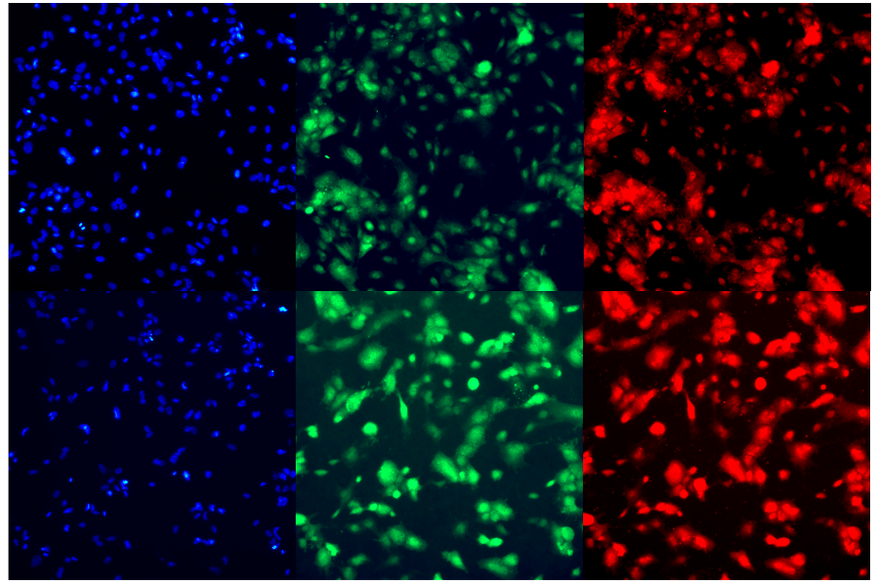
DAPI Cx-40 Cx-37
a
b
c
200 µm
200 µm
200 µm
2µg/mL chalcone treated Control
e
f
d
200 µm
200 µm
200 µm
Supplementary Figure 4

