Slide 1
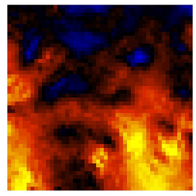

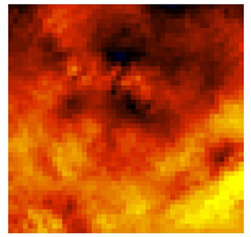
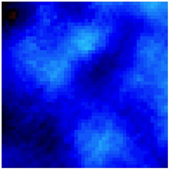
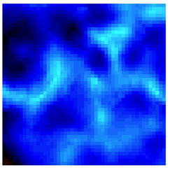
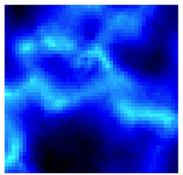
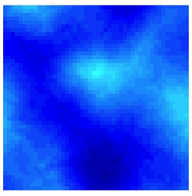
Control 0.2µg/mL chalcone treatment 2µg/mL chalcone treatment
a
b
c
σ _{max}
σ _{min}
500 µm
500 µm
500 µm
d
e
f
500 µm
500 µm
500 µm
Supplementary Figure 8

