Slide 1
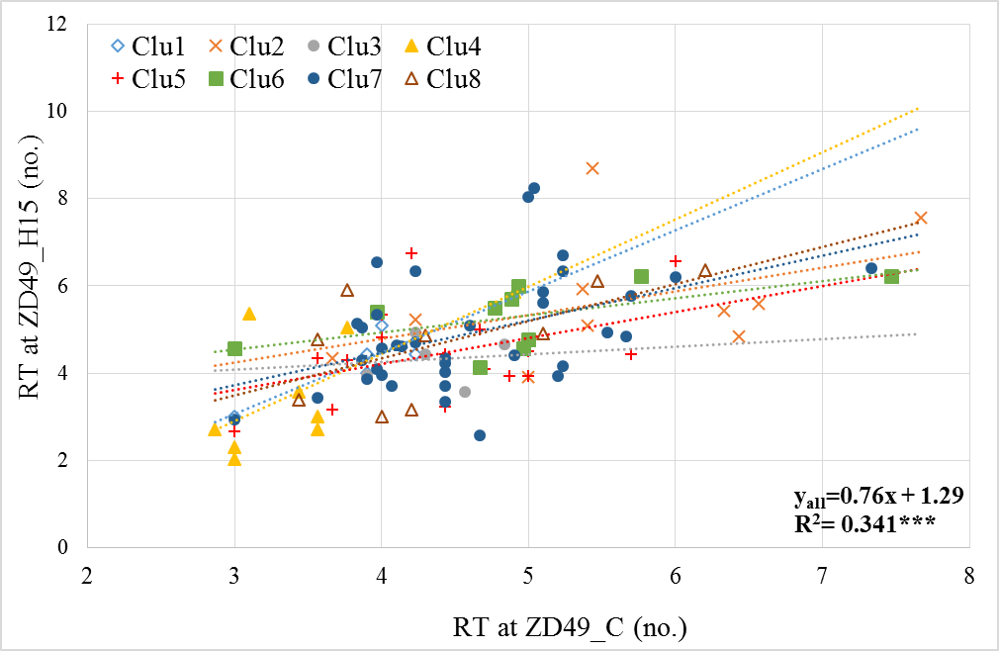
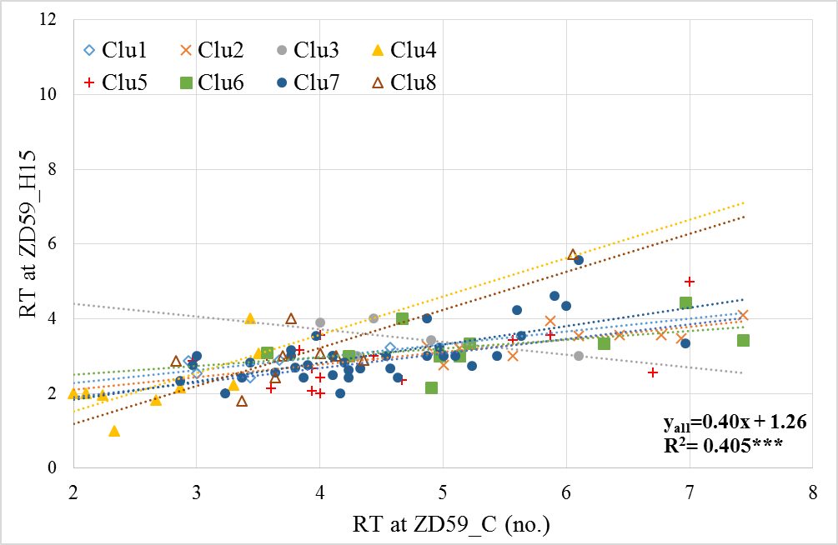
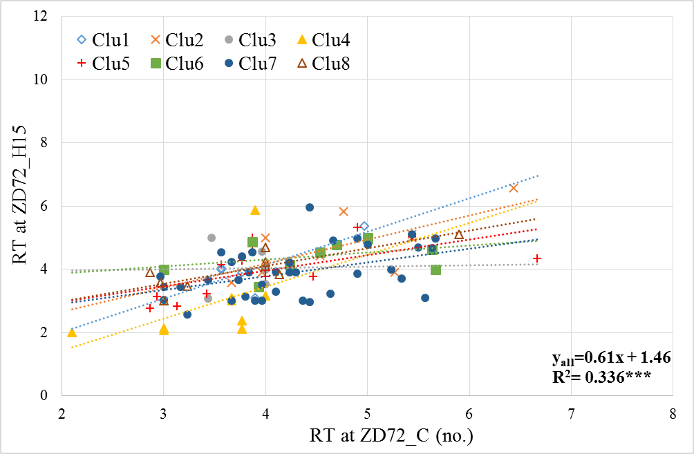
Supplementary Figure 3.
Number of reproductive tillers (RT) in the eight wheat clusters
Clu4, 1.5*
RT (no.) | ZD49 C | ZD49 H15
Clu1 | 3.8c | 4.2bc
Clu2 | 5.6a | 5.7a
Clu3 | 4.4b | 4.3bc
Clu4 | 3.5c | 3.6c
Clu5 | 4.4b | 4.5bc
Clu6 | 4.9ab | 5.3ab
Clu7 | 4.6b | 4.9ab
Clu8 | 4.4b | 4.7ab
P level | 6.04E-05 | 0.013
Clu1, 1.4ns
Clu8, 0.9*
Clu7, 0.7**
Clu2, 0.5ns
Clu5, 0.5ns
Clu6, 0.4ns
Clu3, 0.2ns
RT (no.) | ZD59 C | ZD59 H15
Clu1 | 3.5de | 2.8abc
Clu2 | 6.0a | 3.4a
Clu3 | 4.7bc | 3.5a
Clu4 | 2.7e | 2.3c
Clu5 | 4.5cd | 2.9abc
Clu6 | 5.3ab | 3.3ab
Clu7 | 4.4c | 3.0ab
Clu8 | 4.0cd | 3.2ab
P level | 3.5E-09 | 0.018
Clu4, 1.2*
Clu8, 1.0***
Clu7, 0.5***
Clu5, 0.4*
Clu2, 0.3*
Clu1, 0.3ns
Clu6, 0.2ns
Clu3, -0.3ns
RT (no.) | ZD72 C | ZD72 H15
Clu1 | 4.0b | 4.1ab
Clu2 | 4.8a | 4.7a
Clu3 | 3.8b | 4.0ab
Clu4 | 3.4b | 2.9c
Clu5 | 4.0ab | 4.0b
Clu6 | 4.6a | 4.4a
Clu7 | 4.2ab | 3.9b
Clu8 | 3.8b | 4.0b
P level | 0.014 | 5.07E-04
Clu1, 1.0ns
Clu2, 0.8*
Clu4, 1.0ns
Clu8, 0.6**
Clu7, 0.4**
Clu5, 0.5*
Clu6, 0.2ns
Clu3, 0.0ns

Slide 2
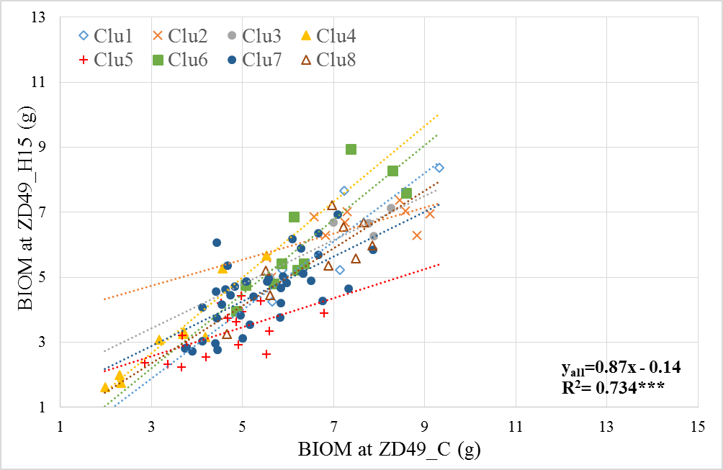
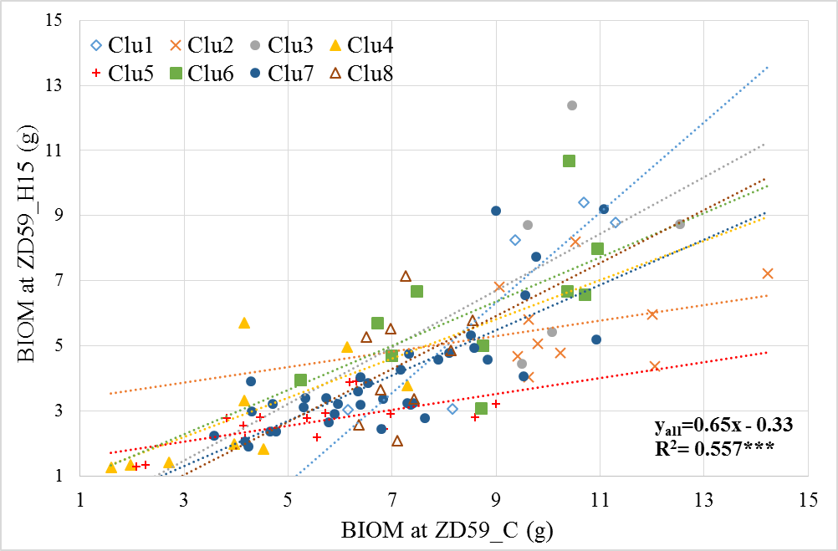
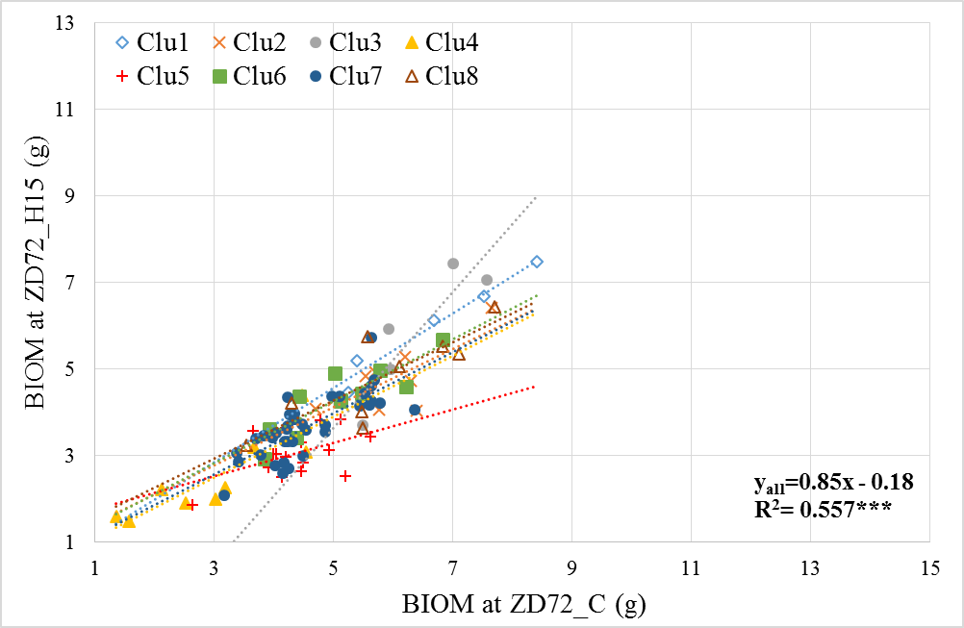
Straw biomass (BIOM) in the eight wheat clusters
Clu4, 1.2***
BIOM (g) | ZD49 C | ZD49 H15
Clu1 | 7.0ab | 6.1a
Clu2 | 7.4a | 6.5a
Clu3 | 7.3ab | 6.4a
Clu4 | 3.5e | 3.2c
Clu5 | 4.6d | 3.3c
Clu6 | 6.4b | 6.1a
Clu7 | 5.4c | 4.5b
Clu8 | 6.6b | 5.6ab
P level | 1.07E-12 | 1.64E-12
Clu6, 1.1**
Clu1, 1.1*
Clu8, 0.9**
Clu3, 0.7*
Clu7, 0.7***
Clu2, 0.4*
Clu5, 0.4*
BIOM (g) | ZD59 C | ZD59 H15
Clu1 | 9.1ab | 6.5ab
Clu2 | 10.7a | 5.7b
Clu3 | 10.4a | 7.9a
Clu4 | 4.1d | 2.8cd
Clu5 | 5.4d | 2.6d
Clu6 | 8.6b | 6.1ab
Clu7 | 6.9c | 4.0c
Clu8 | 7.2bc | 4.5cb
P level | 3.11E-13 | 1.4E-08
Clu1, 1.4*
Clu3, 0.9ns
Clu8, 0.8
Clu6, 0.7*
Clu7, 0.7***
Clu4, 0.6ns
Clu2, 0.2ns
Clu5, 0.2**
Clu3, 1.6*
BIOM (g) | ZD72 C | ZD72 H15
Clu1 | 6.7a | 6.0a
Clu2 | 5.9a | 4.7b
Clu3 | 6.4a | 5.8a
Clu4 | 2.9d | 2.5d
Clu5 | 4.4c | 3.1d
Clu6 | 5.1bc | 4.3b
Clu7 | 4.6c | 3.7c
Clu8 | 5.8ab | 4.8b
P level | 1.06E-12 | 6.57E-15
Clu1, 0.9**
Clu6, 0.7**
Clu4, 0.7**
Clu7, 0.7***
Clu8, 0.7**
Clu2, 0.7*
Clu5, 0.4*

Slide 3
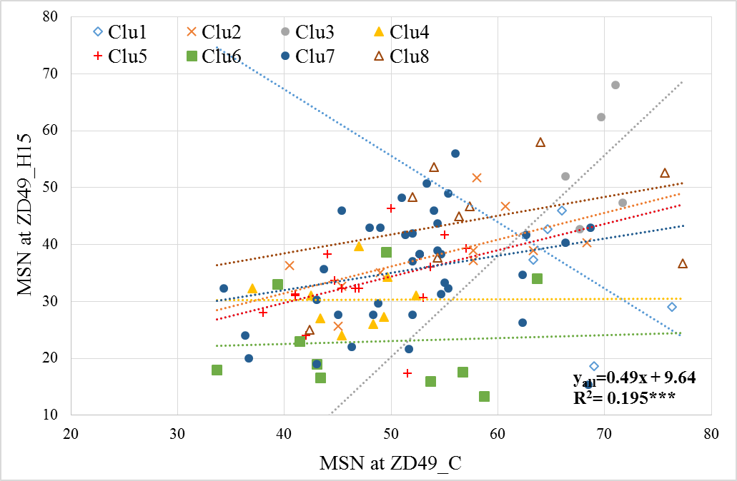
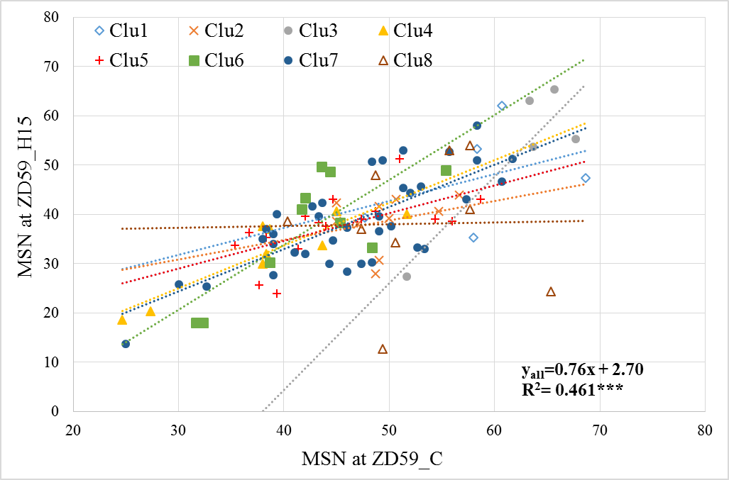
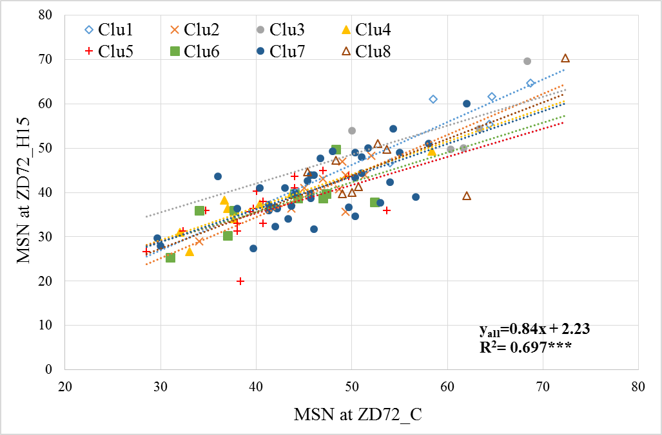
Main ear seed number (MSN) in the eight wheat clusters
MSN (no.) | ZD49 C | ZD49 H15
Clu1 | 67.9ab | 34.7c
Clu2 | 54.6c | 38.4bc
Clu3 | 69.3a | 54.5a
Clu4 | 46.1d | 30.3de
Clu5 | 47.7cd | 33.3d
Clu6 | 48.3cd | 22.9e
Clu7 | 51.9c | 35.6cd
Clu8 | 59.3b | 44.9ab
P level | 1.52E-08 | 7.05E-08
Clu3, 1.8ns
Clu8, 0.3ns
Clu2, 0.5ns
Clu5, 0.4ns
Clu7, 0.3ns
Clu4, 0.0ns
Clu6, 0.1ns
Clu1, -1.2ns
Clu6, 1.3**
MSN (no.) | ZD59 C | ZD59 H15
Clu1 | 58.7ab | 47.5ab
Clu2 | 49.6cd | 38.6bc
Clu3 | 62.4a | 52.9a
Clu4 | 38.4e | 32.2c
Clu5 | 44.9d | 37.4bc
Clu6 | 42.3d | 37.0c
Clu7 | 46.5cd | 38.5bc
Clu8 | 52.5bc | 38.1bc
P level | 1.41E-07 | 0.011
Clu3, 2.2*
Clu4, 0.9***
Clu7, 0.9***
Clu1, 0.5ns
Clu5, 0.6*
Clu2, 0.4ns
Clu8, 0.0ns
Clu1, 1.0ns
MSN (no.) | ZD72 C | ZD72 H15
Clu1 | 62.0a | 57.9a
Clu2 | 46.9c | 40.9bc
Clu3 | 60.7a | 55.5a
Clu4 | 40.3d | 37.0cd
Clu5 | 40.5d | 35.7d
Clu6 | 42.3d | 37.2cd
Clu7 | 46.3c | 40.9c
Clu8 | 53.8b | 47.0b
P level | 2.77E-10 | 5.11E-09
Clu2, 1.0**
Clu8, 0.8*
Clu7, 0.7***
Clu4, 0.7***
Clu3, 0.7ns
Clu6, 0.7*
Clu5, 0.6*

Slide 4
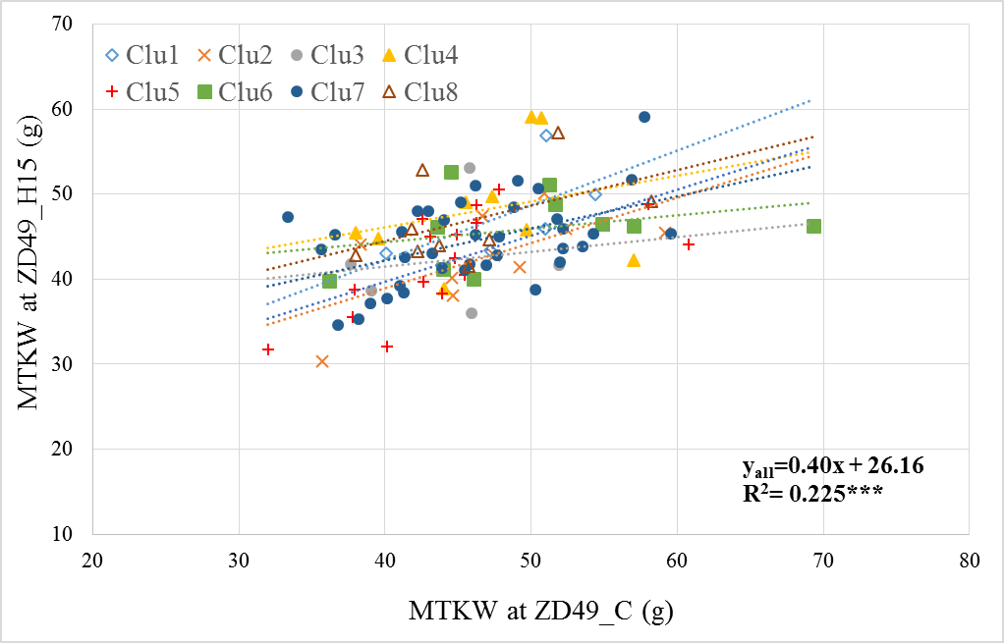
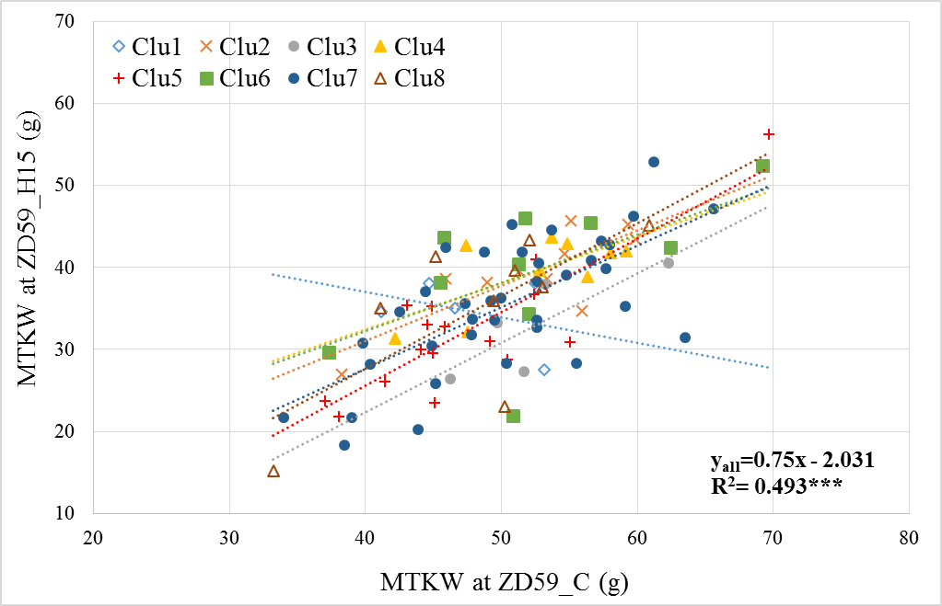
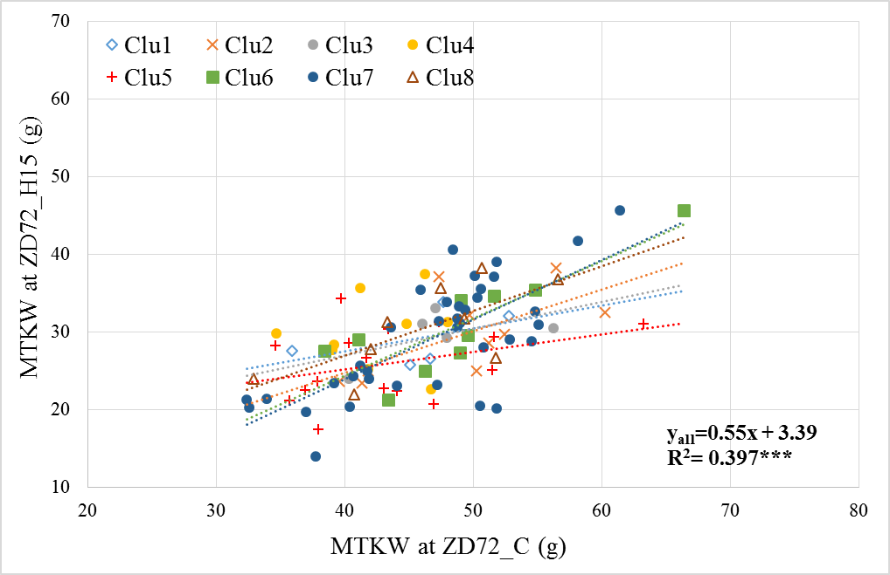
Main ear thousand-kernel weight (MTKW) in the eight wheat clusters
Clu1, 0.4ns
MTKW(g) | ZD49 C | ZD49 H15
Clu1 | 48.8 | 47.9
Clu2 | 46.9 | 42.6
Clu3 | 44.1 | 42.2
Clu4 | 46.9 | 48.2
Clu5 | 44.6 | 42.2
Clu6 | 49.8 | 45.9
Clu7 | 46.0 | 44.5
Clu8 | 45.7 | 46.8
P level | 0.632 | 0.083
Clu4, 0.3ns
Clu2, 0.5*
Clu5, 0.5**
Clu7, 0.4**
Clu8, 0.4ns
Clu6, 0.2ns
Clu3, 0.2ns
MTKW(g) | ZD59 C | ZD59 H15
Clu1 | 47.6 | 34.6
Clu2 | 52.3 | 39.3
Clu3 | 52.6 | 33.1
Clu4 | 52.4 | 39.4
Clu5 | 47.4 | 32.2
Clu6 | 52.3 | 39.4
Clu7 | 50.4 | 35.5
Clu8 | 48.5 | 35.1
P level | 0.487 | 0.171
Clu5, 0.9***
Clu8, 0.9*
Clu7, 0.8***
Clu2, 0.7**
Clu4, 0.6*
Clu6, 0.6ns
Clu3, 0.8ns
Clu1, -0.3ns
MTKW (g) | ZD72 C | ZD72 H15
Clu1 | 45.6 | 29.1
Clu2 | 49.0 | 29.5
Clu3 | 47.5 | 29.5
Clu4 | 42.4 | 29.9
Clu5 | 43.5 | 26.0
Clu6 | 48.9 | 30.9
Clu7 | 46.8 | 29.1
Clu8 | 46.1 | 30.4
P level | 0.257 | 0.571
Clu7, 0.8***
Clu6, 0.7**
Clu8, 0.6*
Clu2, 0.5*
Clu3, 0.3ns
Clu4, 0.1ns
Clu1, 0.3ns
Clu5, 0.2ns

Slide 5
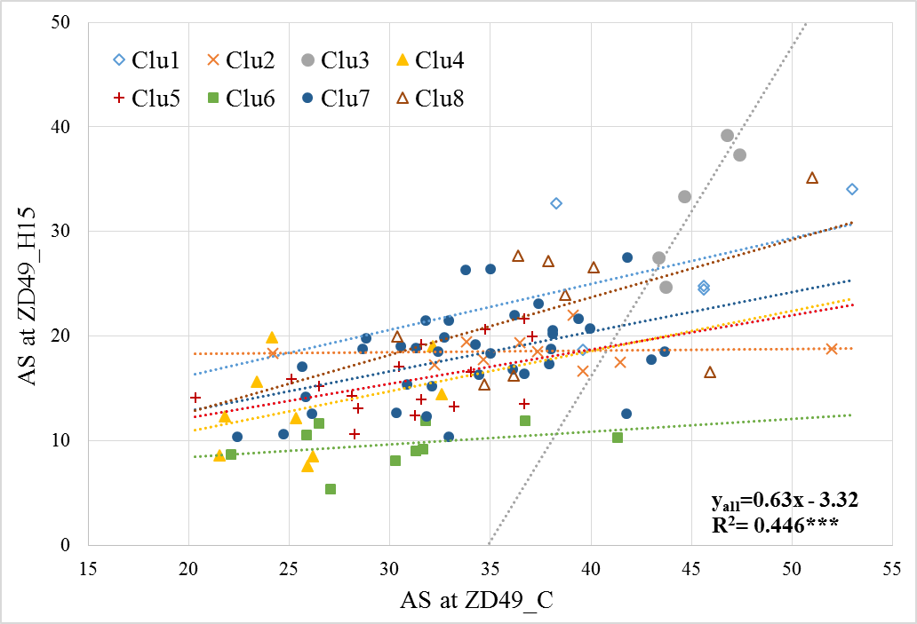
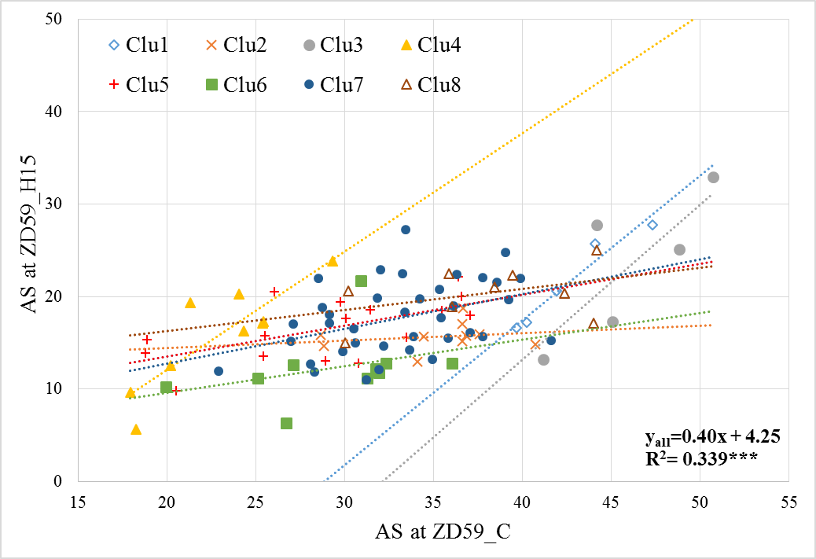
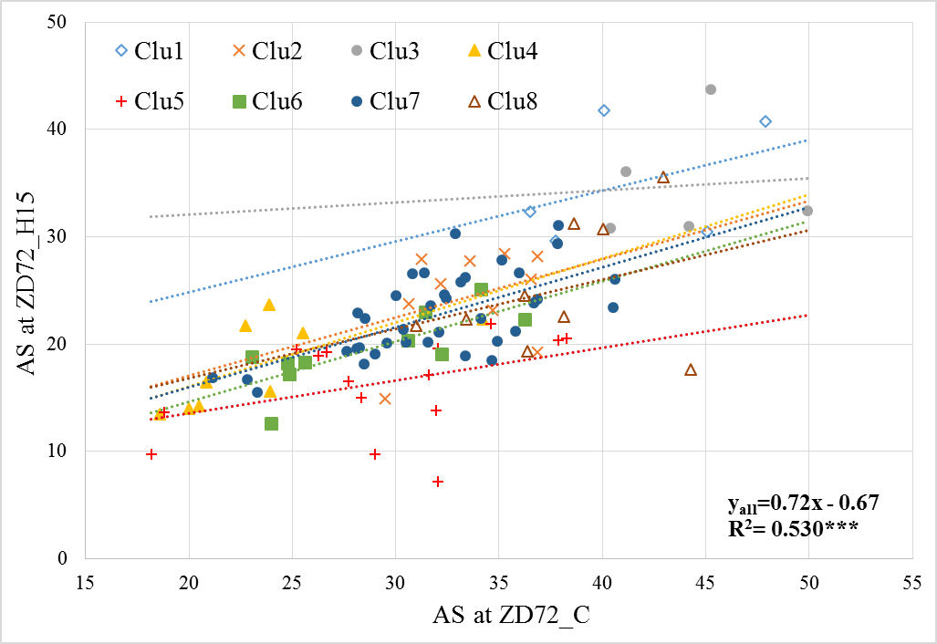
Average seed number/spike (AS) in the eight wheat clusters
Clu3, 3.2*
AS (no.) | ZD49 C | ZD49 H15
Clu1 | 44.4a | 26.9b
Clu2 | 37.1bc | 18.6c
Clu3 | 45.2a | 32.4a
Clu4 | 25.9e | 13.1de
Clu5 | 30.9d | 15.7cd
Clu6 | 30.5de | 9.7e
Clu7 | 33.8cd | 18.1c
Clu8 | 39.0ab | 23.2b
P level | 9.6E-11 | 1.6E-16
Clu1, 0.4ns
Clu8, 0.5ns
Clu7, 0.4**
Clu4, 0.4ns
Clu5, 0.3ns
Clu2, 0.0ns
Clu6, 0.1ns
Clu4, 1.3**
AS (no.) | ZD59 C | ZD59 H15
Clu1 | 42.6ab | 21.6a
Clu2 | 35.1c | 15.7bc
Clu3 | 46.0a | 23.2a
Clu4 | 22.9e | 15.8bc
Clu5 | 29.3d | 16.5b
Clu6 | 29.3d | 12.3c
Clu7 | 33.1c | 17.7b
Clu8 | 37.8bc | 20.3ab
P level | 1.04E-15 | 1.95E-05
Clu1, 1.6**
Clu3, 1.6ns
Clu7, 0.4*
Clu5, 0.3*
Clu8, 0.2ns
Clu6, 0.3ns
Clu2, 0.1ns
AS (no.) | ZD72 C | ZD72 H15
Clu1 | 41.5ab | 35.0a
Clu2 | 33.7c | 24.5b
Clu3 | 44.2a | 34.8b
Clu4 | 23.4e | 18.0c
Clu5 | 29.0d | 16.3c
Clu6 | 28.7d | 19.5c
Clu7 | 31.9c | 22.7b
Clu8 | 37.9b | 25.1b
P level | 4.14E-14 | 2.67E-15
Clu1, 0.5ns
Clu3, 0.1ns
Clu2, 0.5ns
Clu4, 0.6*
Clu7, 0.6***
Clu6, 0.6**
Clu8, 0.5ns
Clu5, 0.3ns

Slide 6
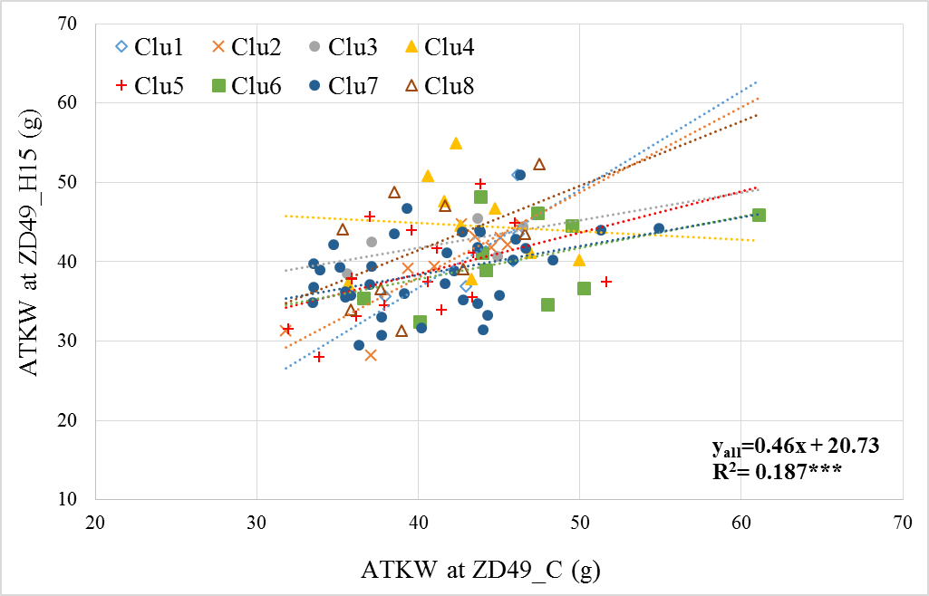
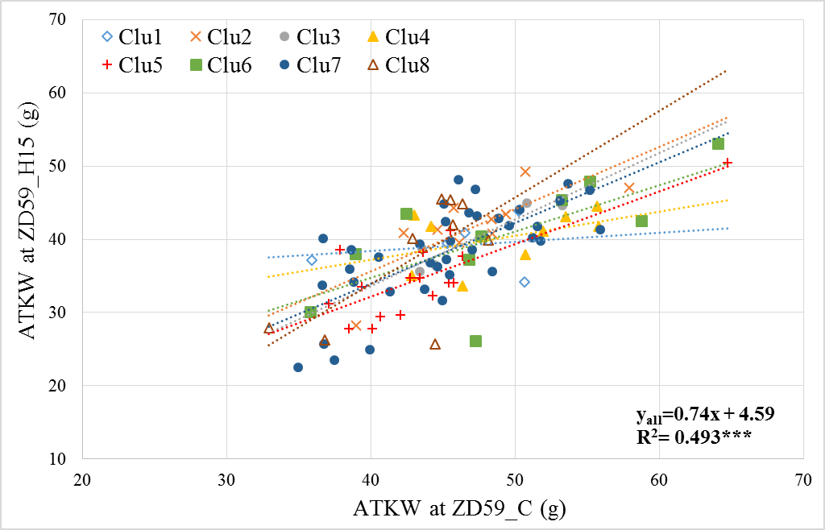
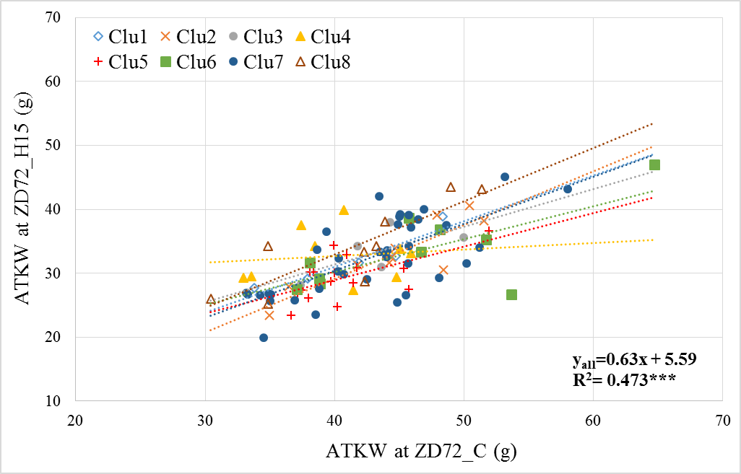
Average thousand-kernel weight/spike (ATKW) in the eight wheat clusters
Clu1, 1.2ns
ATKW (g) | ZD49 C | ZD49 H15
Clu1 | 43.8 | 41.4
Clu2 | 41.7 | 39.8
Clu3 | 41.6 | 42.3
Clu4 | 43.1 | 44.6
Clu5 | 40.0 | 38.4
Clu6 | 46.5 | 40.4
Clu7 | 40.9 | 38.7
Clu8 | 40.5 | 41.9
P level | 0.070 | 0.115
Clu2, 1.7**
Clu8, 0.8ns
Clu3, 0.3ns
Clu5, 0.5ns
Clu6, 0.4ns
Clu7, 0.4*
Clu4, -0.1ns
Clu8, 1.2*
ATKW (g) | ZD59 C | ZD59 H15
Clu1 | 45.7 | 39.1
Clu2 | 47.2 | 41.8
Clu3 | 47.1 | 40.1
Clu4 | 49.3 | 40.2
Clu5 | 43.6 | 34.7
Clu6 | 49.0 | 40.4
Clu7 | 45.2 | 38.2
Clu8 | 43.1 | 37.5
P level | 0.143 | 0.172
Clu2, 0.8**
Clu3, 0.9*
Clu7, 0.8***
Clu6, 0.6*
Clu5, 0.7***
Clu4, 0.3ns
Clu1, 0.1ns
ATKW (g) | ZD72 C | ZD72 H15
Clu1 | 41.3 | 32.0
Clu2 | 44.5 | 32.9
Clu3 | 43.4 | 33.4
Clu4 | 40.0 | 32.7
Clu5 | 40.8 | 29.4
Clu6 | 46.3 | 33.5
Clu7 | 42.8 | 32.4
Clu8 | 41.3 | 34.1
P level | 0.262 | 0.484
Clu8, 0.8**
Clu2, 0.8***
Clu7, 0.7***
Clu1, 0.7*
Clu3, 0.6ns
Clu6, 0.5*
Clu5, 0.5*
Clu4, 0.1ns

