Slide 1
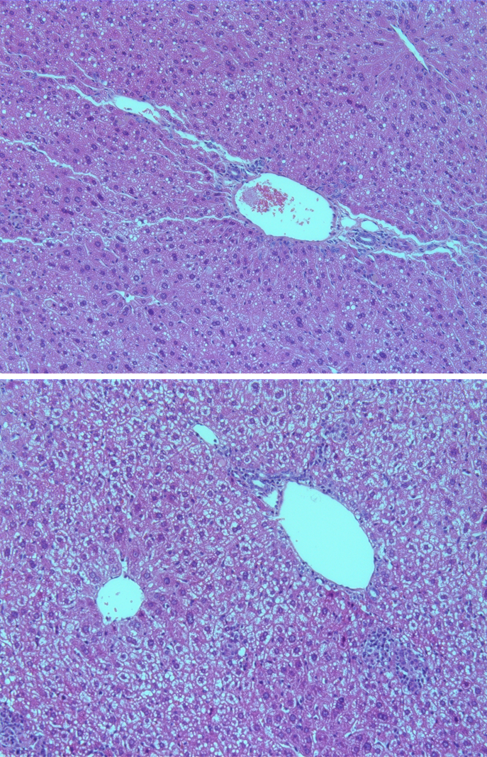
A
B
Figure S1, Effect of CH diet consumption for six weeks on mice hepatic morphology.
Representative histologic microphotographs of H&E stained liver sections in mice fed with normal diet (A) or CH diet-induced dysregulated hepatocytes cords, increased steatosis, inflammation and Mallory‐Denk body formation (B). Magnification X20.

Slide 2
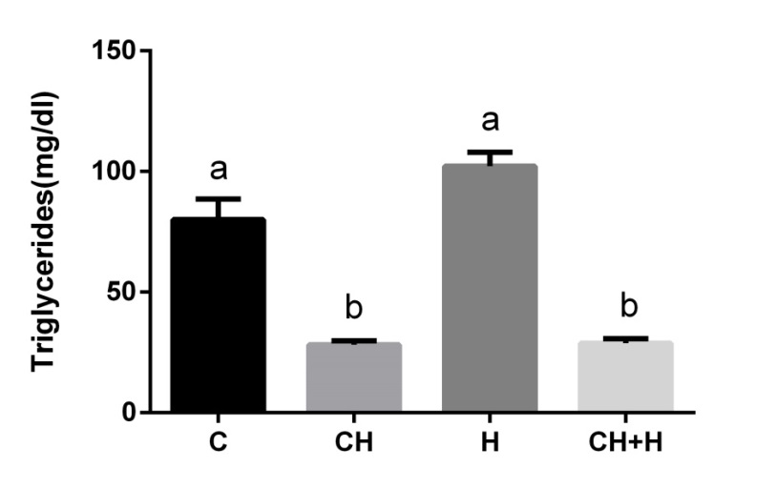
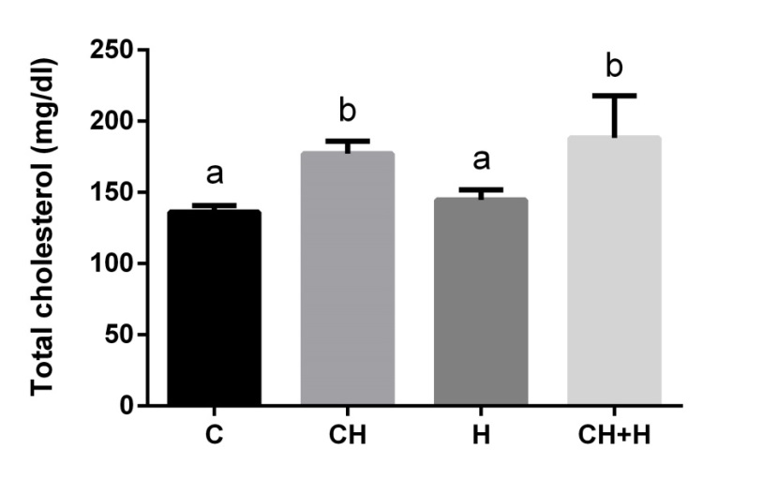
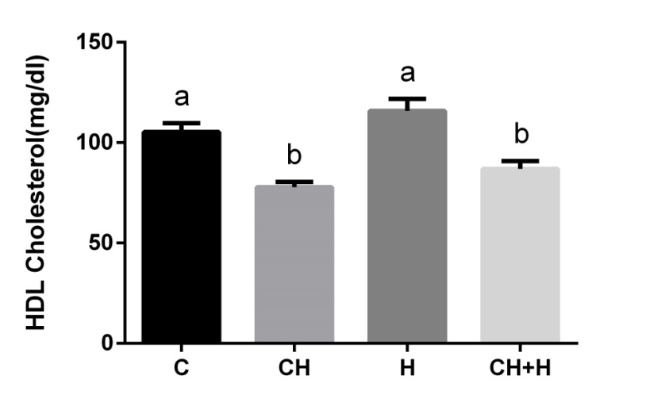
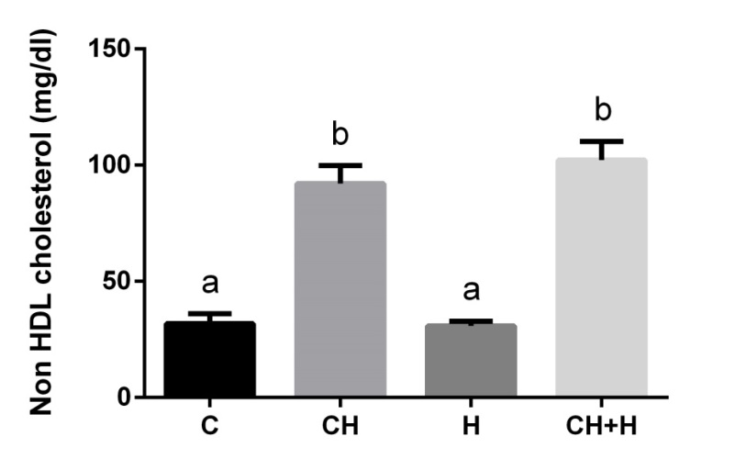
A
B
C
D
    Figure 2S, Effect of high cholesterol diet (CH) and hypoxia (H) on mice serum lipid profile. Effect of CH and H or their combination, as compared to the control, on triglyceride (A), total cholesterol (B), HDL cholesterol (C) and non HDL cholesterol (D) levels in mice sera. Values are expressed as mean ± SE (n = 8–10 for each group).

Slide 3
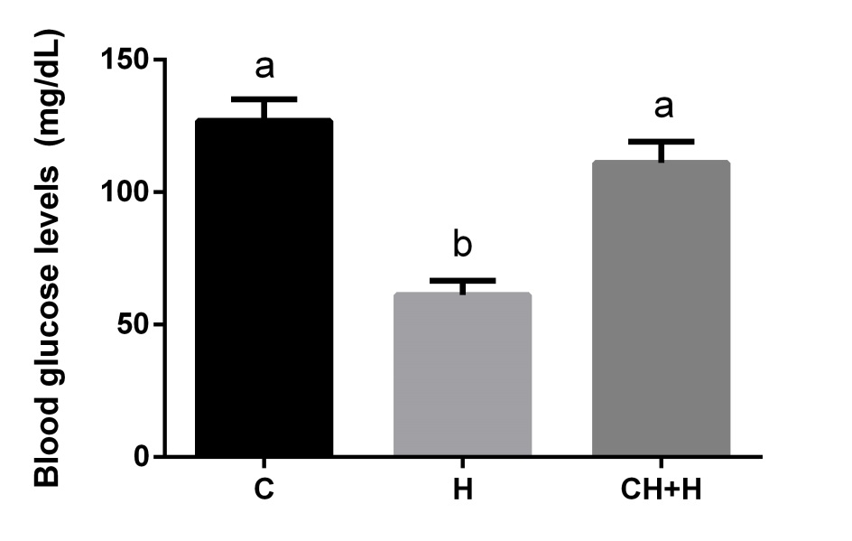
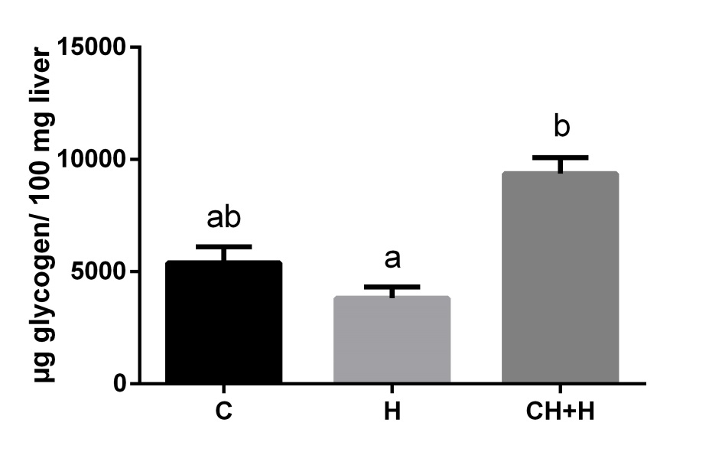
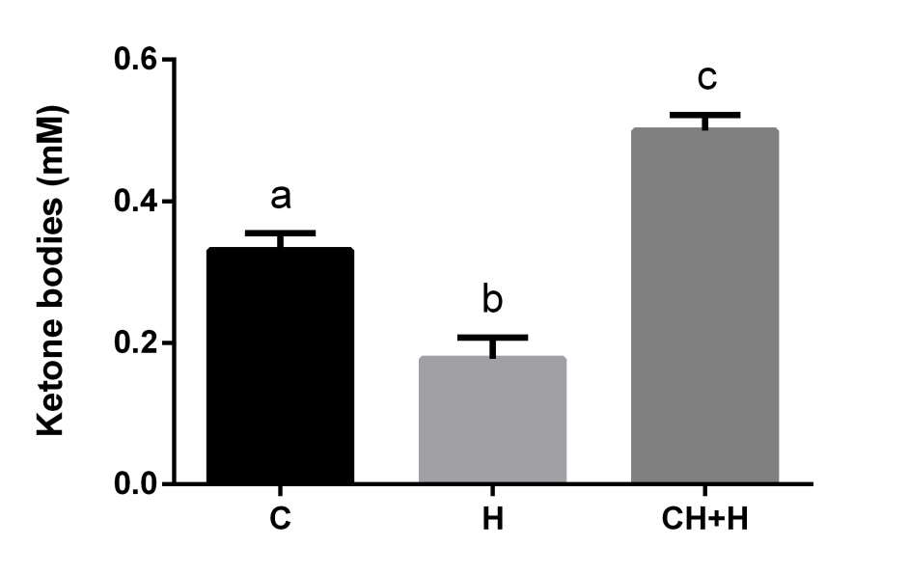
A
B
C
    Figure 3S, Effect of high cholesterol diet diet (CH) consumption for three weeks and hypoxia (H) on mice metabolic parameters. Effect of CH diet, hypoxia (H), or their combination (CH+H) as compared to the control on blood glucose levels (A), liver glycogen content (B ) and serum ketone body levels (C). n=8 , P<0.05.

Slide 4
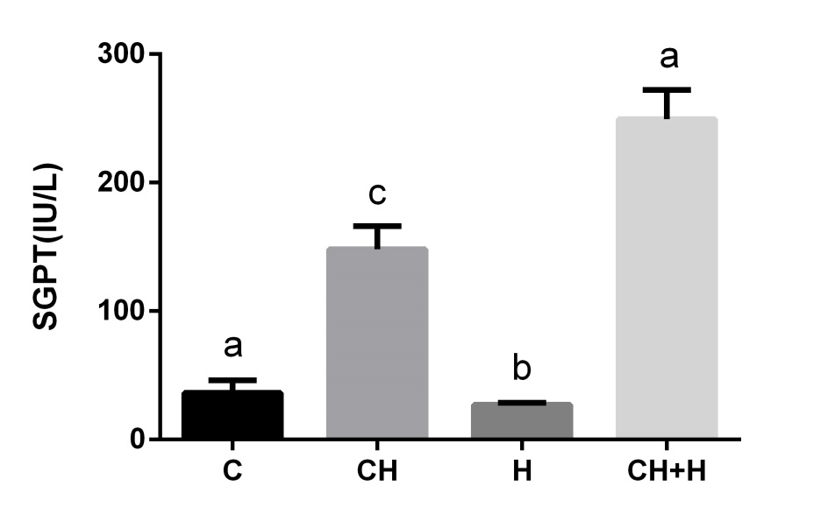
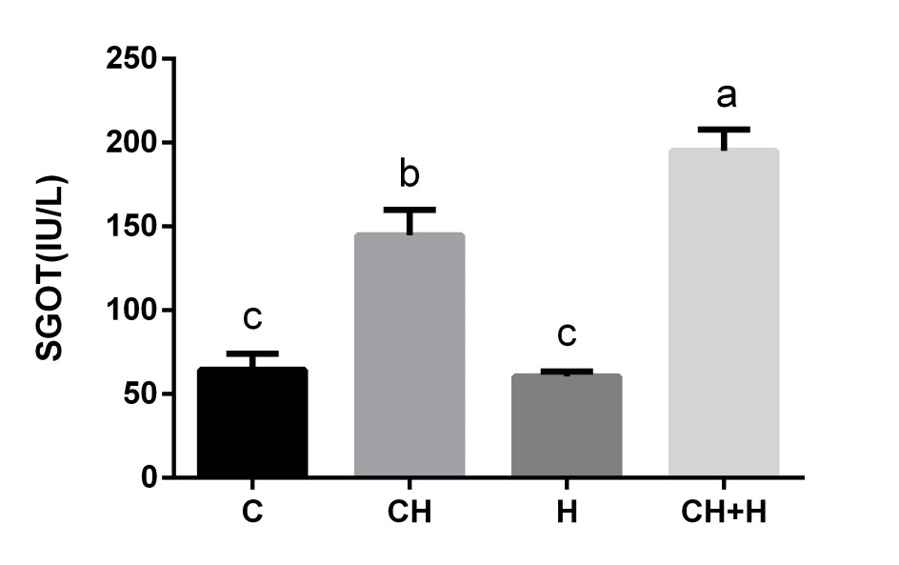
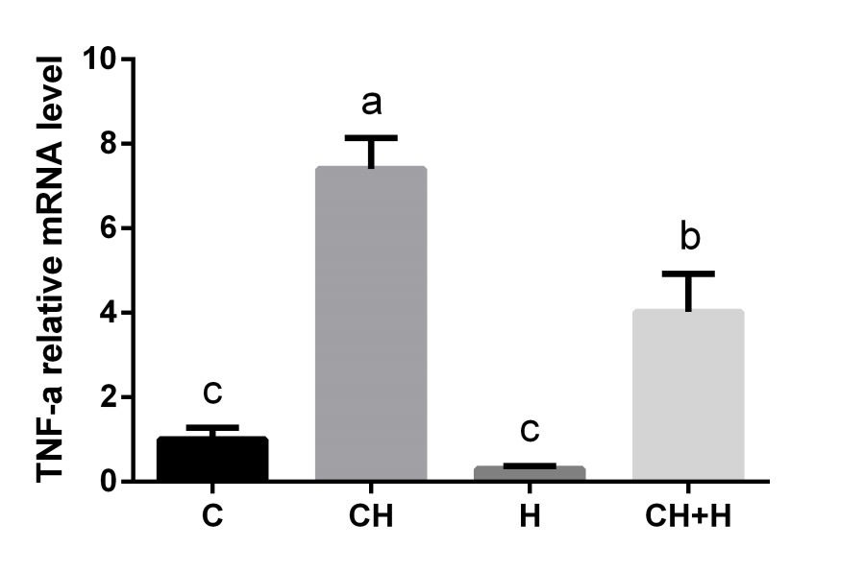
A
B
C
Figure 4S, Effect of high cholesterol diet (CH) and hypoxia (H) on mice liver damage and inflammation.
Effect of CH diet and H or their combination, as compared to the control, on liver enzyme levels;. SGOT (A) and. SGPT (B) in mice sera and on TNFα (C) mRNA levels in mouse liver. Values are expressed as mean ± SE (n =6–10 for each group).

Slide 5
Diet composition
 | ND (g/kg) | ND+ 1% cholesterol+ 0.5% cholic acid (g/kg)
cornstarch | 397.5 | 397.5
maltodextrin | 132 | 132
sucrose | 100 | 100
casein | 200 | 200
soybeen oil | 70 | 70
cellulose | 50 | 50
mineral mix | 35 | 35
vitamin mix | 10 | 10
DL-methionine | 3 | 3
choline | 2.5 | 2.5
BHT | 0.014 | 0.014
cholesterol | 0 | 10
cholic acid | 0 | 5
Table S1

Slide 6
    RT PCR Primers
Table S2

