Slide 1
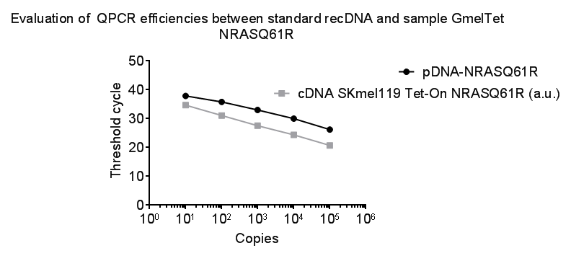
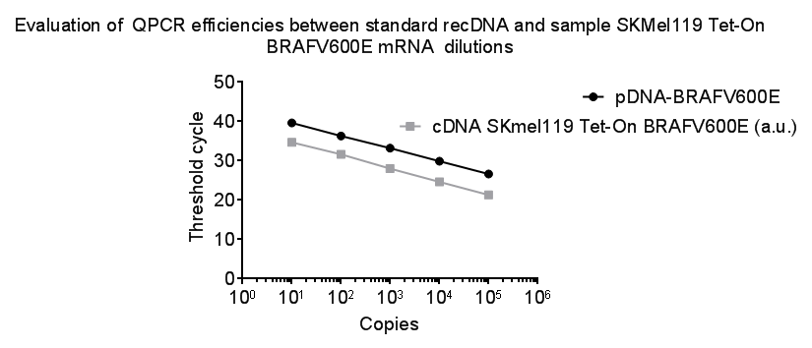
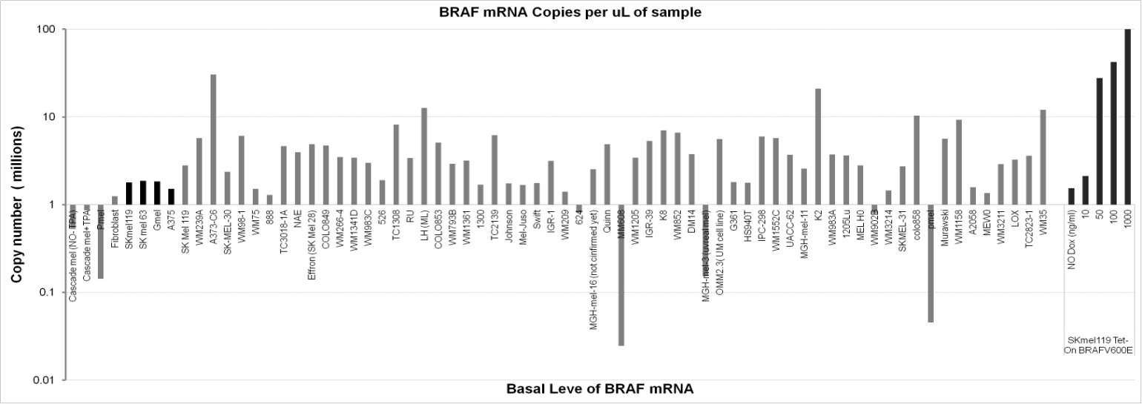
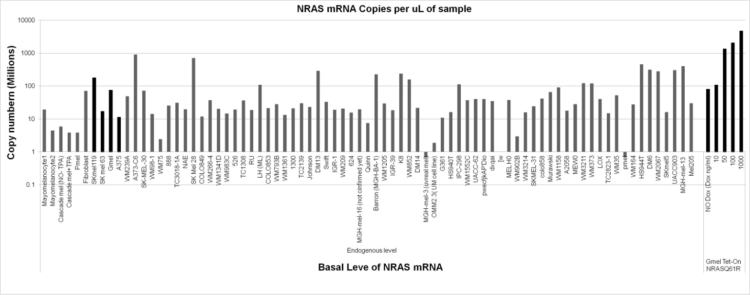
Fig S1
a
pcDNA-BRAF*
b
pcDNA-NRAS*
50
cDNA SK-MEL-119^{NRAS*+}iBRAF(V600E) a.u.
50
cDNA GMEL^{BRAF*+}iNRAS(Q61R) a.u.
40
40
30
30
Threshold cycle
Threshold cycle
20
20
10
10
0
0
10⁰
10¹
10²
10³
10⁴
10⁵
10⁶
10⁰
10¹
10²
10³
10⁴
10⁵
10⁶
Copies
Copies
c
Endogenous versus induced copy number of mRNA
Induced
Level
d
Induced
Level
Figure S1: QPCR analysis to determine the transcript copy number of induced BRAF and NRAS. (a, b) Evaluation of qPCR assay by comparing of amplification efficiencies between standard rDNA solutions and sample or test cDNA of rival oncogene cell lines. The slope of the regression for rDNA plasmid pcDNA-BRAF^{V600E} (black line) is -3.237 and for SK-MEL-119^{NRAS*}+iBRAF(V600E) cDNA (gray line) is -3.381 as well for rDNA plasmid pcDNA-NRAS^{Q61R} (black line) is -2.905 and for GMEL^{BRAF*}+iNRAS(Q61R) cDNA (gray line) is -3.470. The two parallel slopes confirmed that cDNA of sample or test solutions and rDNA plasmid (pcDNA-BRAF^{V600E} or pcDNA-NRAS^{Q61R}) standards could be amplified with the same amplification efficiency in qPCR for both cell lines. (c, d) show that the induction of rival oncogenes with 50-100 ng/ml doxycycline were in physiological range and comparable to endogenous level of many melanoma cell lines. In the bar diagram, black bars represent the cell lines specifically chosen for the study.
Notes:
Fig: qPCR Analysis to determine the copy number of induced mRNAs for BRAF and NRAS and its comparison to endogenous levels.
in (A,B) Assessment of qPCR assay by determination of the copy number of recDNA plasmid at a known concentration in reaction solutions. Standard curve for the starting quantity of BRAF or NRAS DNA. The solid line shows standard recDNA plasmid solutions and the faded line the test samples in 1:10 serial dilutions. (C,D) Copy numbers of BRAF or NRAS mRNA in 1µl samples (1/20 of the total volume of the reverse-transcribed product) of multiple cell lines and dose dependent doxycycline induced BRAFV600E in SKmel119 and NRASQ61R in Gmel test melanoma cell lines.

