Slide 1
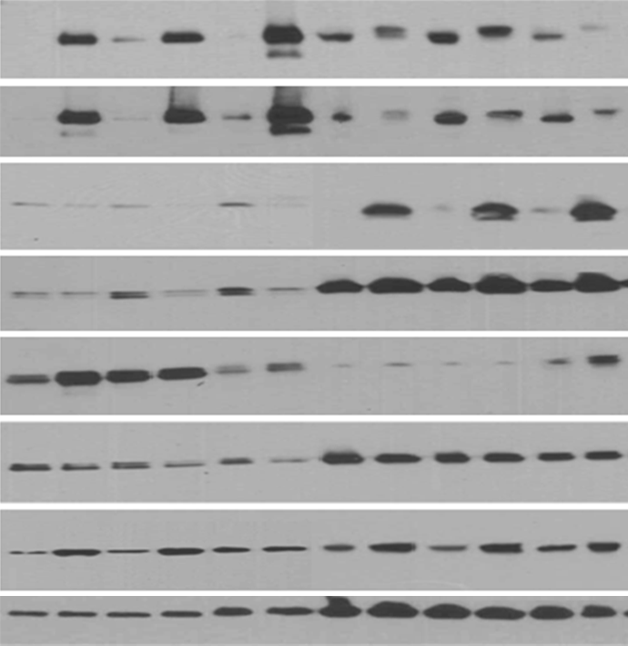
(NRAS*)+iBRAF*
(BRAF*)+iNRAS*
Fig S4
SK-MELl119
MGH-CH-1
SK-MEL63
WM1361
GMEL
A375
-
+
-
+
-
+
-
+
-
+
-
+
Dox
BRAF^{V600E}
BRAF
NRAS^{q61R}
NRAS
pErk1/2^{(T202/Y204)}
Erk1/2
pMEK1/2^{(Ser217/221)}
GAPDH
Figure S4: Effect of rival oncogene expression on MAP kinases were confirmed by Western blotting . Melanoma cells transfected with Tet-On-NRAS* or BRAF* lentivirus. Though, pERK showed inconsistent phosphorylation but pMEK exhibited enhanced phosphorylation in all cell lines upon second oncogene expression. GAPDH is used as internal loading control.
NOTE: Same lysates were used for “figures 6C and S4” hence GAPDH is shared

