Slide 1
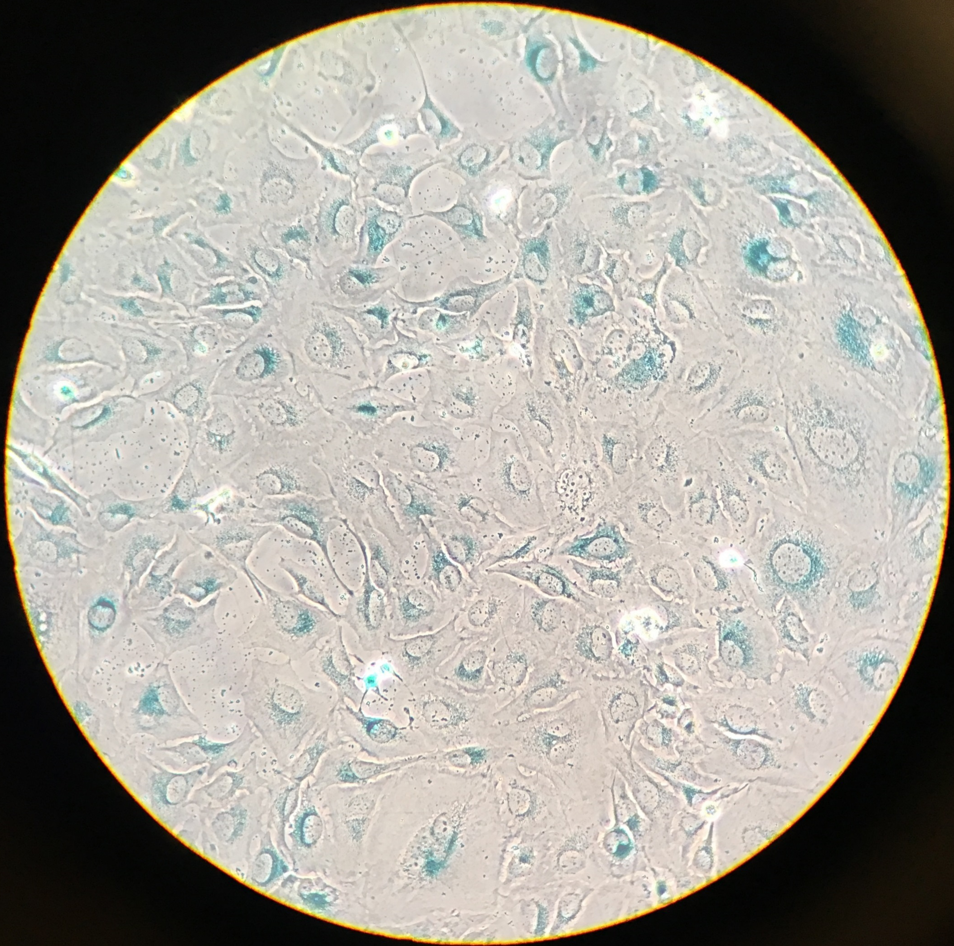
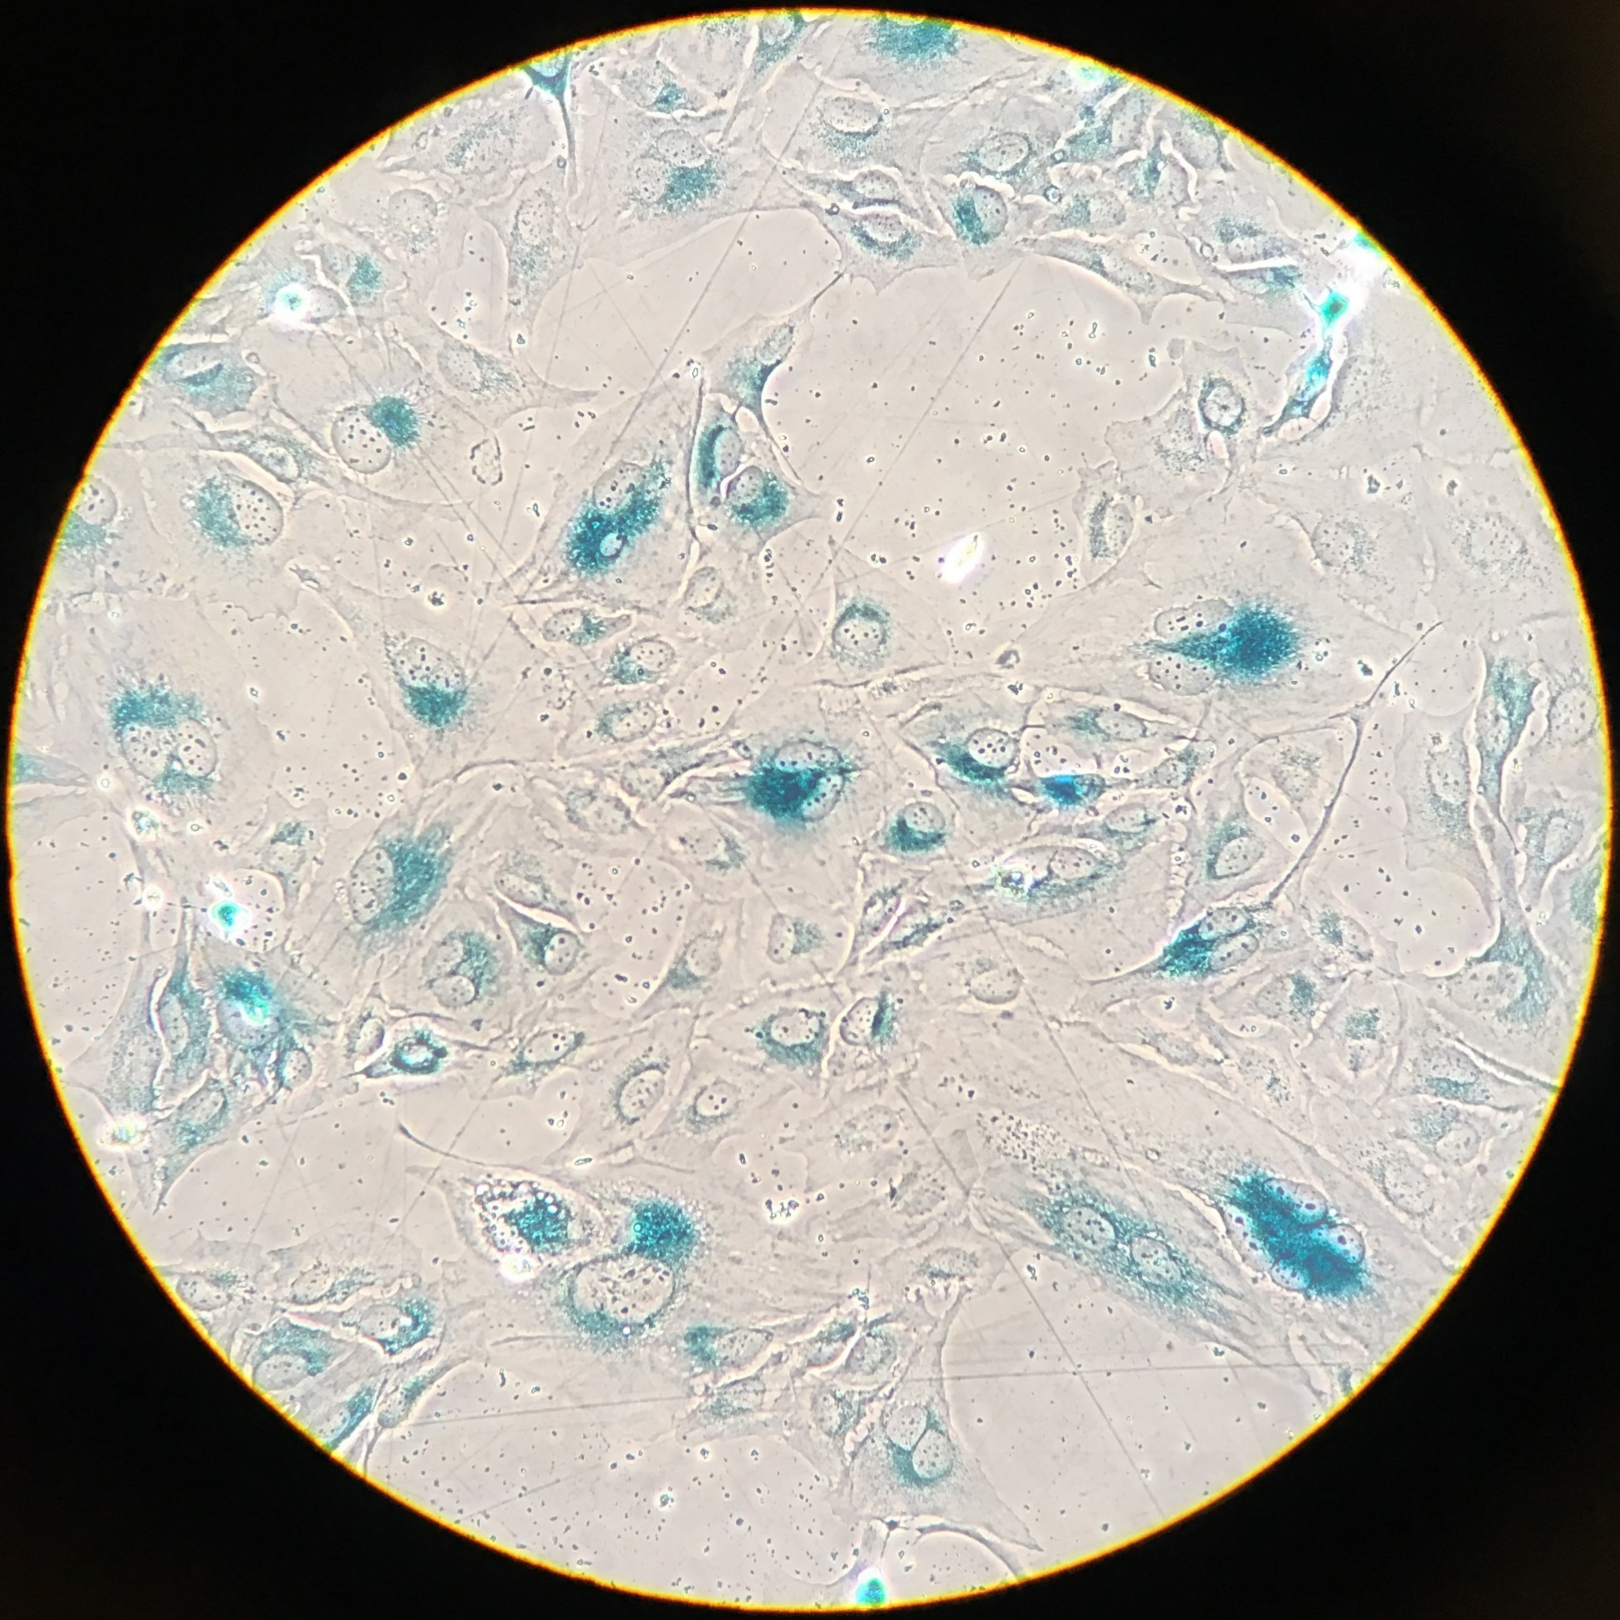
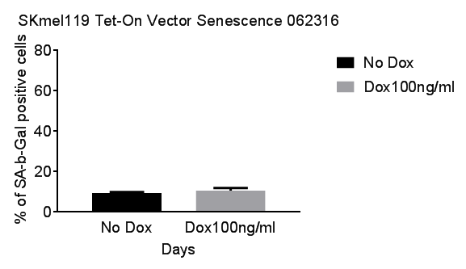
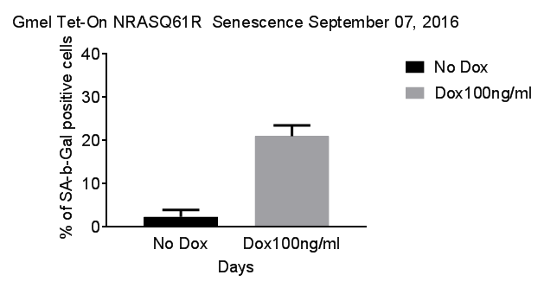
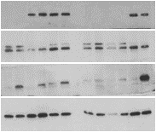
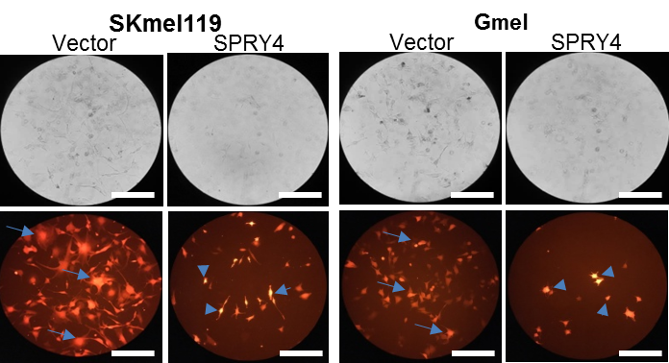
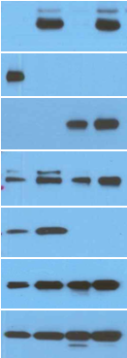
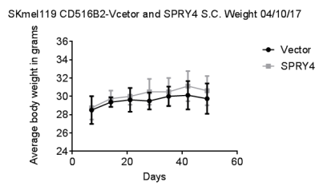
a
SPRY4
SK-MEL-119^{NRAS*}
Fig S5
-Dox
+Dox
40
2
30
SPRY4
Apoptotic Cells (%)
V
β-Gal +ve cells
(fold)
20
SPRY4
1
10
GAPDH
0
0
Vector
SPRY4
b
SK-MEL-119^{NRAS*}
GMEL^{BRAF*}
Vector
SPRY4
Vector
SPRY4
SK-MEL-119
GMEL
SPRY4
SPRY4
V
V
SPRY4
GAPDH
c
SK-MEL-119^{NRAS*}
36
Vector
SPRY4
32
Average Body Weight (Grams)
28
0
0
20
40
60
Days
Figure S5: Senescence and morphological changes upon SPRY4 expression in melanoma cells. (a) Cytochemical staining with substrate X-gal by senescence-associated β-galactosidase (SA-β–gal) indicates that a significant number of SK-MEL-119^{NRAS*} cells undergo senescence at 5th day upon expression of SPRY4 and resulted in apoptosis, Annexin-V+PI assay. (b) SK-MEL-119^{NRAS*} and GMEL^{BRAF*} cells showed changes from an amoeboid (arrow) to bipolar morphology and a small cell soma (arrowhead) upon SPRY4 (CD516B-2-SPRY4) gene expression for 6-10 days. Western blot analysis was performed to detect sprouty4 level in whole cell extract from ectopic expressed sprouty4 and GAPDH was used as internal loading control. (c) SK-MEL-119^{NRAS*}+SPRY4 xenograft; body weight was measured every 7th day for 7 weeks and plotted (mean ± SD, N=8). Bar,100 μm.

