Slide 1
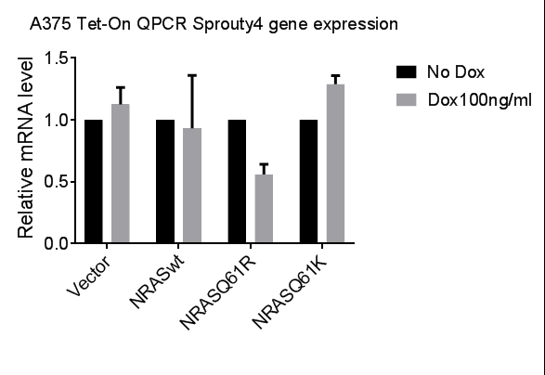
Fig S6
a
1.5
GMEL^{BRAF*}+iNRAS*
- Dox
+ Dox
1.0
Relative mRNA MITF
0.5
◇
0.0
iVector
iNRAS^{Q61R}
b
8
P<0.0001
4
Log₂-Fold change
0
-4
MITF Targets
(Hoek)
Non-MITF Targets
Figure S6: Dual oncogenesis decrease MITF and its target genes. (a) QPCR analysis of GMEL^{BRAF*}+iNRAS cells shows significant suppression of MITF when induced to express NRAS^{Q61R} with doxycycline as compared to vector. (b) Published list of high impact MITF targets (Hoek, K. S. et al. 2008) (7), as a group, were significantly more suppressed than non-MITF targets in the GMEL^{BRAF*} cell line (log2-fold -0.56±0.03 vs -0.0034±0.0032, Student’s t test, ◇p<0.0001. Thus, lineage programming appears to be diminished in the GMEL^{BRAF*} line with ectopic NRAS* expression.

