Slide 1
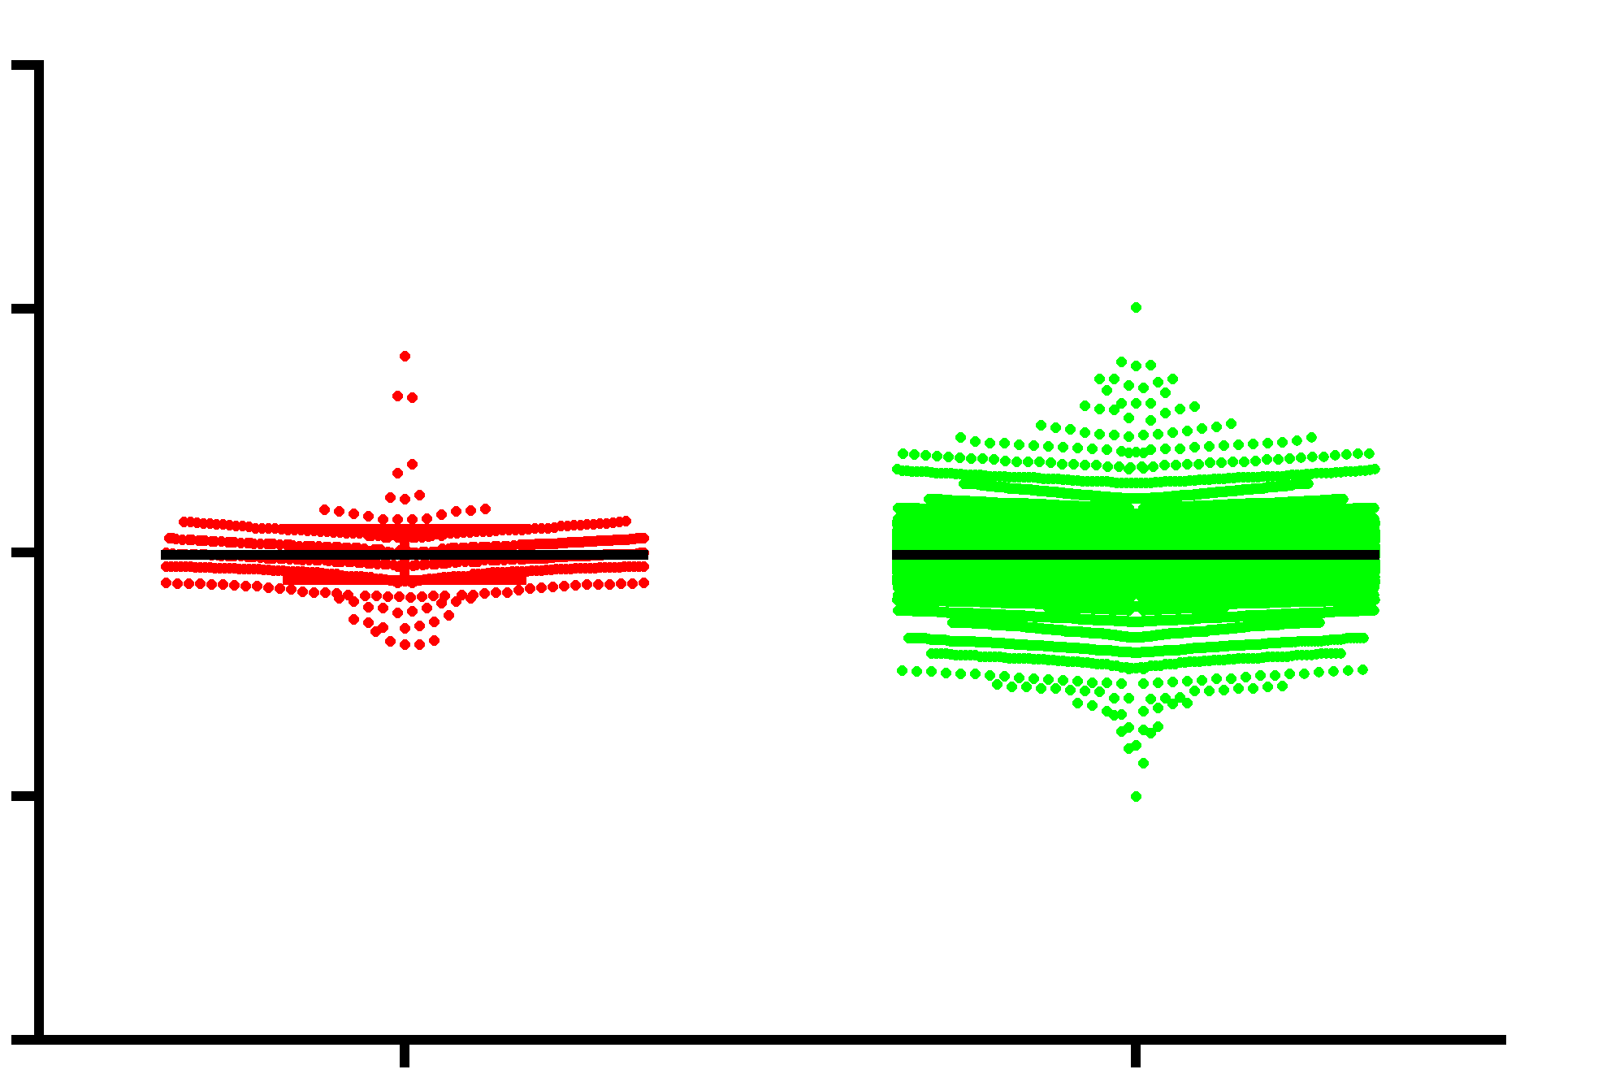
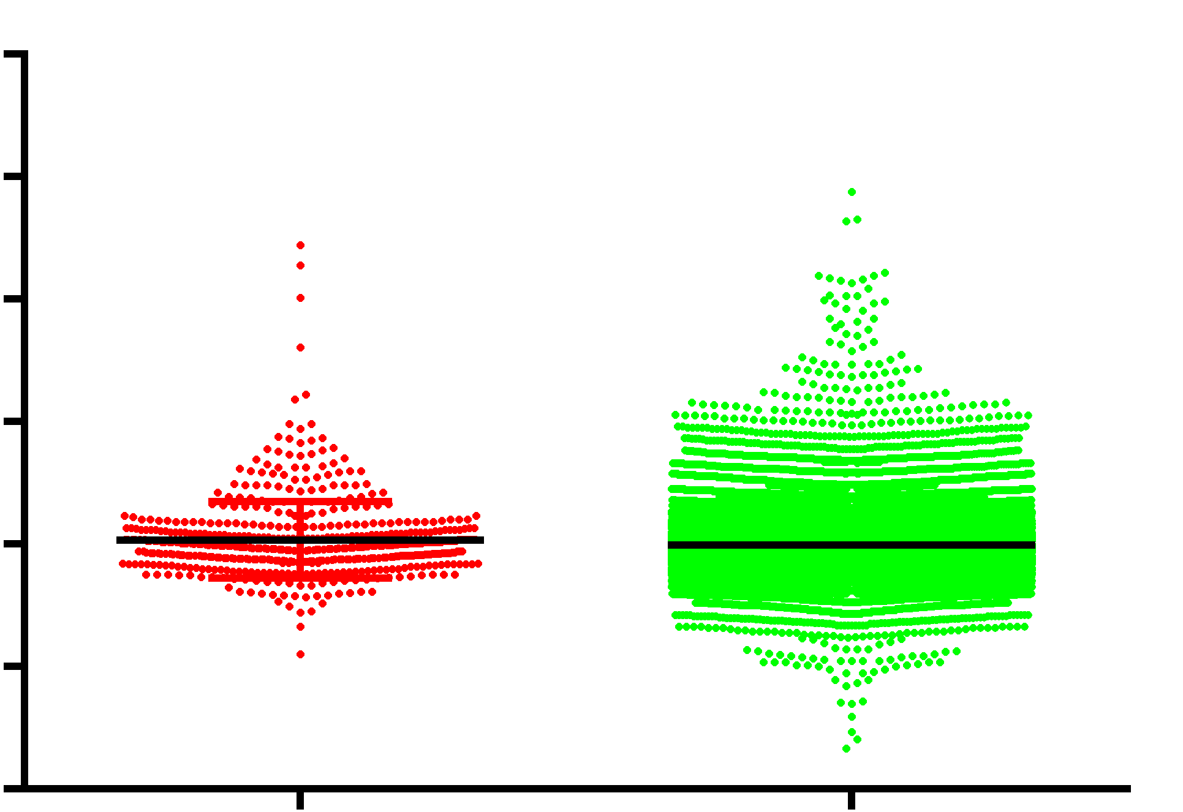
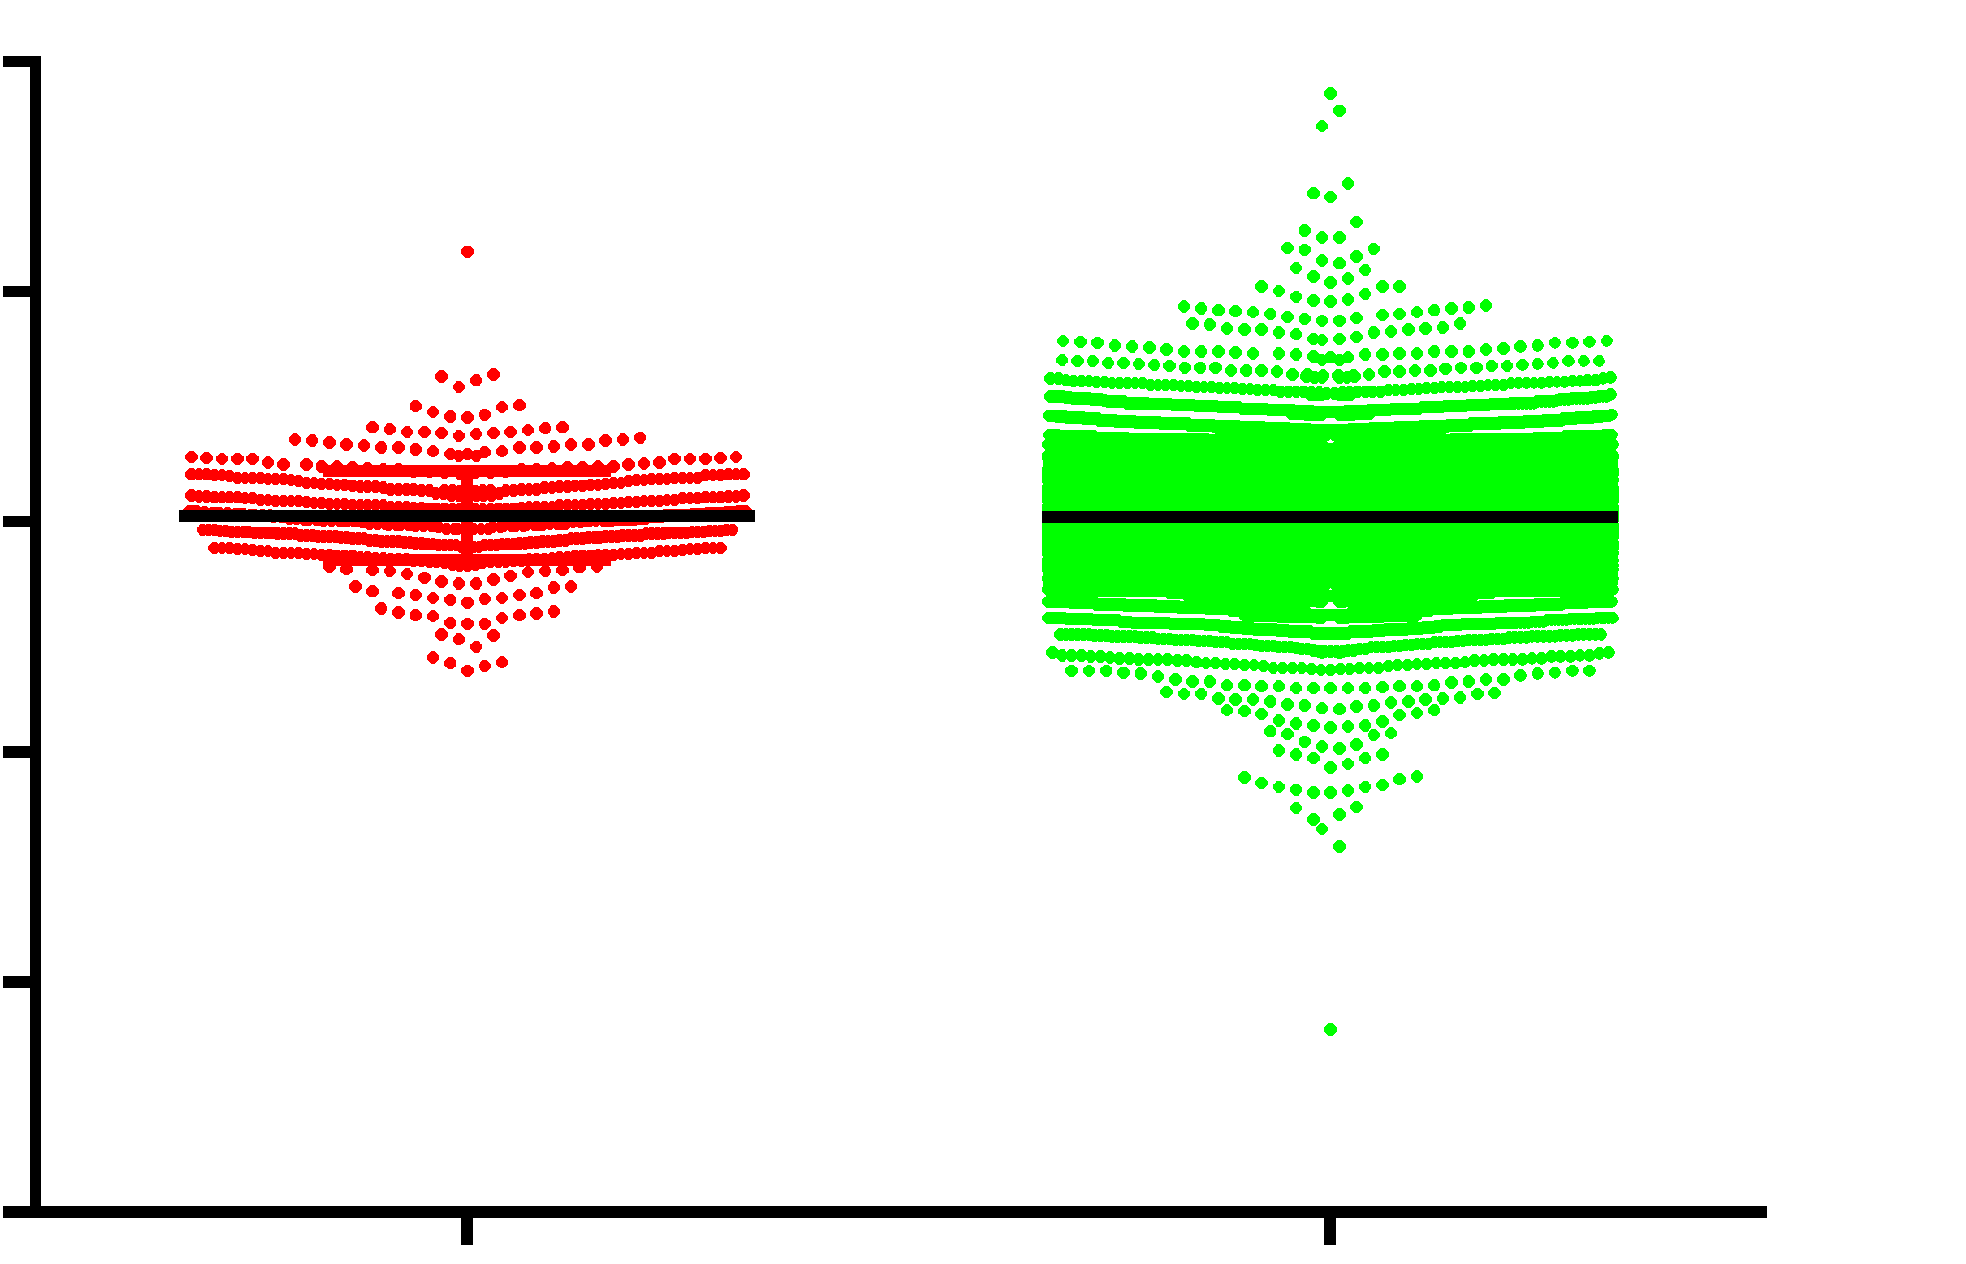
Fig S8
SK-MEL-119^{NRAS*}+iBRAF*
GMEL^{BRAF*}+iNRAS*
A375^{BRAF*}+iNRAS*
10
p=0.97
8
P<0.001
2
p=0.47
5
4
Log₂-fold change
0
0
-2
-5
-4
-6
-10
Senescence
up genes
All genes
Senescence
up genes
All genes
Senescence
up genes
All genes
Figure S8: Fridman senescence signature (GSEA)-up regulated in senescence. (BRAF*) exhibited a significantly higher level of induction of the senescence gene set relative to all other transcripts (mean log2-fold +0.068±0.025 vs -0.012±0.003, p<0.0001). Gene set derived from http://software.broadinstitute.org/gsea/msigdb/cards/FRIDMAN_SENESCENCE_UP.html
ALDH1A3, C9orf3, CCND1, CD44, CDKN1A, CDKN1C, CDKN2A, CDKN2B, CDKN2D, CITED2, CLTB, COL1A2, CREG1, CRYAB, CTGF, CXCL14, CYP1B1, EIF2S2, ESM1, F3, FILIP1L, FN1, GSN, GUK1, HBS1L, HPS5, HSPA2, HTATIP2, IFI16, IFNG, IGFBP1, IGFBP2, IGFBP3, IGFBP4, IGFBP5, IGFBP6, IGFBP7, IGSF3, ING1, IRF5, IRF7, ISG15, MAP1LC3B, MAP2K3, MDM2, MMP1, NDN, NME2, NRG1, OPTN, PEA15, RAB13, RAB31, RAB5B, RABGGTA, RAC1, RBL2, RGL2, RHOB, RRAS, S100A11, SERPINB2, SERPINE1, SMPD1, SMURF2, SOD1, SPARC, STAT1, TES, TFAP2A, TGFB1I1, THBS1, TNFAIP2, TNFAIP3, TP53, TSPYL5, VIM

