Slide 1
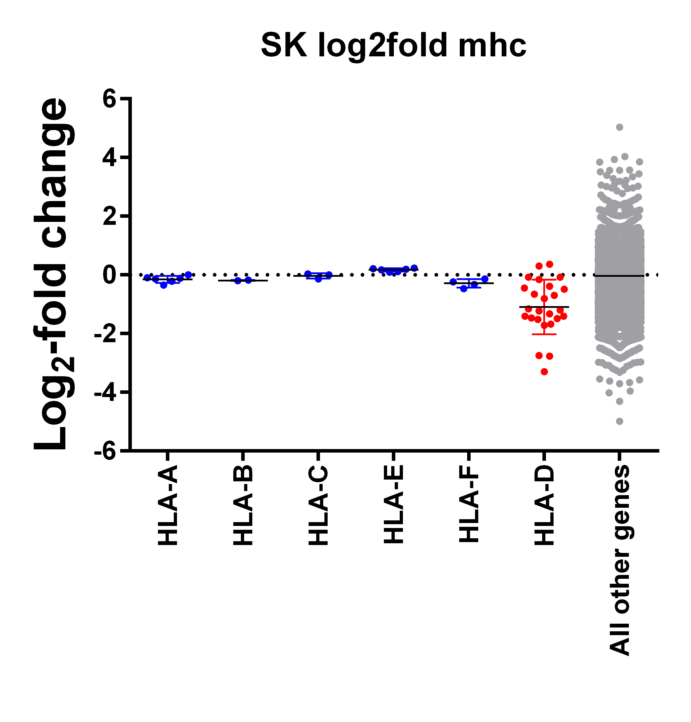
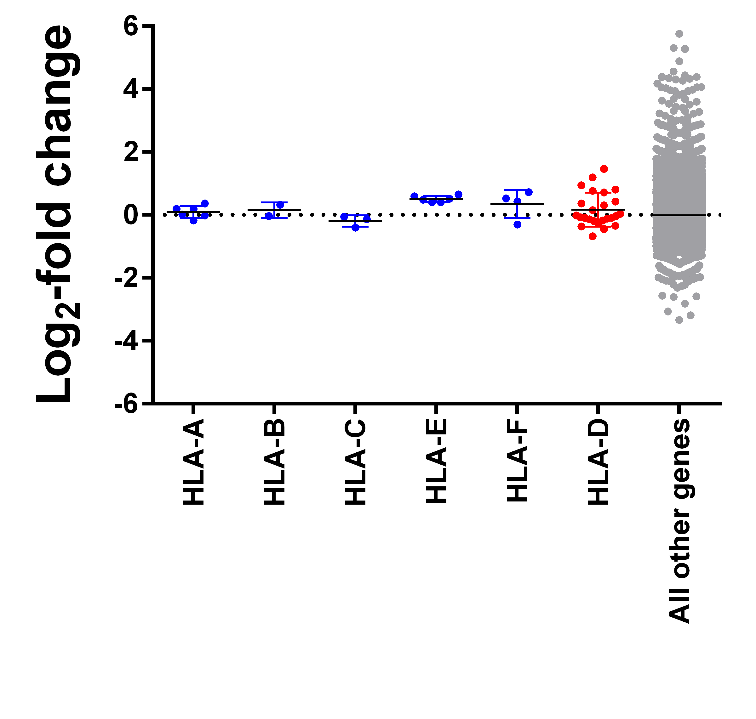
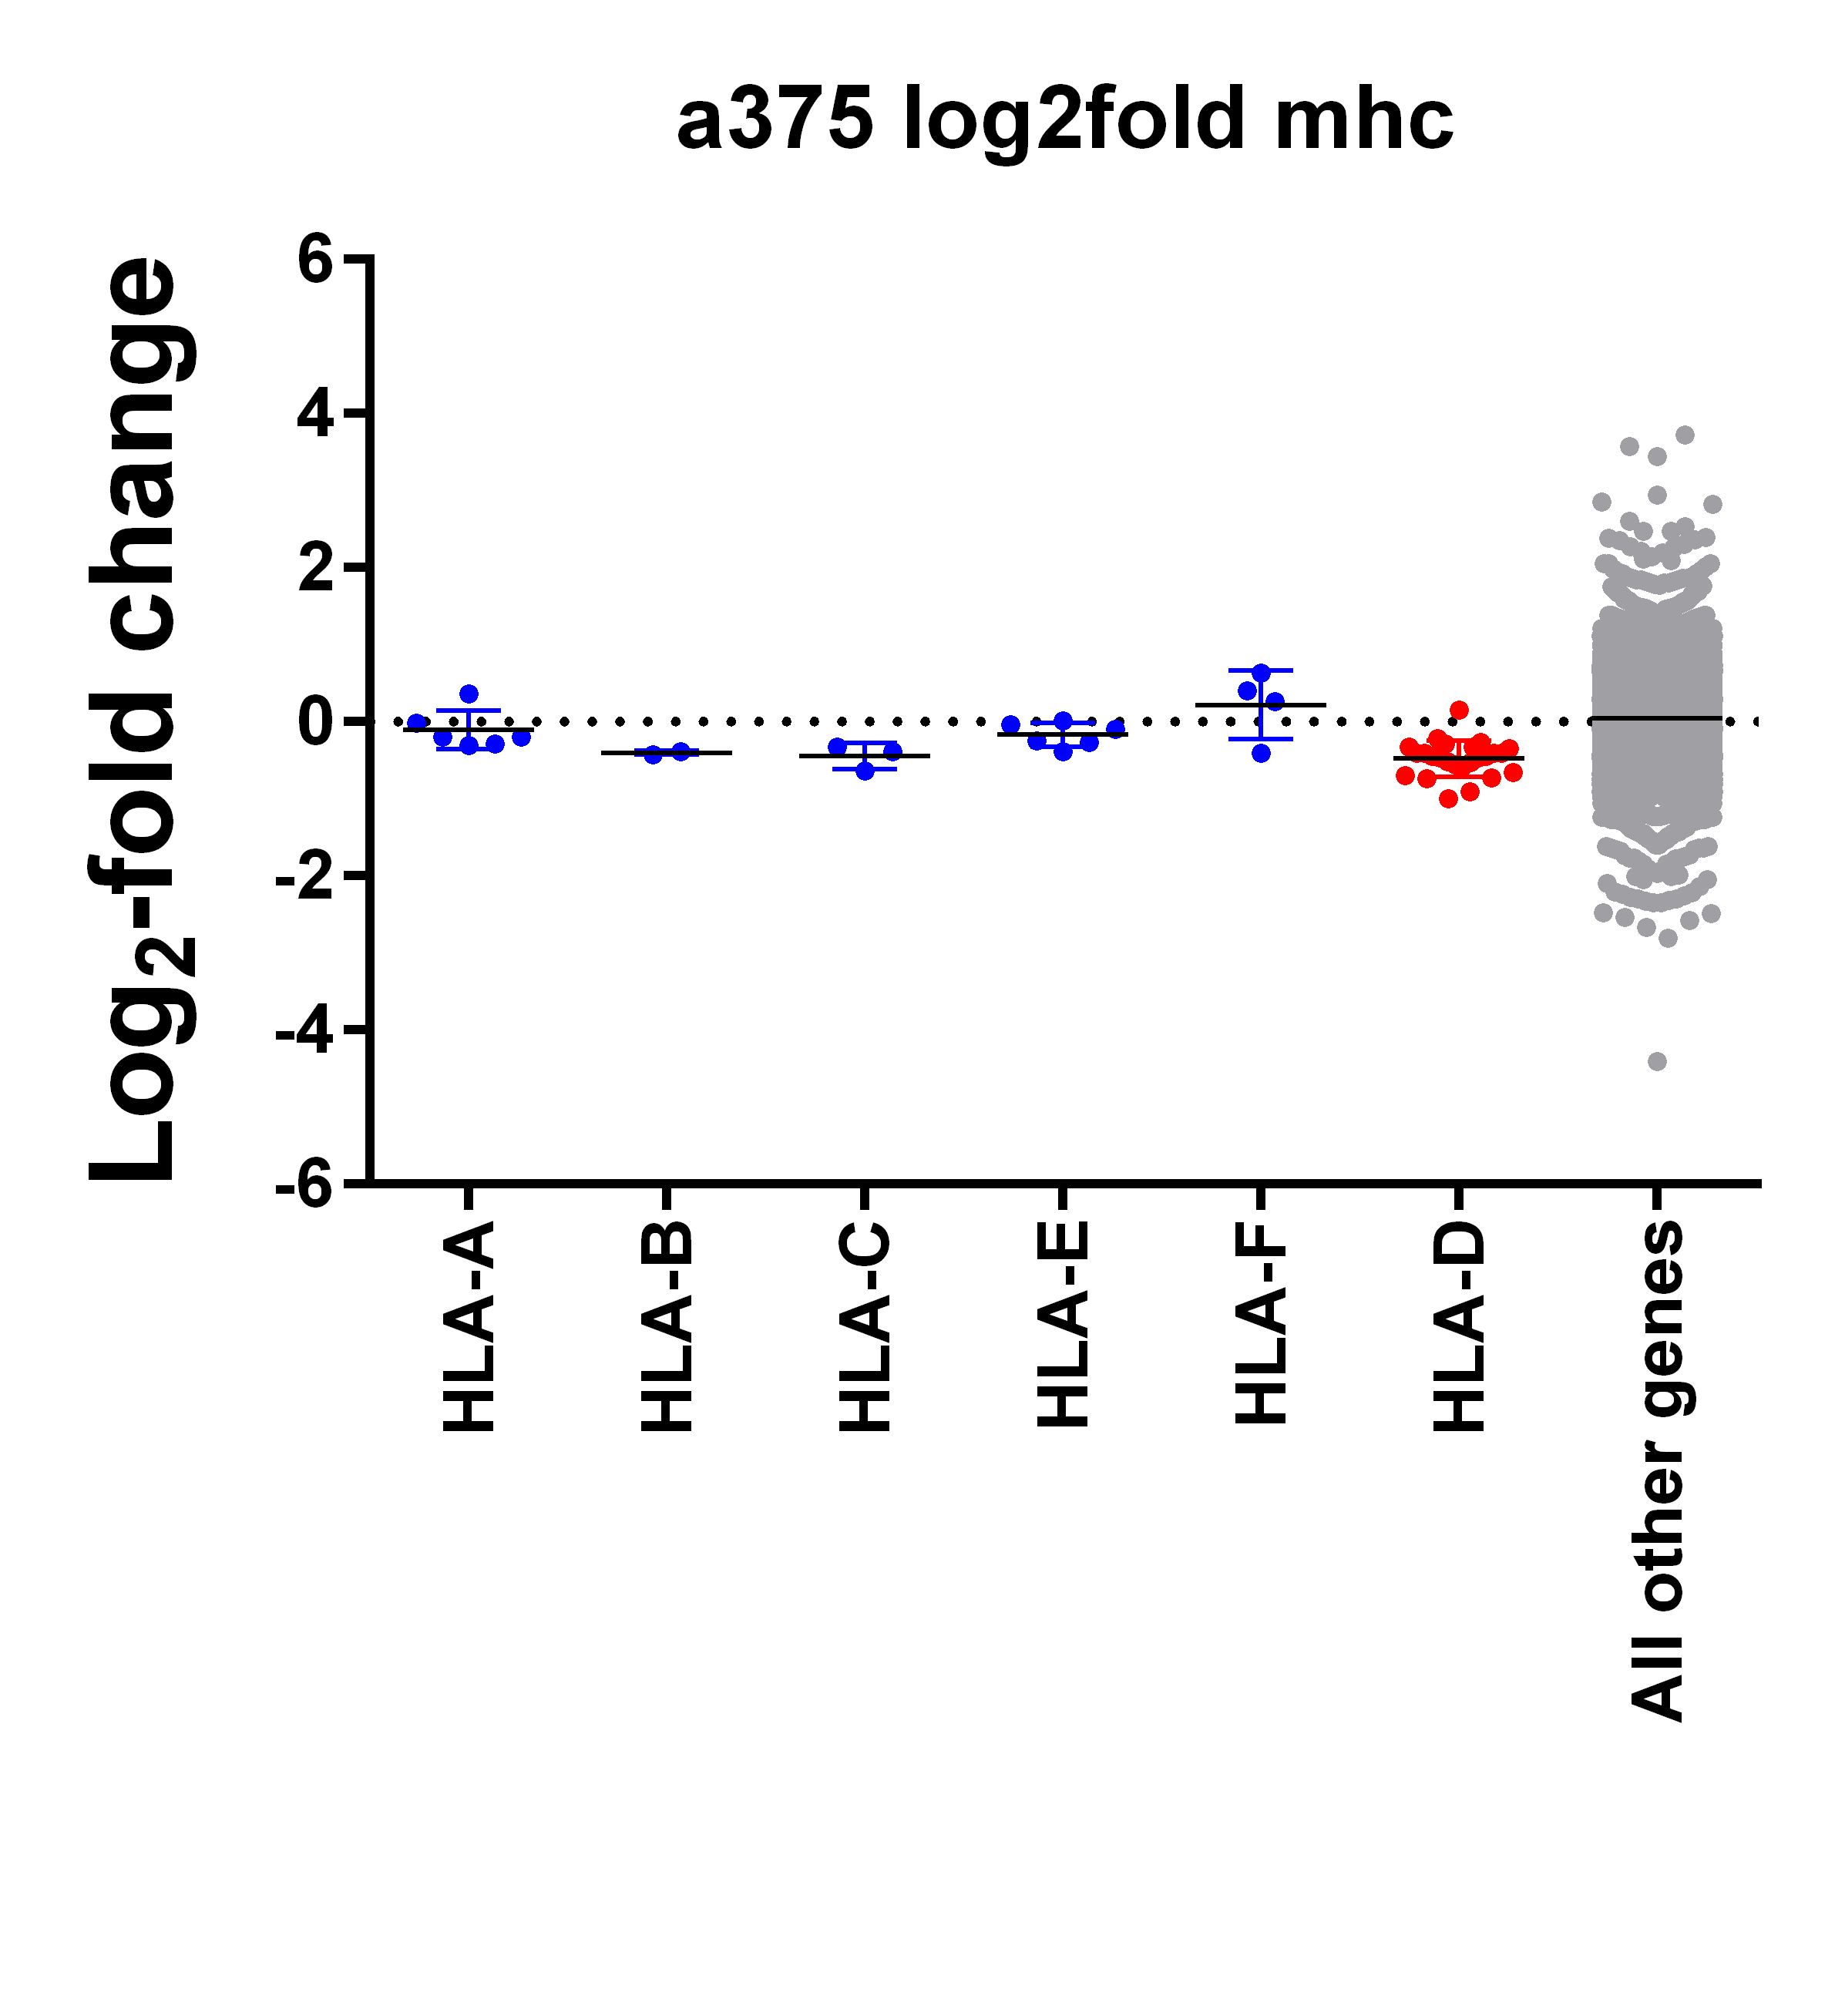
Fig S9
SK-MEL-119^{NRAS*}+iBRAF*
GMEL^{BRAF*}+iNRAS*
A375^{BRAF*}+iNRAS*
p<0.0001, ANOVA
p=0.06, ANOVA
p<0.0001, ANOVA
p<0.001
p=0.012
p<0.001
p=0.08
Figure S9: Immune signatures. At the RNA level for the MHC-II cell surface receptor molecules, both SK-MEL-119^{NRAS*} and A375^{BRAF*} demonstrated significant decreases (p<0.0001 for both) in HLA-DR with variable smaller level changes in HLA-A/B/C/E/F receptors. GMEL^{BRAF*} cells had a significant upregulation of the non-classical MHC class I molecule, HLA-E (p=0.012), which has been shown to be increased during replicative senescence.

