Slide 1
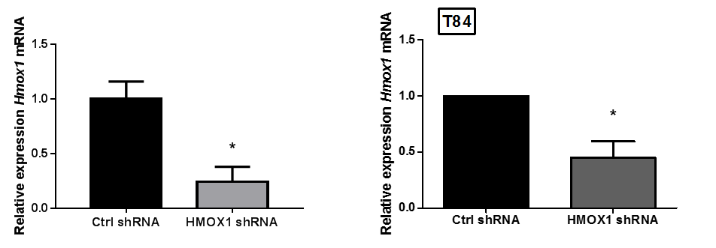
A
B
Supplemental Figure 1.

