Slide 1
Case Report of Histoplasma capsulatum Prosthetic Valve Endocarditis – An Extremely Rare Presentation with Characteristic Findings (EHJ-CR-D-18-00167)
June 2019

Slide 2
Introduction
Fungi are the causative agents in approximately 5 to 7 % of all prosthetic valve endocarditis (1)
Histoplasma capsulatum is a rare cause of endocarditis (1, 2)
      non-specific symptoms and clinical findings
      diagnosis is often delayed with symptoms present for median 7 weeks
      challenges in diagnostic test variances and blood culture yield
We report a rare case of H. capsulatum endocarditis involving an aortic valve bioprosthesis six years after cardiac surgery in a 65-year old male
EHJ-CR-D-18-00167

Slide 3
Case Presentation
History and Examination Findings
65-year old male with 4-month history of subjective fevers, sweats, and 20-pound weight loss
Medical history
      Bicuspid aortic valve - underwent bioprosthetic aortic valve replacement about 6 years prior to presentation
      Non-obstructive coronary artery disease
      Diabetes mellitus type II
      Chronic obstructive pulmonary disease
      Chronic liver disease
      History of cerebrovascular accident with residual deficits
      Medical non-compliance
  Physical examination
VS: Tc 37.3 C HR 88 BP 124/78 RR 18 O₂ 98% on RA
Gen: Appeared chronically ill; cachectic with temporal wasting
Neuro: disoriented and unable to follow command, no localizing signs
Skin: Well healed midline sternotomy
Oral: Dry mucous membranes, upper mouth is edentulous, multiple decayed and fractured teeth in lower jaw
CV: Normal first and second heart sound, regular rate and rhythm, 3/6 late-peaking systolic ejection murmur heard at the upper sternal border radiating to the carotids bilaterally
Abdomen: Soft, non-tender, normoactive bowel sounds; no guarding or rebound
Extremities: No lower extremity edema; dusky appearance of multiple toes on the dorsum of the right foot
EHJ-CR-D-18-00167

Slide 4


Case Presentation
Investigations
Labs | Patient’s Value (Reference range)
Hemoglobin | 10.8 gm/dL (Ref: 13.2 - 16.6 g/dL)
Leukocytes | 5.9 x 10⁹/L (Ref: 3.4 - 9.6 x10⁹/L)
Platelets | 80,000 (Ref: 135 - 317 x10 ⁹/L)
Calcium | 15.8 mg/dL (Ref: 8.8 - 10.2 mg/dL)
Serum Creatinine | 2.0 mg/dL (baseline 1 mg/dL) (Ref: 0.74 - 1.35 mg/dL)
NT-proBNP | 7000 pg/mL (Ref: <=104 pg/mL)
Troponin T | 0.253 ng/mL (Ref: <=0.010 ng/mL)
ESR | 67 mm/hr (Ref: 0-22 mm/hr)
CRP | 101 mg/L (Ref: <=4.9 mg/L)
Ferritin | 1143 mcg/L (Ref: 24 - 336 mcg/L)
Histoplasma Urine Antigen (Day 3) | 5.89 ng/mL (Ref: < 0.10ng/mL)
Histoplasma Serum Antigen (Day 5) | 18.17 ng/mL (Ref: 0.00 - 0.10 ng/mL)
Histoplasma Culture | Positive after 253 hours (Ref: Negative)
Fig 2. CT Head: Remote infarcts involving the left parietal lobe (white arrow).
Fig 1. Lower extremity photograph: Dusky appearance concerning for embolic phenomenon.
Fig 3.
CT Abdomen: Moderately enlarged spleen with new(arrow) wedge-shaped region of abnormal low attenuation involving 50% of the spleen, consistent with an infarct.
EHJ-CR-D-18-00167

Slide 5
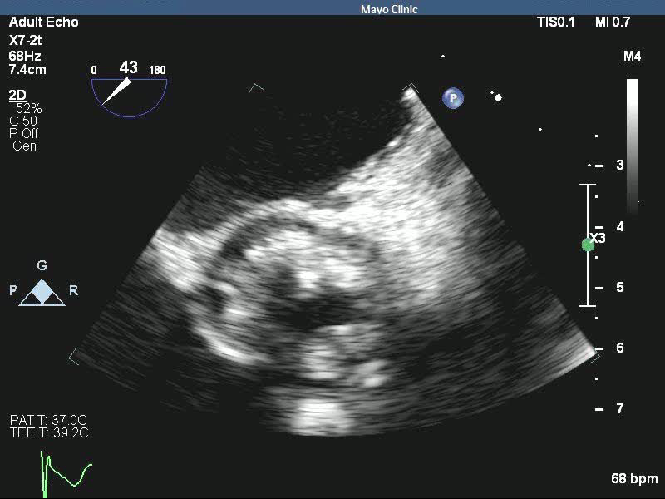
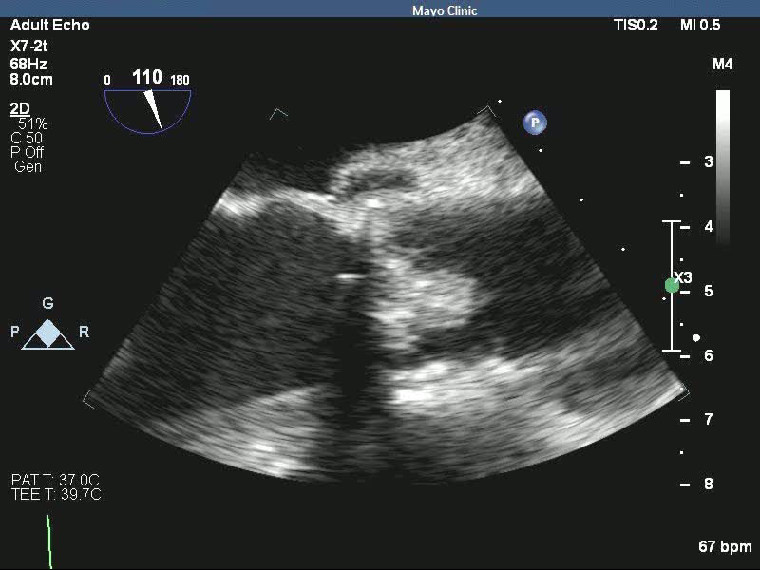
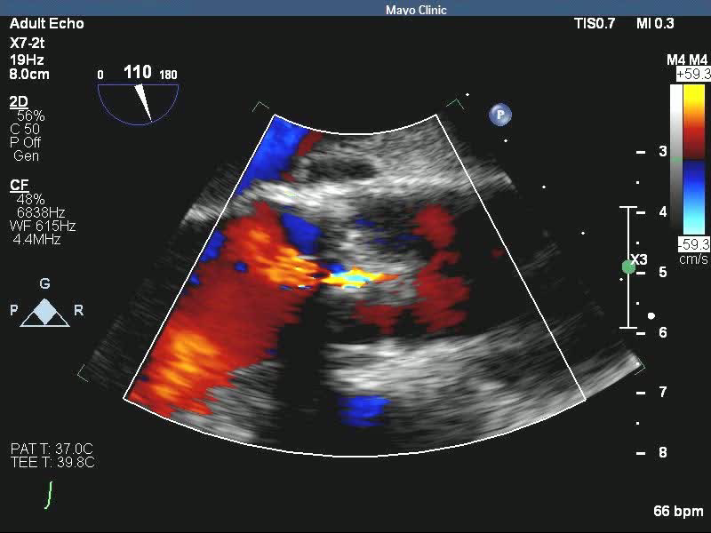
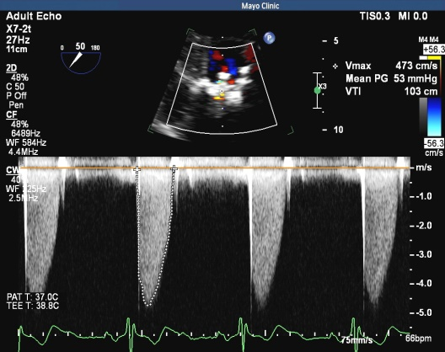
Case Presentation
Investigations
a
b
Fig 4. TEE of the bioprosthetic valve showing: a ) Bulky thickening of the prosthetic aortic valve leaflets in short axis b) Aortic valve in long axis view showing bulky thickening and echolucency of the aortic root concerning for abscess (arrow) c&d) Colorflow assessment and Doppler profile of aortic valve prosthesis showing severe stenosis.
Fig 5. Panorex showing periapical lucency about tooth 21 suspicious for abscess.
c
d
EHJ-CR-D-18-00167

Slide 6
Case Presentation
Investigations
Fig 6a. CT showing distal left main and proximal LAD with severe disease and extensively calcified. Distal LAD does not have adequate targets for bypass.
Fig 6b. CT showing extensive vegetations, primarily on the aortic side of the bioprosthetic aortic valve with no definite perivalvular extension. PET images (not shown) showed a focal area of increased uptake concerning for an abscess posterior to the valve.
EHJ-CR-D-18-00167

Slide 7
Case Presentation
Management
Broad spectrum antibiotics started after initial echocardiogram
After dental panorex, the patient underwent extraction of his remaining teeth
On Day 5, urine Histoplasma antigen was positive and the patient was initiated on IV liposomal Amphotericin B
      Developed progressively worsening kidney injury after 2 days of therapy
Cardiovascular Surgery consult was obtained for surgical intervention
Coronary CTA obtained for operative planning revealed extensive vegetations on the aortic side of the valve; extensive coronary calcification with severe distal left main and proximal LAD disease, and poor distal targets
After discussion with the family, the patient was transitioned to comfort measures
EHJ-CR-D-18-00167

Slide 8
Discussion
The clinical manifestations of infective endocarditis (IE) are highly variable (3)
Acute, subacute, or chronic features with nonspecific symptoms
Echocardiography is central to the diagnosis and management of patients with IE and should be performed when suspected (4,5)
        Echocardiogram features consistent with fungal infections include vegetations that appear “large”(greater than 1cm) and mobile
H. capsulatum is a rare causative agent of endocarditis with devastating implications if the diagnosis is delayed (5,6)
Growth of H. capsulatum in culture is slow (up to four weeks) and variable depending on the fungal burden (4,5,6)
        Increased use of urine and serum antigen detection and molecular identification improve timely detection
EHJ-CR-D-18-00167

Slide 9
Discussion
Current guidelines recommend a two- phase approach to the management of fungal IE (1)
      Parenteral antifungal agent with an amphotericin B–containing product
      Fungal endocarditis require surgery for definitive treatment
      Without appropriate treatment Histoplasma endocarditis is a uniformly fatal infection (1,7)
EHJ-CR-D-18-00167

Slide 10
Learning Points
Histoplasma capsulatum is a rare causative agent of prosthetic valve endocarditis with non-specific symptoms
High index of suspicion, recognition, appropriate diagnostic testing and early treatment(medical and surgical) are critical components to prevent adverse outcomes
Histoplasma capsulatum IE is uniformly fatal without early treatment
EHJ-CR-D-18-00167

Slide 11
References
Baddour LM, Wilson WR, Bayer AS, Fowler VG, Tleyjeh IM, Rybak MJ, et al. Infective endocarditis in adults: diagnosis, antimicrobial therapy, and management of complications. A scientific statement for healthcare professionals from the American Heart Association. Circulation. 2015; 132:1435–86.
Kauffman CA. Histoplasmosis: a Clinical and Laboratory Update. Clinical Microbiology Reviews. 2007;20(1):115-132.
Bhatti S, Vilenski L, Tight R, Smego RA Jr. Histoplasma endocarditis: clinical and mycologic features and outcomes. Journal of Infection 51 2005. 2–9.
Boland JM, Chung HH, Robberts FJ, Wilson WR, Steckelberg JM, Baddour LM, et al. Fungal prosthetic valve endocarditis: Mayo Clinic experience with a clinicopathological analysis. Mycoses. 2011; 54:354–360.
Riddell J, Kauffman CA, Smith JA, Assi M, Blue S, Buitrago MI, et al. Histoplasma capsulatum Endocarditis: Multicenter Case Series with Review of Current Diagnostic Techniques and Treatment. Medicine. 2014; 93(5):186-193.
Pierotti LC, Baddour LM. Fungal endocarditis, 1995–2000. Chest. 2002; 122:302–310.
Prendergast BD. The changing face of infective endocarditis Heart 2006;92:879-885.
EHJ-CR-D-18-00167

