Slide 1
Immunosuppressive therapy to reduce mitral regurgitation in Libman-Sacks endocarditis: a case report
February 2019
EHJ-CR-D-19-00086

Slide 2
Introduction
Libman-Sacks endocarditis is characterised by non-bacterial vegetations with systemic lupus erythematosus (SLE).¹
Improvement of Libman-Sacks endocarditis-related mitral regurgitation (MR) after valve surgery has been reported.^{2, 3}
There are no existing reports in the literature on the effectiveness of immunosuppressive therapy against Libman-Sacks endocarditis-related valvular changes.

Slide 3
Case Presentation
History and Examination Findings
A 67-year-old woman was emergently admitted to our hospital due to acutely decompensated heart failure.
An electrocardiogram showed atrial fibrillation with rapid ventricular response.
A BNP value: 514 pg/mL, haemoglobin level: 99 g/L, platelet count: 59,000 /μL and albumin level: 24 g/L.
A chest X-ray showed severe pulmonary congestion with butterfly shadow and increased cardiothoracic ratio of 68%.

Slide 4
Case Presentation
Investigations
Transthoracic echocardiography showed preserved left ventricular ejection fraction and severe mitral regurgitation (MR).

Slide 5
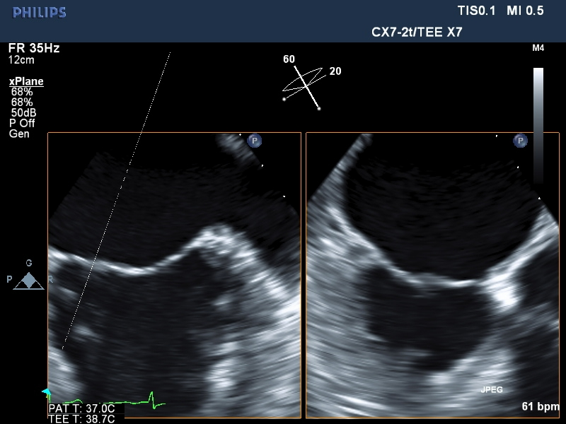
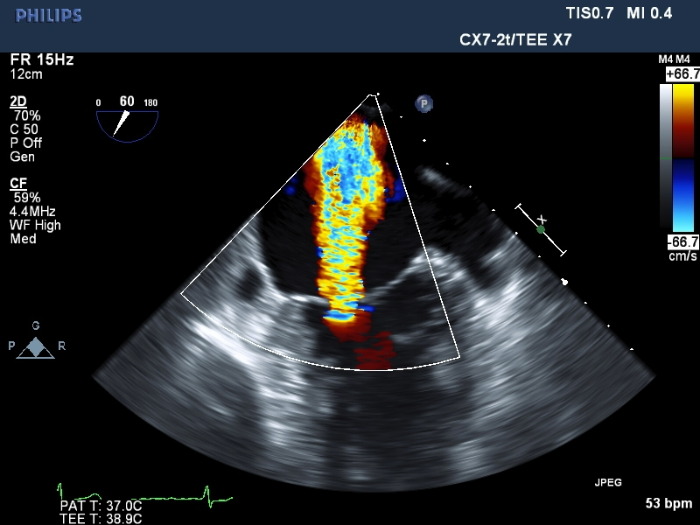
Case Presentation
Investigations
Transoesophageal echocardiography elucidated the low-echoic thickening of medial edge of A2/P2 and lateral edge of A3/P3 with poor coaptation. (a)
Local coaptation loss of mitral valve leaflets caused severe MR. (b)
a
b
5.04mm

Slide 6
Case Presentation
Management
Surgical treatment was indicated for severe symptomatic MR with preserved ejection fraction.
However, photosensitivity, livedo reticularis and pancytopenia developed and she was diagnosed with rapidly progressive SLE.
The changes of mitral valve were speculated to be caused by Libman-Sacks endocarditis.
After immunosuppressive therapy, the changes disappeared and MR decreased to mild.
The patient avoided open-heart surgery.

Slide 7
Discussion
Libman-Sacks endocarditis progresses from a variable extent of inflammation cell infiltration along with oedematous change to healed forms with a fibrous plaque. ⁴
There have been reports that immunosuppressive therapy for SLE could increase the extent of valvular fibrosis.^{3, 5}

Slide 8
Discussion
In our case, MR decreased from severe to mild after immunosuppressive therapy.
Low-echoic thickening of mitral valve leaflets suggested acute edematous changes without scarring and fibrosis.
Immunosuppressive therapy might be effective for early phase of Libman-Sacks endocarditis and should be considered before valve surgery.

Slide 9
Learning points
Libman-Sacks endocarditis may cause significant mitral regurgitation due to inflammatory changes in the mitral leaflets.
Immunosuppressive therapy improved severe mitral regurgitation with acute-phase degenerative changes in the mitral leaflets in a case of Libman-Sacks endocarditis.

Slide 10
References
Libman E, Sacks B. A hitherto undescribed form of valvular and mural endocarditis. Arch Intern Med 1924;33:701–737.
Hachiya K, Wakami K, Tani T, Yoshida A, Suzuki S, Suda H, Ohte N. Double-valve replacement for mitral and aortic regurgitation in a patient with Libman-Sacks endocarditis. Intern Med 2014;53:1769-1773.
Morin AM, Boyer AS, Nataf P, Gandjbakhch I. Mitral insufficiency caused by systemic lupus erythematosus requiring valve replacement: three case reports and a review of the literature. Thorac Cardiovasc Surg 1996;44:313-6.
Chartash EK, Lans DM, Paget SA, Qamar T, Lockshin MD. Aortic insufficiency and mitral regurgitation in patients with systemic lupus erythematosus and the antiphospholipid syndrome. Am J Med 1989;86:407–12.
Hojnik M, George J, Ziporen L, Shoenfeld Y. Heart involvement (Libman Sacks endocarditis) in the antiphospholipid syndrome. Circulation 1996;93:1579–87.

