Slide 1
Figure S1
LP
LP
EP
EP
DOX
-
+
-
+
COL3A1
SMAD2
SMAD3
GAPDH

Slide 2
Figure S2
A
B
C
Notes:
Fig.1 NANOG restores senescence phenotype in aged cells
BDF standard error

Slide 3
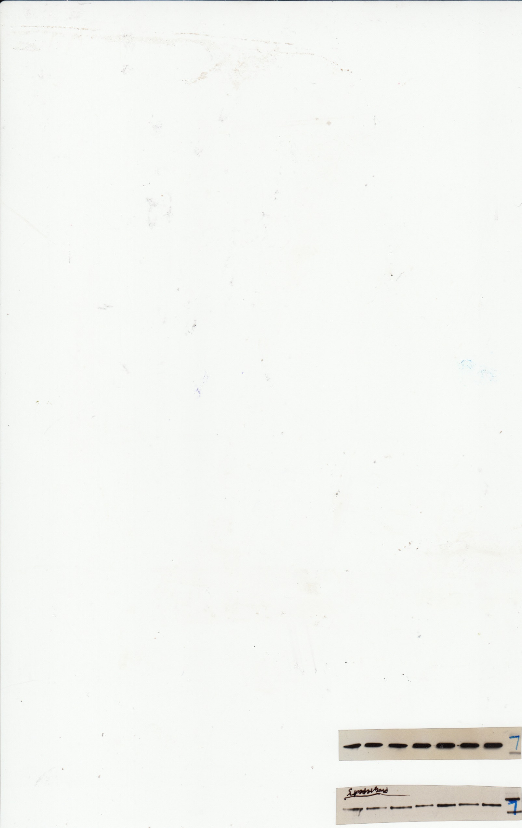
Figure S3
A
B
EP Z
LP Z
LP N
COL1A2
COL1A2
GAPDH
GAPDH
C
D
E
F
Notes:
COL3 qPCR

Slide 4
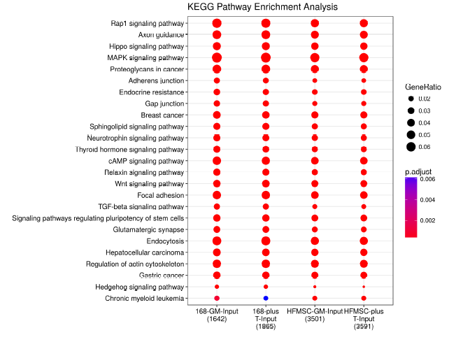
A
Figure S4
B
GNRH Signaling
TGF-β Signaling
Corticotropin Releasing hormone Signaling
Thrombin Signaling
STAT3 Pathway
CREB Signaling in Neurons
GPCR-Mediated Nutrient Sensing in Enteroendocrine Cells
Neurotrophin/TRK Signaling
P2Y Purigenic Receptor Signaling Pathway
CDK5 Signaling
B Cell Receptor Signaling
HMGB1 Signaling
PKCθ Signaling in T Lymphocytes
C
Gene

Slide 5
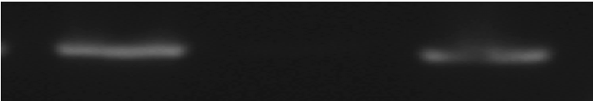
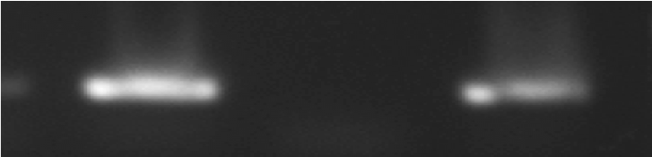
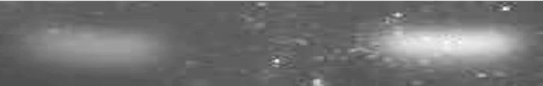
Figure S5
Anti-NANOG
IgG
Anti-RNA polymerase
SMAD3 promoter
-218 to -119 from TSS
SMAD3 promoter
-259 to -115 from TSS
SMAD2 promoter
-282 to -161 from TSS

Slide 6
Figure S6
LPZ | LPZ-shSMAD4
P-SMAD2/SMAD3
DAPI

