Slide 1
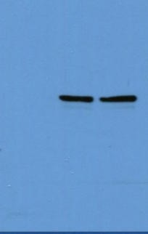

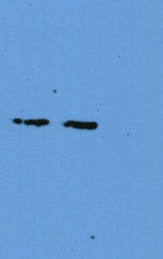
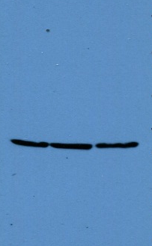
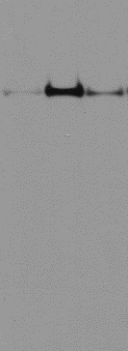
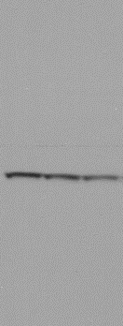
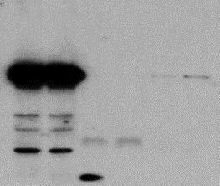
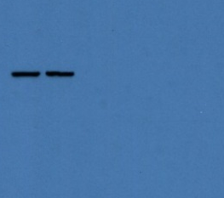
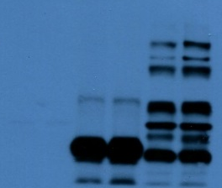
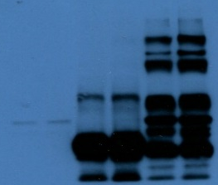
Supplemental Figure 5
Figure 1C
PKN1
PKN1
SRF
ß-Actin
(low exposure)
(high exposure)
Figure 2C
PKN1
β-Actin
Figure 3A
PKN1
ß-Actin
Figure 3B
PKN1
PKN1
SRF
SRF
(high exposure)
(low exposure)
(low exposure)
(high exposure)

Slide 2
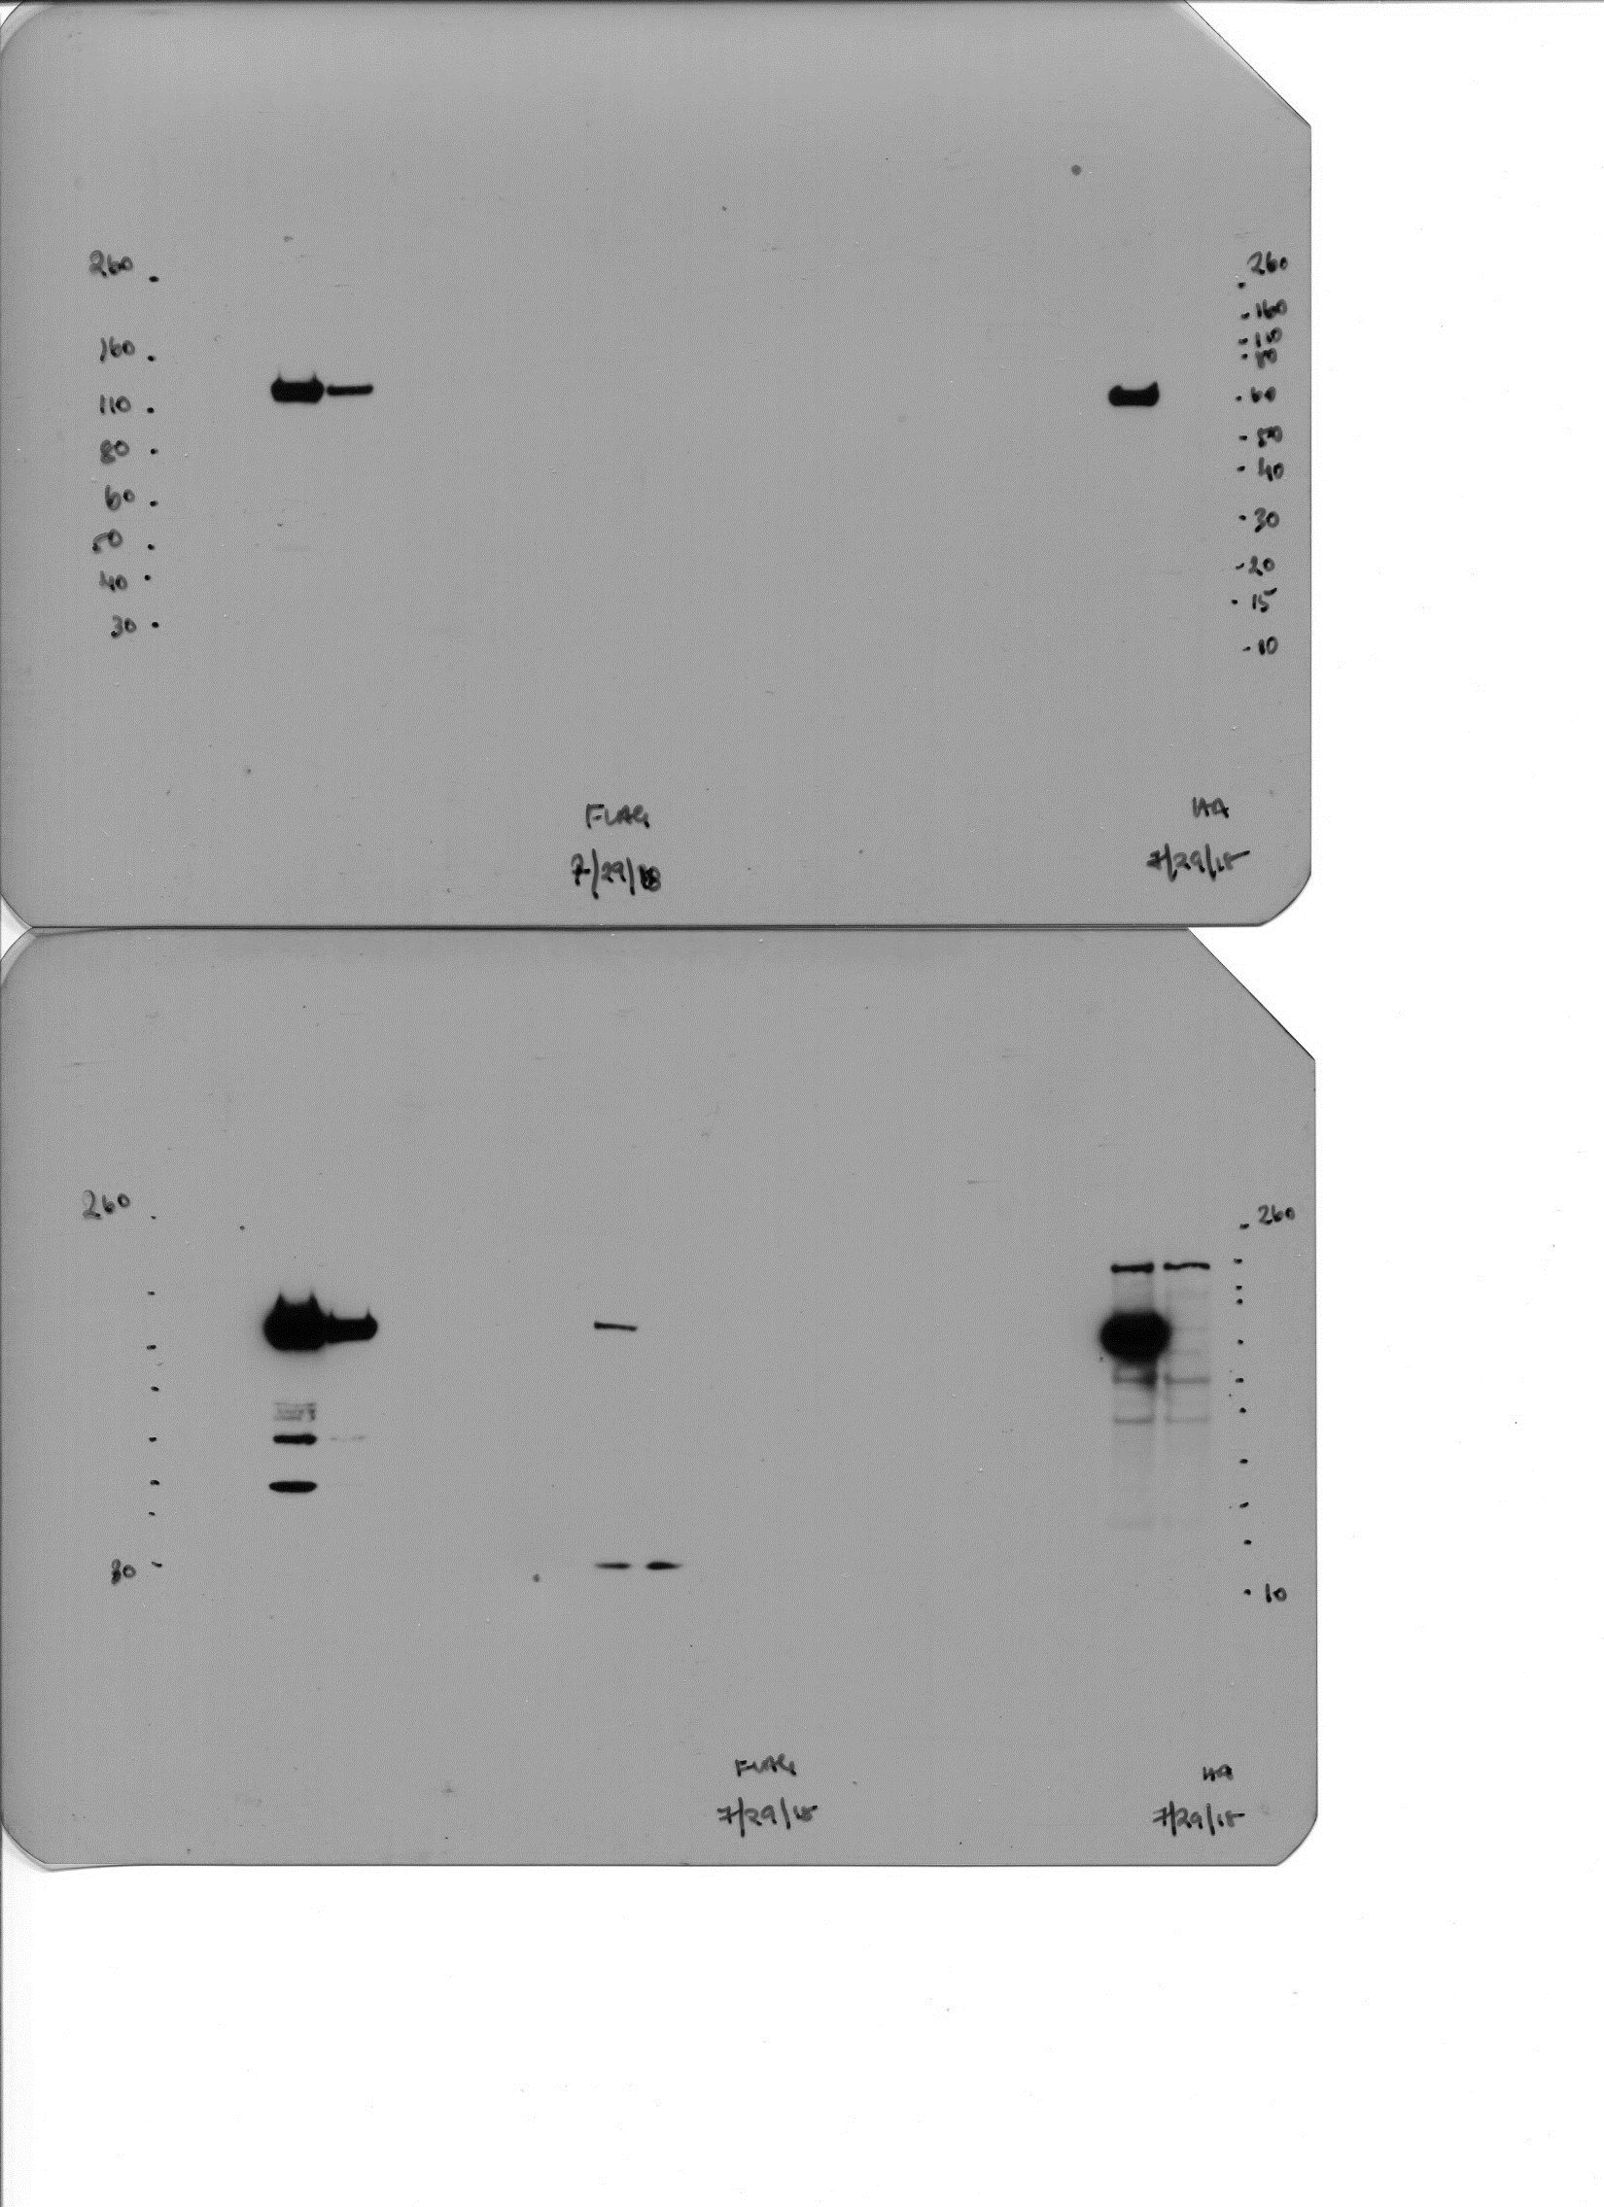
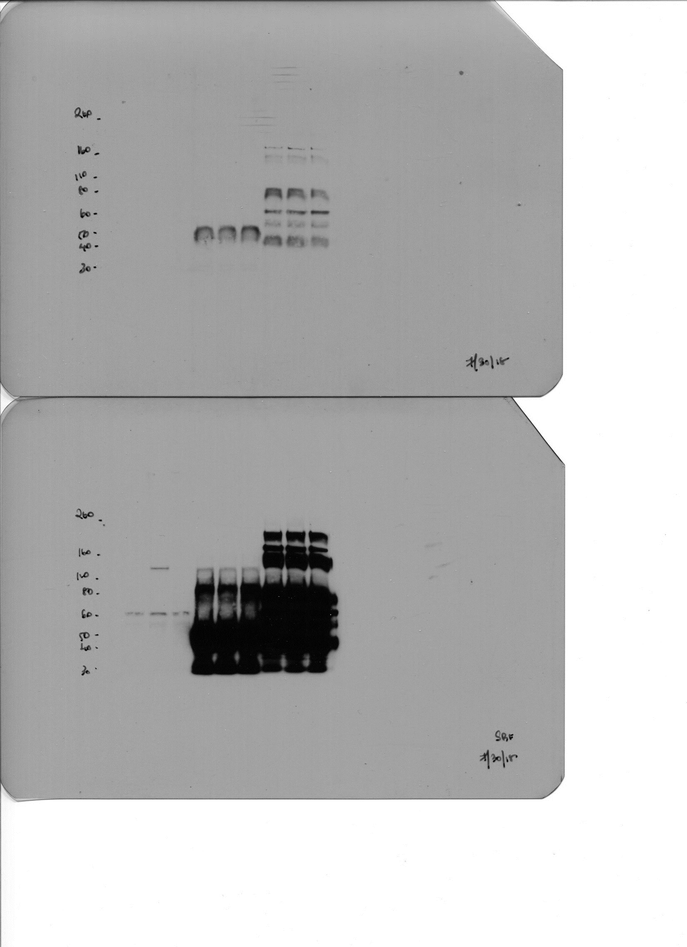
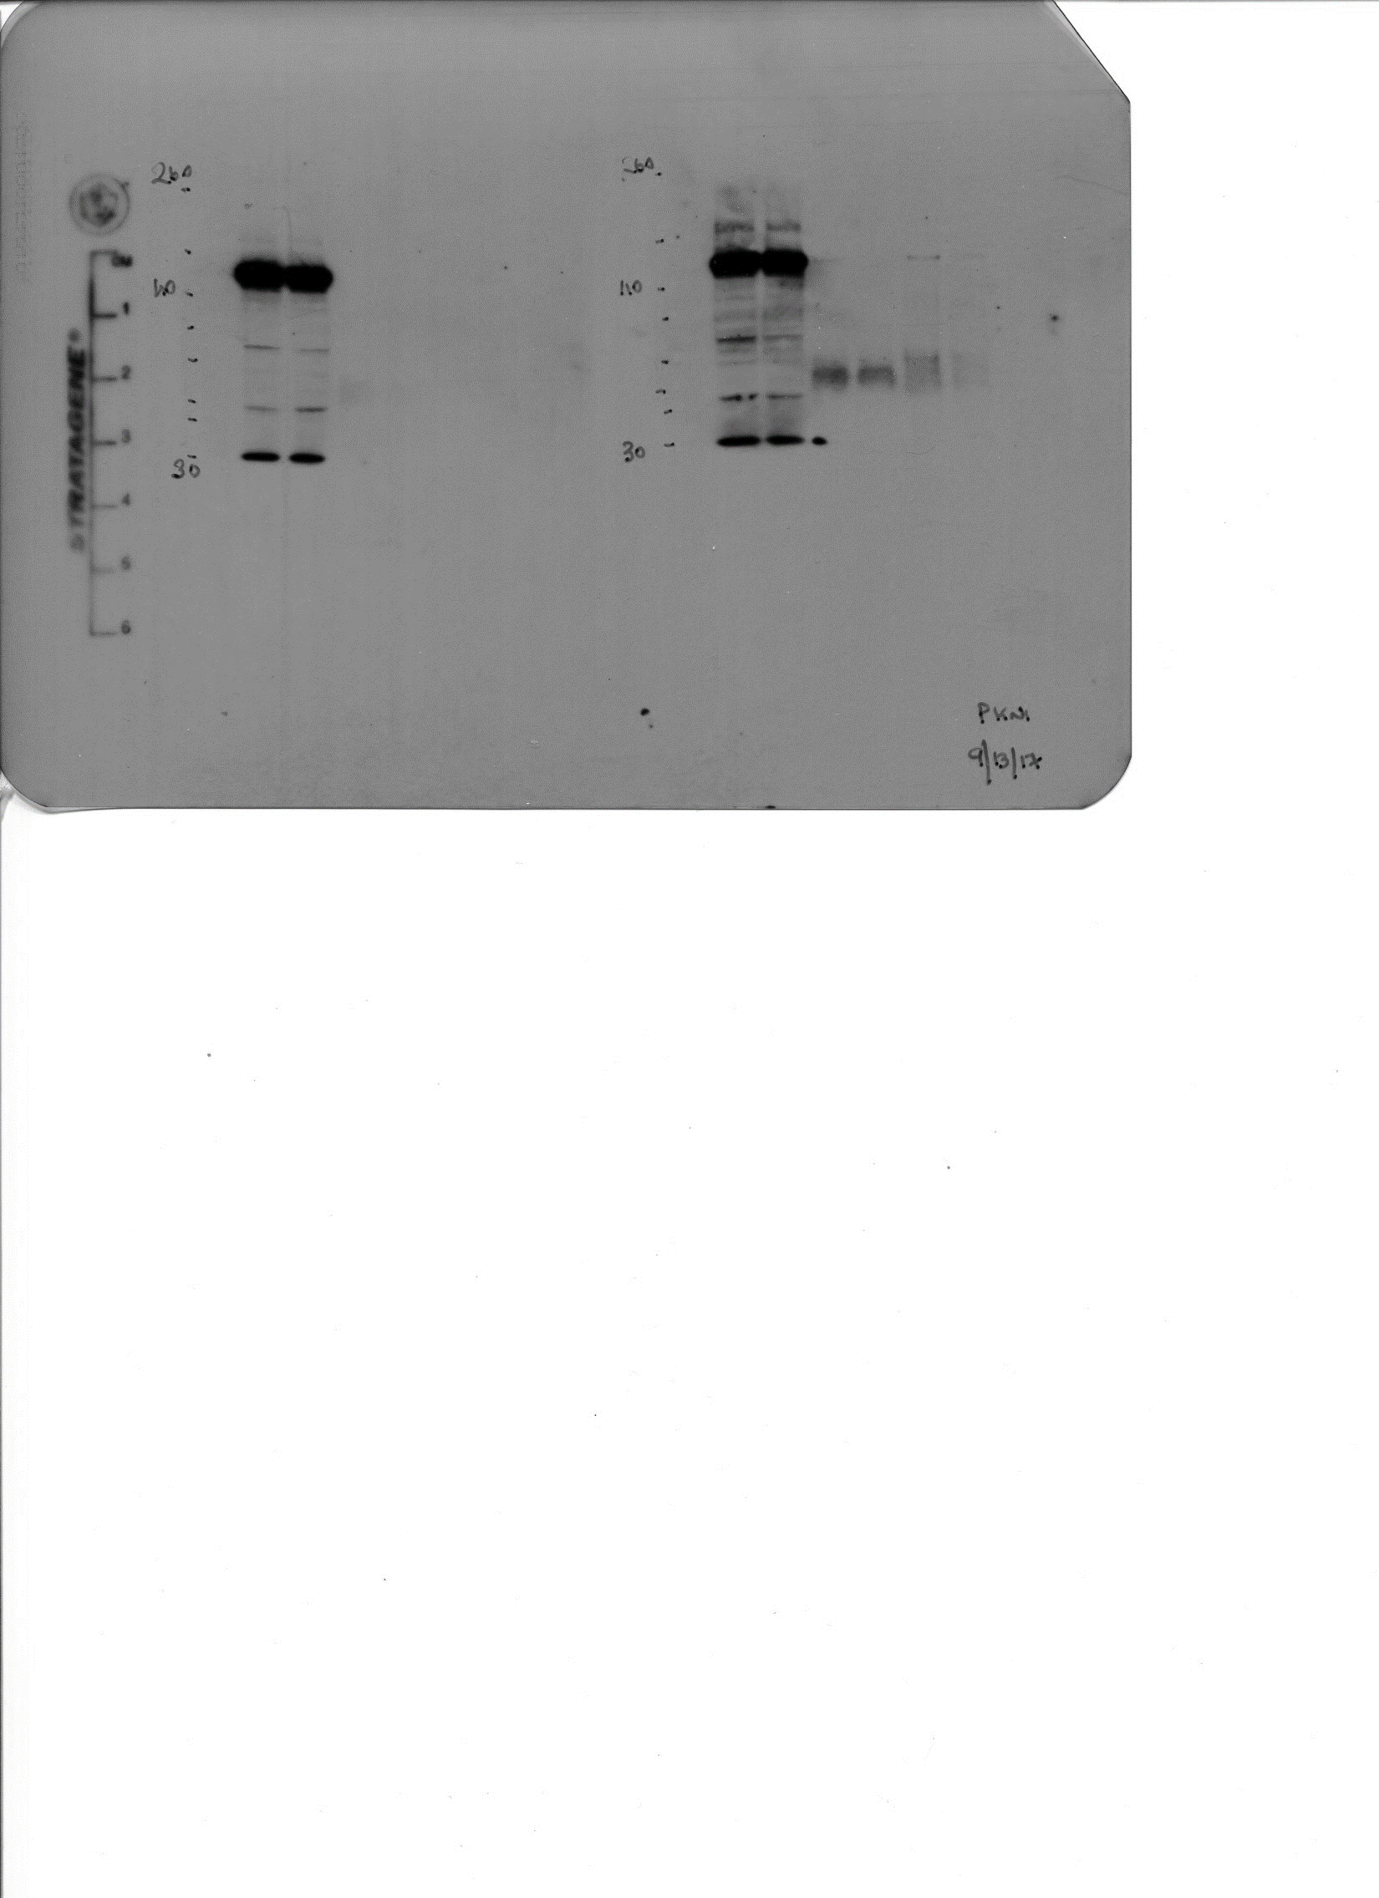
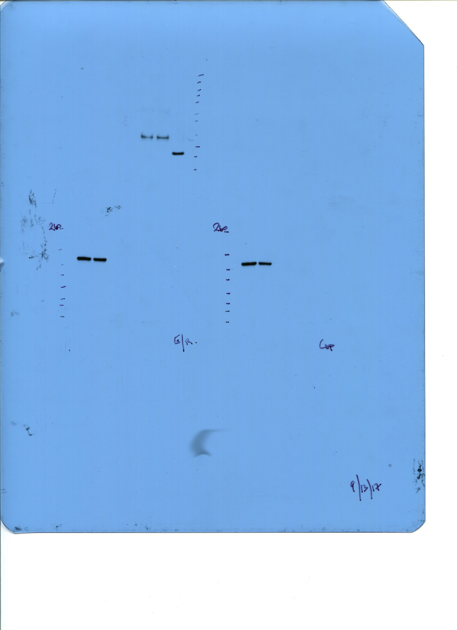
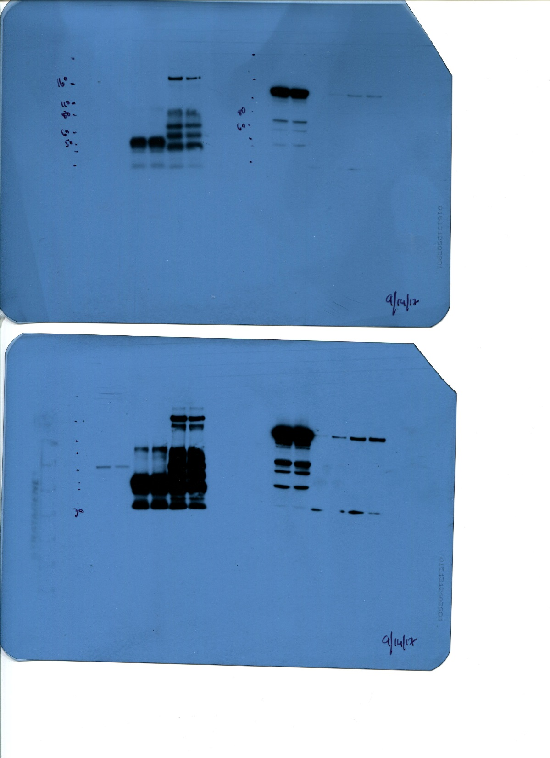
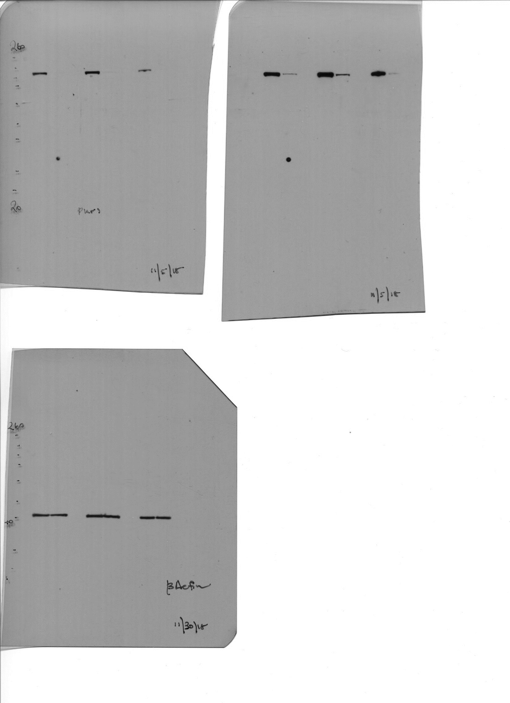
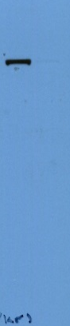
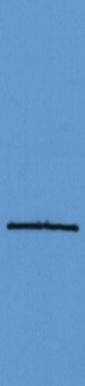
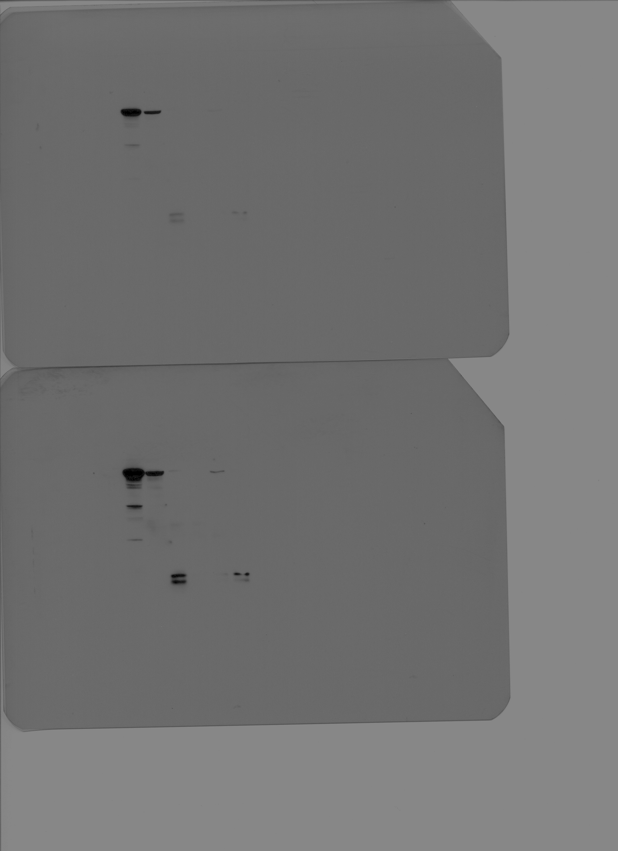
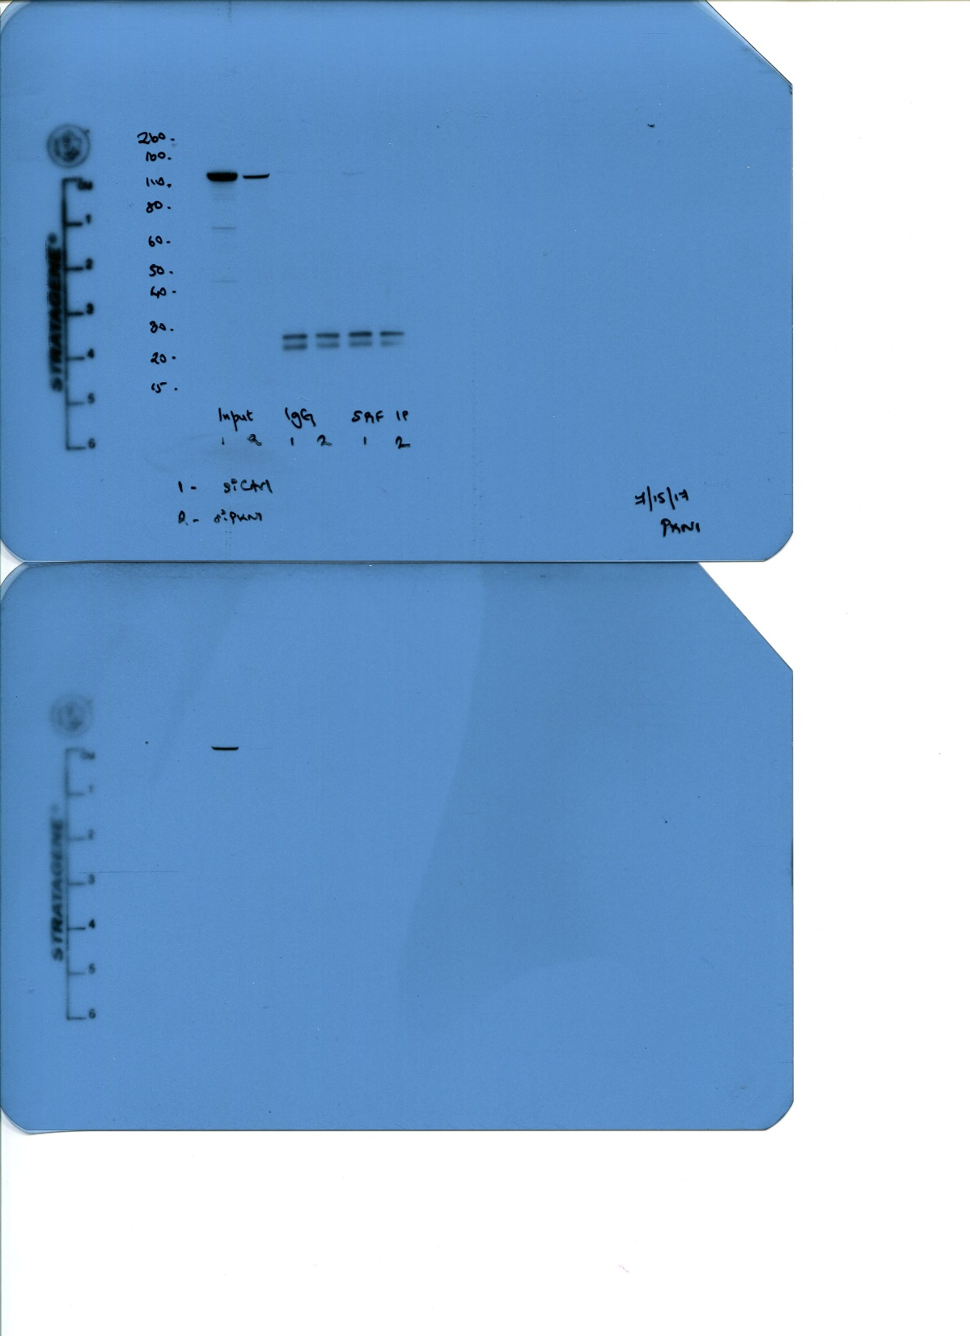
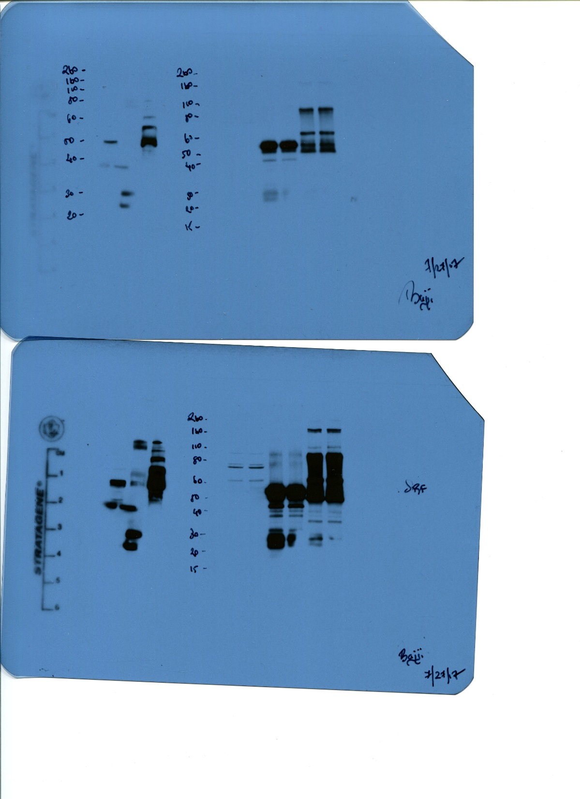
Figure 3C
PKN1
PKN1
(high exposure)
(low exposure)
SRF
SRF
Figure 4B
(low exposure)
(high exposure)
PKN1
PKN1
SRF
SRF
(high exposure)
(low exposure)
(low exposure)
(high exposure)
Supplemental Figure 2A
PKN1
ß-Actin
Day 3
Day 6
Day 9
Day 3
Day 6
Day 9
Supplemental Figure 2B
PKN1
PKN1
SRF
SRF
(high exposure)
(low exposure)
(low exposure)
(high exposure)

Slide 3
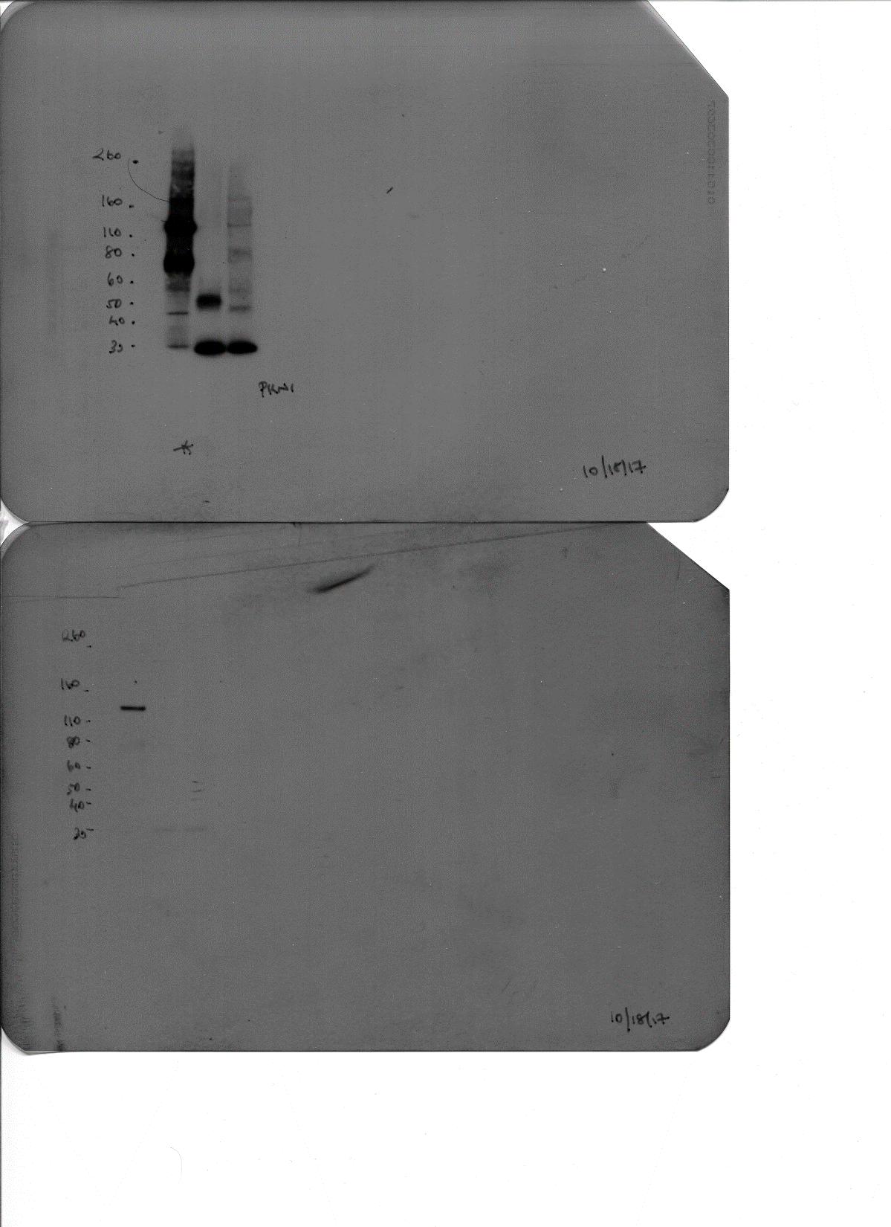
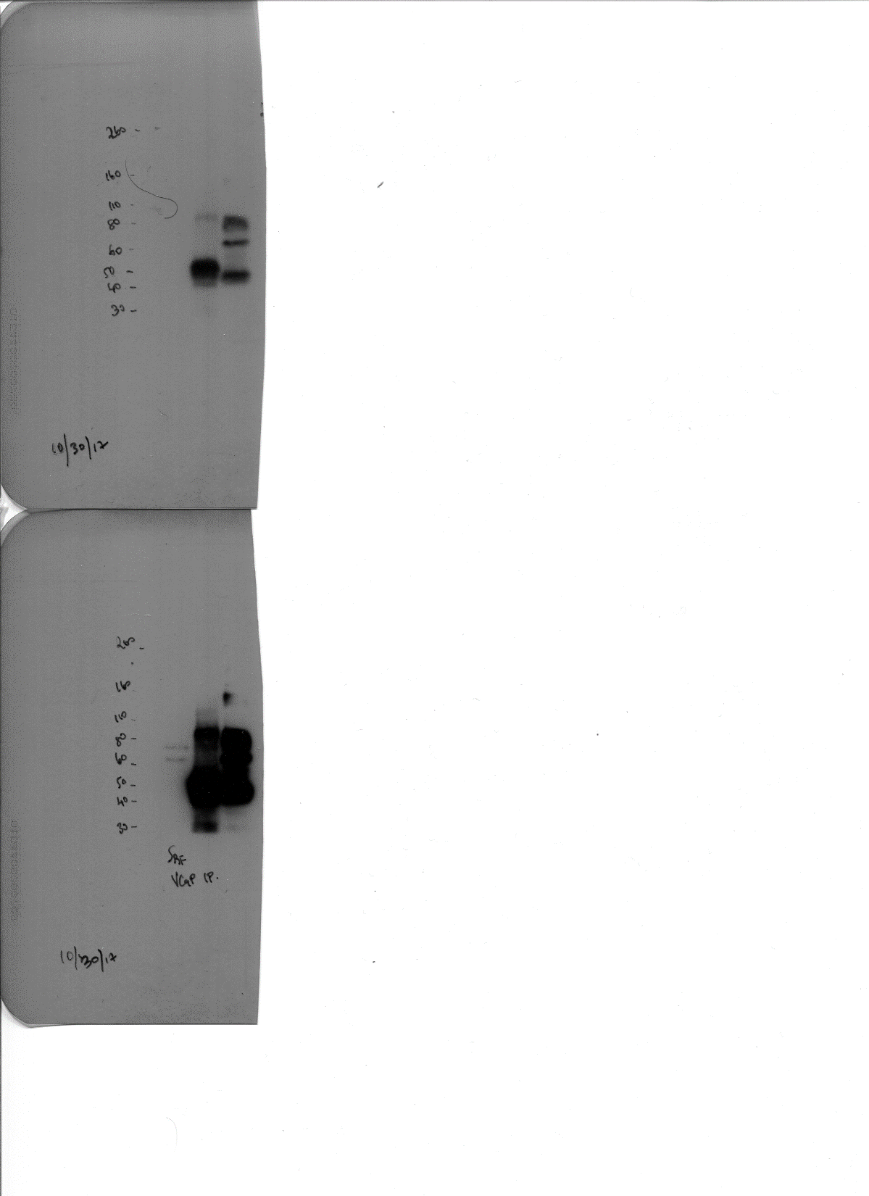
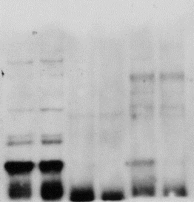
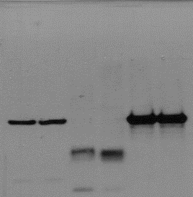
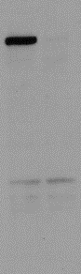

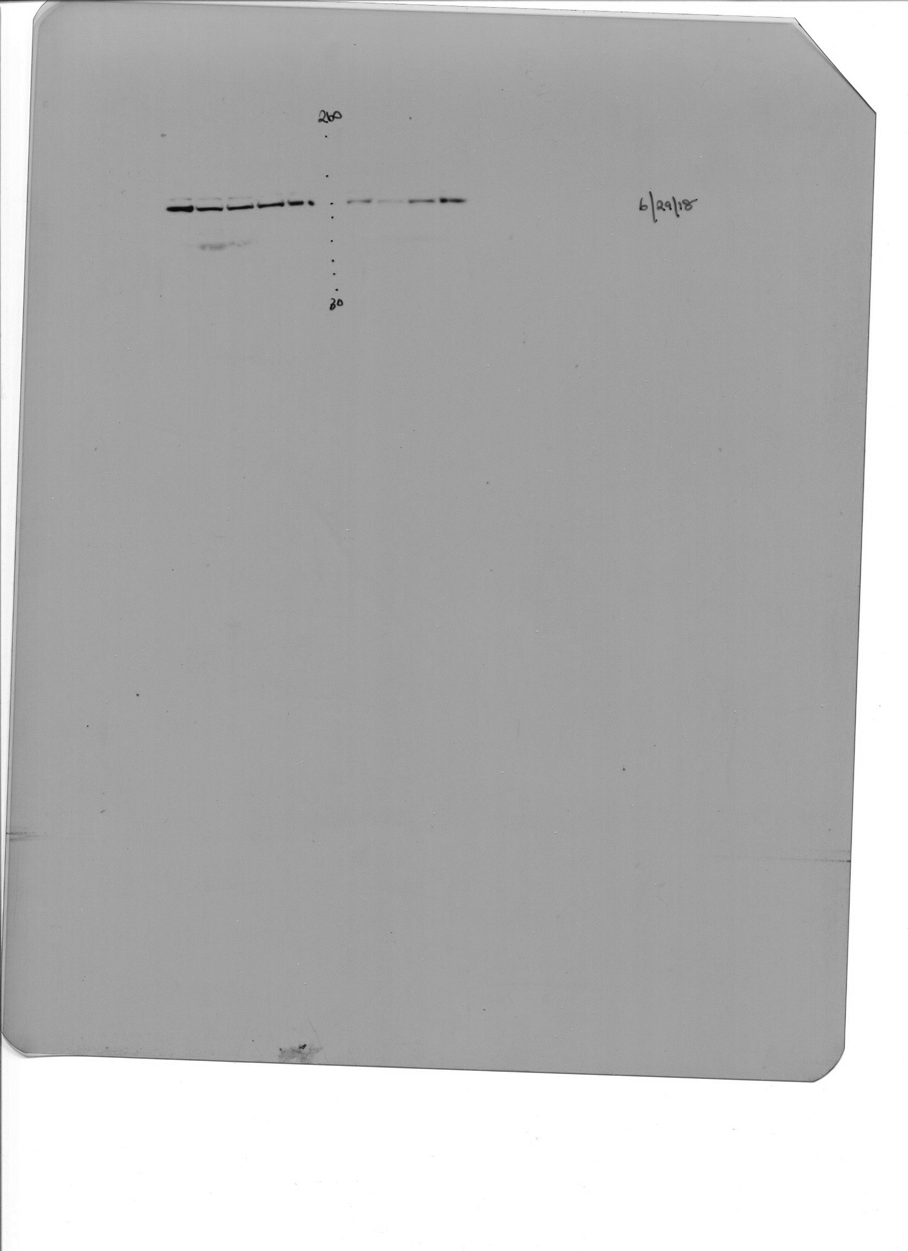
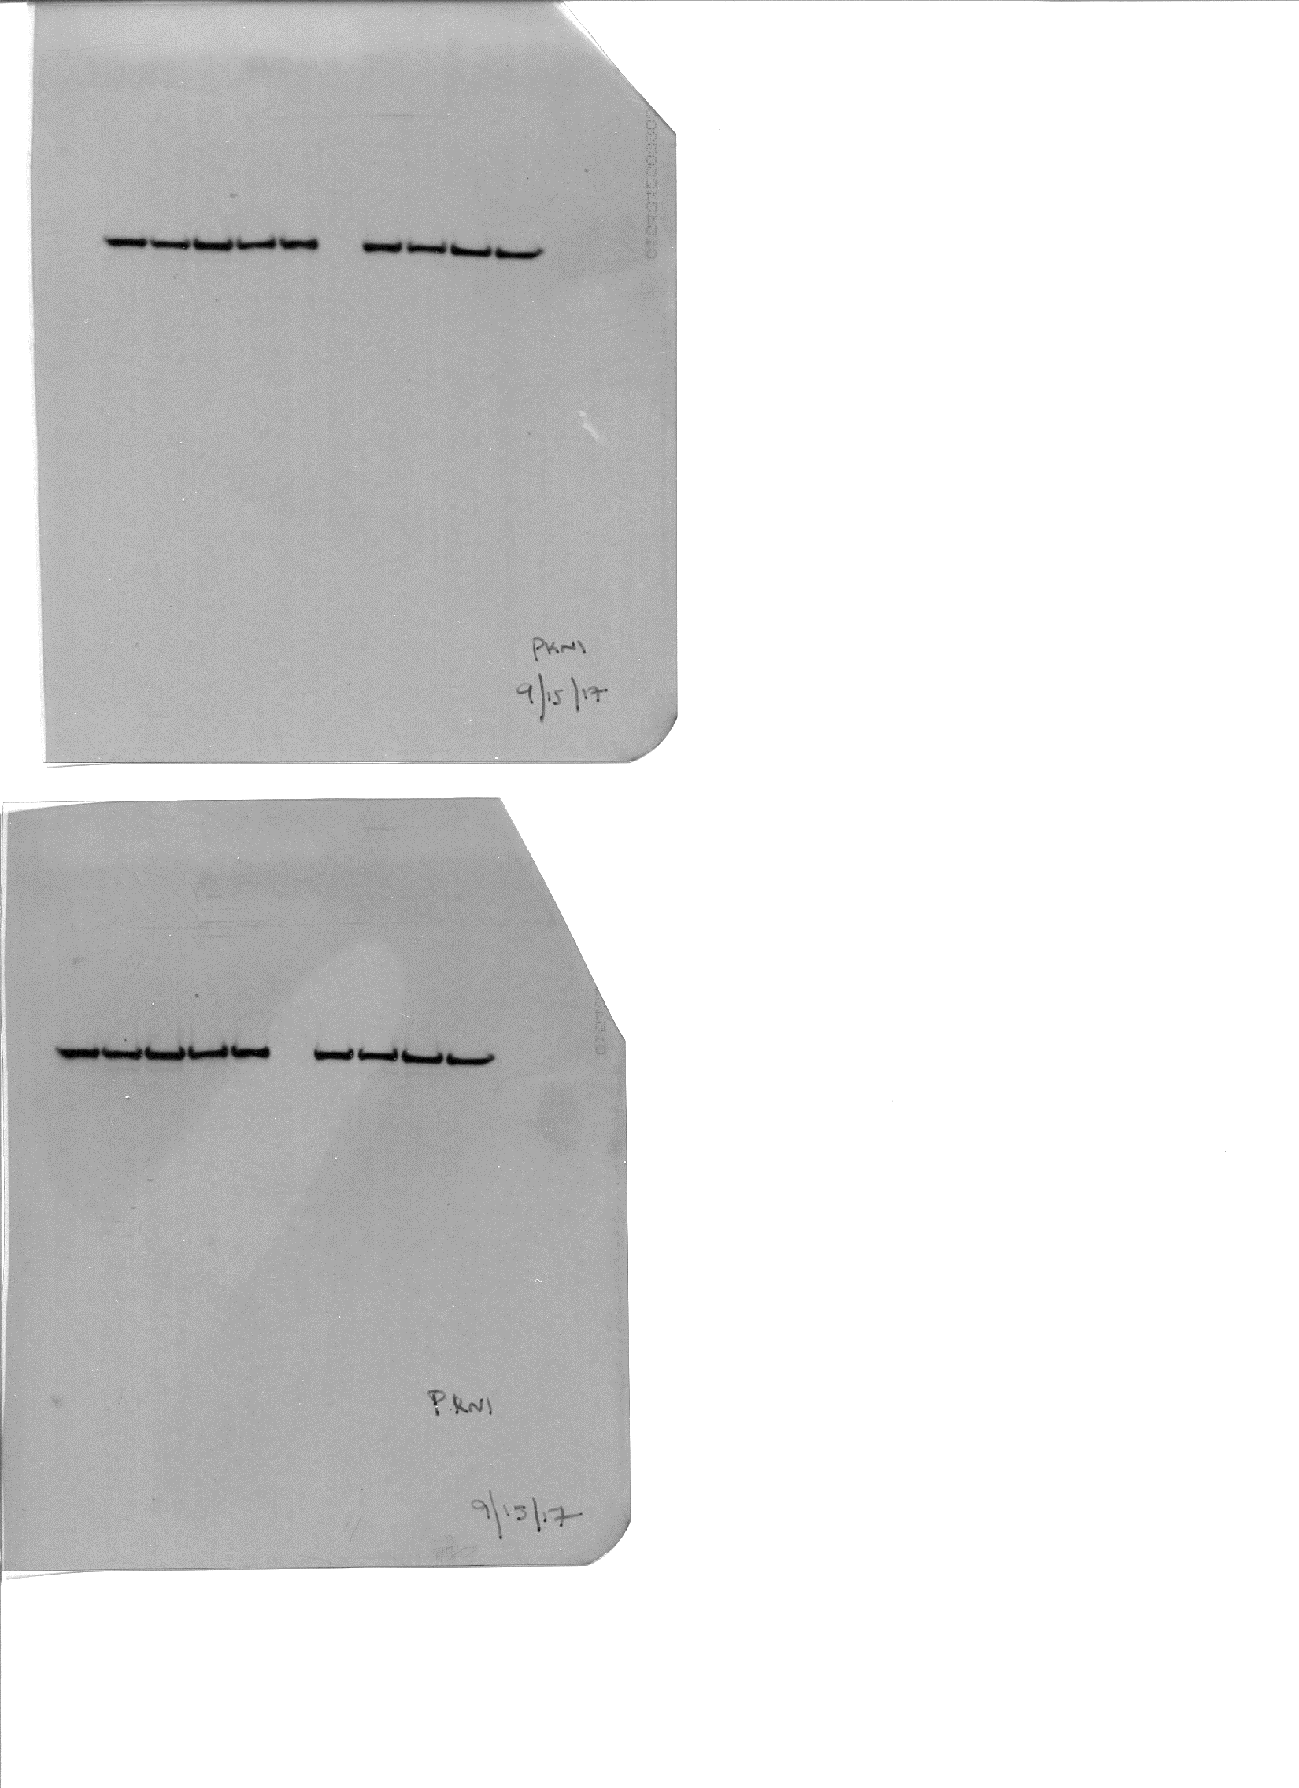
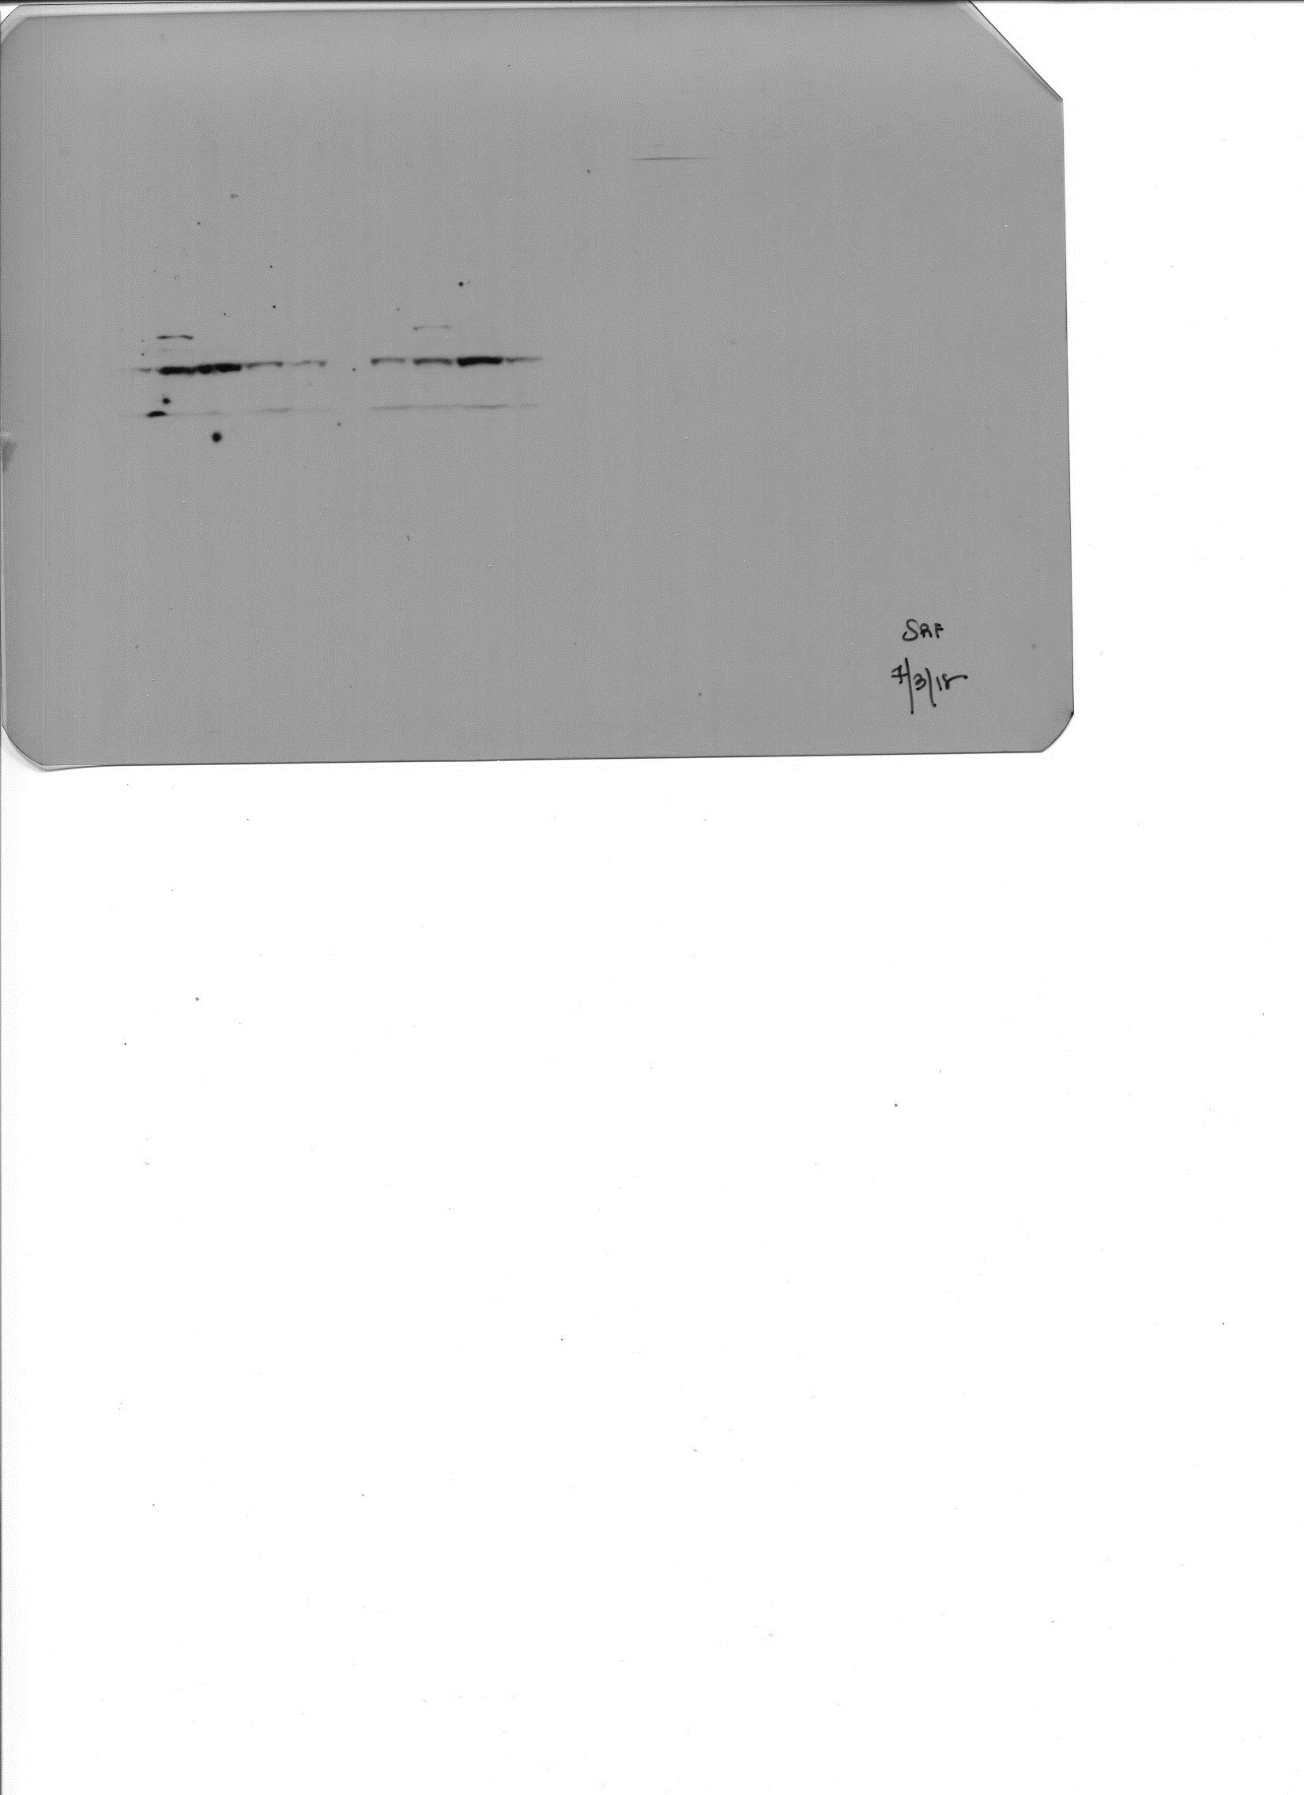
Supplemental Figure 2C
PKN1
PKN1
SRF
SRF
(high exposure)
(low exposure)
(low exposure)
(high exposure)
Supplemental Figure 2D
PKN1
PKN1
ß-Actin
SRF
Supplemental Figure 2F
Cleaved PARP
AR
PKN1
SRF
β-Actin

