Slide 1
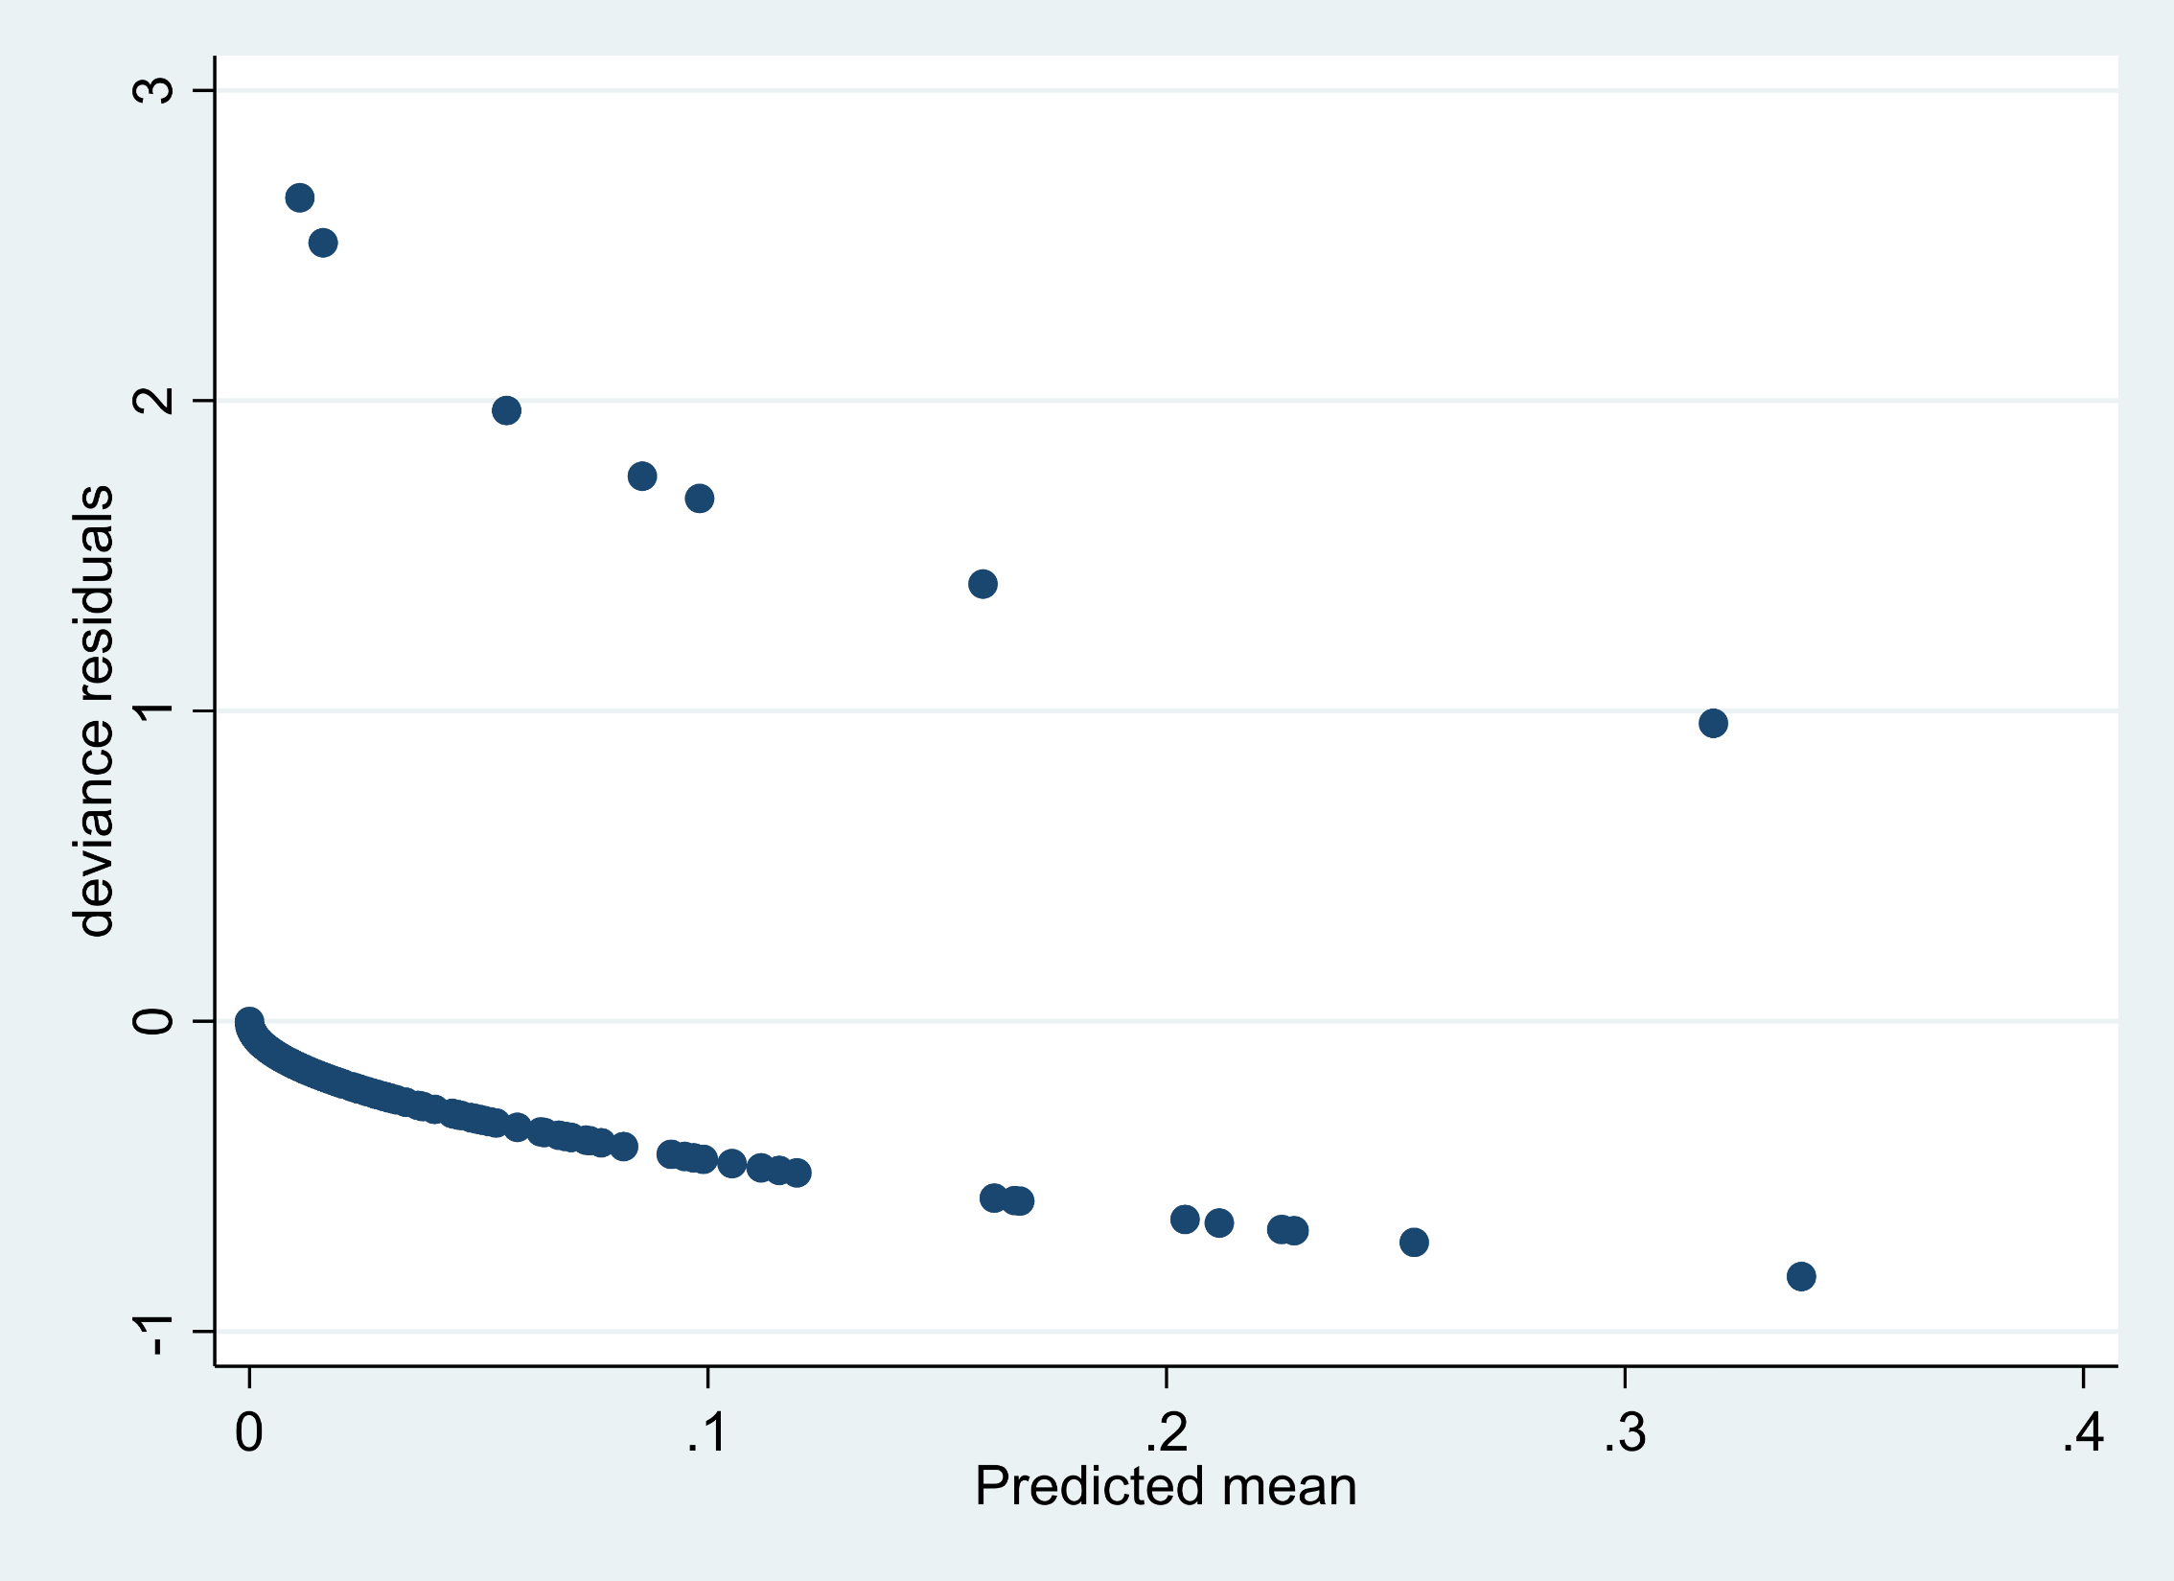
Notes:
Supplemental Figure 1. Deviance residuals versus predicted for outcome of death at 24 hours (n=408).

Slide 2
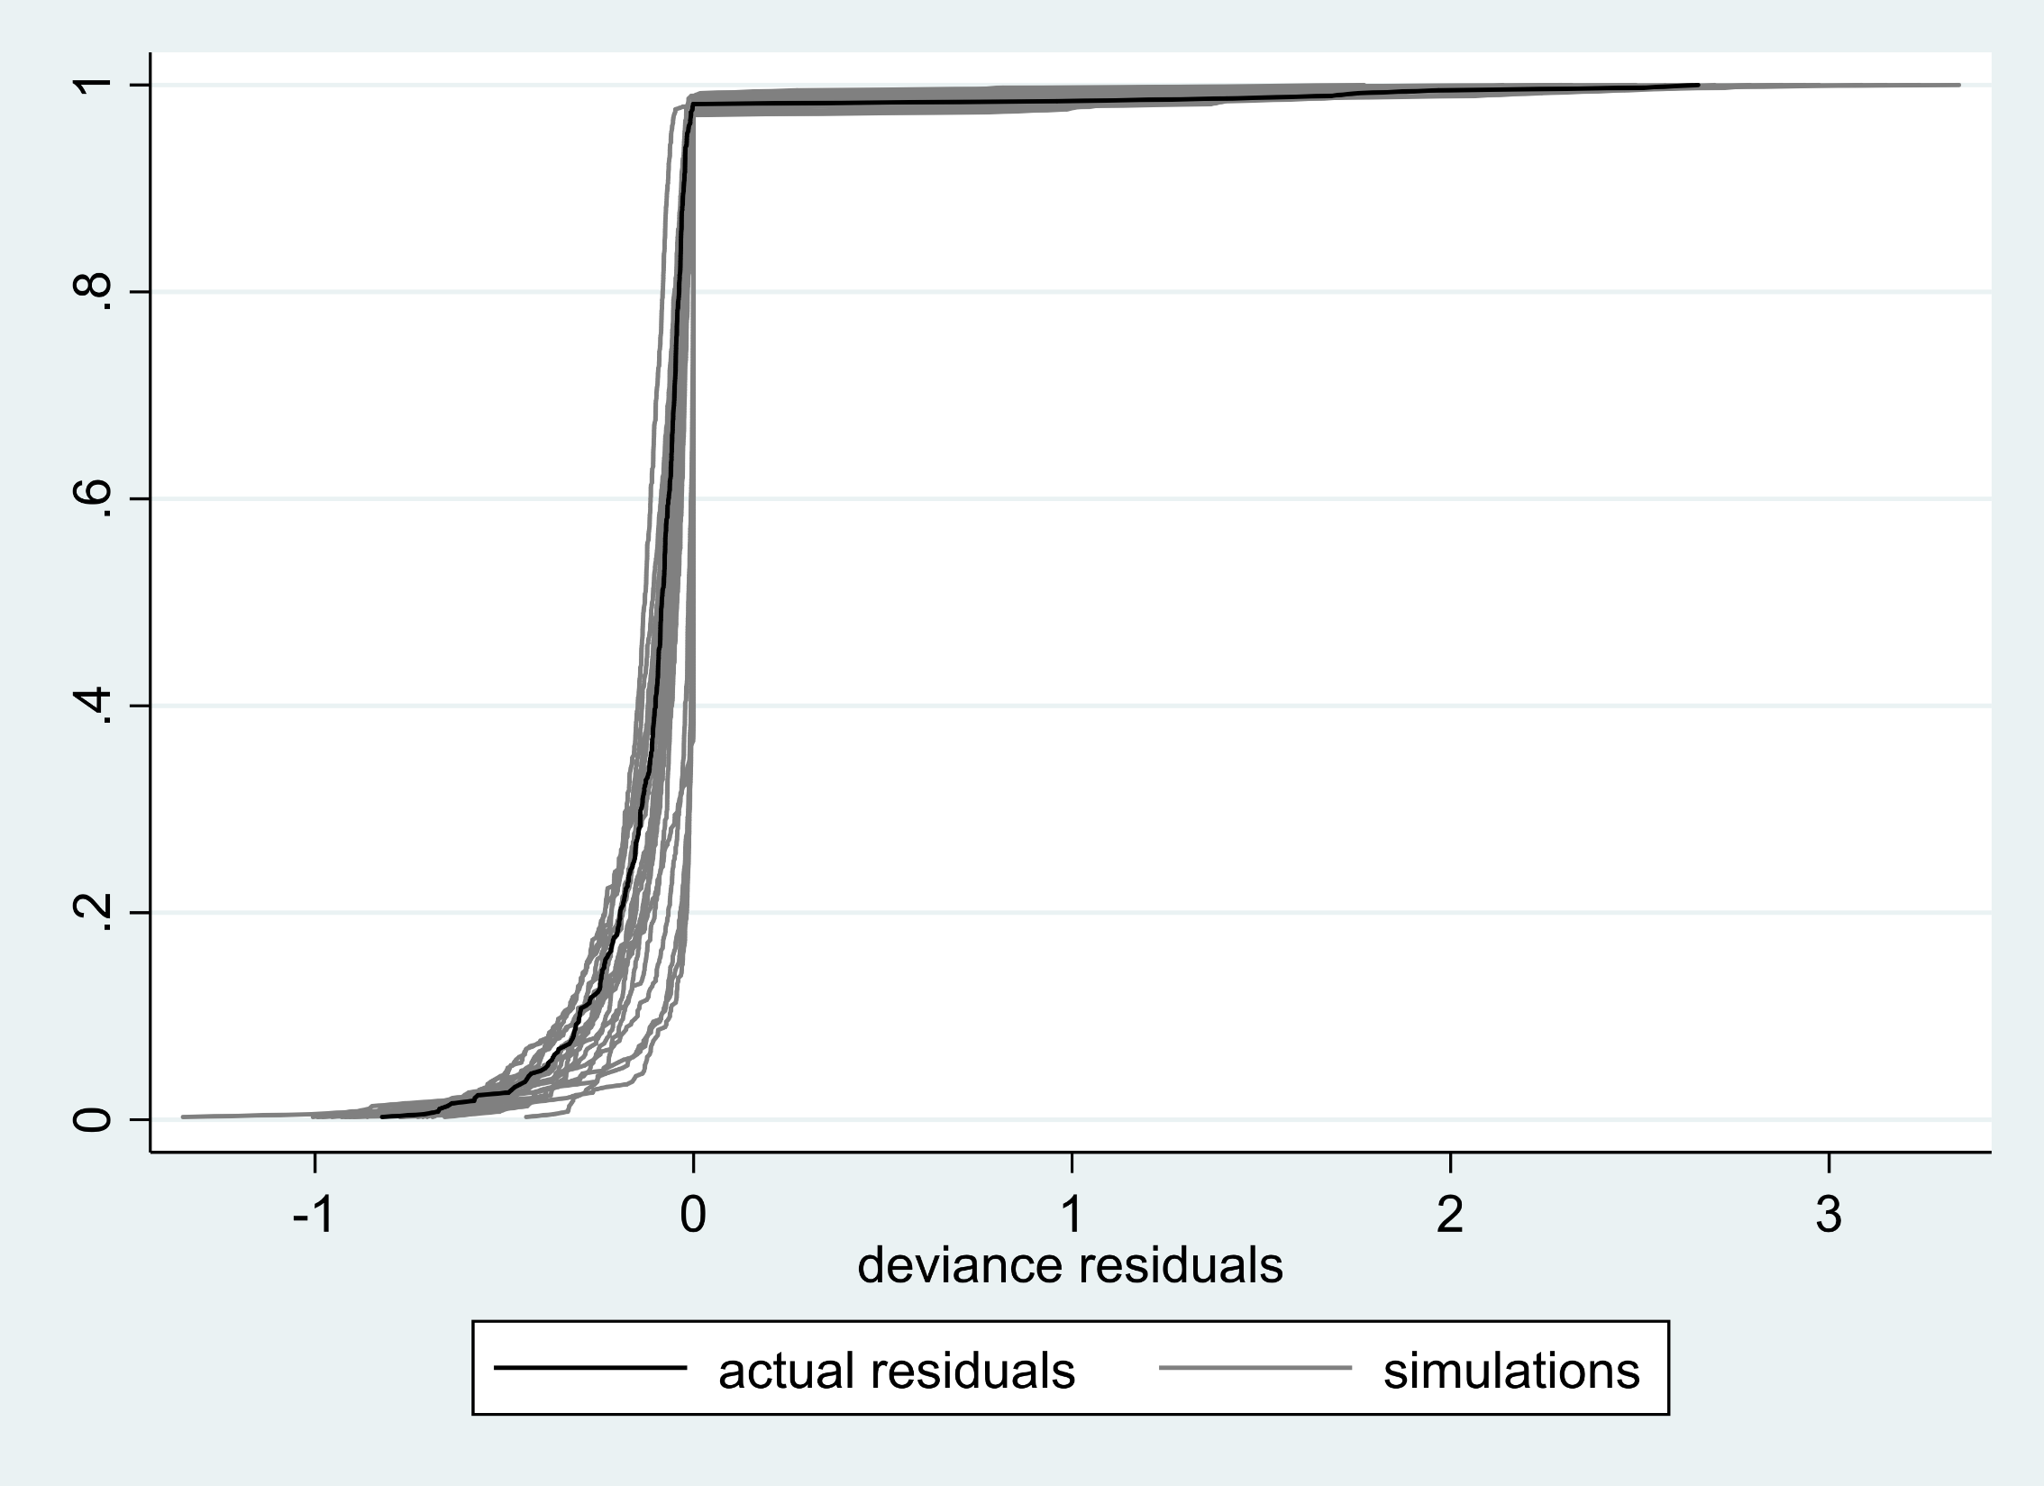
Notes:
Supplemental Figure 2. Actual (black) versus simulated deviance residuals (grey, n=20) using simulated data generated by the model in Figure 1.

Slide 3
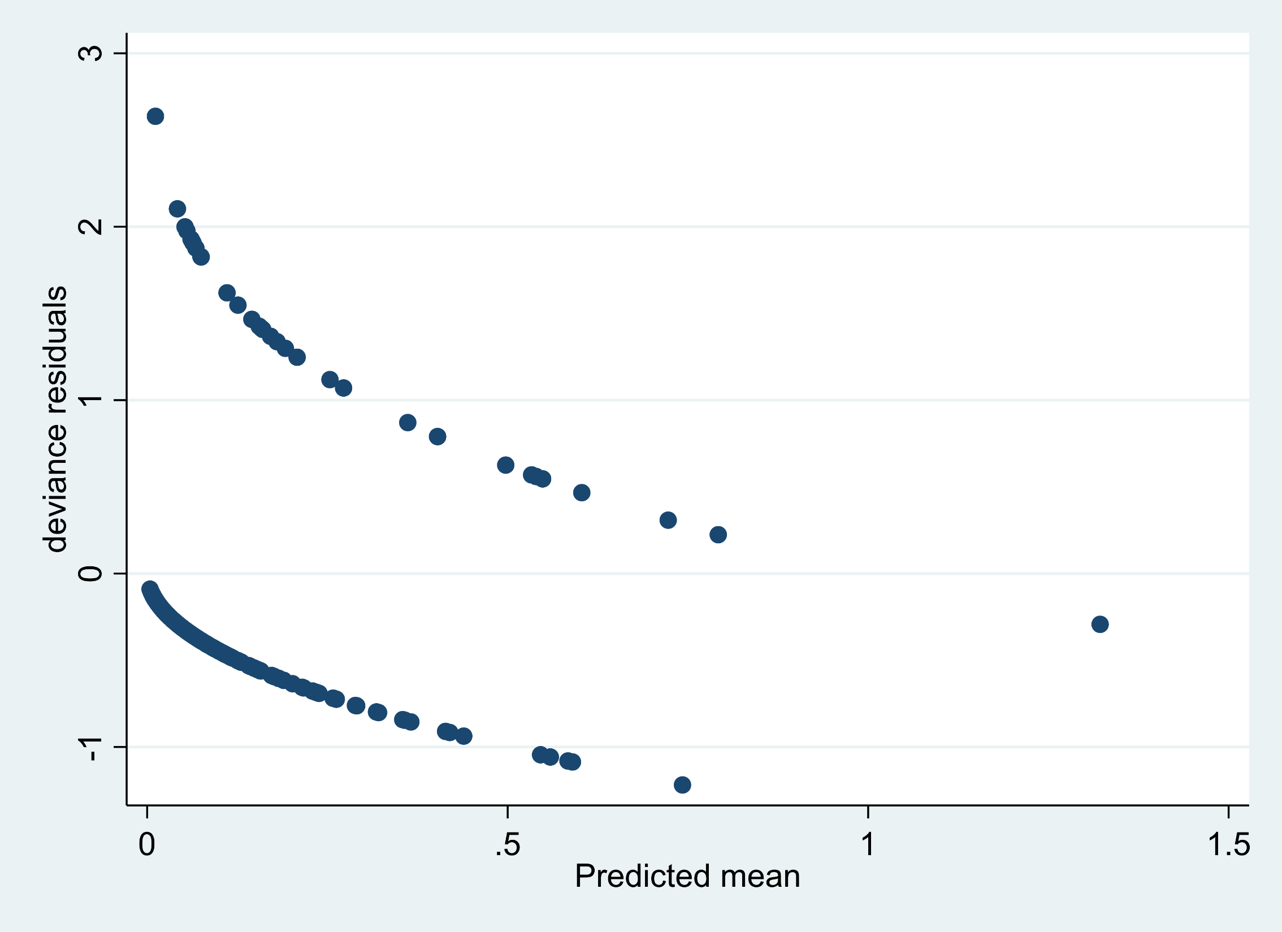
Notes:
Supplemental Figure 3. Deviance residuals versus predicted for outcome of death at 30 days (n=408).

Slide 4
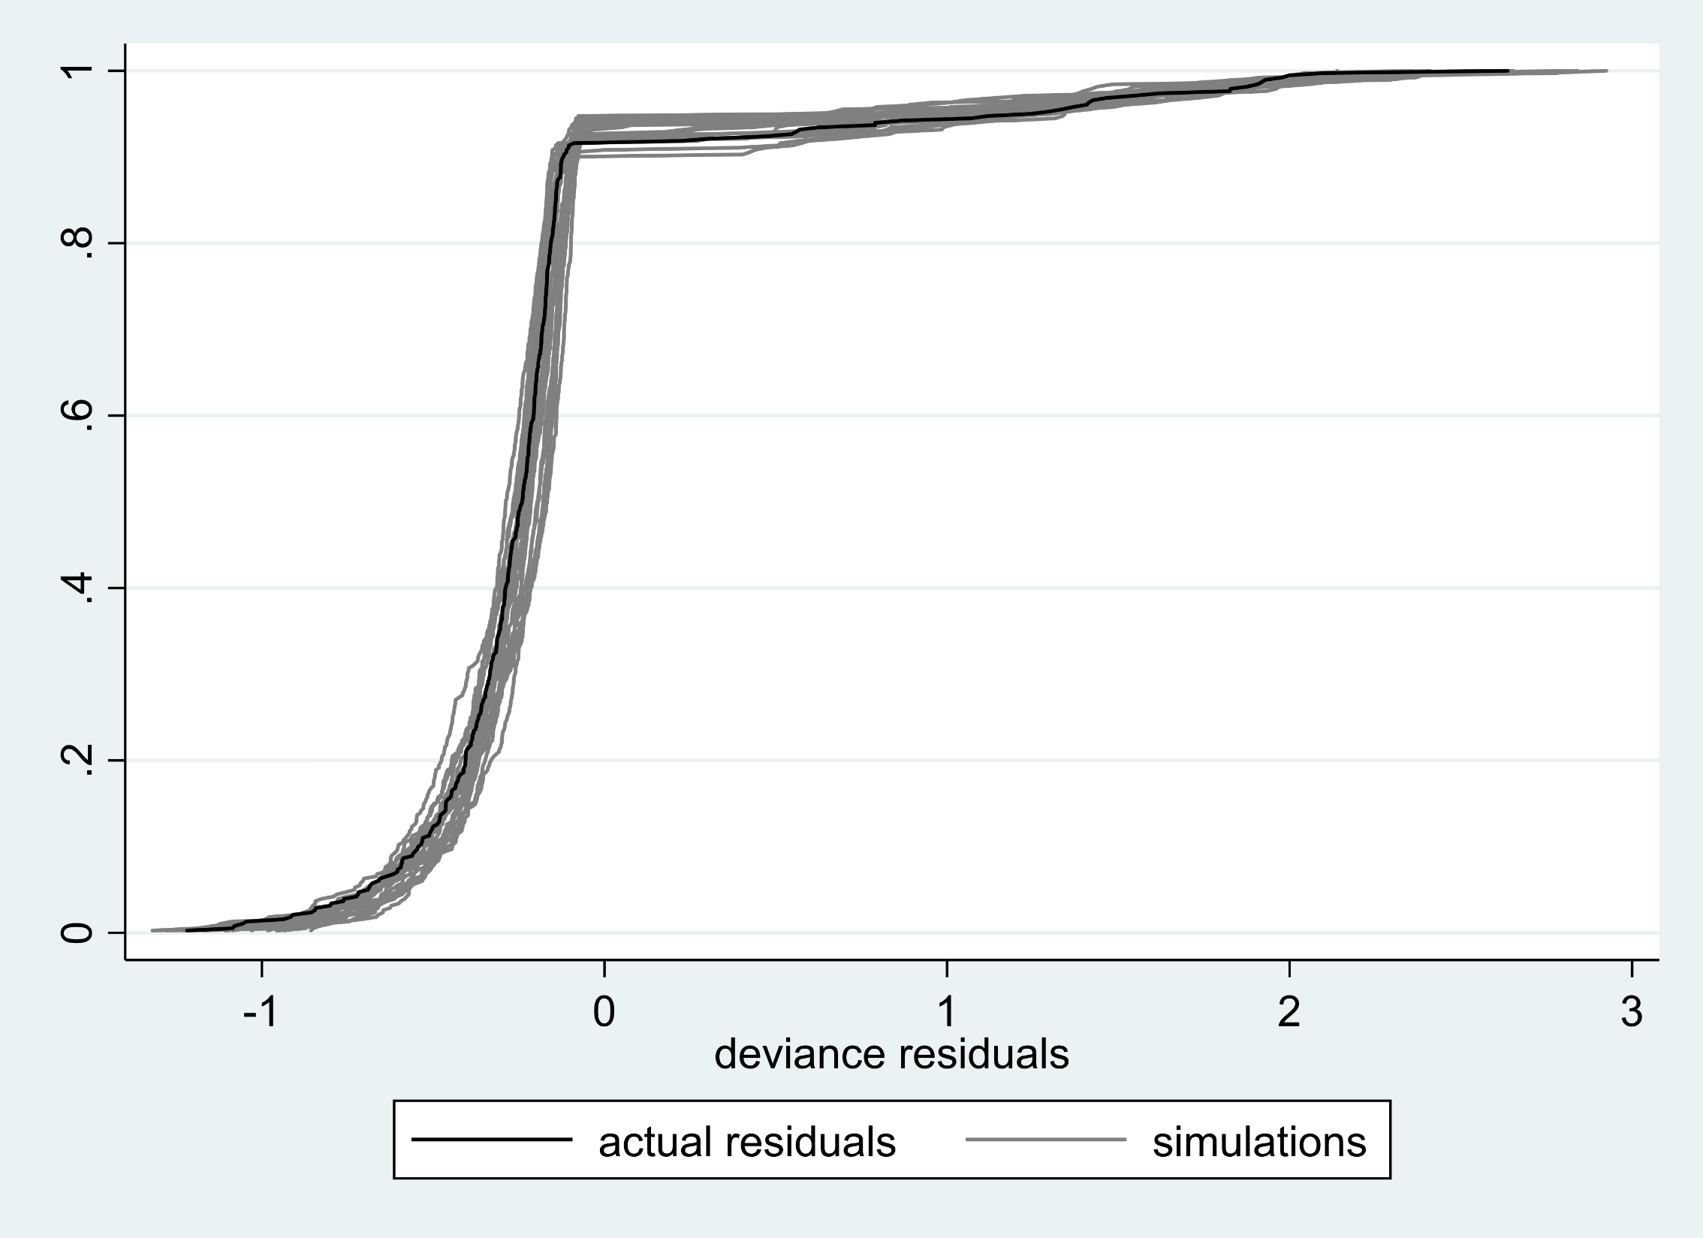
Notes:
Supplemental Figure 4. Actual (black) versus simulated deviance residuals (grey, n=20) using simulated data generated by the model in Figure 3.

Slide 5
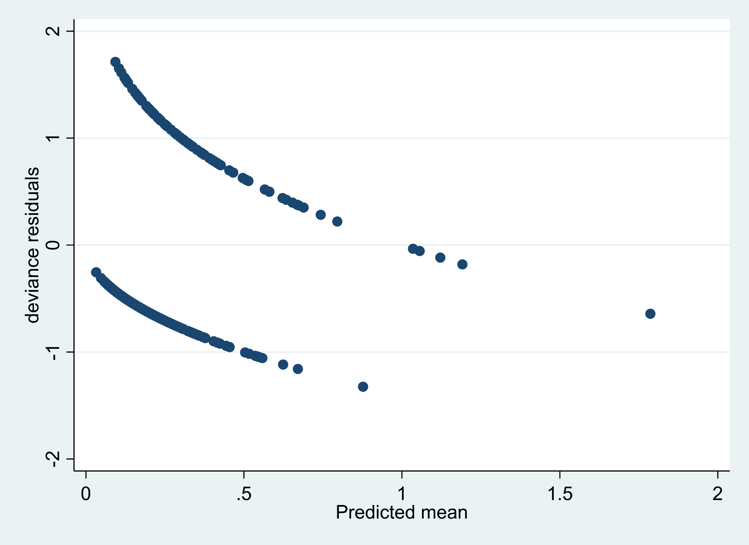
Notes:
Supplemental Figure 5. Deviance residuals versus predicted for outcome of AKI (n=408).

Slide 6
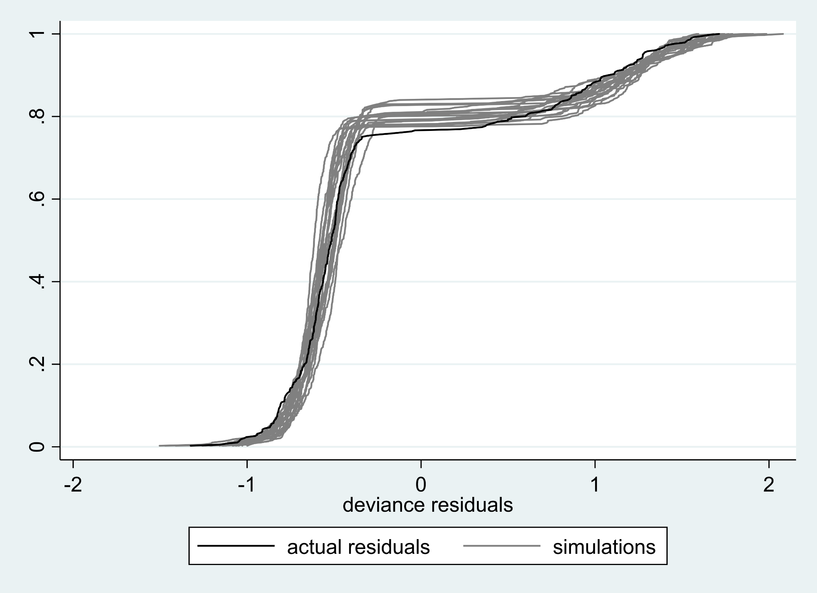
Notes:
Supplemental Figure 6. Actual (black) versus simulated deviance residuals (grey, n=20) using simulated data generated by the model in Figure 5.

Slide 7
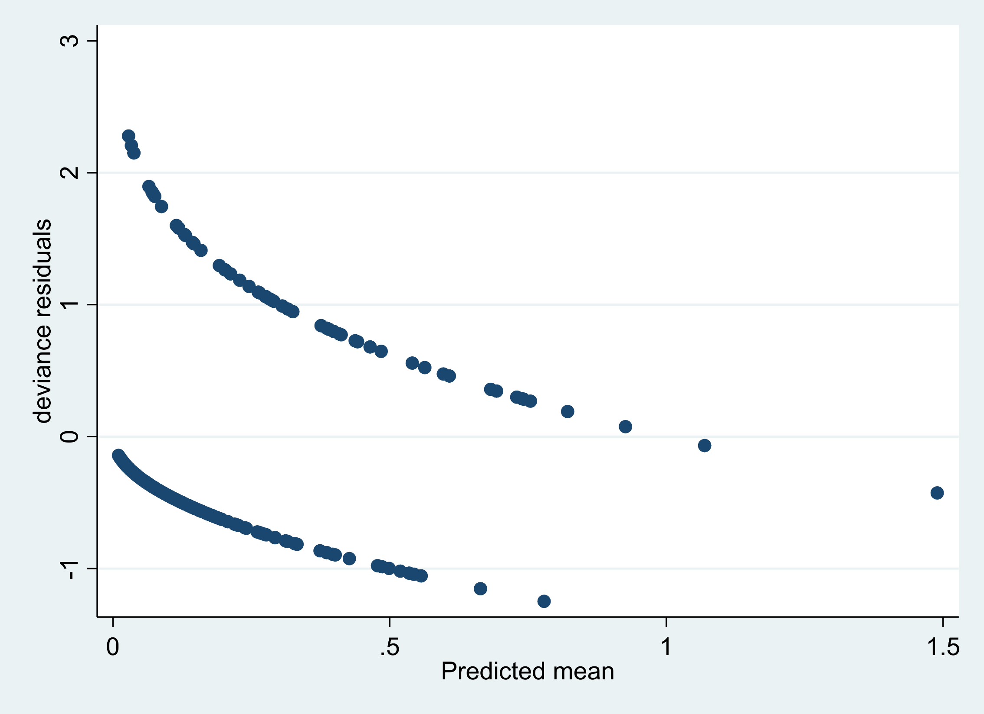
Notes:
Supplemental Figure 7. Deviance residuals versus predicted for outcome of ARDS (n=408).

Slide 8
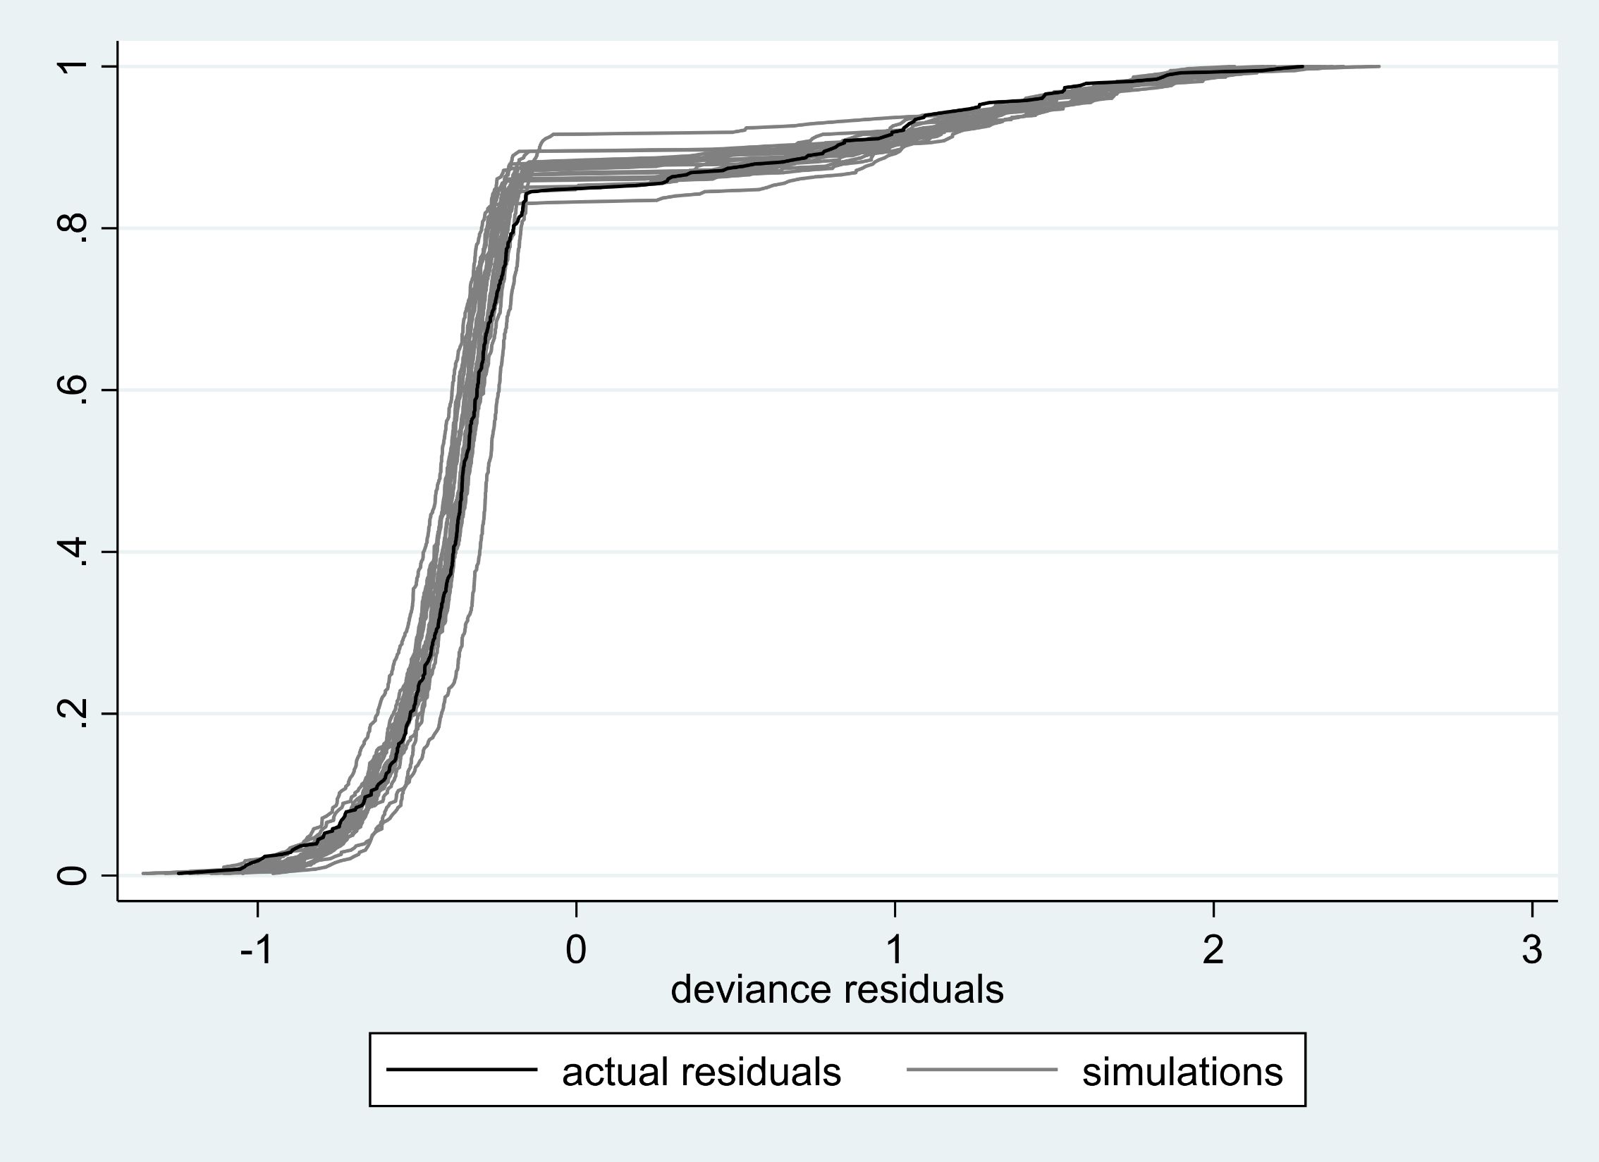
Notes:
Supplemental Figure 8. Actual (black) versus simulated deviance residuals (grey, n=20) using simulated data generated by the model in Figure 7.

Slide 9
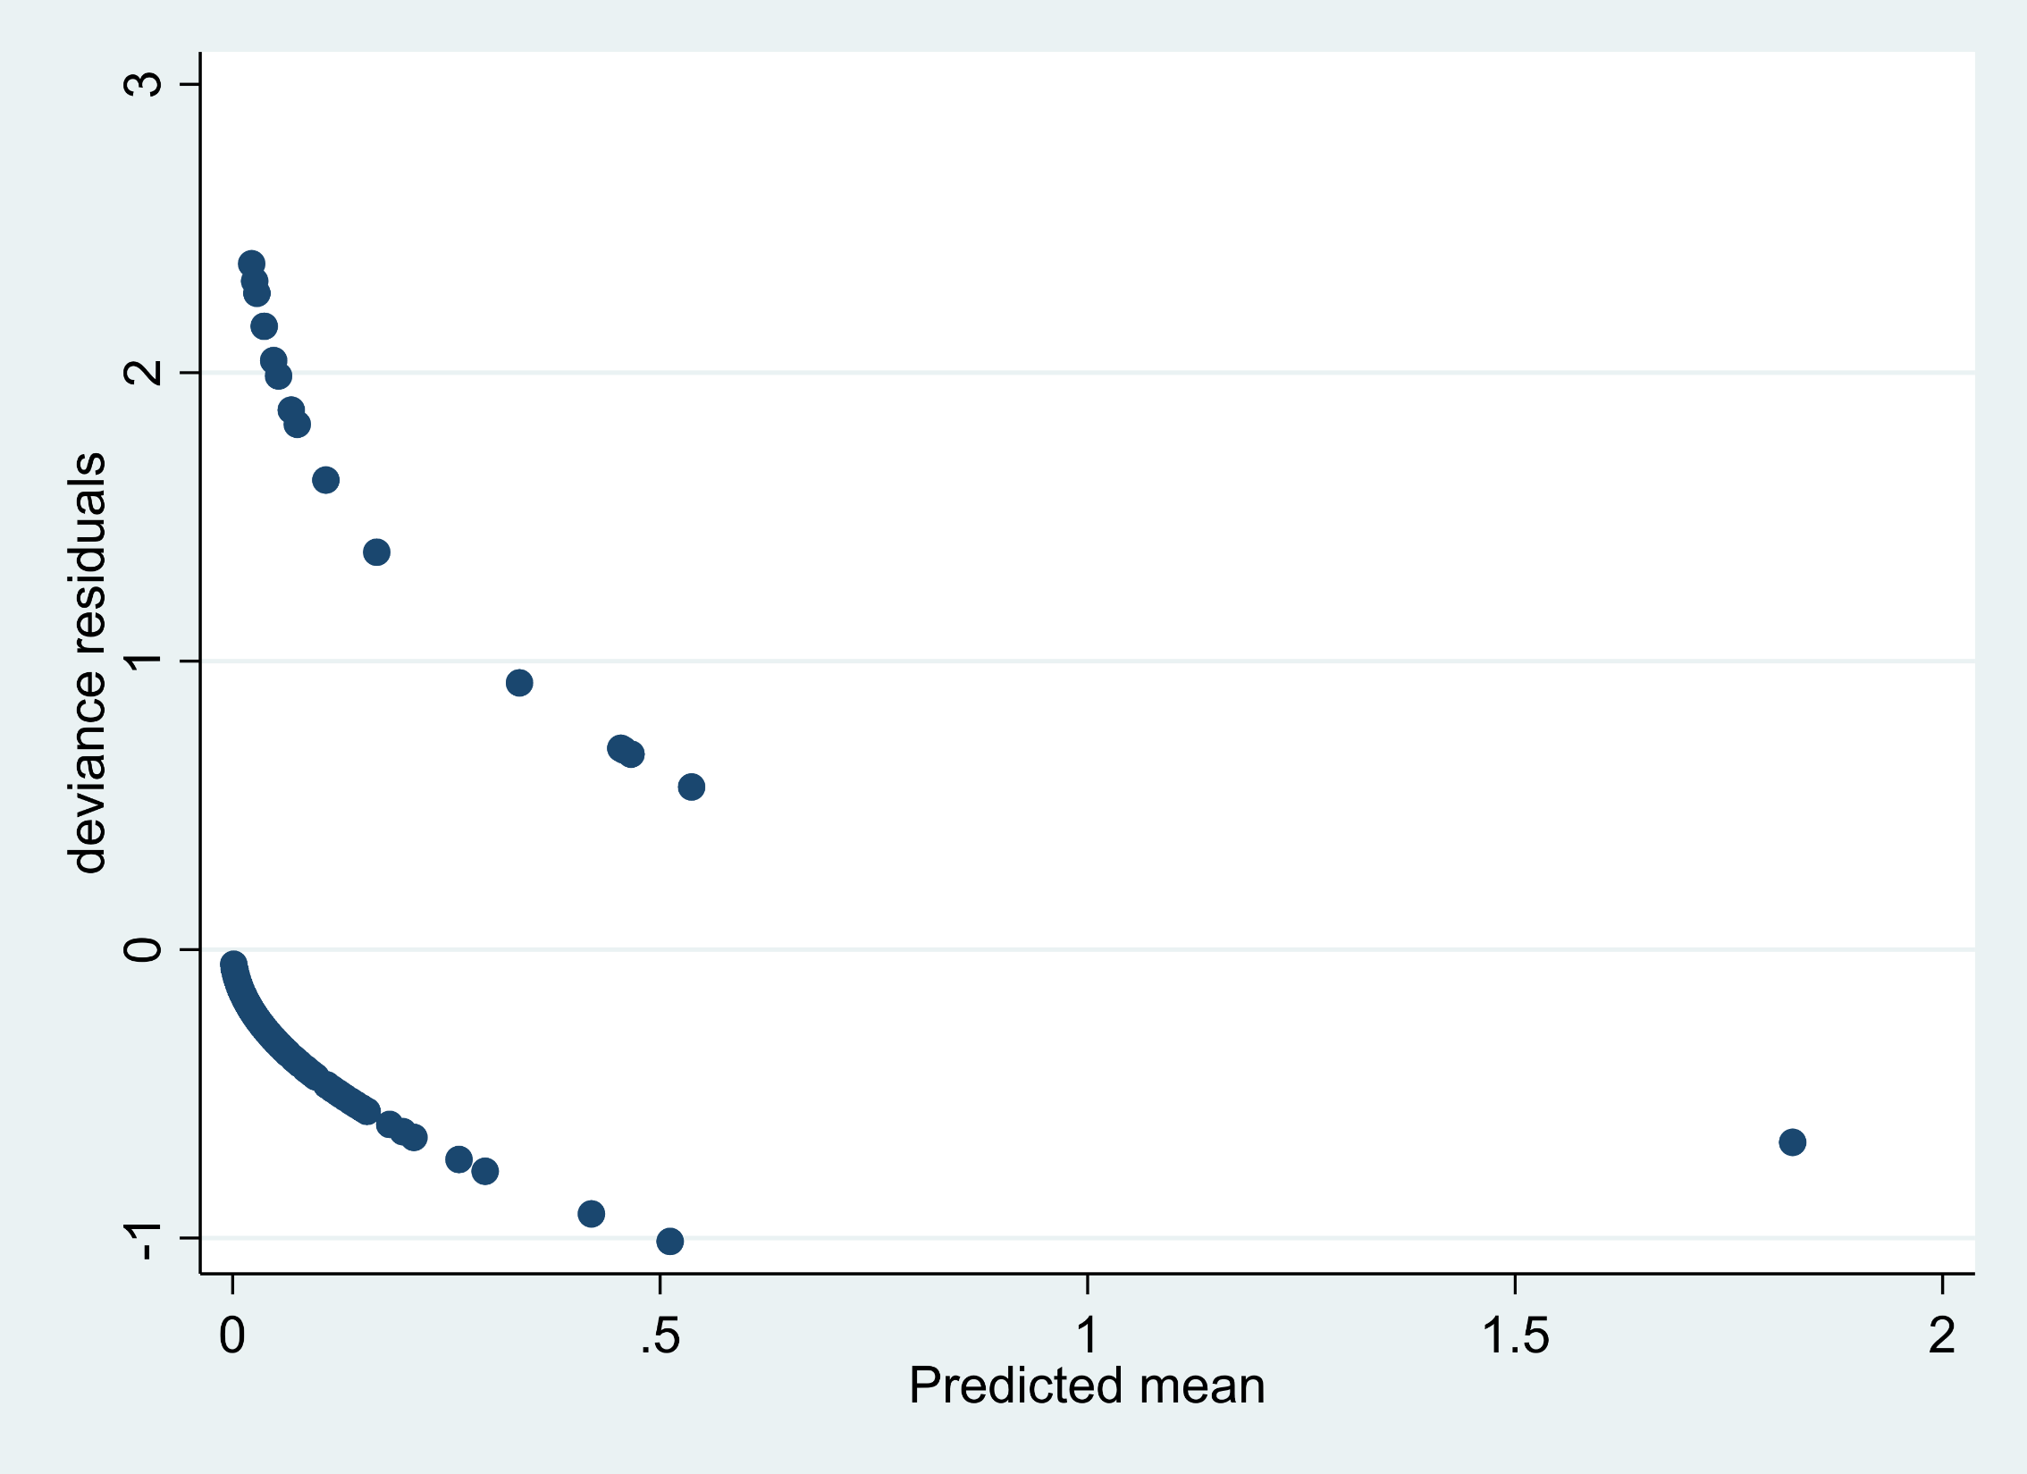
Notes:
Supplemental Figure 9. Deviance residuals versus predicted for outcome of MOF (n=408).

Slide 10
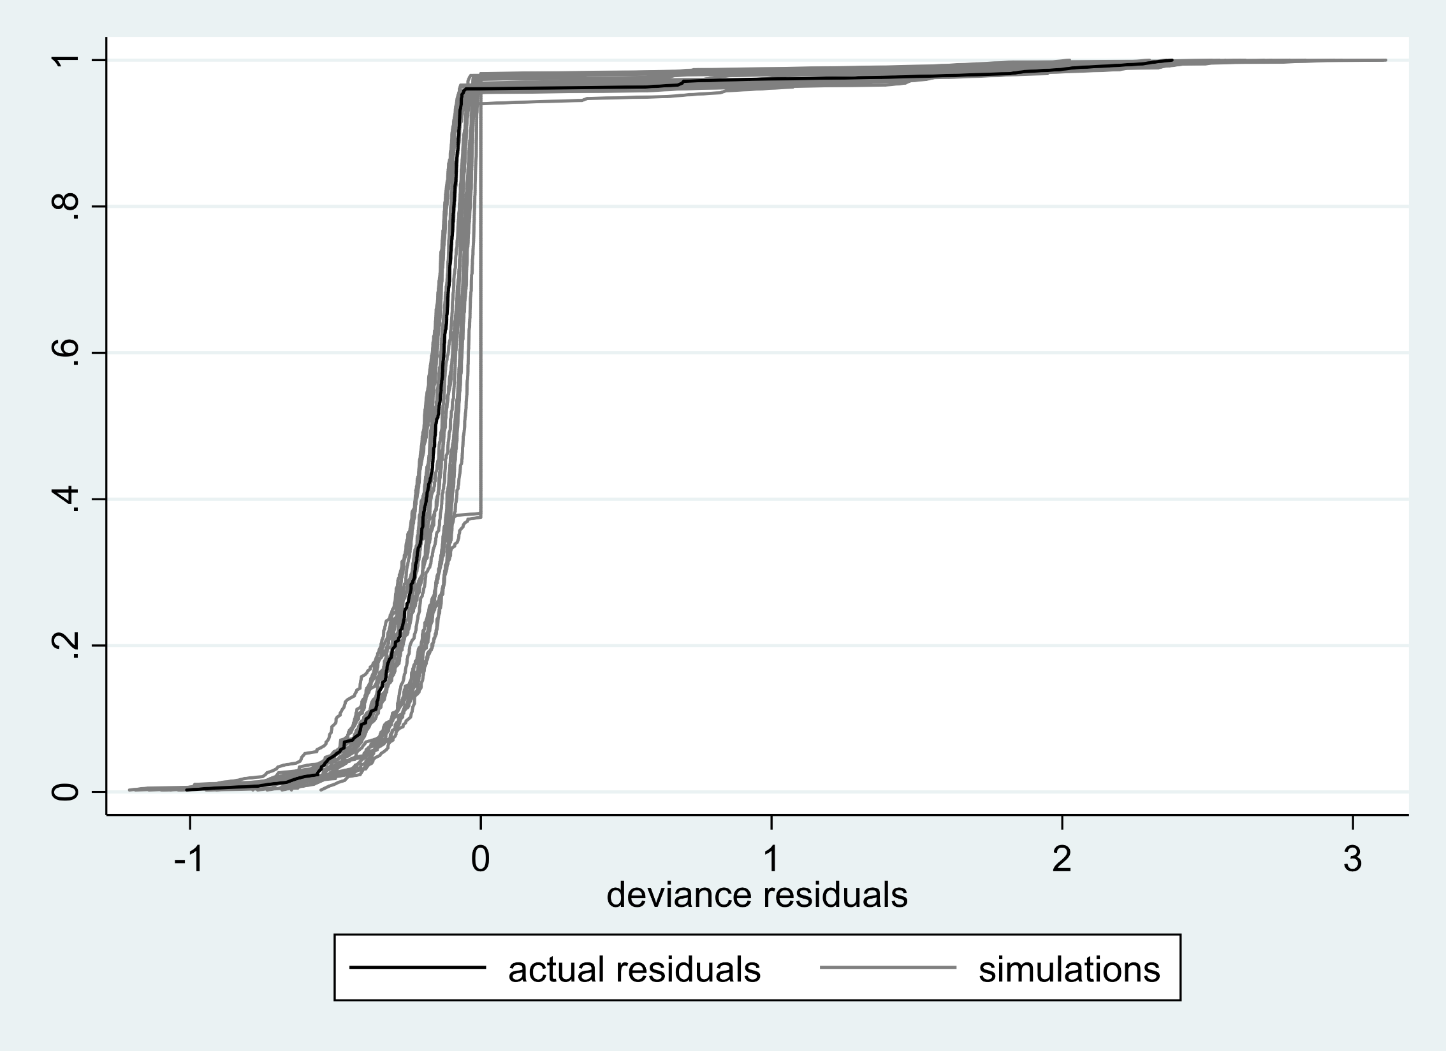
Notes:
Supplemental Figure 10. Actual (black) versus simulated deviance residuals (grey, n=20) using simulated data generated by the model in Figure 9.

Slide 11
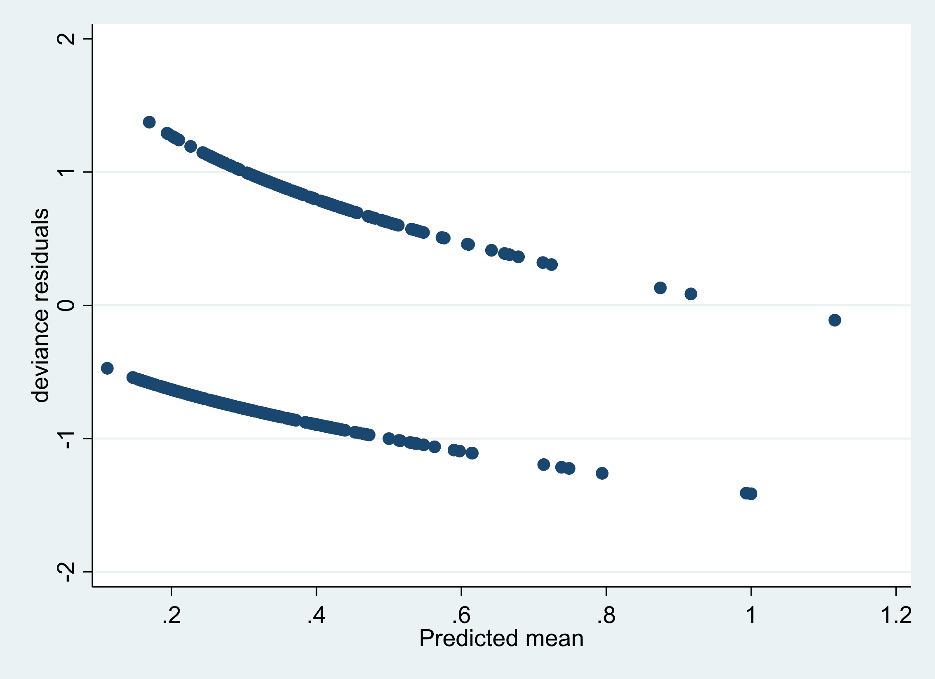
Notes:
Supplemental Figure 11. Deviance residuals versus predicted for outcome of sepsis (n=408).

Slide 12
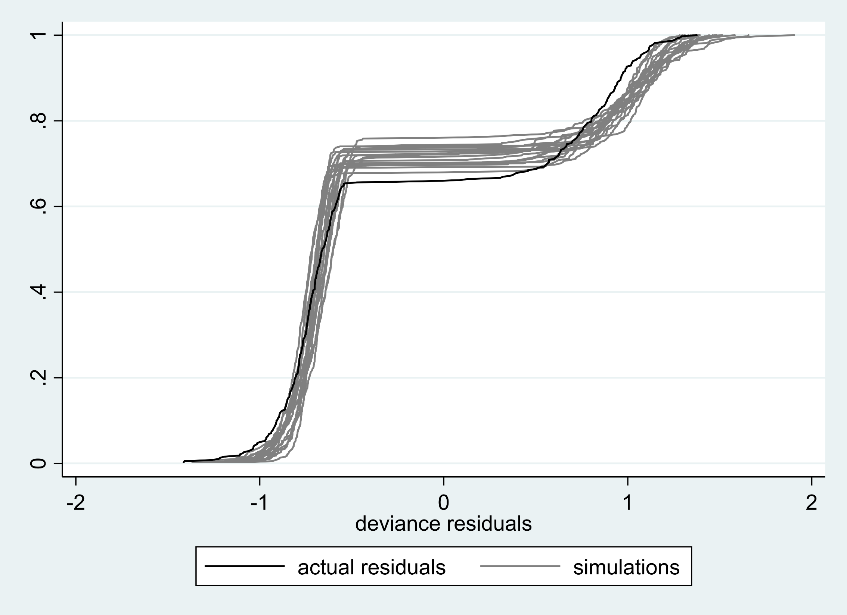
Notes:
Supplemental Figure 12. Actual (black) versus simulated deviance residuals (grey, n=20) using simulated data generated by the model in Figure 11. Moderate deviations present.

Slide 13
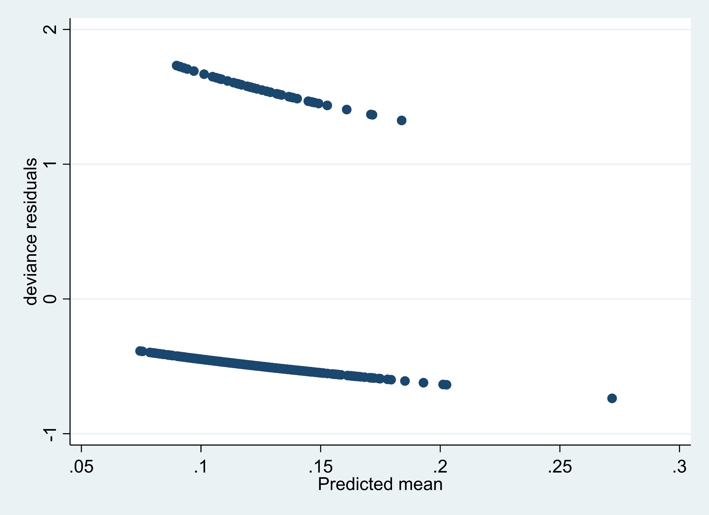
Notes:
Supplemental Figure 13. Deviance residuals versus predicted for outcome of VTE (n=408).

Slide 14
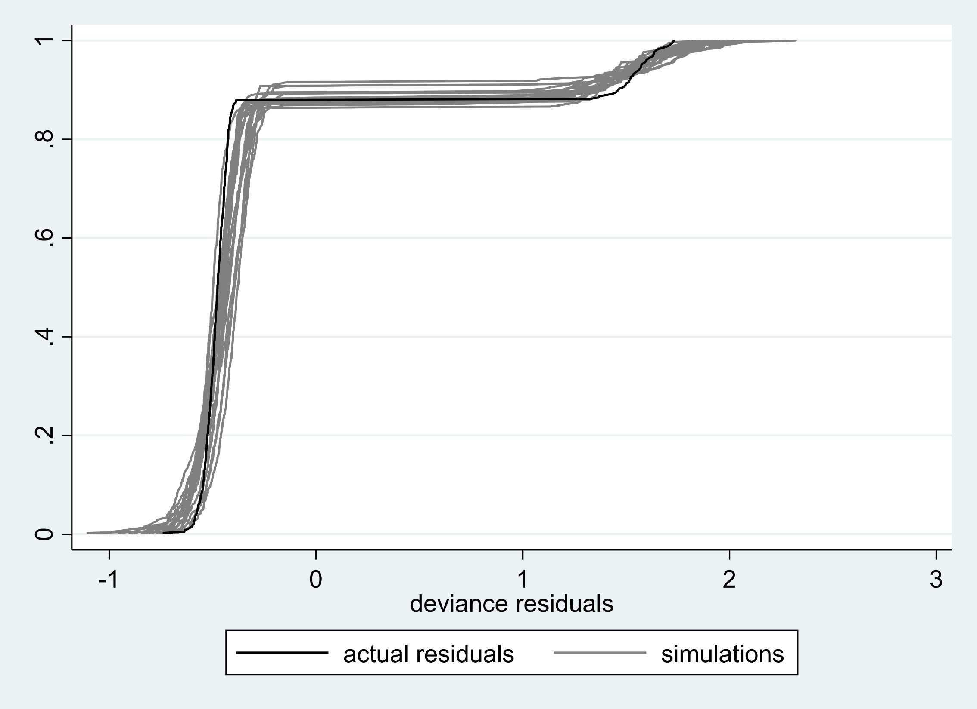
Notes:
Supplemental Figure 14. Actual (black) versus simulated deviance residuals (grey, n=20) using simulated data generated by the model in Figure 13.

