Slide 1
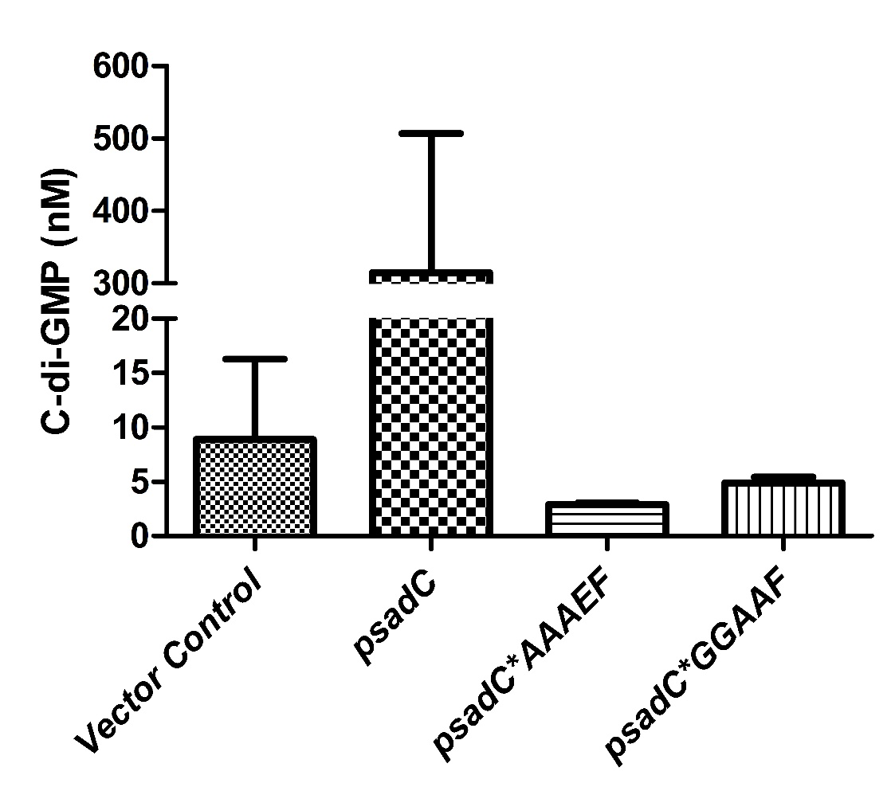
Supporting Information Figure 1
Notes:
Supporting Information Figure 1. Role of GGEEF Domain in SadC Diguanylate Cyclase Activity. C-di-GMP levels were quantified via LC-MS/MS in strains expressing either an empty vector control, psadC, psadC*AAAEF and psadC*GGAAF. Cells were grown for 16 hrs in LB medium and cells equivalent to an OD₆₀₀ 5 were collected. Samples of interest were compared to a standard curve derived from measurements of known concentrations of pure cdi-GMP to determine the concentration (in nM) of c-di-GMP in the samples. All experiments are the mean of two independent biological experiments with standard deviation error bars.

Slide 2
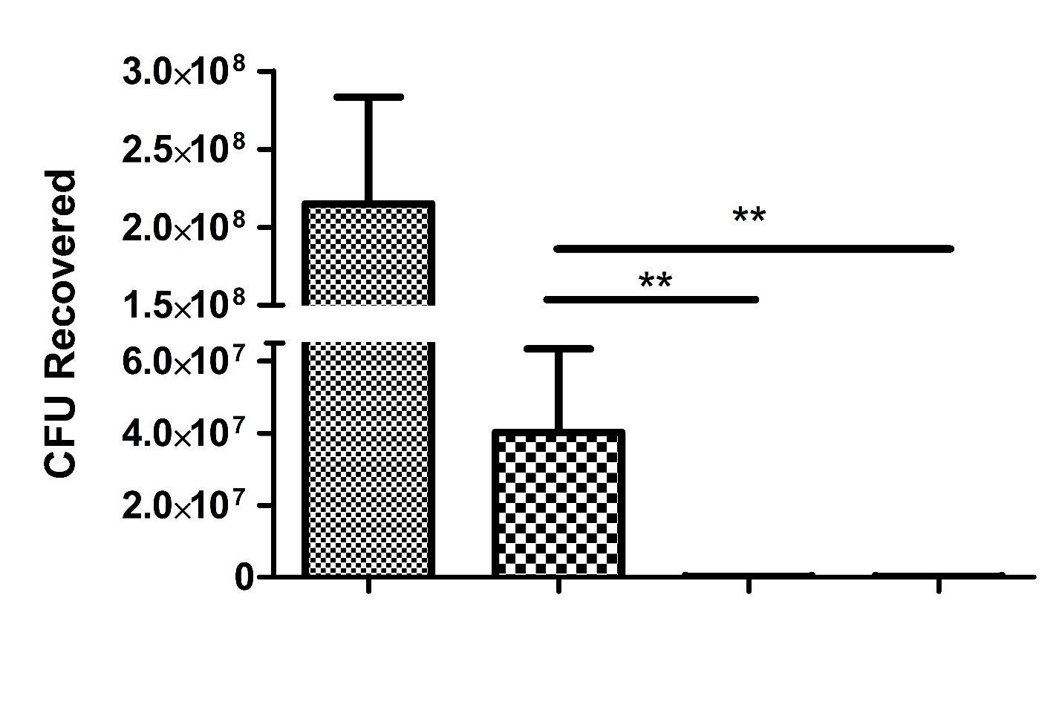
Supporting Information Figure 2
Prey
Alone
PAO1
Vector Control
PAO1ΔrsmA
Vector Control
PAO1psadC
Notes:
Supporting Information Figure 2. Impact of SadC on interspecies killing in P. aeruginosa. Competition assays performed on LB agar plates without antibiotics using a 1:1 ratio of attacker to prey and incubated at 37°C for 24 hours. Attacker strains were P. aeruginosa PAO1 and PAO1 ΔrsmA and prey strain was E. coli Top10 pRL662-gfp. Competitions were recovered and serially diluted prior to spot plating on LB agar plates with antibiotics for selection and grown overnight at 37°C. Statistical significance was determined using students t test comparing each strain to the vector control with p<0.05 *, p<0.01 **.

Slide 3
Supporting Information Figure 3
1
Atu1207
GGEEF
421
1
DgcC
1
GGEEF
379
DgcA
1
GGEEF
415
A. tumefaciens C.58
Atu2691
1
GGEEF
361
Atu2091
1
GGEEF
269
Atu5372
1
GGEEF
411
1
SadC
GGEEF
487
P. aeruginosa
WspR
1
GGEEF
347
PA2133
1
EAL
285
TM Domain
REC Domain
I-site
Notes:
Supporting Information Figure 3. Domain architecture of selected A. tumefaciens C. 58 diguanylate cyclases. Domain architecture of At.C58 diguanylate cyclases used in this study. P. aeruginosa diguanylate cyclases and phosphodiestarases are also shown. All domains are predicted using Mist 2.2. Protein sizes are shown to relative scale. Transmembrane domains shown in green, receiver domains in blue and inhibitory sites shown in red.

