Slide 1
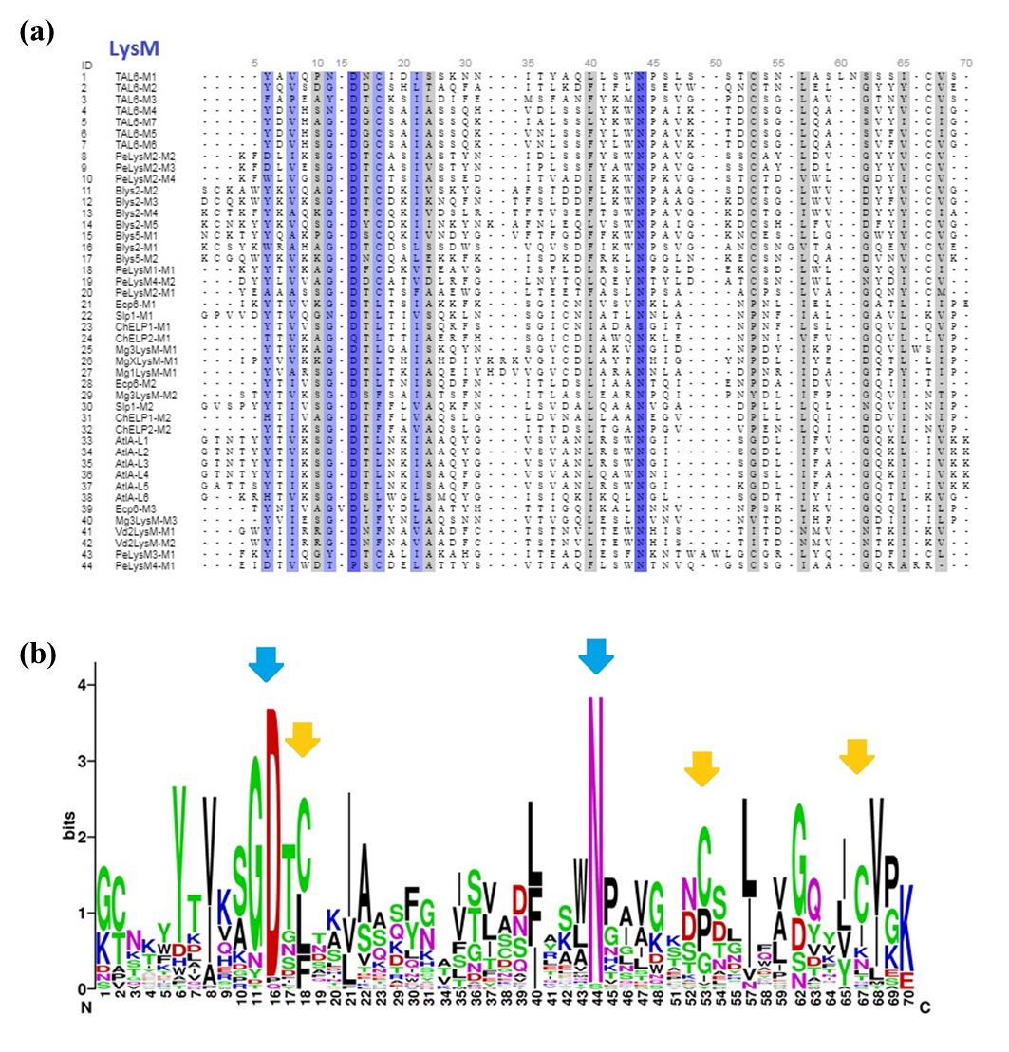
Supplementary Figure 4. Sequence analysis of LysM motifs from T. atroviride. a) Analysis of the sequence from the Tal6 effector along with other effectors previously reported in pathogenic fungi. b) LogoSequence analysis, showing the highly conserved amino acids cysteine (yellow arrows), asparagine and aspartic acid (blue arrows) between Tal6 and other LysM effectors from pathogenic fungi.

