Slide 1
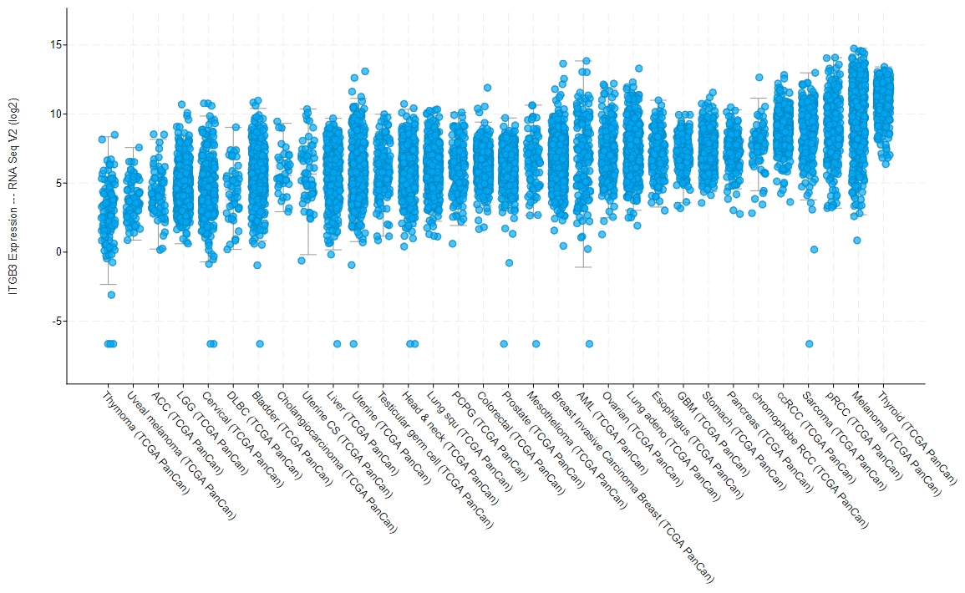
a
Fig. S1
 | KIRP | SARC | THCA | SKCM | OV | KIRC | BRCA | GBM | LUAD | STAD | PRAD | PAAD | ESCA | CRC
T Cell | -0.1 | -0.1 | 0.0 | 0.0 | 0.2 | 0.0 | 0.1 | 0.0 | 0.1 | 0.3 | 0.2 | 0.3 | 0.4 | 0.4
B Cell | 0.0 | -0.1 | 0.0 | 0.0 | 0.1 | 0.0 | 0.0 | 0.0 | 0.1 | 0.3 | 0.2 | 0.2 | 0.3 | 0.3
Exhausted CD8 | -0.1 | 0.0 | 0.0 | 0.0 | 0.1 | 0.0 | 0.0 | 0.0 | 0.1 | 0.2 | 0.2 | 0.2 | 0.2 | 0.3
Cytotoxic Cell | -0.1 | -0.1 | -0.1 | 0.1 | 0.2 | -0.1 | 0.0 | 0.1 | 0.1 | 0.1 | 0.2 | 0.2 | 0.2 | 0.3
CD8+ T Cell | -0.1 | -0.1 | 0.0 | 0.0 | 0.1 | -0.1 | 0.0 | 0.0 | 0.0 | 0.1 | 0.2 | 0.2 | 0.2 | 0.2
Mast Cell | -0.1 | 0.1 | 0.0 | 0.2 | 0.3 | 0.1 | 0.2 | 0.1 | 0.3 | 0.4 | 0.3 | 0.3 | 0.4 | 0.6
PD-1 (PDCD1) | 0.0 | -0.2 | -0.1 | 0.0 | 0.1 | -0.1 | -0.1 | 0.1 | 0.1 | 0.1 | 0.1 | 0.3 | 0.3 | 0.3
PD-L1 (CD274) | 0.2 | 0.3 | 0.3 | 0.1 | 0.2 | 0.1 | 0.3 | 0.4 | 0.3 | 0.1 | 0.5 | 0.5 | 0.1 | 0.5
b
Figure S1:
Co-enrichment of ITGB3 (β3 mRNA) with gene markers for additional tumor-infiltrating leukocyte cell types for TCGA datasets. The correlation between ITGB3 expression and combined markers of immune cell types was analyzed for the datasets listed in Figure 1. The markers used for each cell type are indicated in Supplementary Table 2. The table shows the average Pearson’s correlation coefficients using the same immune cell type markers listed in Figure 1A.
Expression of ITGB3 mRNA for the TCGA pan-cancer dataset, graphed using cBioPortal.

