Slide 1
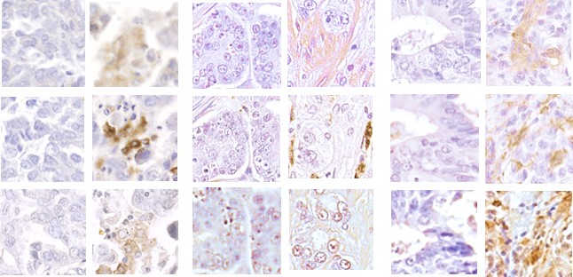
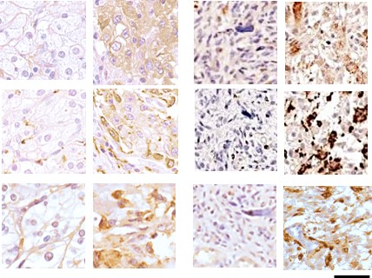
Immunohistochemistry staining of integrin β3 and macrophage markers in high magnification
Fig. S2
β3-
Lung
β3+
β3-
Prostate
β3+
β3-
Colon
β3+
β3
CD68
CD163
β3-
Kidney
β3+
β3-
GBM
β3+
β3
CD68
CD163
25 µm
Figure S2:
Tumor microarray slides were stained for β3 integrin and macrophage markers, CD68 and CD163. Graphs show mean±SE for the % positive area for CD68 or CD163, grouped by β3+ vs. β3- status. The number of samples analyzed per array is indicated. *P<0.05 and **P<0.1 using Student’s t test or Mann-Whitney U test compared to β3-negative. The same areas of serial sections stained for integrin β3 and macrophage markers are shown. The same areas of serial sections stained for integrin β3 and macrophage markers are shown. Bar = 25 µm.

