Slide 1
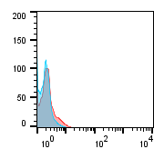
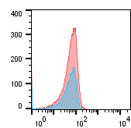
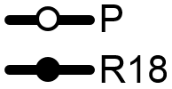
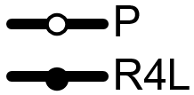
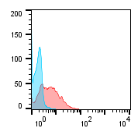
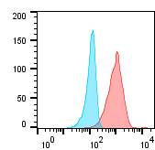
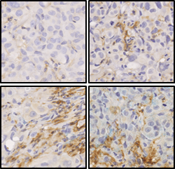
a
Fig. S3
HCC827 xenograft
PC9 xenograft
HCC827-P
PC9-P
Cells isolated from vehicle-treated mice
Count
Control
anti-αvβ3
Tumor volume (mm³)
HCC827-R18
PC9-R4L
Count
Cells isolated from erlotinib-resistant tumors
Days after treatment
αvβ3
αvβ3
b
Vehicle
LM609
% F4/80+ area
Vehicle
**
**
*
Erlotinib
Brown: F4/80 macrophage marker
Figure S3:
HCC827 and PC9 xenograft bearing mice were treated with the vehicle or erlotinib. Tumor cells from the vehicle and erlotinib treated mice were isolated (P and R18 or R4L respectively) and αvβ3 levels were analyzed by flow cytometry.
Representative pictures of tumors from the experiment shown in Figure 2C harvested on day 15 (Vehicle and LM609 groups, n=5) or day 50 (erlotinib and erlotinib/LM609 groups, n=5), stained for the mouse macrophage marker F4/80. The F4/80-positive area fraction was quantified using ImageJ. Scale bar = 50 µm. **P<0.05 and *P<0.1 using Student’s t-test. Error bars indicate standard errors.

