Slide 1
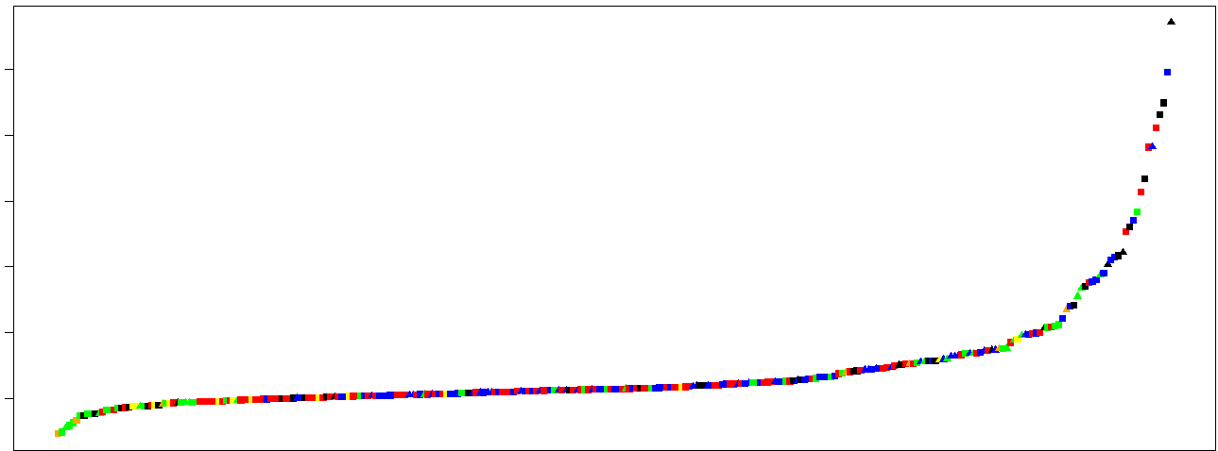
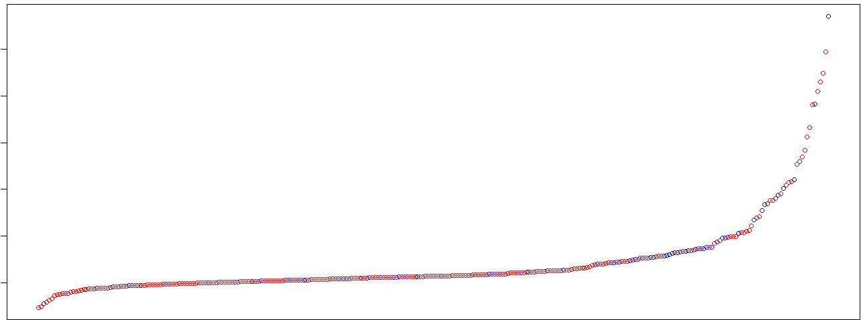
Figure S1
a
MB49
MHC I
500
B16F10
MHC II
P815
BBN963
400
T11
UPPL1541
300
ELISpot score
200
100
0
b
MHC I
500
MHC II
400
300
ELISpot score
200
100
0
Figure S1: Waterfall plot of tumor-specific antigen ELISpot scores by a) tumor model and MHC class, and b) MHC class for all tumor models.
Notes:
Figure S1: Waterfall plot of tumor-specific antigen ELISpot scores by a) tumor model and MHC class, and b) MHC class for all tumor models.

Slide 2
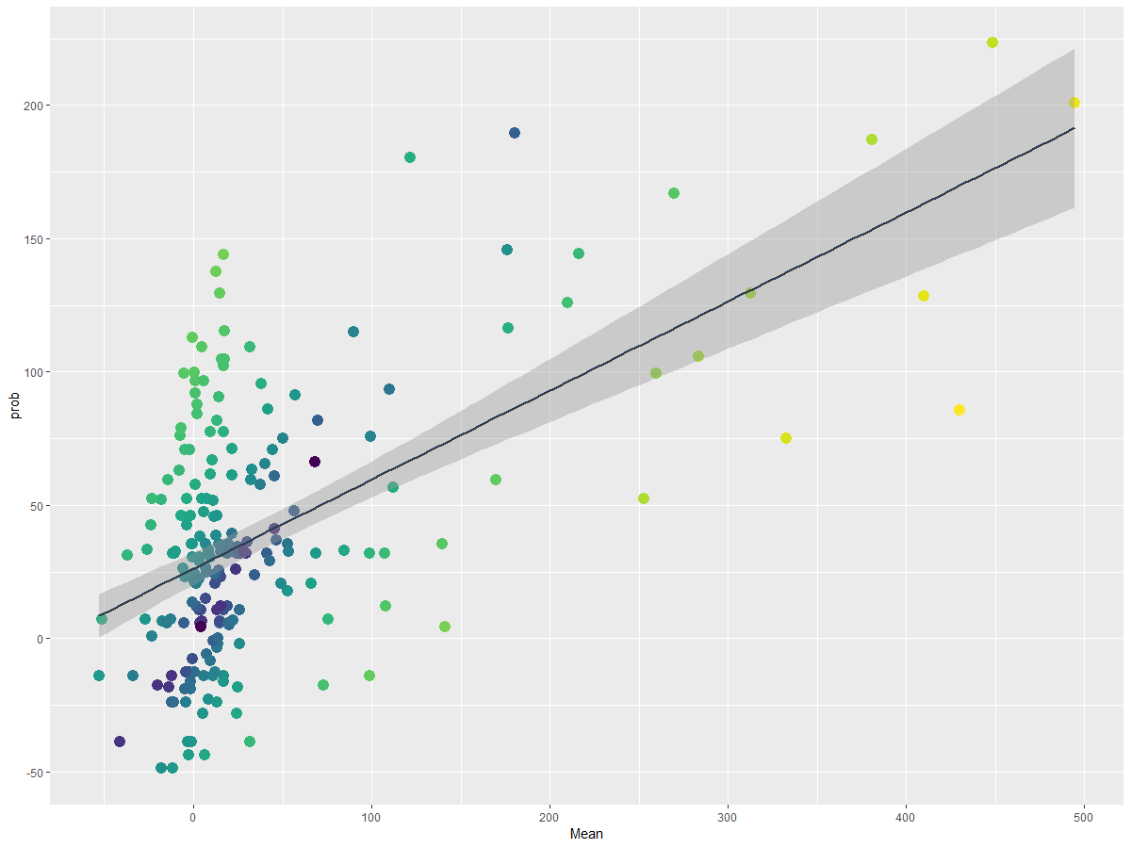
Figure S2
a
200
300
Abs(Actual – Predicted)
150
150
100
0
Predicted
50
0
-50
0
100
200
300
400
500
Actual
b
Figure S2: Multivariable generalized linear model analysis of class I peptide-intrinsic features as a predictor for immunogenicity. (a) Actual versus predicted immunogenicity per class I peptide using final GLM model. (b) Regression coefficient +/- 95% confidence interval for all predicted features of the final GLM model. Color represents absolute differences in value between predicted and actual immunogenicity scores. Significant features (p < 0.05) are shown in red, while insignificant features (p > 0.05) are in black.
Notes:
Figure S1: Multivariable generalized linear model analysis of class I peptide-intrinsic features as a predictor for immunogenicity. (a) Actual versus predicted immunogenicity per class I peptide using final GLM model. (b) Regression coefficient +/- 95% confidence interval for all predicted features of the final GLM model. Color represents absolute differences in value between predicted and actual immunogenicity scores. Significant features (p < 0.05) are shown in red, while insignificant features (p > 0.05) are in black.

Slide 3
Table S1
Feature | Coefficient | 2.50% | 97.50% | p-value
Absolute_position_3_Y | 42.925 | 14.66786 | 71.18231 | 0.00328
Last_position_V | 60.05 | 24.62061 | 95.48006 | 0.00107
Absolute_position_6_NonPolar | 19.763 | -1.09563 | 40.62136 | 0.06483
Mutation_at_position_1 | 20.384 | -7.92878 | 48.69604 | 0.15983
Reference_AA_at_mutated_position_Charged | -56.119 | -128.128 | 15.88953 | 0.12828
Reference_AA_at_mutated_position_Basic | 91.48 | 10.86377 | 172.0953 | 0.0273
Mutated_position_change_of_Small_feature | 24.753 | 6.933012 | 42.57262 | 0.00707
Mutated_position_change_of_Charged_feature | -55.393 | -128.763 | 17.97778 | 0.14058
Mutated_position_change_of_Basic_feature | 65.994 | -12.6008 | 144.5882 | 0.10145
Relative_site_1_V | 26.154 | -4.82899 | 57.13679 | 0.09965
Relative_site_2_V | 38.781 | 1.877546 | 75.68512 | 0.04077
Relative_site_4_C | 46.931 | 10.78618 | 83.07598 | 0.01171
Relative_site_4_V | 25.768 | -8.66018 | 60.19572 | 0.14402
Relative_site_5_A | -29.735 | -59.5983 | 0.128096 | 0.05244
Relative_site_5_K | 54.54 | 11.20328 | 97.87758 | 0.01451
Relative_site_6_Tiny | -26.267 | -47.4018 | -5.13253 | 0.01576
Table S1: Features included in final class I GLM model of immunogenicity.
Notes:
Table S1: Features included in final class I GLM model of immunogenicity.

Slide 4
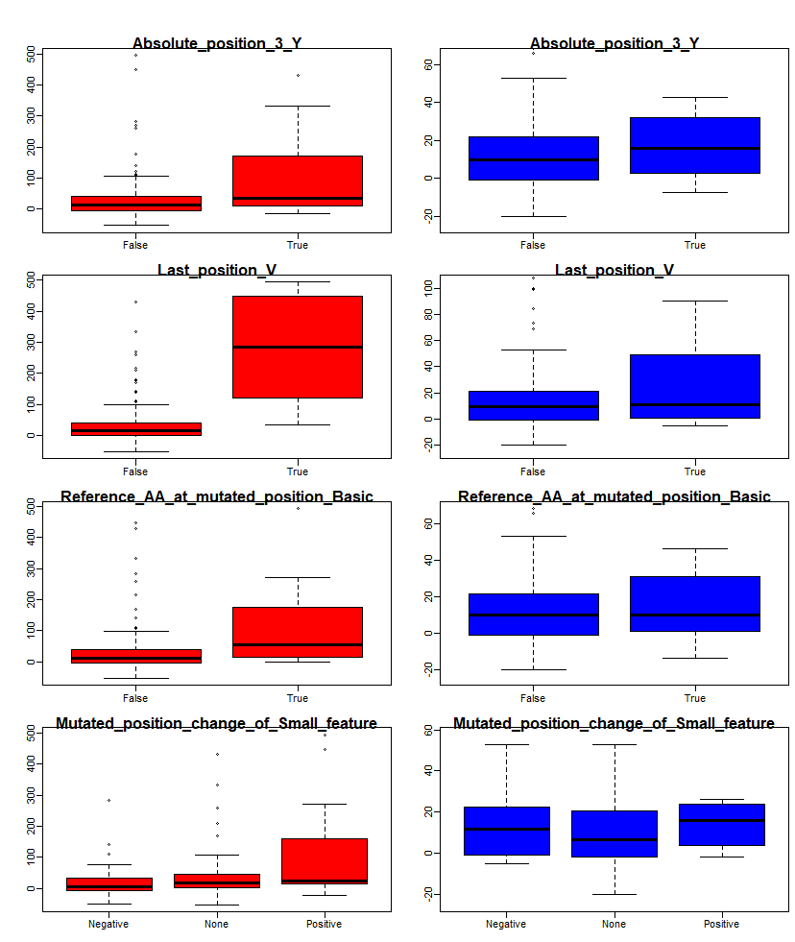
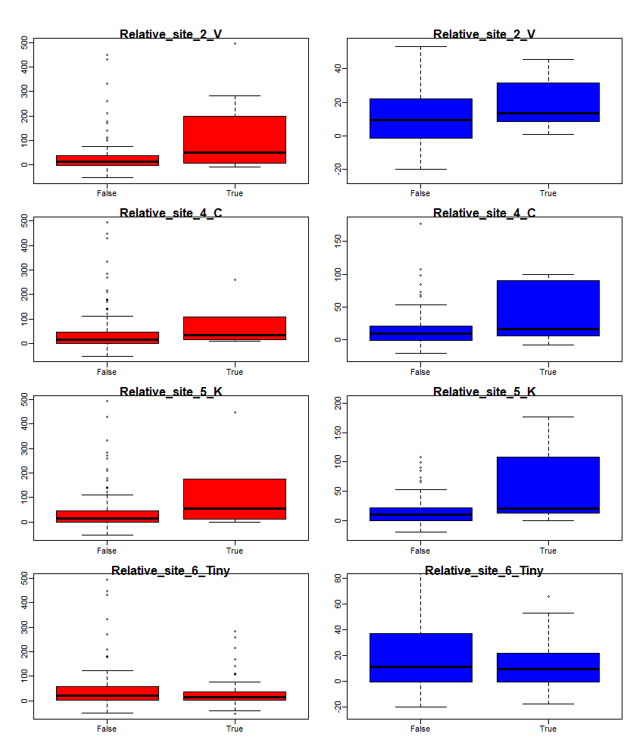
Figure S3
Haplotype
H2-D/K^{b}
H2-D/K^{d}
Figure S3: Immunogenicity scores for class I H2-D/K^{b} (red) and H2-D/K^{d} (blue) epitopes, split by each significant predictor in final class I GLM model.
Notes:
Figure S2: Immunogenicity scores for class I H2-D/K^{b} (red) and H2-D/K^{d} (blue) epitopes, split by each significant predictor in final class I GLM model.

Slide 5
Figure S4
Figure S4: Immunogenicity scores for in-frame and out-of-frame, class I and class II epitopes.
Notes:
Figure S3: Immunogenicity scores for in-frame and out-of-frame, class I and class II epitopes.

Slide 6
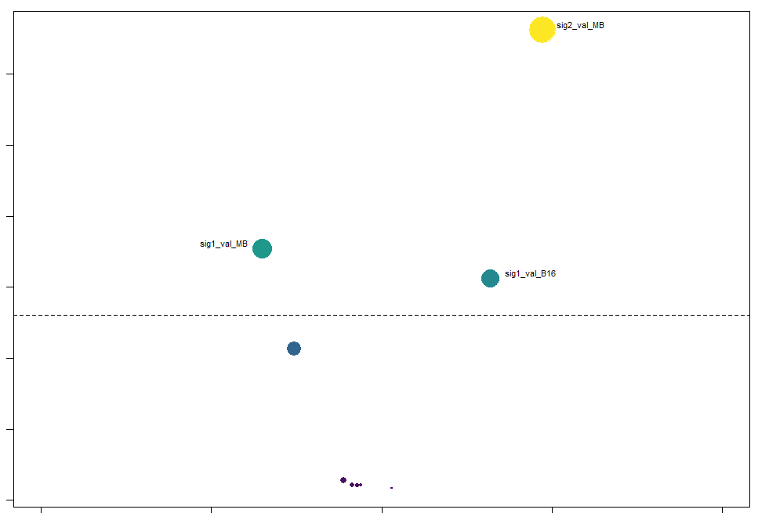
Figure S5
3.0
MB49 vs Sig2
3
1.5
2.5
-log10(q-value)
2.0
0
-log10(q-value)
MB49 vs Sig1
1.5
B16F10 vs Sig1
1.0
0.5
0
-1
-0.5
0
0.5
1
Coefficient
Figure S5: Volcano plot representing Spearman coefficient (x-axis) and –log10(q-value) (y-axis) for tumor model as a predictor for mean of features grouped by hierarchical clustering in Figure 2d (Sig1: 7 features on right-hand side of dendrogram; Sig2: 8 features on left-hand side of dendrogram). Dashed line represents q-value = 0.05. Spot color represents –log10(q-value) magnitude and size represents magnitude of the coefficient.
Notes:
Figure S5: Volcano plot representing Spearman coefficient (x-axis) and –log10(q-value) (y-axis) for tumor model as a predictor for mean of features grouped by hierarchical clustering in Figure 2d (Sig1: 7 features on right-hand side of dendrogram; Sig2: 8 features on left-hand side of dendrogram). Dashed line represents q-value = 0.05. Spot color represents –log10(q-value) magnitude and size represents magnitude of the coefficient.

Slide 7
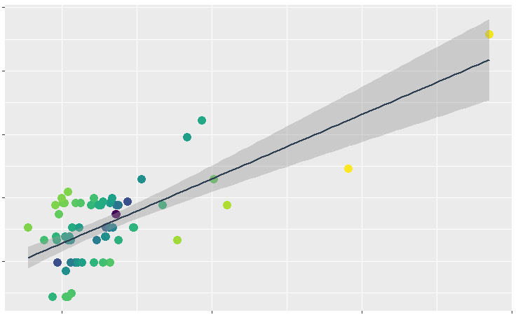
Figure S6
a
400
200
Abs(Actual – Predicted)
300
100
0
200
Predicted
100
0
0
200
400
600
Actual
b
Figure S6: Multivariable generalized linear model analysis of class II peptide-intrinsic features as a predictor for immunogenicity. (a) Actual versus predicted immunogenicity per class II peptide using final GLM model. (b) Regression coefficient +/- 95% confidence interval for all predicted features of the final GLM model. Color represents absolute differences in value between predicted and actual immunogenicity scores. Significant features (p < 0.05) are shown in red, while insignificant features (p > 0.05) are in black.
Notes:
Figure S4: Multivariable generalized linear model analysis of class II peptide-intrinsic features as a predictor for immunogenicity. (a) Actual versus predicted immunogenicity per class II peptide using final GLM model. (b) Regression coefficient +/- 95% confidence interval for all predicted features of the final GLM model. Color represents absolute differences in value between predicted and actual immunogenicity scores. Significant features (p < 0.05) are shown in red, while insignificant features (p > 0.05) are in black.

Slide 8
Table S2
Feature | Coefficient | 2.50% | 97.50% | p-value
Absolute_position_1_V | 101.26 | 38.5527 | 163.971 | 0.00242
Absolute_position_6_Y | 75.7 | 11.578 | 139.8144 | 0.02406
Absolute_position_2_Basic | 52.48 | -4.87234 | 109.8258 | 0.07786
Mutated_position_change_of_Tiny_feature | 34.95 | -0.60942 | 70.51459 | 0.05872
Mutated_position_change_of_Small_feature | -89.58 | -127.047 | -52.1203 | 1.60E-05
First_three_AA_Basic | 40.79 | -2.20042 | 83.78637 | 0.06776
Table S2: Features included in final class II GLM model of immunogenicity.
Notes:
Table S2: Features included in final class II GLM model of immunogenicity.

Slide 9
Predicted high
Predicted low
Peptide | Predicted | Actual | Model
VVYTFFDF | 180.3917 | 180.1666 | B16F10
LNVYYLPL | 167.1917 | 13.33334 | B16F10
SQVANWNLVVM | 167.1917 | 270 | B16F10
QSLGFTYLRL | 61.1175 | 14.33333 | B16F10
RMLQNSDTL | 61.1175 | 19.33333 | B16F10
VAVAHVAAF | 71.94313 | 44.33334 | B16F10
VALLPSVML (B2) | 71.94313 | 15.5 | BBN963
VSLTLFSSWL (C2) | 71.94313 | 107.5 | BBN963
SNVMQLLL (A5) | 54.97577 | -37 | BBN963
AFQRVTCTTL | 61.1175 | 21.66667 | BALB/c → DBA2
QYSSANDWTV | 71.88348 | 2 | BALB/c → DBA2
QYFNGAPVLYL | 61.1175 | 14.33333 | P815 (BALB/c)
SYIVGCSQRI | 61.1175 | 381.0033 | P815 (BALB/c)
SYTRNCCLV | 39.64407 | 11.33333 | P815 (BALB/c)
RYIRNDSNYV | 39.64407 | 12.33333 | P815 (DBA2)
RYQLAGAASSV | 43.31829 | 53 | T11
IYFKCHQTV | 39.64407 | 90 | T11
Peptide | Predicted | Actual | Model
YGYILRSYL | 1.933884 | 4.333334 | B16F10
ETLLNSATI (B5) | 1.933884 | -41.3333 | BBN963
MISRNRHTL (B12) | 1.933884 | 26 | BBN963
SSISIHQIHLI | 1.933884 | 0.333332 | MB49
YSYFLSLPNQL | 1.933884 | 141.5 | MB49
HYAANEWI | 1.933884 | -2 | BALB/c → DBA2
KFFPNCIFL | 1.933884 | -1.66333 | BALB/c → DBA2
LYISPNPEVL | 1.933884 | 12 | BALB/c → DBA2
FYISHTLRSL | 1.933884 | 24.33333 | P815 (BALB/c)
GYWTVSYL | 1.933884 | -1 | P815 (BALB/c)
SYLTVLQKI | 1.933884 | 84.66667 | P815 (BALB/c)
SYQPVEIL | 1.933884 | -4.33333 | P815 (BALB/c)
KYACFQVEI | 1.933884 | 24.66667 | P815 (DBA2)
Table S3
Table S3: Validation set epitopes with predicted high (top quartile) or predicted low (bottom quartile) immunogenicity scores predicted from final GBM model. Tumor models are distinguished by color.
Notes:
Table S3: Validation set epitopes with predicted high (top quartile) or predicted low (bottom quartile) immunogenicity scores predicted from final GBM model. Tumor models are distinguished by color.

Slide 10
a
b
Figure S7
c
d
Figure S7: BBN963 validation experimental results. (A and B) Kaplan-Meier survival curves (a) and tumor growth curves (b) for BBN963-bearing animals treated with predicted high (red) or low (blue) immunogenicity antigens, or no-peptide control (black). (c and d) Omnibus tumor growth curves for BBN963-bearing animals treated with predicted high (red) or low (blue) immunogenicity antigens, or no-peptide control (black). (c) represents tumor area, with values >200mm² dropped from each graph, while values in (d) maintain tumor areas at the last measured size when animals reach tumor burden of >200mm².
Notes:
Figure S5: BBN963 validation experimental results. (A and B) Kaplan-Meier survival curves (a) and tumor growth curves (b) for BBN963-bearing animals treated with predicted high (red) or low (blue) immunogenicity antigens, or no-peptide control (black). (c and d) Omnibus tumor growth curves for BBN963-bearing animals treated with predicted high (red) or low (blue) immunogenicity antigens, or no-peptide control (black). (c) represents tumor area, with values >200mm² dropped from each graph, while values in (d) maintain tumor areas at the last measured size when animals reach tumor burden of >200mm².

Slide 11
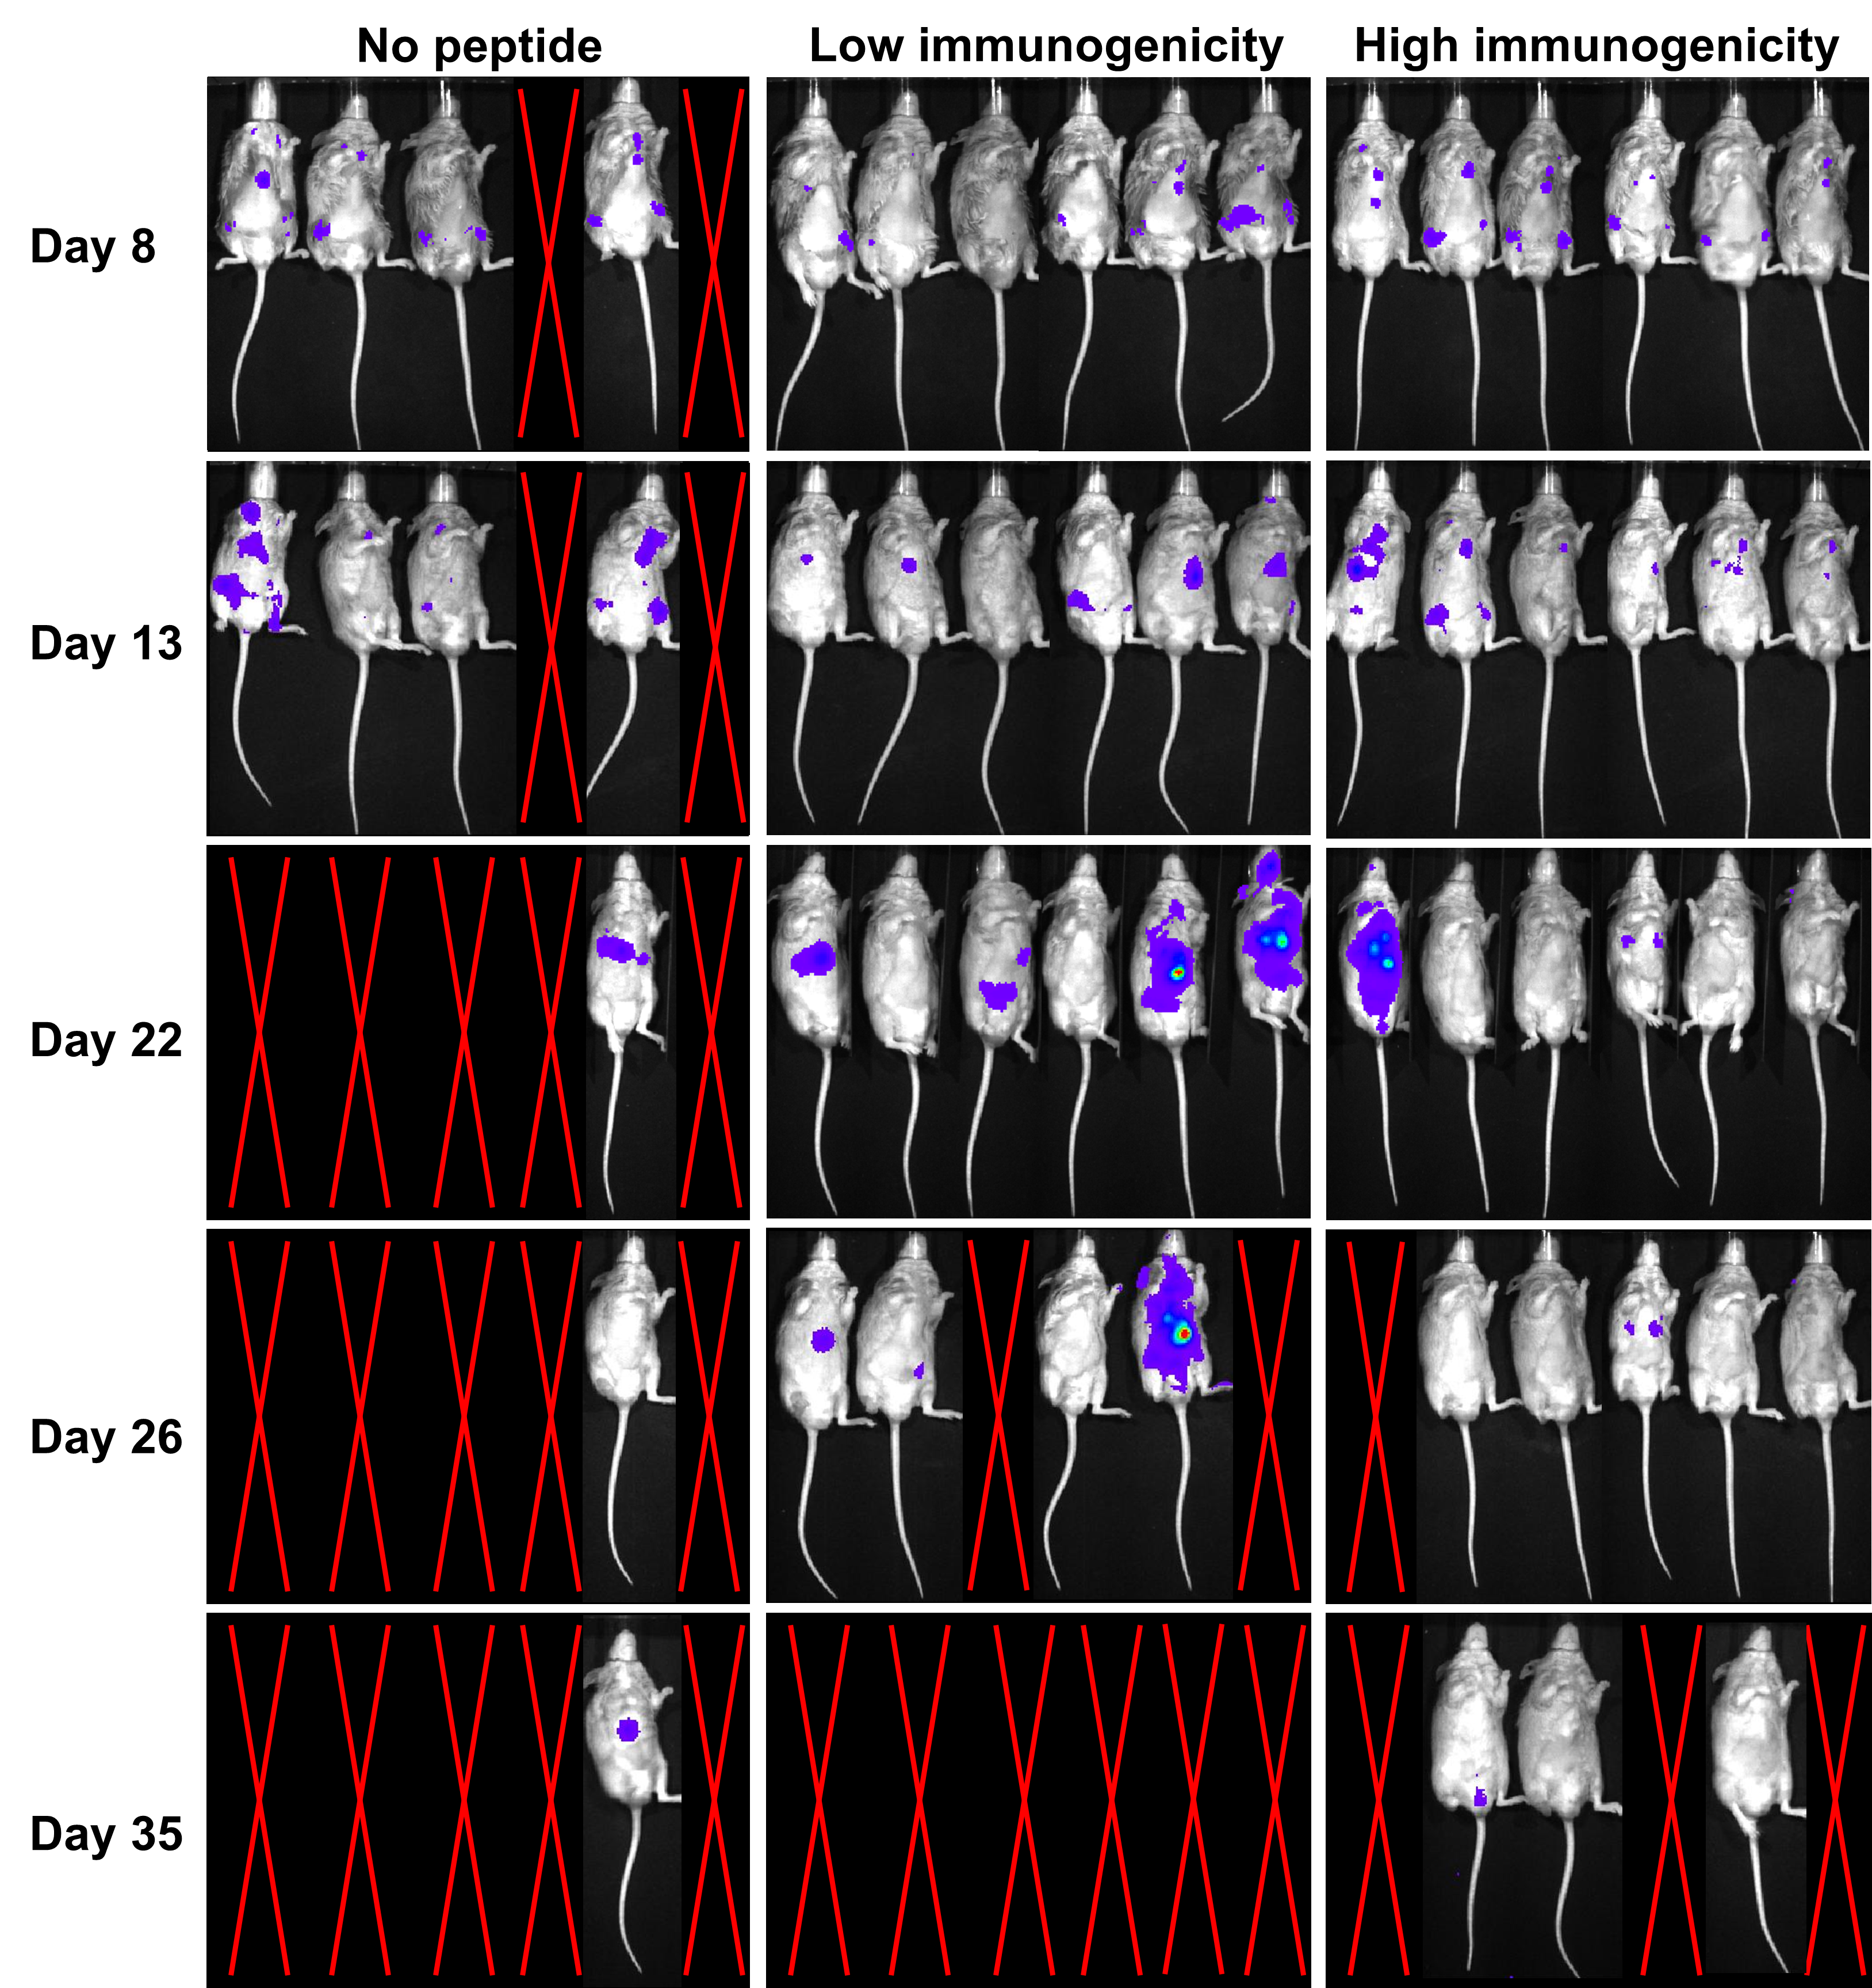
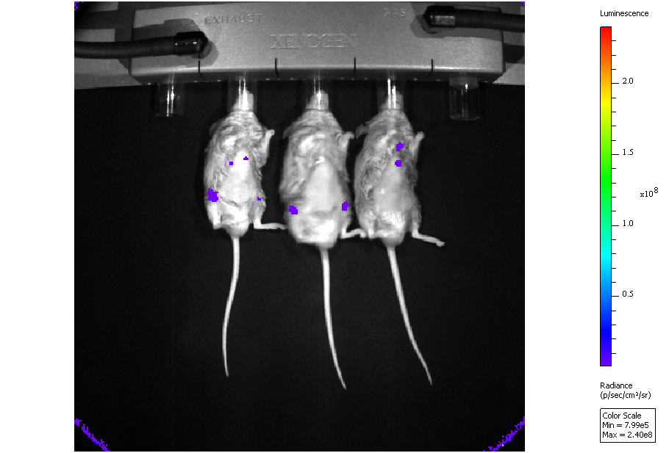
Luminescence
Figure S8
2.0x10⁸
1.5x10⁸
1.0x10⁸
0.5x10⁸
Radiance
(p/sec/cm²/sr)
Figure S8: Luciferase imaging of luc-P815 tumor burden in DBA/2 recipients.
Notes:
Figure S8: Luciferase imaging of luc-P815 tumor burden in DBA/2 recipients.

Slide 12
Figure S9
*
Figure S9: Quantification for luciferase imaging of luc-P815 tumor burden in DBA/2 recipients. Statistics performed with Mann-Whitney u-test (*: p < 0.05).
Notes:
Figure S7: Quantification for luciferase imaging of luc-P815 tumor burden in DBA/2 recipients. Statistics performed with Mann-Whitney u-test (*: p < 0.05).

Slide 13
Figure S10
a
b
Figure S10: Percentage weight change (a) and graft-versus-host disease clinical score (b) for transplant study represented in Figure 3e.
Notes:
Figure S10: Percentage weight change (a) and graft-versus-host disease clinical score (b) for transplant study represented in Figure 3e.

Slide 14
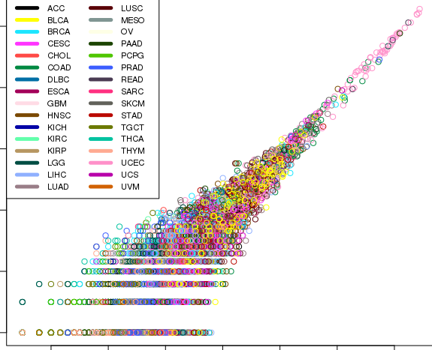
10
Figure S11
8
6
log2(Count > 95th percentile + 1)
4
2
0
2
4
6
8
10
12
14
log2(Count + 1)
Figure S11: Total neoantigen burden (x-axis) versus number of highly immunogenic neoantigens (y-axis) in TCGA pan-cancer dataset, with cancer types split by color.
Notes:
Figure S9: Total neoantigen burden (x-axis) versus number of highly immunogenic neoantigens (y-axis) in TCGA pan-cancer dataset, with cancer types split by color.

Slide 15
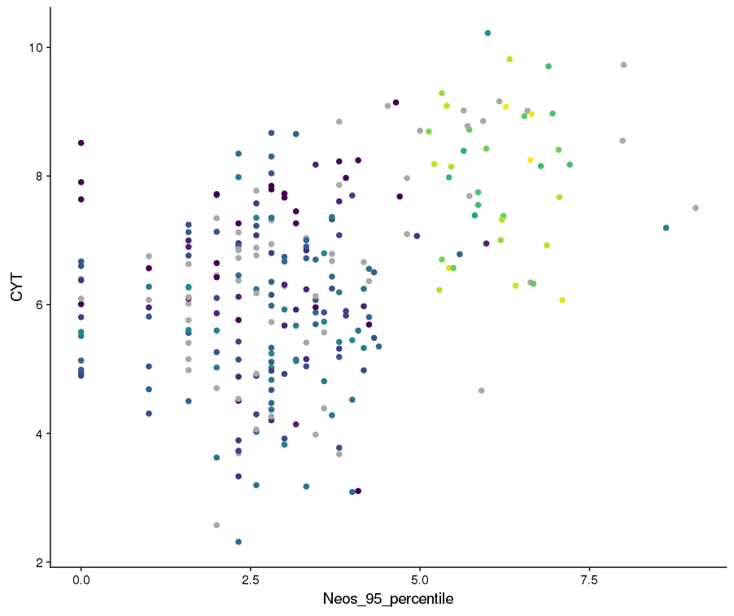
10
Log₂(MSI count)
Figure S12
5
0
Figure S12: Number of highly immunogenic neoantigens (x-axis) versus cytotoxicity gene signature (y-axis) in TCGA COAD dataset. Colors represent MSI status.
Notes:
Figure S10: Number of highly immunogenic neoantigens (x-axis) versus cytotoxicity gene signature (y-axis) in TCGA COAD dataset. Colors represent MSI status.

Slide 16
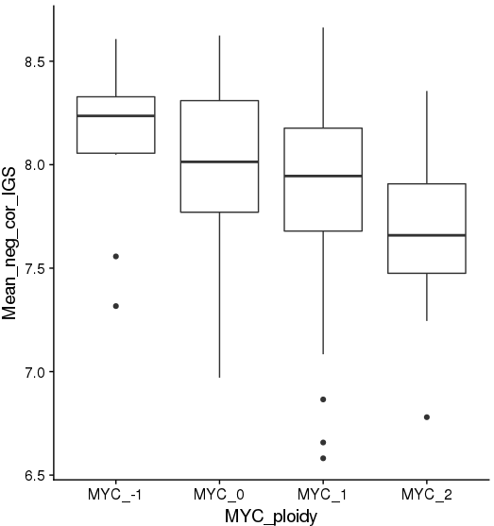
Figure S13
Significant gene signatures
Het. loss
Diploid
Gain
High amp
MYC copy number
Figure S13: Mean expression of immune gene signatures negatively correlated with number of highly immunogenic neoantigens (Figure 4b) in TCGA LUAD, split by MYC copy number.
Notes:
Figure S11: Mean expression of immune gene signatures negatively correlated with number of highly immunogenic neoantigens (Figure 4b) in TCGA LUAD, split by MYC copy number.

Slide 17
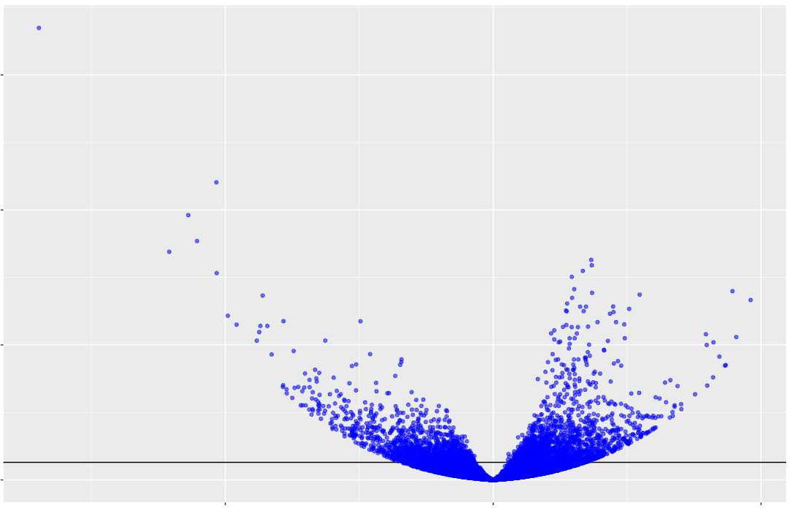
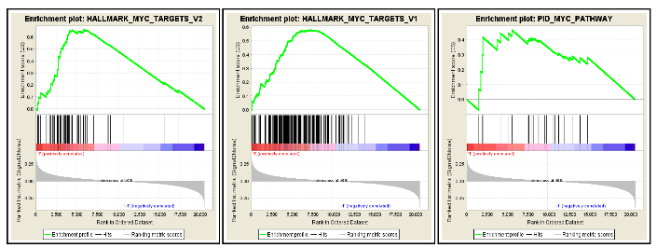
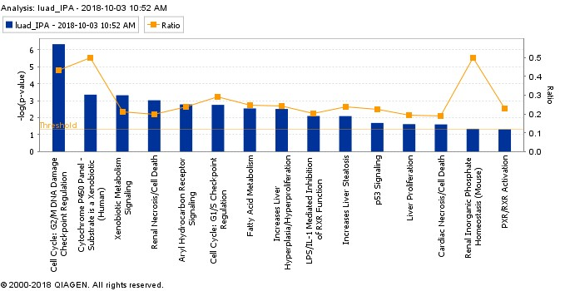
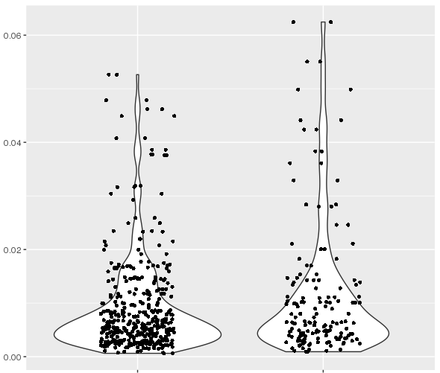
a
b
30
Figure S14
Q = 0.002
Q = 0.018
Q = 0.039
20
-log10(q-value)
10
0
d
-2
0
2
Annotation Cluster 1 (Enrichment Score: 22.89)
Category | Term | P value | Benjamini
UP_KEYWORDS | Cell_cycle | 2.8E-33 | 1.6E-30
UP_KEYWORDS | Mitosis | 2.8E-25 | 5.5E-23
UP_KEYWORDS | Cell division | 1.0E-23 | 1.5E-21
GOTERM_BP_DIRECT | Cell division | 2.0E-18 | 1.1E-14
GOTERM_BP_DIRECT | Mitotic Nuclear Division | 2.3E-17 | 6.5E-14
Annotation Cluster 2 (Enrichment Score: 9.34)
Category | Term | P value | Benjamini
GOTERM_BP_DIRECT | Sister chromatid cohesion | 2.8E-33 | 1.6E-30
UP_KEYWORDS | Centromere | 2.8E-25 | 5.5E-23
UP_KEYWORDS | Kinetochore | 1.0E-23 | 1.5E-21
GOTERM_BP_DIRECT | Condensed chromosome kinetochore | 2.0E-18 | 1.1E-14
GOTERM_BP_DIRECT | Kinetochore | 2.3E-17 | 6.5E-14
Annotation Cluster 3 (Enrichment Score 8.37)
Category | Term | P Value | Benjamini
UP_KEYWORDS | DNA replication | 9.1E-14 | 7.6E-12
GOTERM_BP_DIRECT | DNA replication initiation | 4.6E-7 | 3.3E-4
KEGG_PATHWAY | DNA replication | 1.8E-6 | 2.6E-4
c
Coefficient
e
P = 0.019 (with zeros)
P = 0.028 (dropped zeros)
Morisita Diversity Index
MYC-high
MYC-low
Figure S14: (a) Volcano plot of differentially expressed genes from DESeq2 analysis between MYC-high (gain/high amp) and low groups (het. loss/diploid). Horizontal line represents FDR p-value < 0.05. (b) Gene Set Enrichment Analysis plot depicting enrichment scores for three MSigDB MYC gene sets comparing MYC-high and low groups. FDR-corrected statistical significance of GSEA enrichment score shown by q-value. (c) Top significant gene pathways found by Ingenuity Pathway Analysis for significantly differentially expressed genes from the DESeq2 analysis. (d) DAVID gene ontology results of significantly differentially expressed genes from the DESeq2 analysis. Statistical significance of DAVID analysis shown as uncorrected (“P value”) or Benjamini corrected (“Benjamini”) p-values. (e) MiXCR-derived T-cell receptor Morisita diversity indices between MYC-high and low groups. Statistics performed with Mann-Whitney u-test, showing p-values for all samples and all non-zero samples.
Notes:
Figure S12: (a) Volcano plot of differentially expressed genes from DESeq2 analysis between MYC-high (gain/high amp) and low groups (het. loss/diploid). Horizontal line represents FDR p-value < 0.05. (b) Gene Set Enrichment Analysis plot depicting enrichment scores for three MSigDB MYC gene sets comparing MYC-high and low groups. FDR-corrected statistical significance of GSEA enrichment score shown by q-value. (c) Top significant gene pathways found by Ingenuity Pathway Analysis for significantly differentially expressed genes from the DESeq2 analysis. (d) DAVID gene ontology results of significantly differentially expressed genes from the DESeq2 analysis. Statistical significance of DAVID analysis shown as uncorrected (“P value”) or Benjamini corrected (“Benjamini”) p-values. (e) MiXCR-derived T-cell receptor Morisita diversity indices between MYC-high and low groups. Statistics performed with Mann-Whitney u-test, showing p-values for all samples and all non-zero samples.

Slide 18
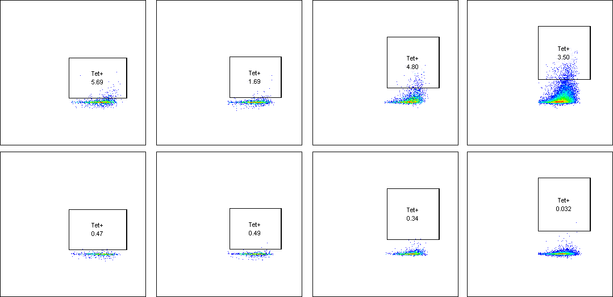
Tumor 1
Tumor 2
Tumor 3
Tumor 4
VALLPSVML
Figure S15
SIINFEKL
CD8
Figure S15: Percent B2-tetramer positive (top) versus irrelevant SIINFEKL-tetramer control (bottom), BBN963 tumor infiltrating CD8+ T cells. Tetramer gating was determined per-sample, setting the SIINFEKL control gate to < 0.5% positive cells.
Notes:
Figure S13: Percent B2-tetramer positive (top) versus irrelevant SIINFEKL-tetramer control (bottom), BBN963 tumor infiltrating CD8+ T cells. Tetramer gating was determined per-sample, setting the SIINFEKL control gate to < 0.5% positive cells.

Slide 19
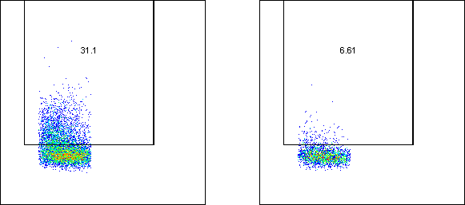
VALLPSVML (B2) tetramer
SIINFEKL tetramer
Figure S16
Tetramer - PE
FSC-A
Figure S16: Percent B2-tetramer positive (left) versus irrelevant SIINFEKL-tetramer control (right) CD8+ T cells after dendritic cell co-culture expansion protocol.
Notes:
Figure S14: Percent B2-tetramer positive (left) versus irrelevant SIINFEKL-tetramer control (right) CD8+ T cells after dendritic cell co-culture expansion protocol.

Slide 20
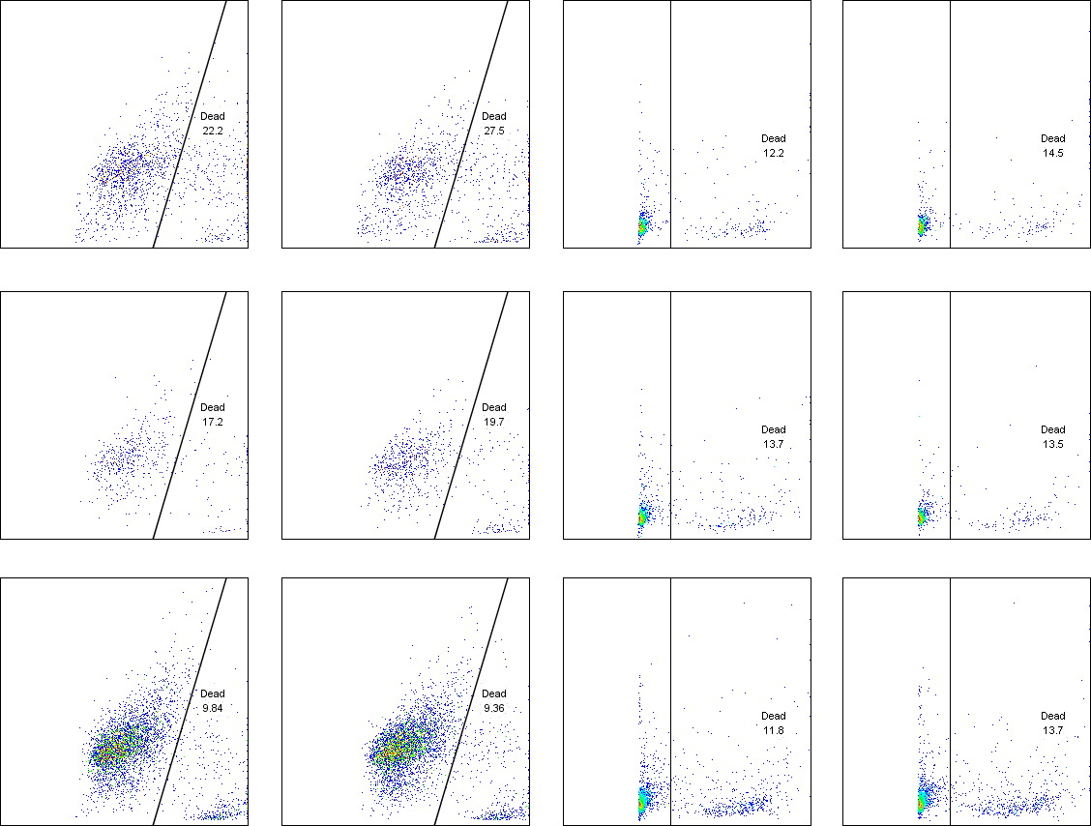
BBN963
Splenocytes
Figure S17
SSC-H
Tet+ Tc
OT1 Tc
Target only
FVS-700
Figure S17: Gating schema for Figure 5b, showing percent dead targets (CFSE+) in co-culture cytotoxicity assay.
Notes:
Figure S15: Gating schema for Figure 5b, showing percent dead targets (CFSE+) in co-culture cytotoxicity assay.

