Slide 1
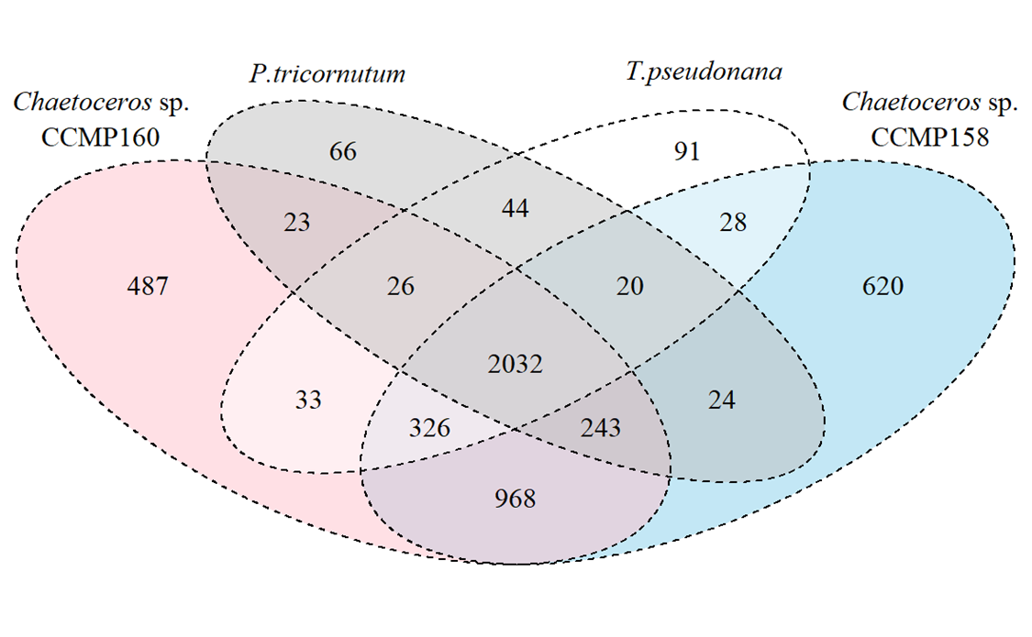
Supplementary Fig. 1. a) Shared and novel KEGG IDs across Chaetoceros CCMP158 and CCMP160 and the two model diatom species Thalassiosira pseudonana and Phaeodactylum tricornutum. b) Shared and novel OrthoMCL groups across the four species. c) taxonomic distribution of genes annotated with shared and novel KEGG IDs across the four species.
a
b
c

