Slide 1
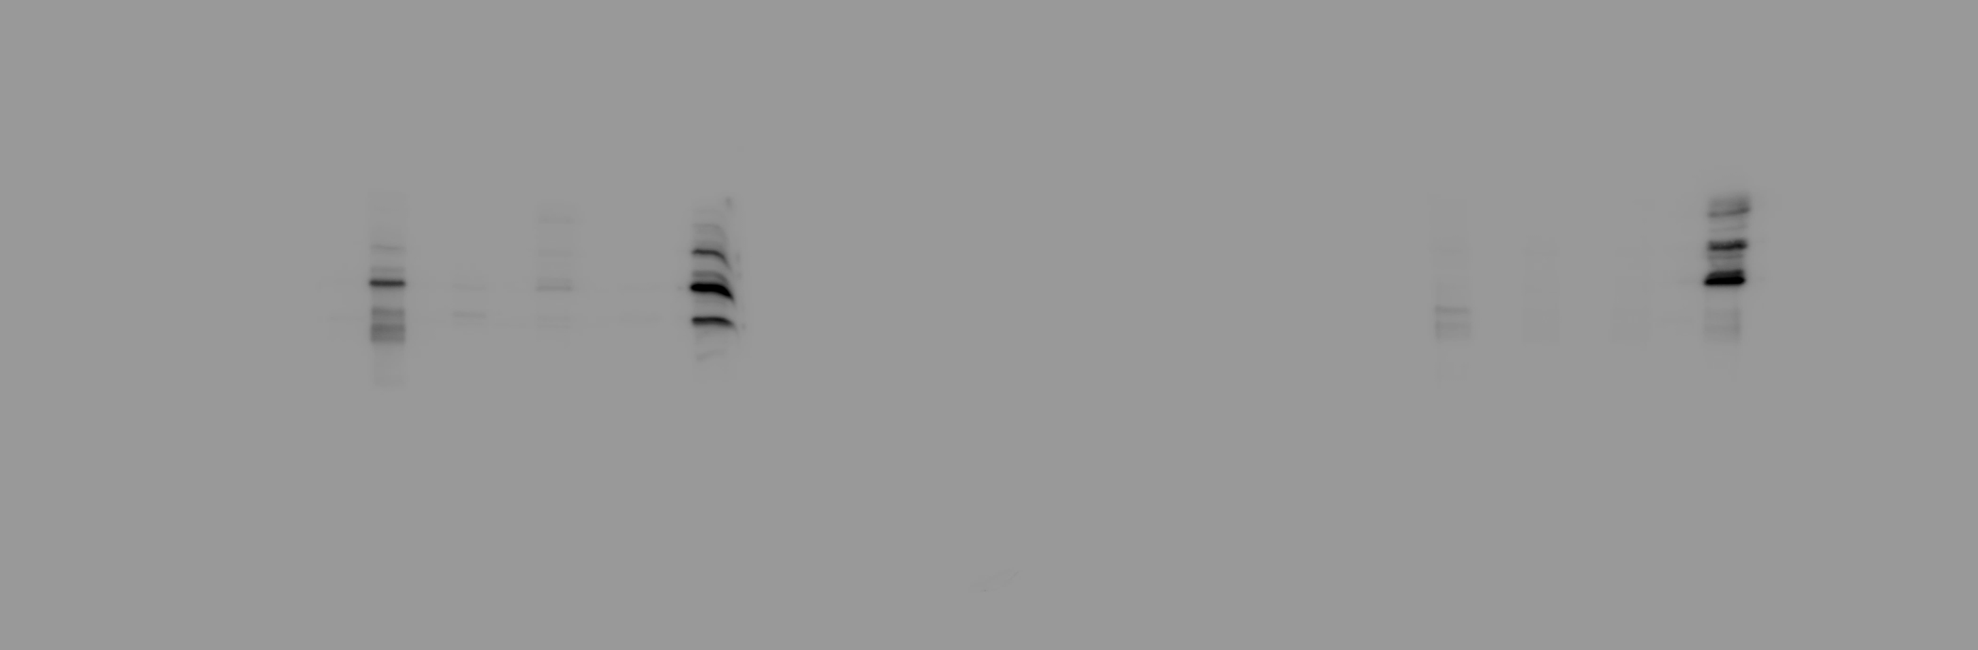
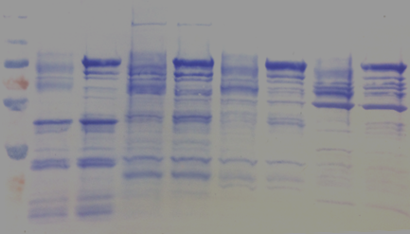
Repeat 1
His-SLAH3-N
His-MBP-PBL27 KD
His-MBP-PBL27
His-MBP-PBL27
/ PBL27 KD
100
70
His-SLAH3-N
55
35
His-MBP-PBL27
/ PBL27 KD
100
70
His-SLAH3-N
55
35

Slide 2

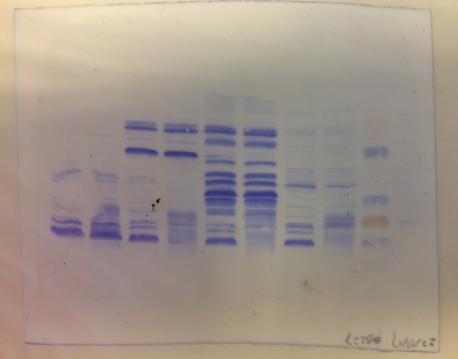
GST-SLAH3-C
His-MBP-PBL27 KD
His-MBP-PBL27
His-MBP-PBL27
/ PBL27 KD
100
70
55
Autorad
GST-SLAH3-C
35
His-MBP-PBL27
/ PBL27 KD
100
70
55
CBB
GST-SLAH3-C
35

Slide 3
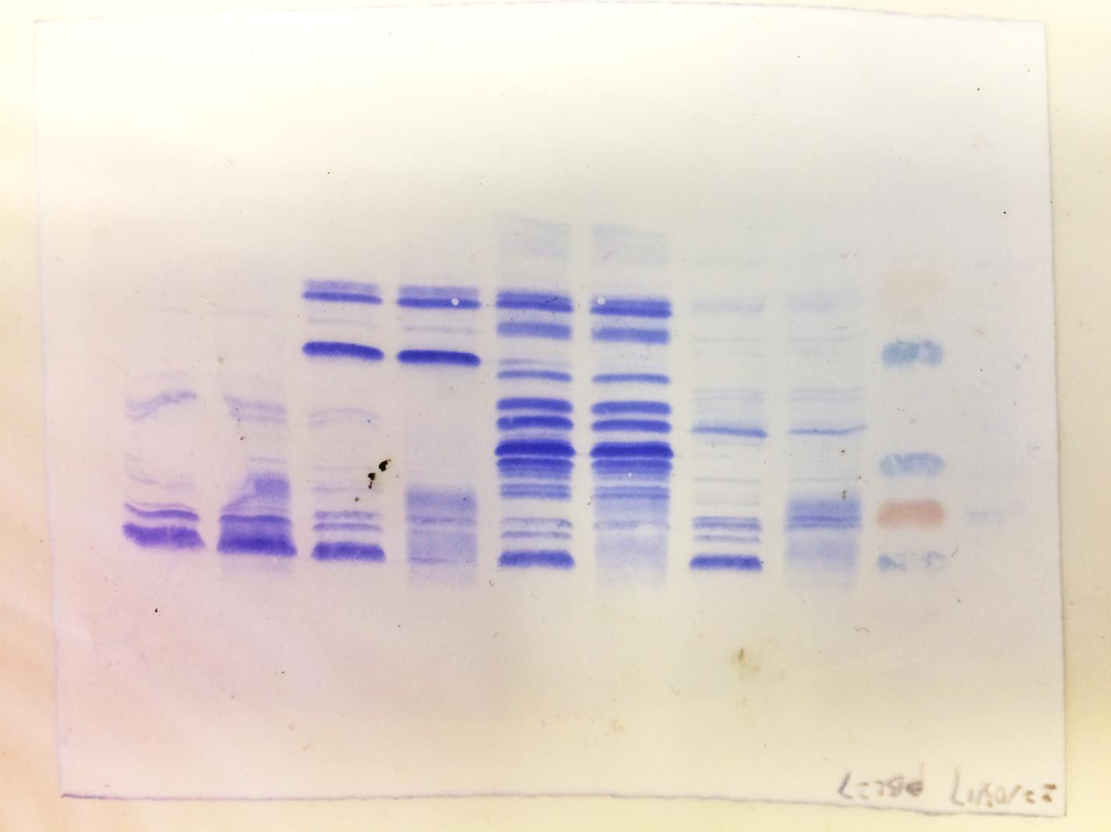

Repeat 2
Slah3-N
PBL27 K112E

Slide 4
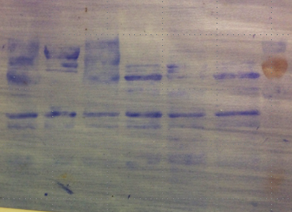
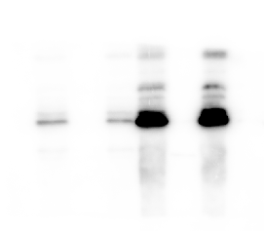
Repeat 3
Slah3-N
PBL27 K112E

