Slide 1
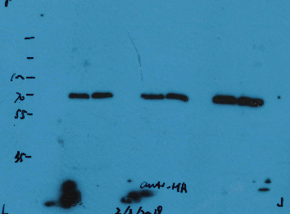

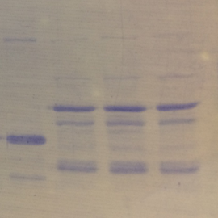
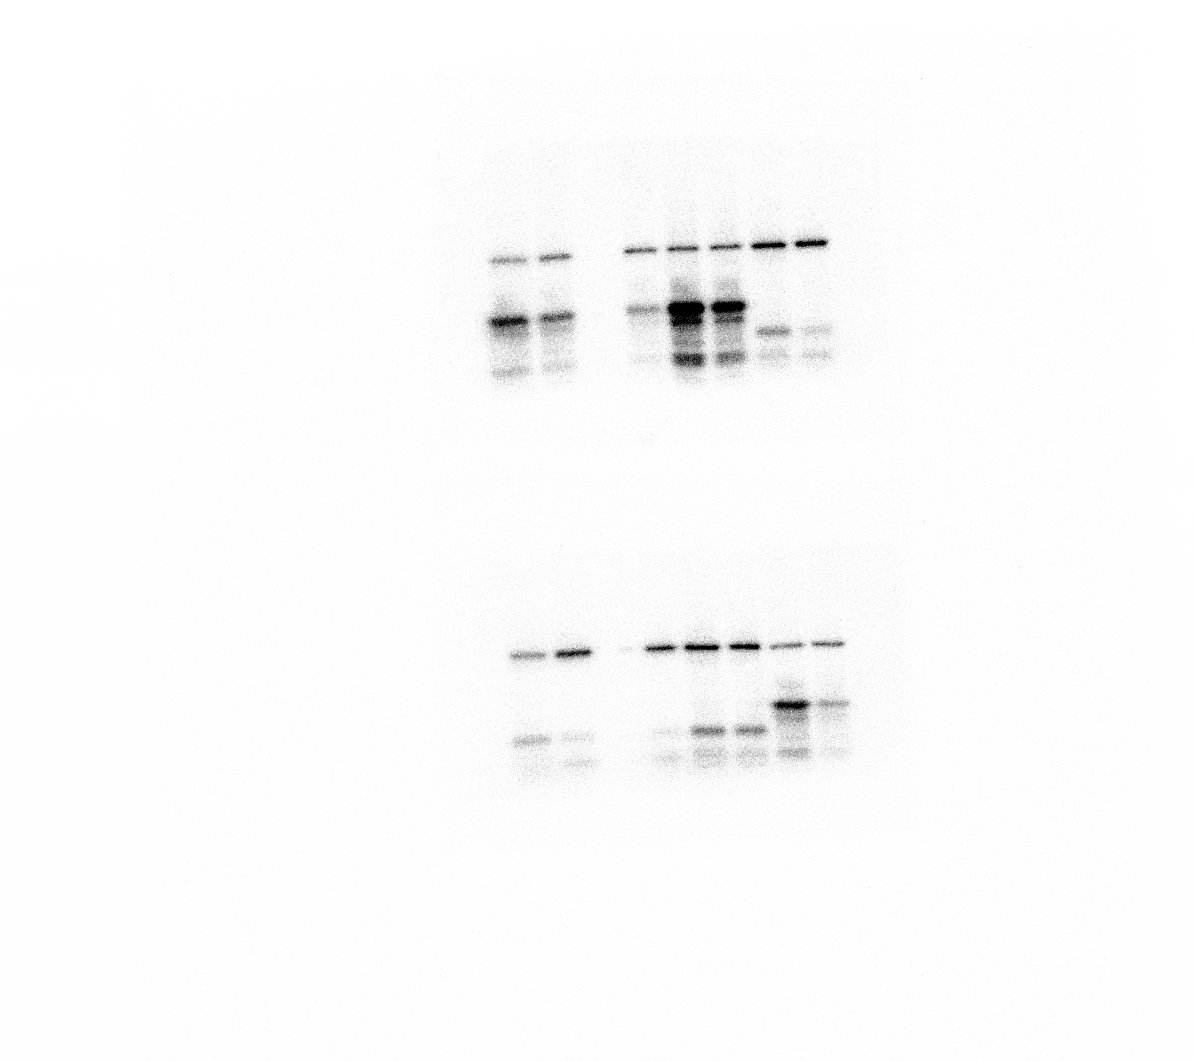
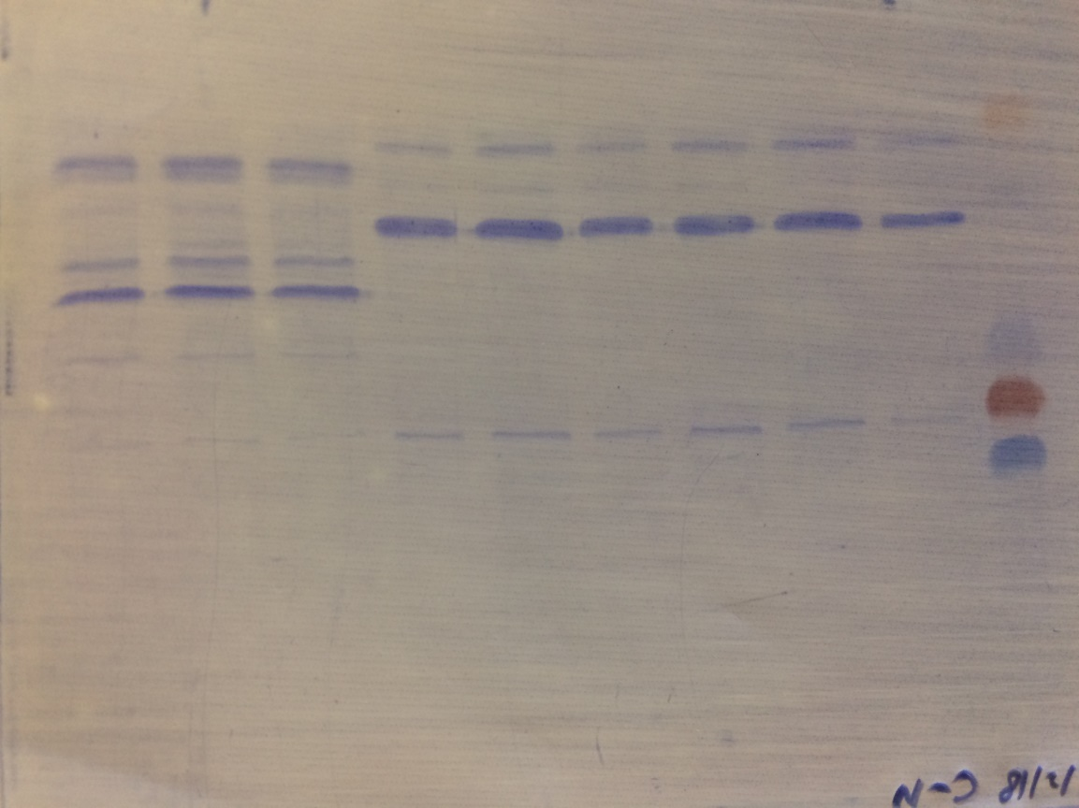
D
pbl27-1/pPBL27:PBL27-3×HA
Repeat 1
Col-0
Chitin - - +
anti-HA
70
PBL27-3×HA
70
IP: anti-HA
55
His-SLAH3-N
35
PBL27-3×HA
70
55
His-SLAH3-N
35

Slide 2

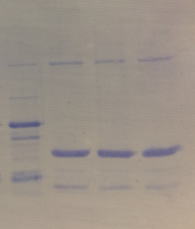
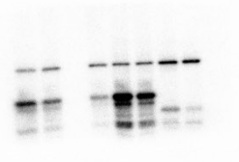
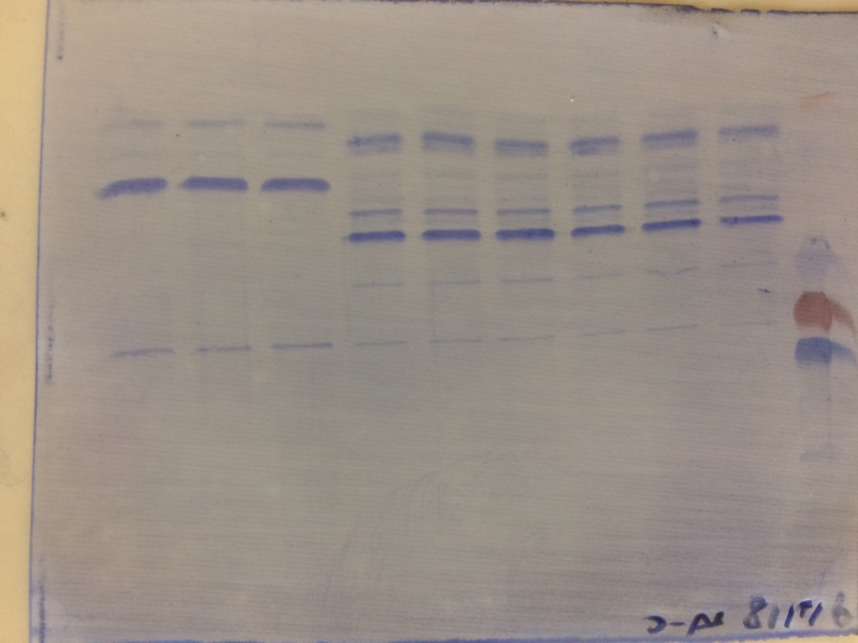
pbl27-1/pPBL27:PBL27-3×HA
Repeat 1
Col-0
Chitin - - +
anti-HA
70
PBL27-3×HA
70
55
Autorad
IP: anti-HA
GST-SLAH3-C
35
PBL27-3×HA
70
55
CBB
GST-SLAH3-C
35

Slide 3
pbl27-1/pPBL27:PBL27-3×HA
Repeat 2
Col-0
Chitin - - +
anti-HA
IP: anti-HA
PBL27-3×HA
His-SLAH3-N
PBL27-3×HA
His-SLAH3-N

Slide 4
pbl27-1/pPBL27:PBL27-3×HA
Repeat 2
Col-0
Chitin - - +
PBL27-3×HA
His-SLAH3-C
PBL27-3×HA
His-SLAH3-C

Slide 5
pbl27-1/pPBL27:PBL27-3×HA
Repeat 3
Col-0
Chitin - - +
anti-HA
IP: anti-HA
PBL27-3×HA
His-SLAH3-N
PBL27-3×HA
His-SLAH3-N

Slide 6
pbl27-1/pPBL27:PBL27-3×HA
Repeat 3
Col-0
Chitin - - +
PBL27-3×HA
His-SLAH3-C
PBL27-3×HA
His-SLAH3-C

