Slide 1
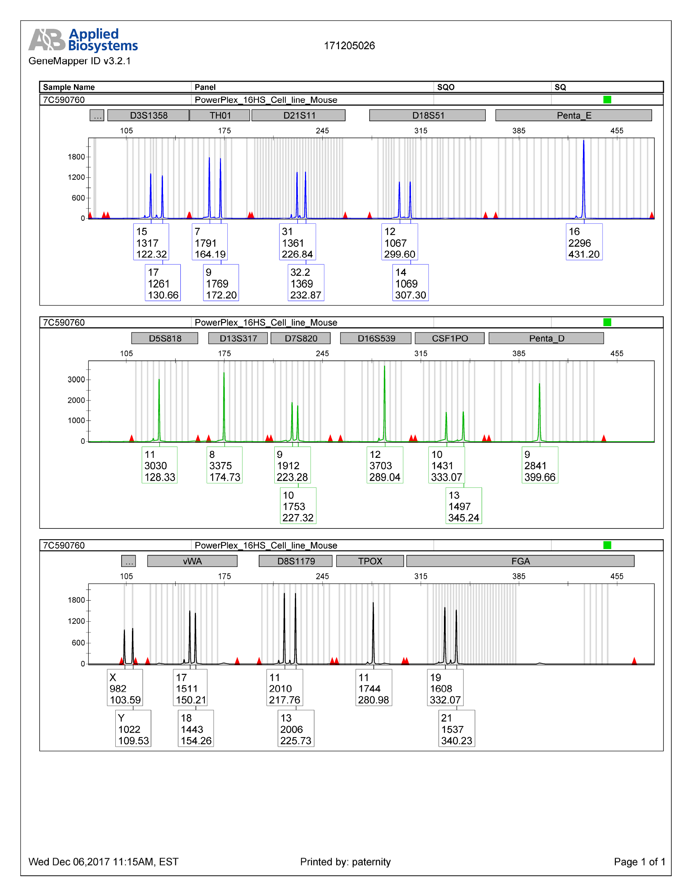
Additional file 1: Figure S1. Electropherograms for CRC269.

Slide 2
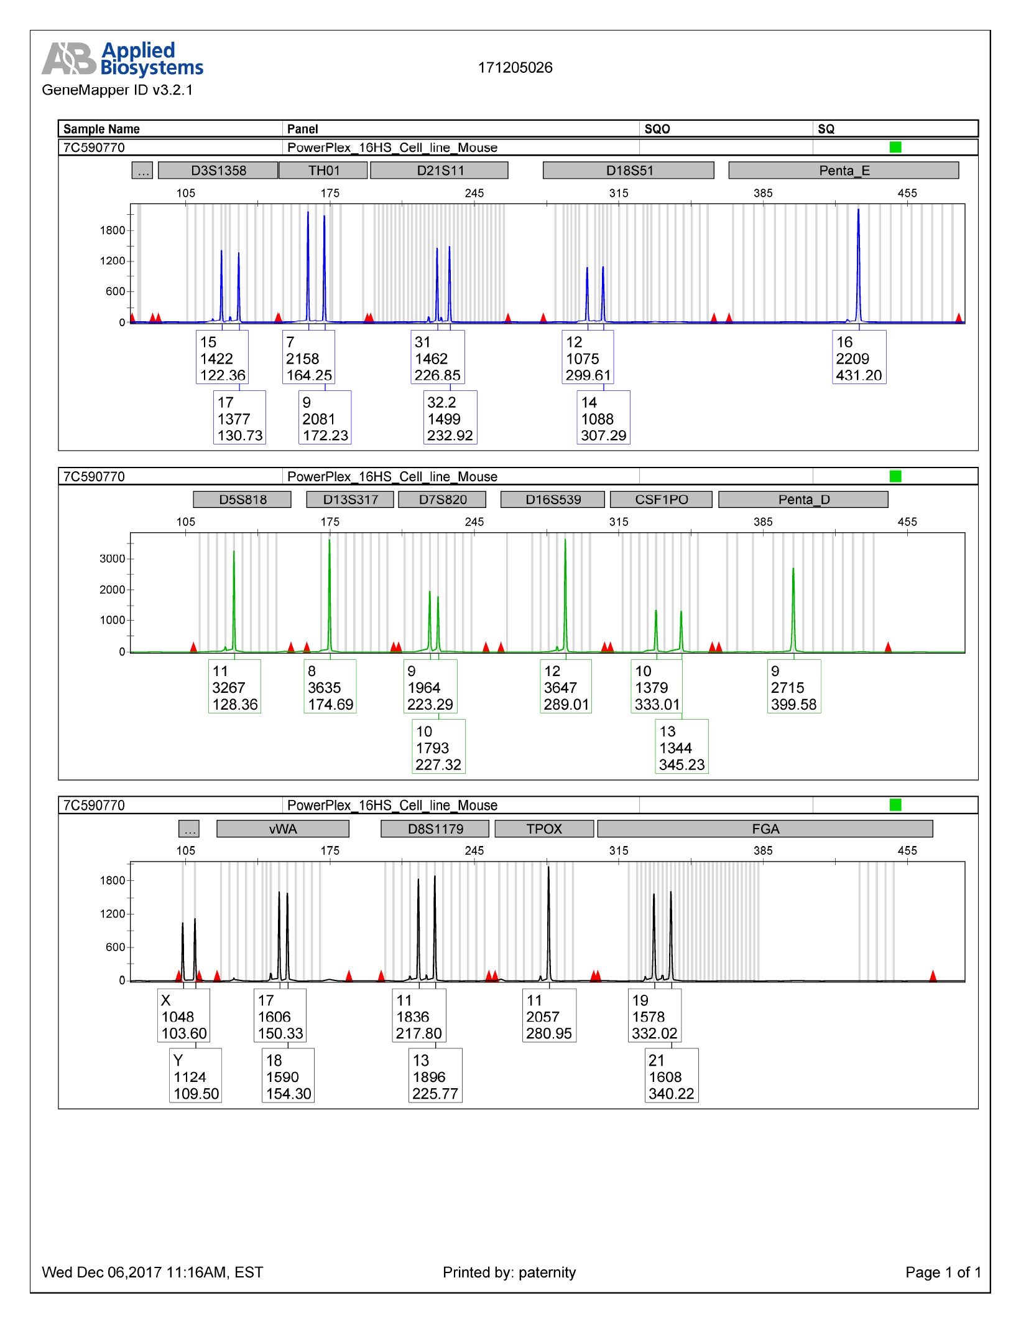
Additional file 2: Figure S2. Electropherograms for CRC269-R.

Slide 3
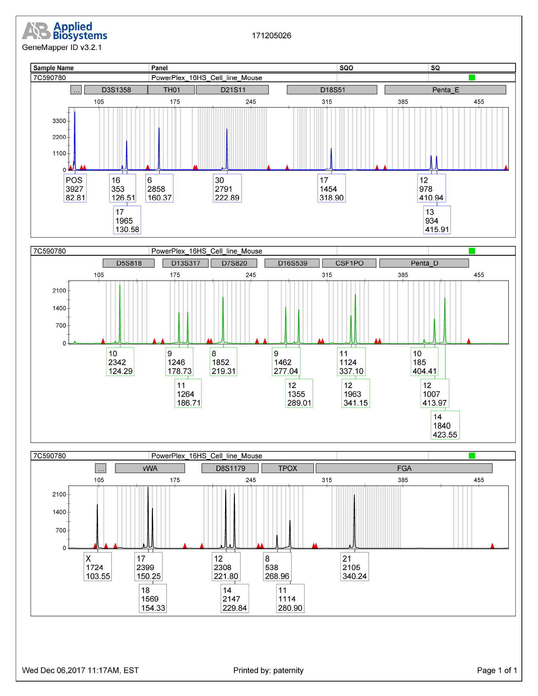
Additional file 3: Figure S3. Electropherograms for CRC263.

Slide 4
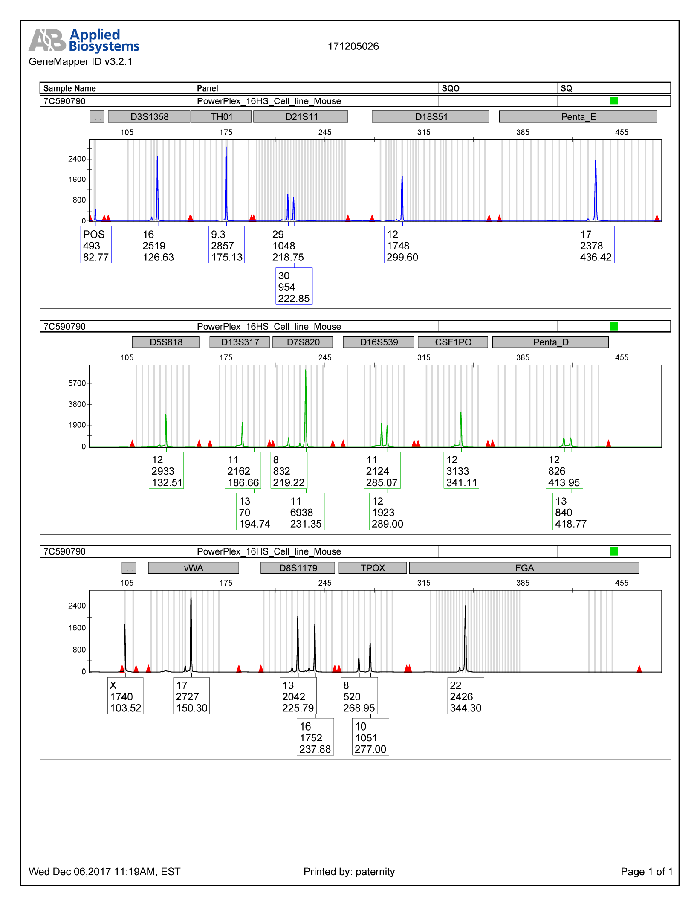
Additional file 4: Figure S4. Electropherograms for CRC382.

Slide 5
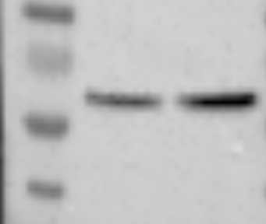
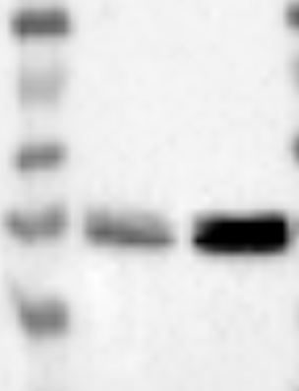
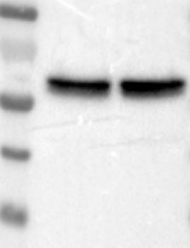
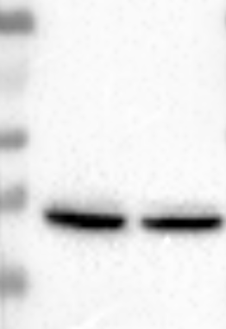
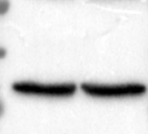
Additional file 5: Figure S5. Original scans of the immunoblots.
CRC269-R
CRC269-R
CRC269
CRC269
Phospho-Akt
Phospho-ERK
CRC269-R
CRC269-R
CRC269
CRC269
Total-Akt
Total-ERK
CRC269-R
CRC269
GAPDH

