Slide 1


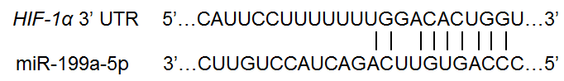
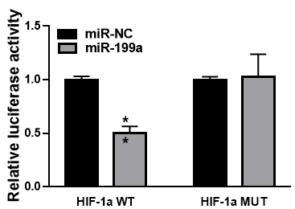
Suppl. Fig. 1
Suppl. Fig. 2
Suppl. Fig. 3
Trichostatin A treatment
*
Vector Sp1
*
miR-199a overexpression
Sp1
Relative extracellular lactate production (% cont)
*
β-actin
0 2.5 5
Cont 2w 4w 8w
Trichostatin A (µM)
Arsenic 0.5µM
Suppl. Fig. 4
Suppl. Fig. 5
*
miR-199a overexpression
miR-cont
miR-199a-5p
Supplementary Figures. He. J et al

