Slide 1
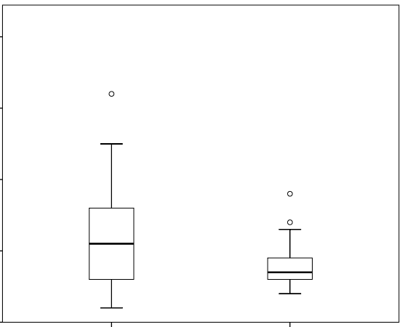
40
P= 0.03
30
Region B MetI (%)
20
10
0
Copy number loss at CDH19
(n = 39)
No copy number alteration at CDH19
(n = 27)
Supplementary Figure S2. Methylation density at TERT Region B in SI-NETs with copy number loss in 18q at the CDH19 locus as compared to SI-NETs without copy number alteration in 18q.

