Slide 1
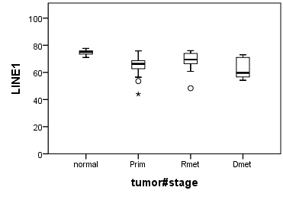
P= 0.04
100
80
LINE1 MetI (%)
60
40
20
0
P< 0.001
Normal ileum
(n = 15)
Primary tumors
(n = 37)
Regional metastases
(n = 23)
Distant metastases
(n = 10)
Supplementary Figure S1. LINE1 MetI in normal ileum and different SI-NET subgroups

