Slide 1
Supplemental Data

Slide 2
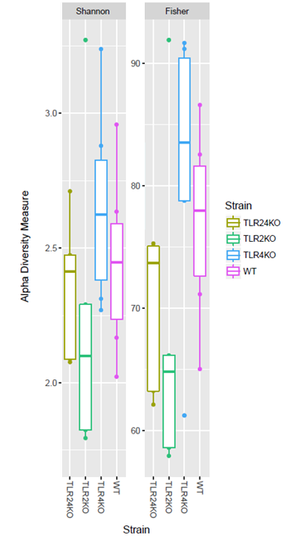
Supplementary Figure 1
Supplementary Figure 1. Alpha diversity measurements do not show differences between mouse groups. 16S rDNA V3-V4 sequence data were filtered and assigned a taxonomy using the Greengenes 16S rRNA database version 13_8 then rarefied to a sequence depth of 15,200 reads/sample to calculate alpha diversity measures. OTUs were defined as groups of sequences that differ by ≤ 3% at the DNA level. Charts were generated through R 3.0.2 (n=5-6 / group). Box and whisker plot comparing Shannon’s (left) and Fisher’s (right) alpha diversity indexes. (n=5-6).

