Slide 1
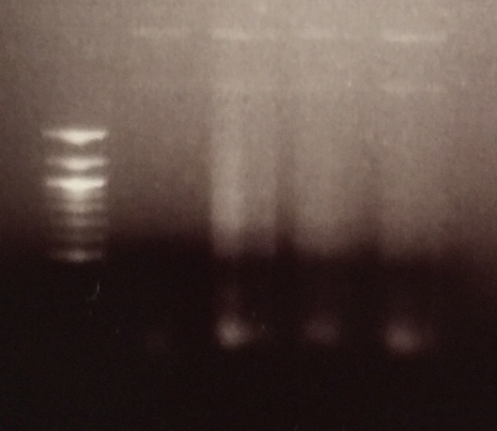
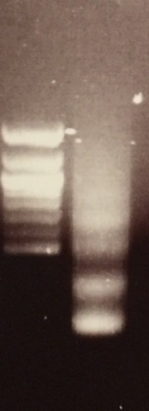
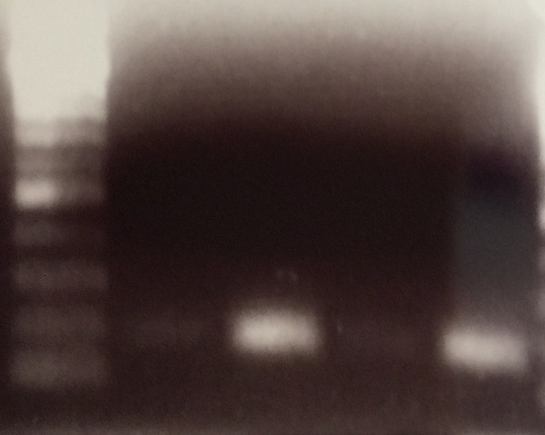
Supplementary Figure S1
Crosslinked chromatin digested by sonic into 1-5 nucleosomes (150-900 bp)
A
1
2
3
4
5
1 KHOS CDK11 siRNA sample
2 KHOS sample
3 U-2OS CDK11 siRNA sample
4 U-2OS sample
5 Second KHOS CDK11 siRNA sample
1000 bp
500 bp
100 bp
Immunoprecipitated chromatin was analyzed by PCR with human RPL30 primers using KHOS CDK11 siRNA sample
B
1
2
3
4
DNA sample from KHOS treated with CDK11 siRNA
1 + CDK11 antibody (Ab)
2 + H3 Ab
3 + IgG Ab
4 + 2% input
500 bp
100 bp

