Slide 1
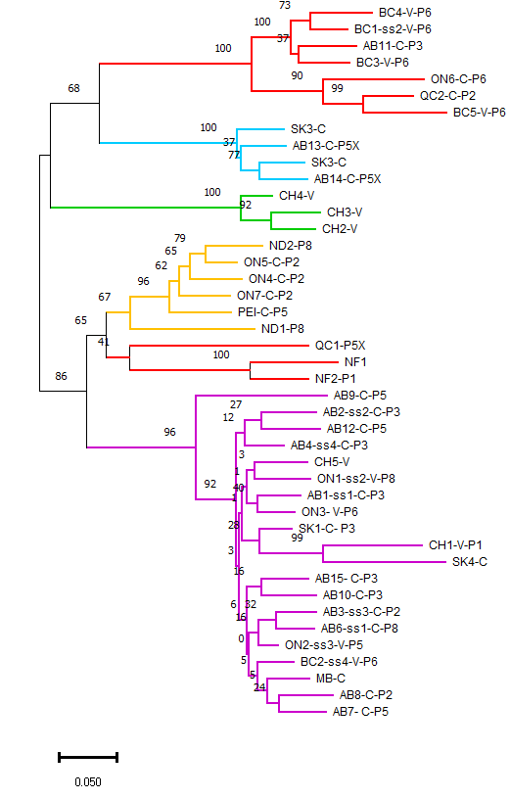
Origin- Host- Pathotype
Notes:
Additional file 2: Figure S 2. Molecular phylogenetic analysis by Maximum Likelihood method using RAxML. The percentage of 1000 bootstrap trials (1000 replicates) are shown above the branches. The bar represents the likelihood scale. Strains details are summarized in their names: location by province (e.g., AB = Alberta), Williams’ pathotype (e.g., P3) where available, and SS = single-spore isolate, V= vegetable host, and C= canola host.

