Slide 1
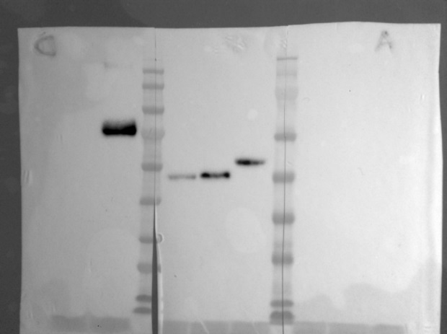

A
GO = irrelevant Ag
LAG3 = intact rec LAG
LAG3*= heat-stressed rec LAG3
(by boiling 5’)
O.D. (nm 450-nm 620)
Primary Ab:
scFvF7
Ab anti-His
Ab 17B4
B
Primary Ab:
scFvGO
α-6×His
scFvF7
kDa
GO
100
75
LAG3**: -DTT/-boiling
LAG3* : -DTT/+boiling
GO/LAG3: +DTT/+boiling
LAG3
63
48
35
25
LAG3**
LAG3*
GO/LAG3
LAG3**
LAG3*
GO/LAG3
LAG3**
LAG3*
GO/LAG3
Antibodies
Antigen
scFvGO
α-6xHis
scFvF7
ELISA
(O.D.)
GO | 0.007 | 1.54 | 0.05
LAG3 | 0.95 | 0.052 | 0.77
Figure S3D^{II}

