Slide 1
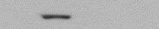





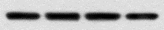
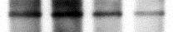
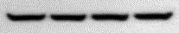
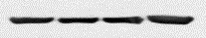
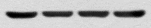
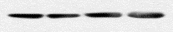
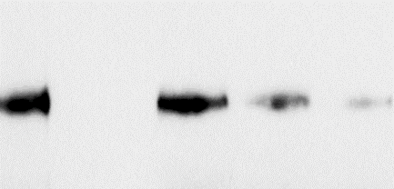
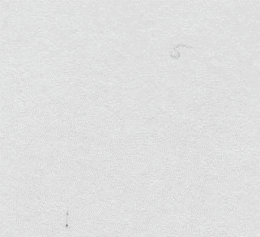
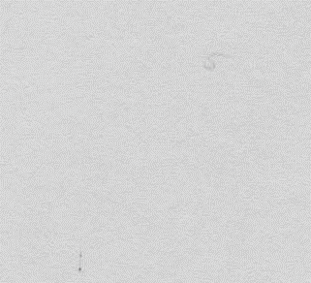
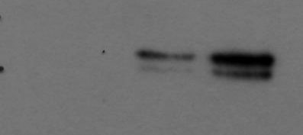

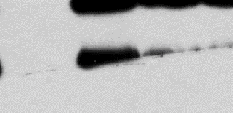
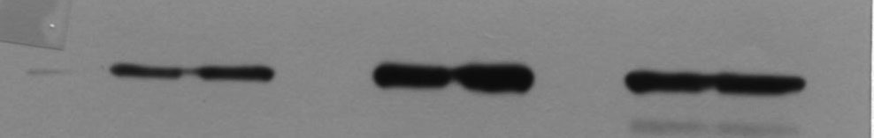
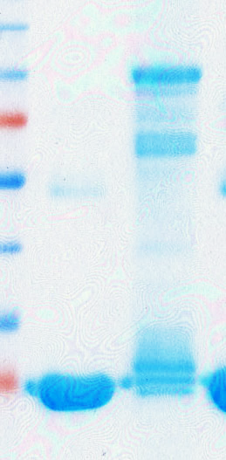
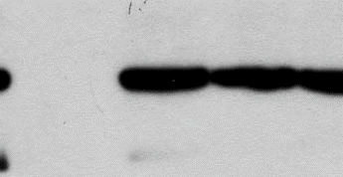
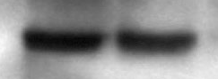
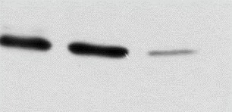
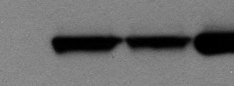
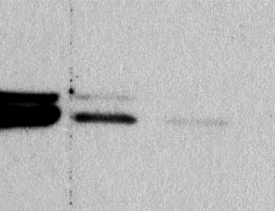
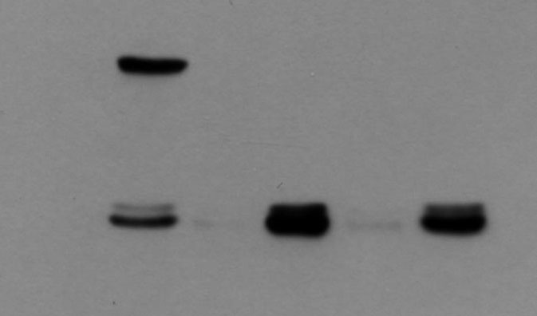
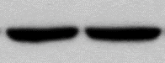
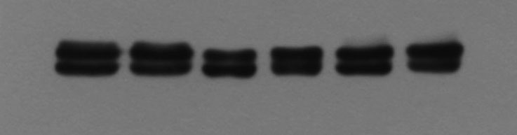
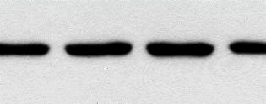
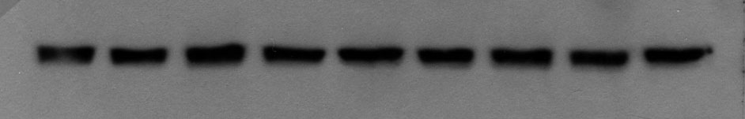
Supplementary Figure 1
a
EGF
TNF-α
TGF-β
EGF
TNF-α
TGF-β
-
-
p-Ser
p-Ser
IP:HSP70
p-Thr
p-Thr
IP:HSP90
p-Tyr
p-Tyr
HSP70
HSP90
WCL
HSP70
HSP90
WCL
Actin
Actin
b
c
d
Mock
GST
+
+
EGF
-
+
si-ERK
+
Input
+
GFP-ERK
EV
p-Ser
HSP70
+
Mock
+
Strep-HSP70
p-Thr
-
+
EGF
+
+
+
GFP-ERK
IP:HSP70
p-Tyr
IP:Strep
GFP
GFP
ERK
Strep
HSP70
GFP
p-ERK
Strep
GST
WCL
ERK
WCL
p-ERK
HSP70
ERK
Actin
Actin

Slide 2
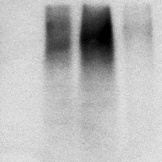
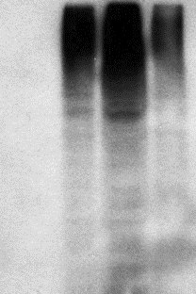
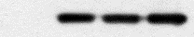
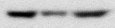
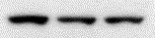

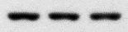
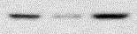


Supplementary Figure 2
a
S385A/S400A
S385A/S400A
S385D/S400D
S385D/S400D
-
-
Strep-
HSP70
WT
Strep-
HSP70
WT
Mock
Mock
-
-
IP:Akt
Ub
IP:CDK4
Ub
Akt
Akt
WCL
Strep
CDK4
Actin
CDK4
WCL
Strep
Actin

Slide 3
Supplementary Figure 3
a
b
1.2
**
1.4
S385A/S400A
**
1.2
1.0
1.0
0.8
**
0.8
0.6
Relative luminescence
Relative luminescence
0.6
0.4
0.4
0.2
0.2
0
0
-
-
ERK
+
EGF (min)
EGF
-
+
+
0
30
60
90
120

Slide 4
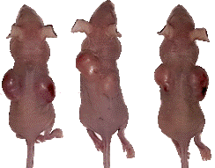
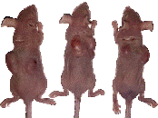
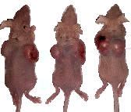
Supplementary Figure 4
a
2.0
1.5
*
1.0
*
HSP70^{WT}
Relative cell death
HSP70^{S385A/S400A}
0.5
HSP70^{S385D/S400D}
0
**
-0.5
0 μM
2.5 μM
5 μM
10 μM
20 μM
(VER)
-1.0
b
1.4
*
25
1.2
20
1.0
15
0.8
Body weight (g)
Tumor weight (g)
HSP70^{WT}
0.6
10
HSP70^{S385A/S400A}
0.4
5
HSP70^{S385D/S400D}
0.2
0
0
3
6
9
12
15
HSP70
Day
WT
S385A/S400A
S385D/S400D
WT
S385A/S400A
S385D/S400D

