Slide 1
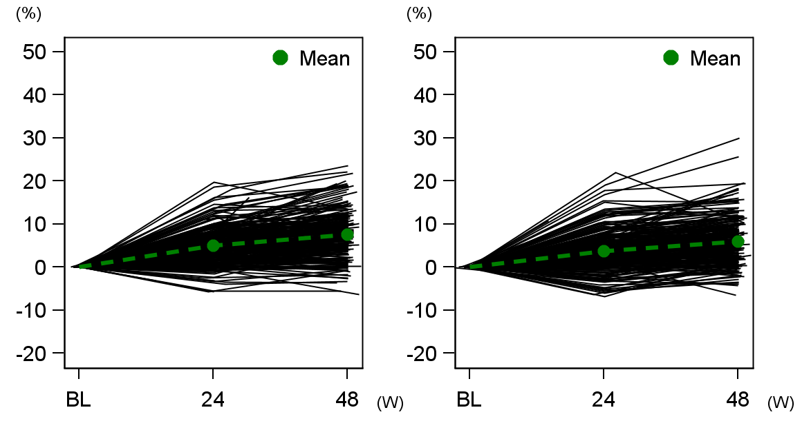
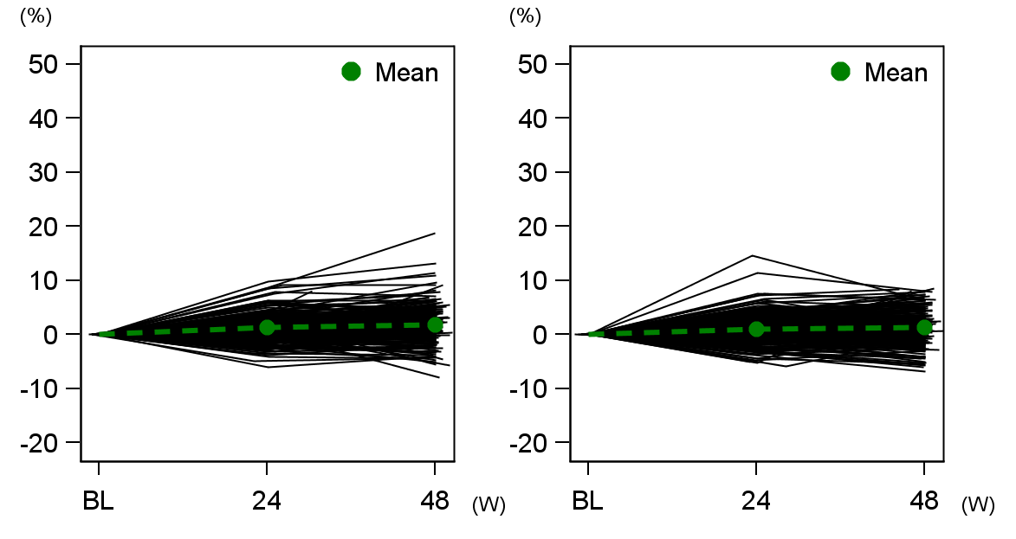
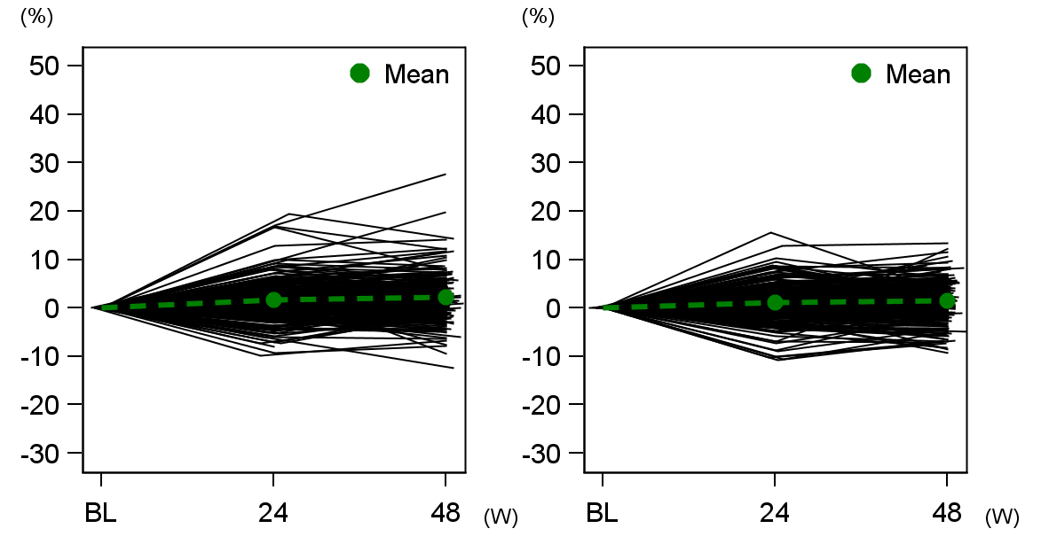
(a)
28.2-μg twice-weekly (N=251)
56.5-μg once-weekly (N=239)
Change from baseline (%)
0
Weeks
0
Weeks
(b)
28.2-μg twice-weekly (N=258)
56.5-μg once-weekly (N=249)
Change from baseline (%)
0
Weeks
0
Weeks
(c)
28.2-μg twice-weekly (N=258)
56.5-μg once-weekly (N=249)
Change from baseline (%)
0
Weeks
0
Weeks
Supplementary Fig. 1 Spaghetti plots of percentage change from baseline in BMD
(a) lumbar spine (L2–L4), (b) total hip, and (c) femoral neck

