Slide 1
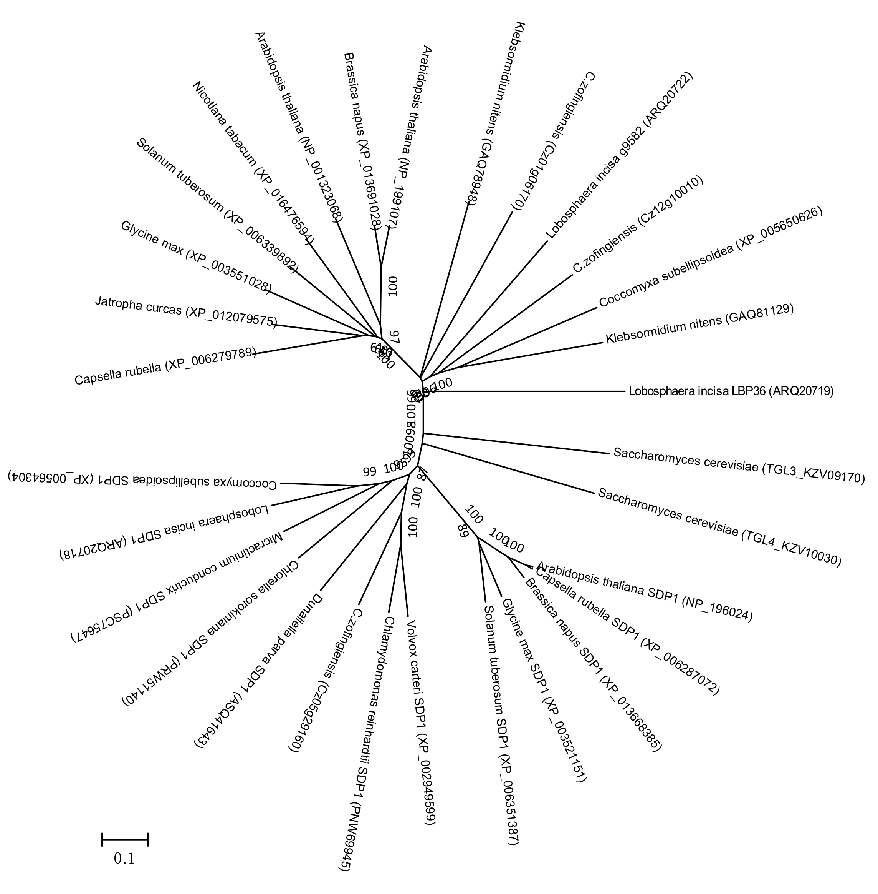
Unknown lipases
Higher plants
Arabidopsis thaliana
Klebsormidium nitens
Brassica napus
Arabidopsis thaliana
C.zofingiensis
Nicotiana tabacum
Algae
Solanum tuberosum
Lobosphaera incisa
Glycine max
C.zofingiensis
Coccomyxa subellipsoidea
Jatropha curcas
Klebsormidium nitens
Capsella rubella
Lobosphaera incisa
Saccharomyces cerevisiae
Coccomyxa subellipsoidea
Yeast
Lobosphaera incisa
Saccharomyces cerevisiae
Micractinium conductrix
Arabidopsis thaliana
Chlorella sorokiniana
Capsella rubella
Dunaliella parva
Brassica napus
C.zofingiensis
Glycine max
Volvox carteri SDP1
Solanum tuberosum
Chlamydomonas reinhardtii
Algae
0.1
Sugar-dependent 1 (SDP1)

