Slide 1
Supplementary Figure 1
A
Distribution of mutational burden in FGFR1-Amplified vs. Non-Amplified patients
 | Overall n = 95 No. (%) | FGFR1 AMP n = 29 No. (%) | FGFR1 WT n = 66 No. (%) | p-Value
TP53 Mutation | 26 (27) | 12 (41) | 14 (21) | .050
PI3K Mutation | 30 (32) | 3 (10) | 27 (41) | .004
FGFR Mutation | 4 (4) | 0 (0) | 4 (6) | .31
ESR1 Mutation | 8 (8) | 1 (3) | 7 (11) | .43
B
Co--existing mutations in FGFR1-Amplified Tumors based on targeted tissue genotyping
TP53
PI3K
FGFR
ESR1
 | = MUT
 | = WT
Notes:
Supp Table 1. Multivariate analysis for TTP on first exposure to pure endocrine therapy

Slide 2
Supplementary Figure 2
A
Time to Progression (TTP) on Endocrine Therapy alone based on FGFR1 amplification status in multivariate analysis
 | HR for Progression with endocrine therapy (95% CI) | p-Value
FGFR Amplification | 3.21 (1.39-7.42) | 0.006
Age | 1.04 (1.01-1.06) | 0.006
De Novo MBC | .68 (.33 - 1.41) | 0.31
Visceral Metastases | .80 (.45-1.42) | 0.46
PR Negativity | 1.34 (.59-3.1) | 0.49
B
Time to Progression (TTP) on Endocrine Therapy and mTOR inhibitor (everolimus) combination based on FGFR1 amplification status in multivariate analysis
 | HR for Progression with everolimus-based therapy (95% CI) | p-Value
FGFR Amplification | 0.44 (0.13-1.52) | 0.20
Age | 0.96 (0.90-1.01) | 0.16
De Novo MBC | .096 (.91 - 1.02) | 0.09
Visceral Metastases | 0.96 (0.40-2.30) | 0.933
PR Negativity | 0.31 (0.10-0.94) | 0.04
Notes:
Supp Table 1. Multivariate analysis for TTP on first exposure to pure endocrine therapy

Slide 3
Supplementary Figure 3
Growth inhibition of ER+/FGFR1 amplified CAMA-1 breast cancer cells
Selumetinib
Alpelisib
Fulvestrant
Fulvestrant
Lucitanib
Everolimus
Fulvestrant
Fulvestrant

Slide 4
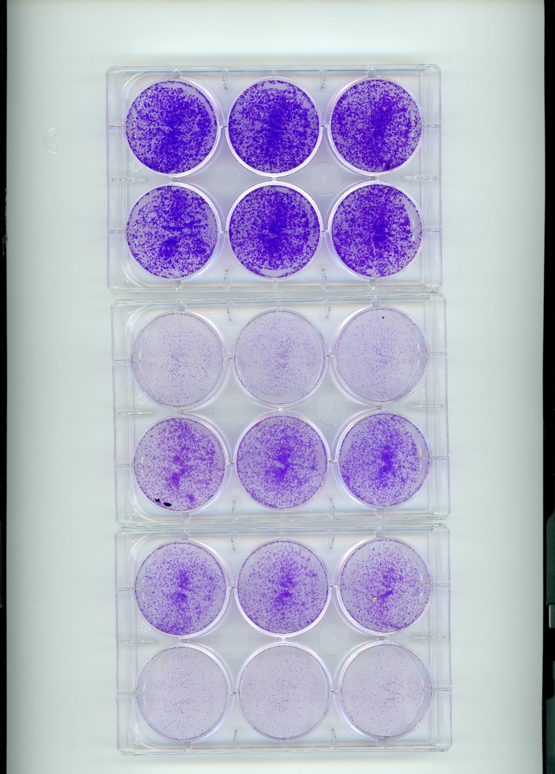

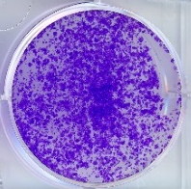
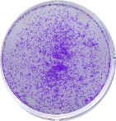
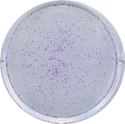
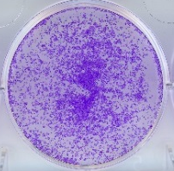

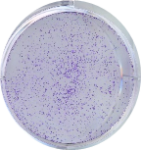
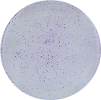







Supplementary Figure 4
Growth inhibition of ER+/FGFR1 amplified CAMA-1 breast cancer cells and pharmacodynamic impact by various inhibitors
A
B
Control
Fulvestrant
Lucitanib
Fulv + Pal
Fulv + Pal + Ev
Fold change relative to vehicle
***
***
**
Palbociclib
Everolimus
Fulv + Ev
Fulv + Luc
Fulv + Pal + Luc
**
Vehicle | + | - | - | - | - | - | - | - | - | -
Fulvestrant | - | + | - | - | - | + | + | + | + | +
Palbociclib | - | - | + | - | - | + | - | - | + | +
Everolimus | - | - | - | + | - | - | + | - | + | -
Lucitanib | - | - | - | - | + | - | - | + | - | +
C
Vehicle | + | - | - | - | - | - | - | - | - | -
Fulvestrant | - | + | - | - | - | + | + | + | + | +
Palbociclib | - | - | + | - | - | + | - | - | + | +
Everolimus | - | - | - | + | - | - | + | - | + | -
Lucitanib | - | - | - | - | + | - | - | + | - | +
p-Rb
Rb
p-ERK1/2
ERK1/2
S6
P-S6
Actin

