Slide 1
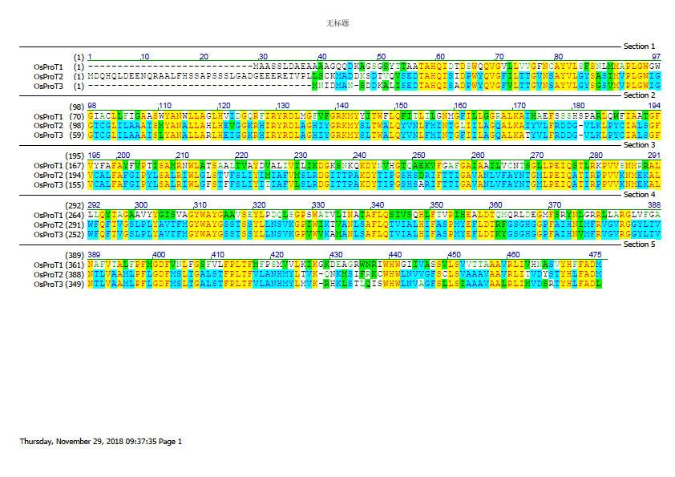
Figure S1. Alignment of OsProT proteins. Alignment of full length of OsProT protein sequences using CLUST W with default parameters. Red character on yellow background represent identical amino acid basis; Blue character on light blue background represent conservation amino acid basis; Black and green character on white background indicate the non-similar and weakly similar amino acid basis respectively.

Slide 2
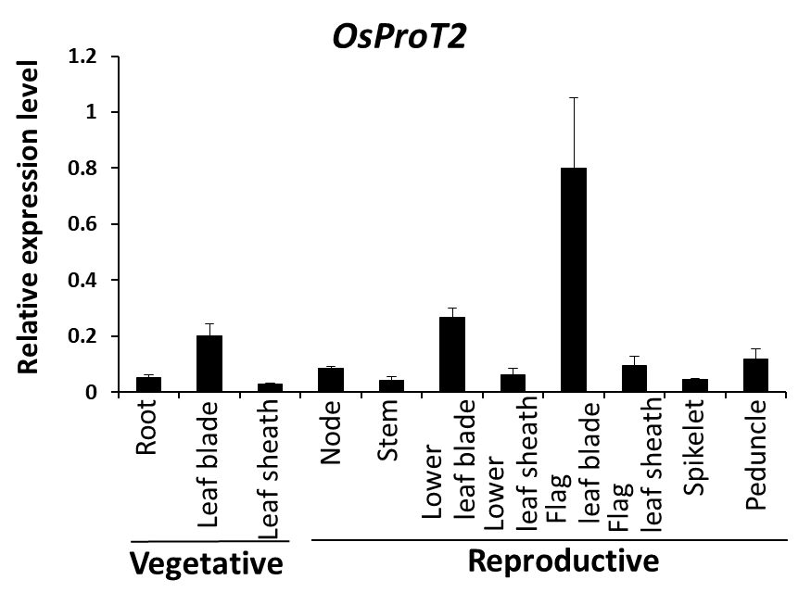
Figure S2. Expression of OsProT2 in different organs at vegetative and reproductive stages.
The expression level of OsProT2 were determined by real-time RT-PCR using the OsACTIN1 gene as internal control. Values are means ± SD, n = 4.

Slide 3
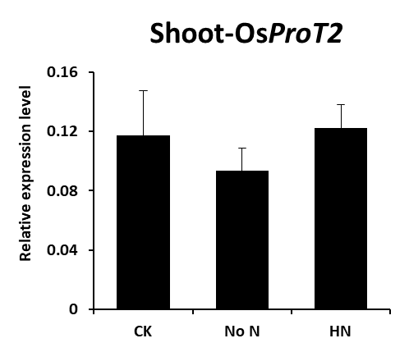
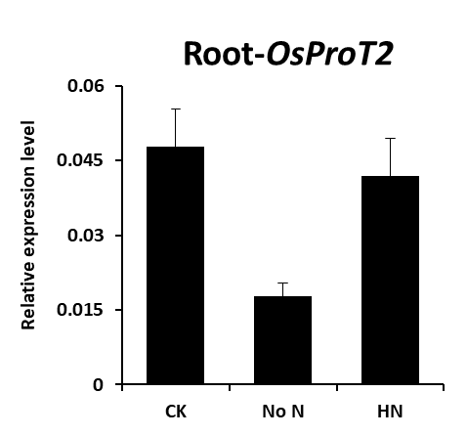
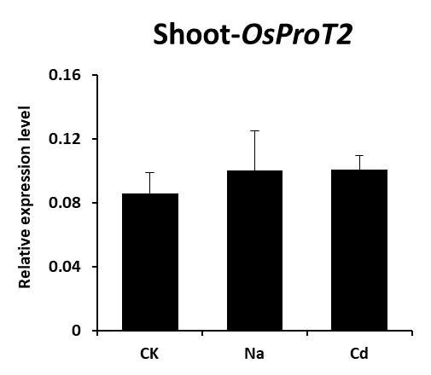
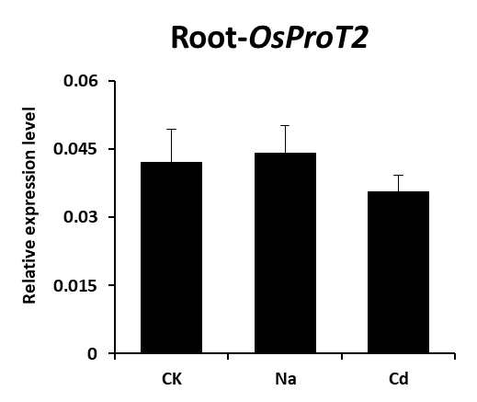
a
b
*
c
d
Figure S3. OsProT2 transcript levels in rice plants under different abiotic stress conditions. About 14-day-old hydroponically grown rice plants were exposed to Yoshida solution (CK) or Yoshida solution without NH₄NO₃ (No N), with 10 mM NH₄NO₃ (HN), with 50 μM CdCl₂ (Cd) or with 100 mM NaCl (Na) for two days. Roots and shoots then were taken for determination of OsProT2 expression level. Values are means ± SD, n = 3. Statistical significances were tested by two-tailed Student’s t tests. Differences were deemed significant at P < 0.05 (*).

Slide 4
Table S1. The primers used in this study.
 | Forward primer | Reverse primer
qRT-OsProT1 | AGGGAGATGGAACAGGATTTG | GTCCGCGAAGAAATGGTAGA
qRT-OsProT2 | ATCTGTCTGCTCTCAGGATTTG | AGGTTTGCTACAGCACCTATC
qRT-OsProT3 | ATGGGCTATTGGGCTTATGG | GGTCTGAAGAAACGCTGATAGA
qRT-OsActin1 | TGAAGTGCGACGTGGATATTAG | CCAATCCAGACACTGTACTTCC
p426-OsProT1 | gattctagaactagtggatccATGGCTGCTTCATCGCTCGA | gataagcttgatatcgaattcTTACATGTCCGCGAAGAAATG
p426-OsProT3 | gattctagaactagtggatccATGAACATCGACATGGCCAAT | gataagcttgatatcgaattcTCACAGATCAGCAAACAAATG
pA7-ProT1 | gctctagacATGGCTGCTTCATCGCTCGA | cgggatccTTACATGTCCGCGAAGAAATGG
pA7-ProT3 | gagctgtacaagggtctagacATGAACATCGACATGGCCAATTCCGA | tctatcgatcaatcaggatccTCACAGATCAGCAAACAAATGGTAA
The underlined nucleotides are the digestion sites.

